Slide 1

KONGU ENGINEERING COLLEGE
PERUNDURAI ERODE-638060
ARTIFICIAL INTELLIGENCE
Full Stack REV-1
FOOD ORDERING SYSTEM
Team Members:
23ADR066-Jagan B
23ADR102-Maiyarasu P
23ADR113-Mukesh hari S
Team Mentor :
Mr.N.Vigneshwaran

Slide 2
PROBLEM OBJECTIVE
To design and develop a user-friendly online food ordering platform for South Indian dishes.
To allow customers to browse menus, view special dishes, and order food seamlessly.
To implement a cart system and instant ordering option for enhanced user experience.
To provide a scalable and responsive application accessible on multiple devices.
Long-term objective: integrate order tracking, online payments, and admin management

Slide 3
Technical Stack
Frontend
React.js → For building interactive UI components.
HTML, CSS, JavaScript → For responsive design & styling.
Backend
Node.js + Express.js
Database
MongoDB
Others
GitHub → Version control.

Slide 4
Architecture
Git
(version control)
Frontend
React.js
Backend
Node.js
Express.js
Database
MongoDB
Sign up
Login
Home page
Authentication
Api end points for check-in
User data
Cart item

Slide 5
Features & Functionality
Implemented (40%)
Home Page with login/signup.
Special Dish of the Day highlight.
Menu section with Most Popular Dishes.
Cart & Buy Now functionality.
Chat support option.
Pending
Secure login authentication system.
Online payment gateway.
Order tracking system.
Admin panel for menu & order management.

Slide 6
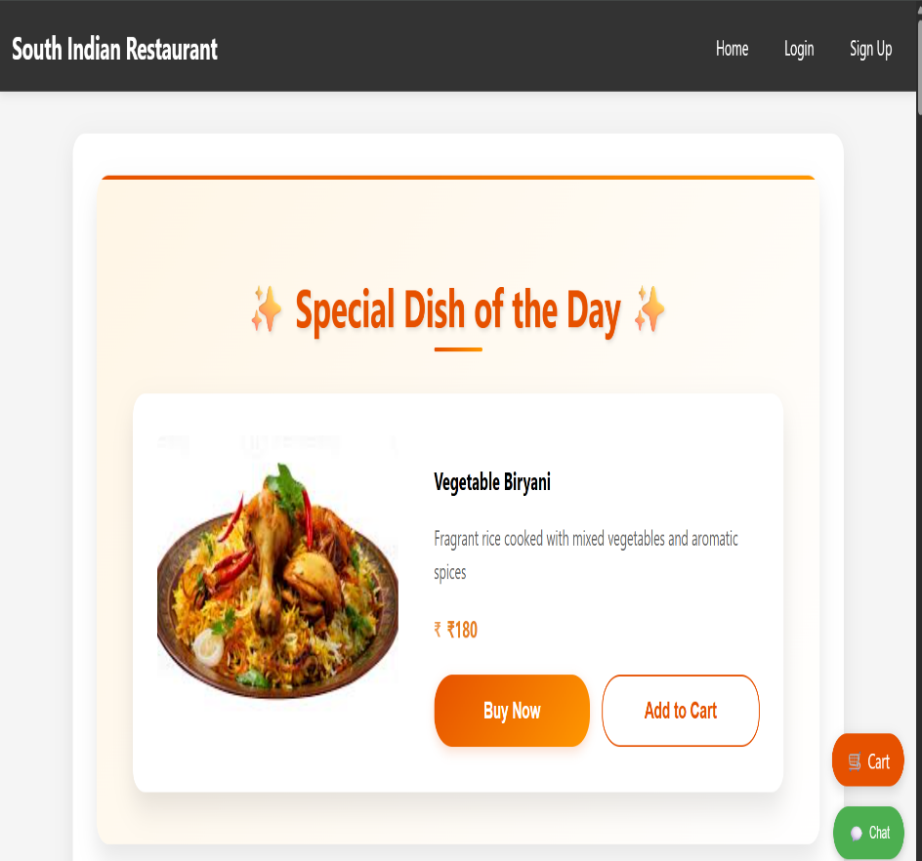
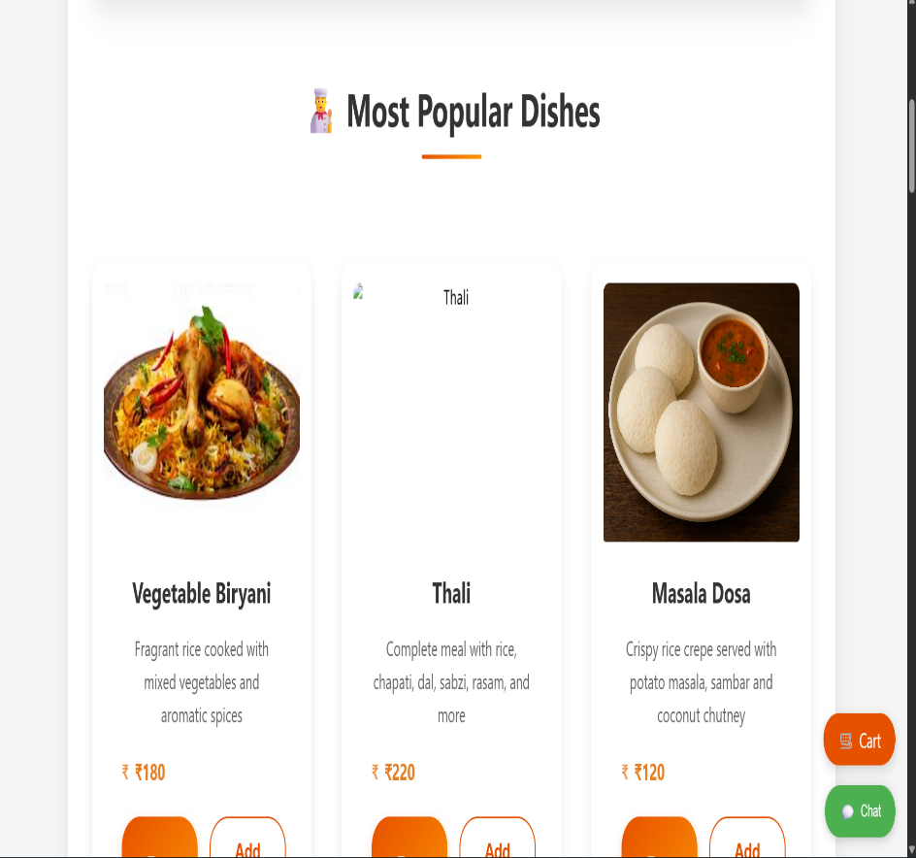
Output
User dashboard
Popular dishes

Slide 7
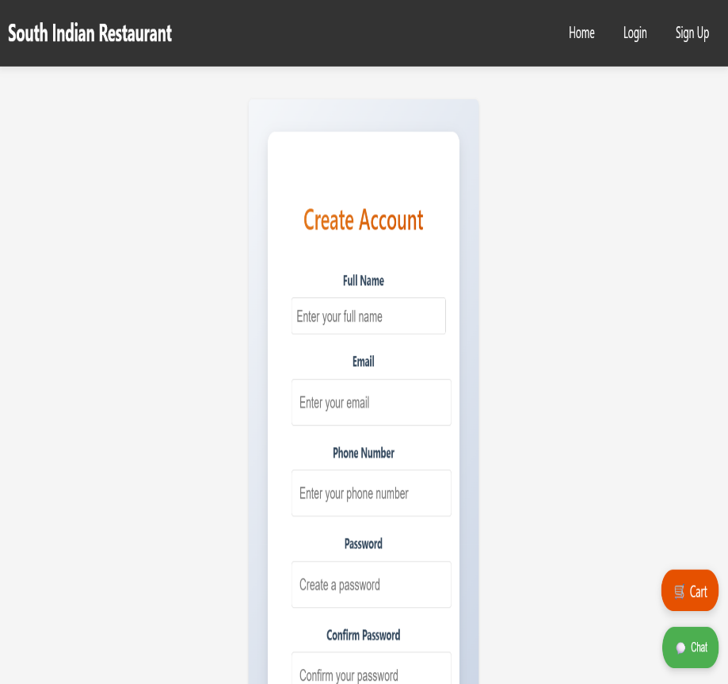
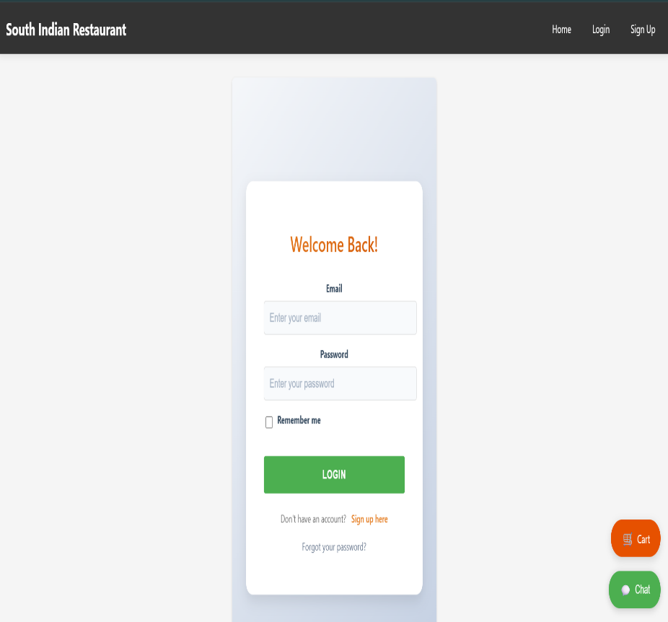
Sign up page
Login page

Slide 8
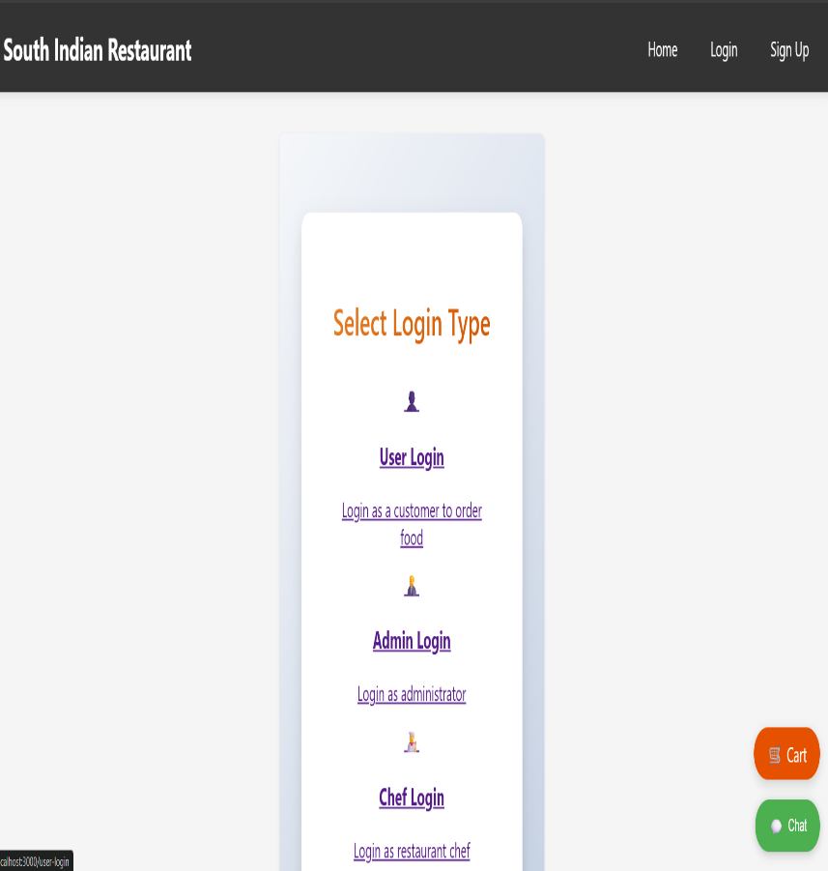
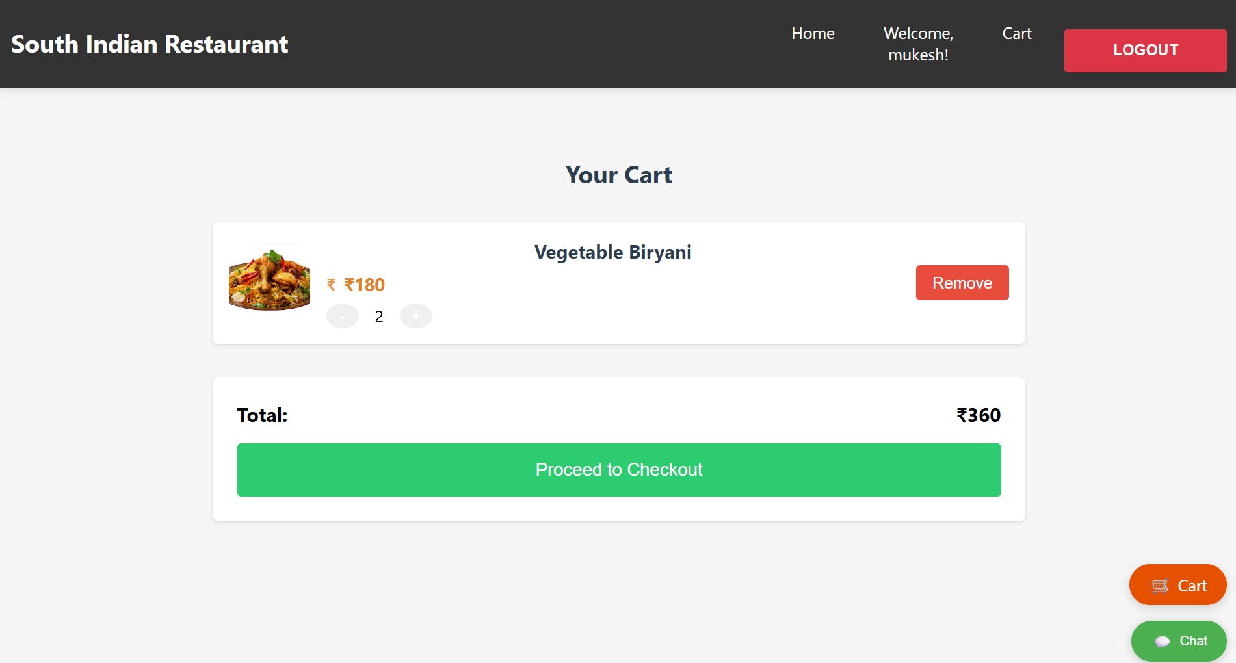
Login type
Cart

Slide 9
References
kaushikjadhav01 / Online-Food-Ordering-Web-App A widely-used implementation of an online food ordering system built using PHP, MySQL, HTML, CSS, and JS, complete with admin and user roles. Highly practical for full-stack architecture inspiration.
nikulram / Online-Food-Ordering-System A clean and functional platform using PHP and MySQL, covering features like menu browsing, cart, checkout, order history, and admin menu & user management. Excellent for core functionality reference.

Slide 10
Thank You !!

