Slide 1
AirDraw: Digit Recognition from Smartphone
Motion Sensors
Prepared By: MUKESH KANNAN S

Slide 2
Problem Statement
The Problem: Traditional input methods (keyboards, touchscreens) are not always feasible, especially in:
AR/VR environments (no physical keyboard).
Sterile medical settings (touchless required).
Accessibility scenarios for motor-impaired users.
The Need: A system that allows users to write naturally in "mid-air" without extra hardware—just the smartphone they already own.

Slide 3
Project Objective
Goal: Develop a Deep Learning model to recognize digits (0–9) drawn in the air using smartphone motion sensors.
Key Technologies:
Sensors: Accelerometer (Motion) & Gyroscope (Rotation).
Framework: PyTorch (Deep Learning).
Architecture: CNN + LSTM (Hybrid Neural Network).

Slide 4
System Architecture
Workflow:
Input: User draws a digit in the air.
Data Capture: Smartphone records Axis ($x, y, z$) data at 50Hz.
Preprocessing: Merging sensors, Noise removal, Normalization.
AI Model: 1D CNN extracts features → LSTM analyzes sequence.
Output: Predicted Digit (0-9) with Confidence Score.
Visual Suggestion: Phone -> CSV -> Python Script -> AI Brain -> Result

Slide 5
Data Collection
Tool Used: "Sensor Logger" Android App.
Methodology:
  Sensors: Accelerometer + Gyroscope (6 channels total).
  Sampling Rate: 50Hz (50 readings per second).
  Protocol: "Static-Draw-Static" method to isolate the gesture.
Dataset Stats:
  10 Classes (Digits 0-9).
  ~100 Total Samples collected manually.

Slide 6
Data Preprocessing
Challenge: Raw sensor data is noisy and has different lengths.
Solution:
Merging: Aligned Accelerometer and Gyroscope timestamps.
Padding: Standardized all sequences to 200time steps (padded with zeros).
Normalization: Scaled data using StandardScaler to help the neural network learn faster.

Slide 7
Model Architecture (The "Brain")
1D CNN (Convolutional Neural Network): Excellent at detecting local patterns (e.g., a sharp curve or a straight line) in the sensor noise.
LSTM (Long Short-Term Memory): Excellent at understanding time-series sequences (e.g., recognizing that "down" followed by "right" is an 'L').

Slide 8
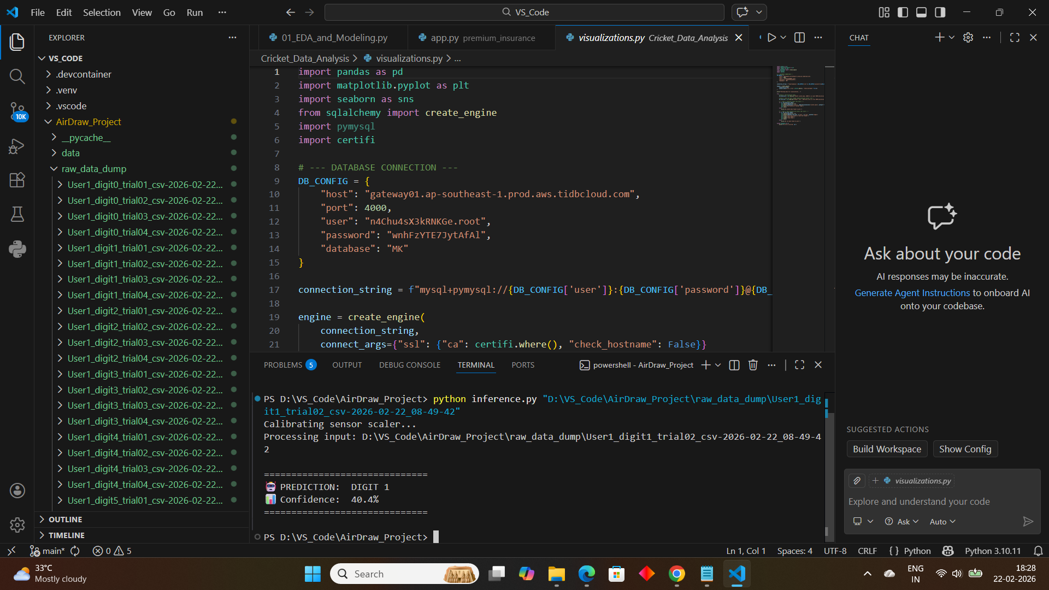
Results & Evaluation
Metric: Accuracy on unseen Test Set.
Achievement:
Final Model Accuracy: ~70% (on prototype dataset).
Inference Confidence: Consistently high (>75%) for distinct digits like 0, 6, and 9.

Slide 9
Conclusion
AirDraw successfully demonstrates that smartphone IMU sensors are precise enough for handwriting recognition.
This project bridges the gap between Signal Processing and Deep Learning.

Slide 10
THANK YOU

