Slide 1
SmartPremium: Predicting Insurance Costs with Machine Learning
Prepared By: MUKESH KANNAN S

Slide 2
Problem Statement
The Problem: Traditional insurance premium calculations are often slow, manual, and lack transparency for the customer.
The Gap: Customers want instant estimates based on their specific lifestyle and health data.
The Goal: Build an automated system that uses historical data to predict annual premiums with high accuracy in real-time.

Slide 3
The Dataset & Features
Source: Synthetic Insurance dataset (simulating real-world variables).
Key Features Used:
Demographics: Age, Gender, Income, Education, Location.
Health Metrics: Health Score, Smoking Status, Exercise Frequency.
Policy Details: Policy Type, Duration, Previous Claims, Credit Score.
Target Variable: Annual Insurance Premium Amount.

Slide 4
Data Science Workflow
Preprocessing: Handled missing values and used One-Hot Encoding for categorical data (e.g., Gender, Location).
Feature Scaling: Applied log transformation (np.log1p) to the Target Variable to handle skewed data and improve model convergence.
Algorithm: XGBoost Regressor (chosen for its speed and performance with tabular data).
Evaluation: Used Mean Absolute Error (MAE) and R^2 Score to measure accuracy.

Slide 5
The Web Application
Technology Stack: Python, Streamlit, Scikit-learn, XGBoost.
Functionality: * Clean, 3-column interactive UI for user inputs.
Real-time prediction engine.
Instant visual feedback (Balloons 🎈 and Success banners).
Hosting: Deployed via GitHub and Streamlit Cloud for global access.

Slide 6
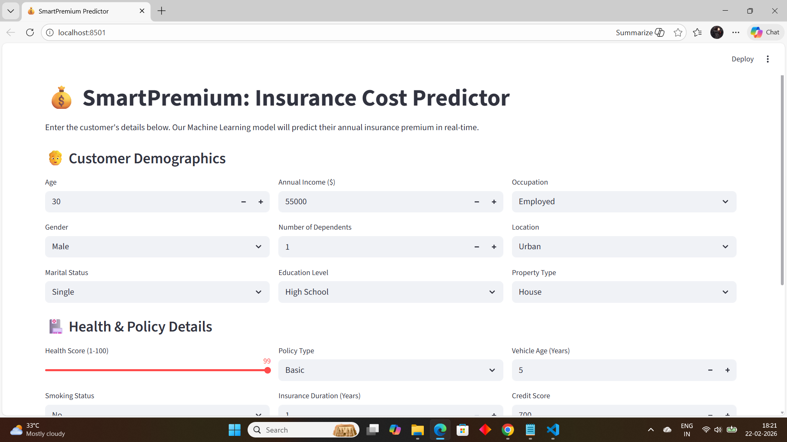
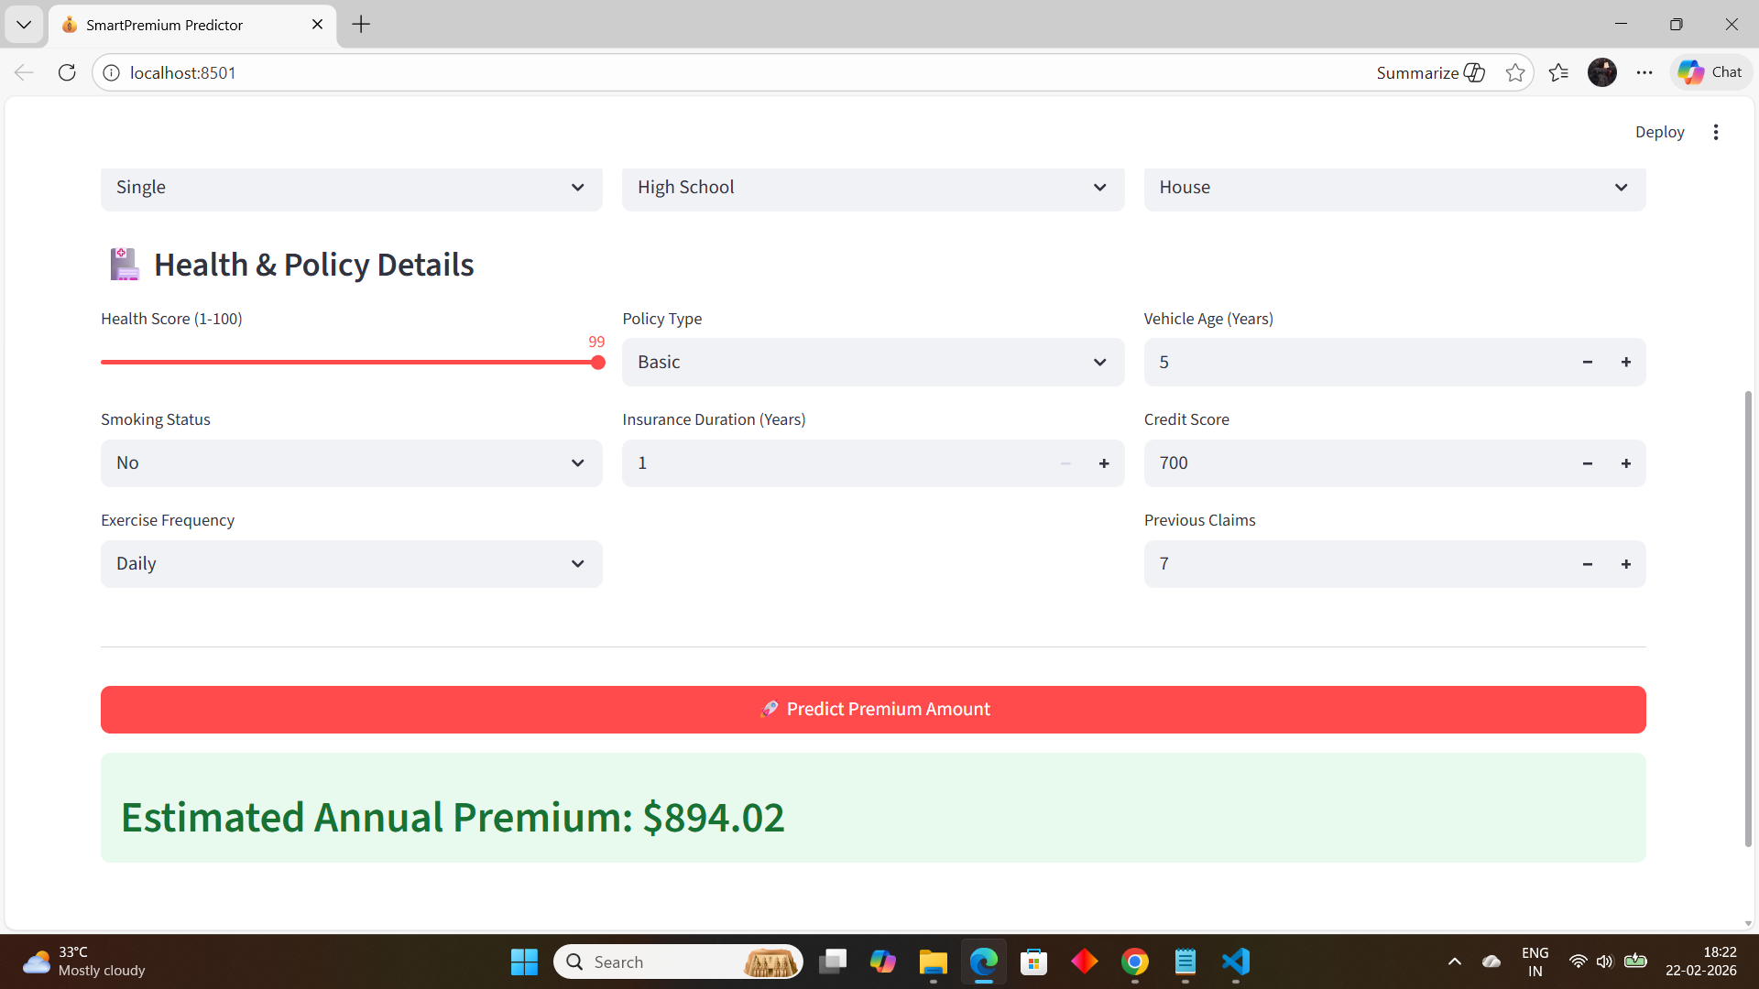
Streamlit_output

Slide 7
THANK YOU

