Slide 1
Advanced Sales Analytics Dashboard
End-to-End Sales Analytics Project
Dataset: Superstore
Tools: Excel | SQL | Python | Power BI

Slide 2
Project Overview
Objective:
• Analyze sales performance
• Build interactive dashboard
• Generate business insights

Slide 3
Workflow
Excel → SQL → Python → Power BI
Cleaning → Queries → EDA → Dashboard

Slide 4
Business KPIs
• Total Sales
• Total Profit
• Total Orders
• Total Customers
• Profit Margin

Slide 5
Key Business Insights
• Technology generated highest sales
• West region showed strong performance
• Consumer segment contributed the largest share
• Higher discounts reduced profitability

Slide 6
Project Outcome
Skills:
• Excel Analytics
• SQL Queries
• Python EDA
• Power BI Dashboard
• Business Storytelling

Slide 7
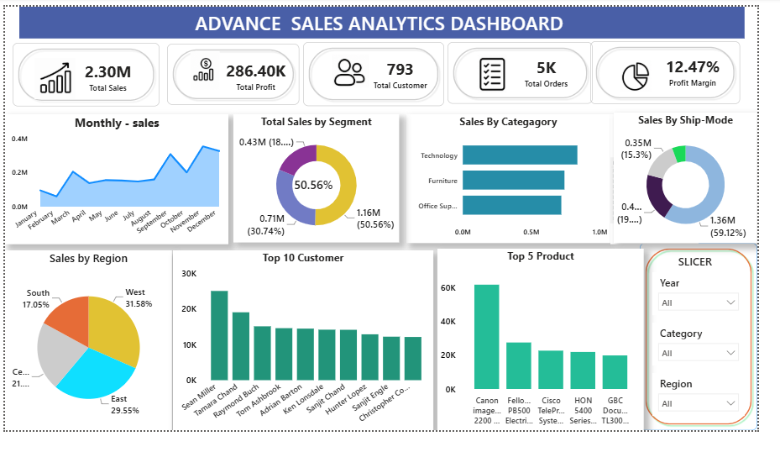
Dashboard Screenshot

