Slide 1
SOLID
(SOLID PRINCIPLES)

Slide 2
S
O
L
I
D
the SOLID principles are a set of five design principles that help in creating well-structured, maintainable, and scalable software.
these principles are especially useful in object-oriented programming
these principles were mainly promoted by Robert C. Martin in his book published in 2000

Slide 3
„Bad programmers worry about the code. Good programmers worry about data structures and their relationships.”
Linus Tordvalds

Slide 4
S
O
L
I
D
Single Responsibility
Principle

Slide 5
S
O
L
I
D
Open-Closed
Principle

Slide 6
S
O
L
I
D
Liskov Substitution
Principle

Slide 7
S
O
L
I
D
Interface Segregation
Principle

Slide 8
S
O
L
I
D
Dependency Inversion
Principle

Slide 9
SOLID Principles
in software engineering SOLID is an acronym for 5 design principles
why to use design patterns?
The aim of design patterns is to make software design more understandabe and maintainable
these principles are mainly promoted by Robert C. Martin in his book back in 2000
A
C
I
D
atomicity
consistency
isolation
durability

Slide 10
SOLID Principles
„Bad programmers worry about the code. Good programmers worry about data structures and their relationships.”
Linus Tordvalds

Slide 11
SOLID Principles
1.) single responsibility principle

Slide 12
SOLID Principles
1.) single responsibility principle
2.) open-closed principle

Slide 13
SOLID Principles
1.) single responsibility principle
2.) open-closed principle
3.) Liskov substitution principle

Slide 14
SOLID Principles
1.) single responsibility principle
2.) open-closed principle
3.) Liskov substitution principle
4.) interface segregation principle

Slide 15
SOLID Principles
1.) single responsibility principle
2.) open-closed principle
3.) Liskov substitution principle
4.) interface segregation principle
5.) dependency inversion

Slide 16
SINGLE RESPONSIBILITY PRINCIPLE
every software entity (class or method) should have only a single responsibility
if a given class (or method) performs multiple operations, it is advisable to separate them into distinct classes (or methods)
this can be easily achieved with the help of interfaces
THIS IS WHY SOLID PRINCIPLES ARE OFTEN COMBINED
if a class has more than one reason to change, it is a sign that it violates the single responsibility principle
each class or method should handle only a single responsibility
by following this approach, we can achieve loosely coupled software components

Slide 17
SINGLE RESPONSIBILITY PRINCIPLE
„Every class (or method) in a computer program should have responsibility over a single part of that program's functionality, which it should encapsulate”

Slide 18
SINGLE RESPONSIBILITY PRINCIPLE
TIGHT COUPLING
classes are highly dependent on
one another
this is typically happens when the
classes have too many
responsibilities
LOOSELY COUPLING
classes are independent of
each other
interfaces (abstraction) are quite
powerful tools to achieve
this feature
it can be done with the help
of the SOLID principles

Slide 19
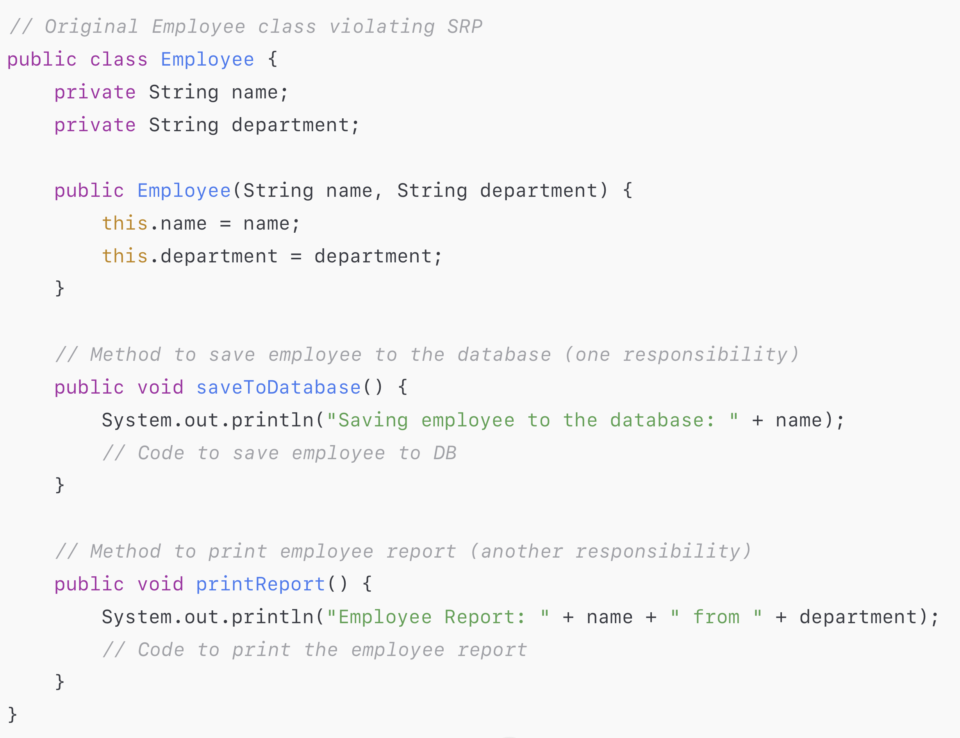
SINGLE RESPONSIBILITY PRINCIPLE

Slide 20
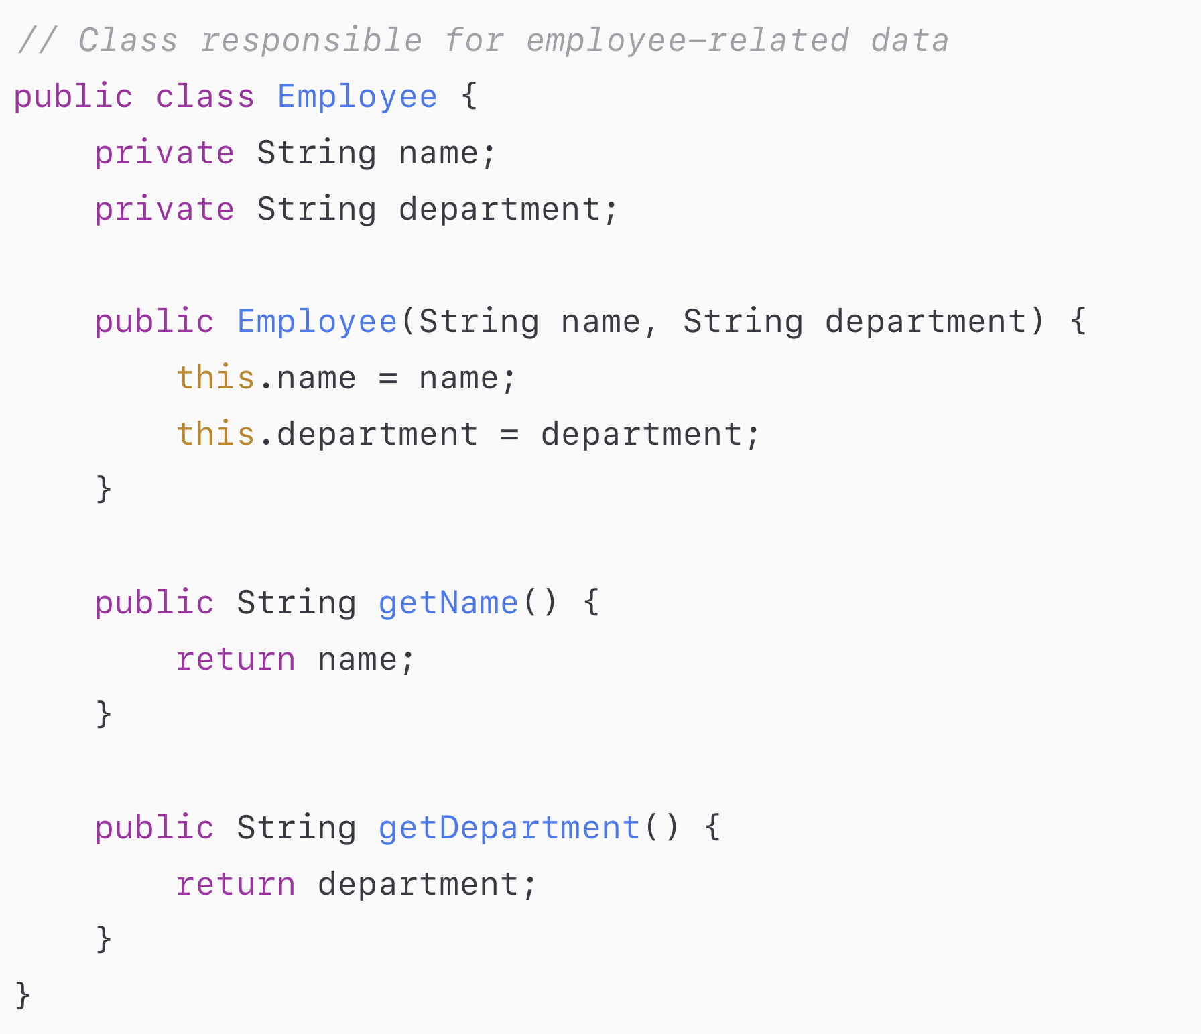
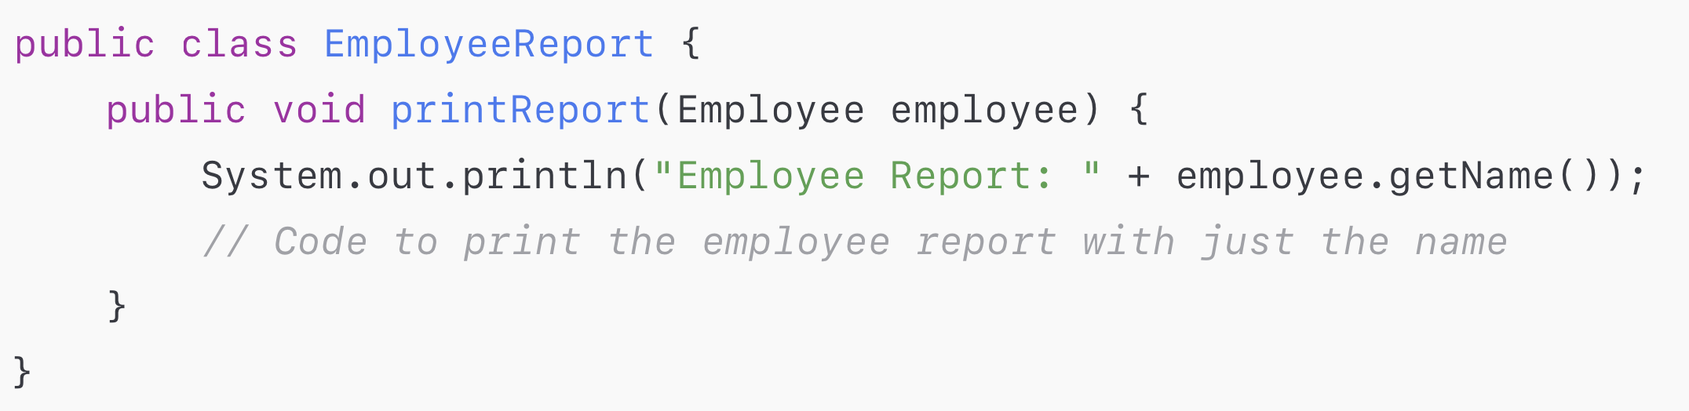
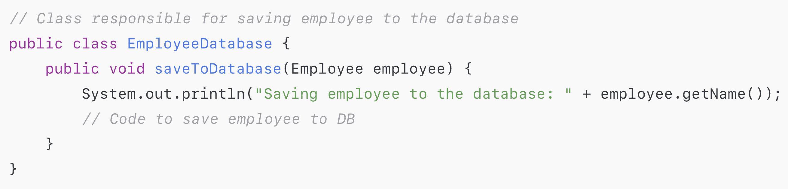
SINGLE RESPONSIBILITY PRINCIPLE

Slide 21
S - Single Responsibility Principle
„Every class (or method) in a computer program should have responsibility over a single part of that program's functionality, which it should encapsulate”

Slide 22
S - Single Responsibility Principle
TIGHT COUPLING
classes are highly dependent on
one another
this is typically happens when the
classes have too many
responsibilities
LOOSELY COUPLING
classes are independet of
each other
interfaces (abstraction) are quite
powerful tools to achieve
this feature
it can be done with the help
of the SOLID principles

Slide 23
Open/Closed Principle
(SOLID PRINCIPLES)

Slide 24
O – Open/Closed Principle
what is the motivation behind SOLID principles?
UNFORTUNATELY DURING SOFTWARE DEVELOPMENT THERE
WILL BE SEVERAL CHANGES AND UPDATES !!!
an application should take care of the frequent changes that are done during the development and the maintenance phases
for example adding new features

Slide 25
O – Open/Closed Principle
changes in the existing code should be minimized
it's assumed that the existing code is already unit tested
and changes in already written code might affect the existing functionality in an unwanted manner.
implementing
classes and modules
testing the modules
(unit tests)

Slide 26
O – Open/Closed Principle
open closed principle states that the design and writing of the code should be done in a way that new functionality should be added with minimum changes in the existing code
WE SHOULD KEEP AS MUCH EXISTING CODE
UNCHANGED AS POSSIBLE

Slide 27
O – Open/Closed Principle
„Software entities should be open for extension, but closed for modification”

Slide 28
O – Open/Closed Principle
software entities should be open for extension and closed for modification
we have to design every new module such that if we add a new behavior then we do not have to change the existing modules
CLOSELY RELATED TO SINGLE RESONSIBILITY PRINCIPLE
a class should not extend an other class explicitly – we should define a common interface instead
we can change the classes at runtime due to the common interface

Slide 29

O – Open/Closed Principle
PROGRESS DIALOGS
we want to show a progress dialog
it can due to some download or
loading of some music etc ...
we want to decide at runtime why we
want to show the dialog

Slide 30
O – Open/Closed Principle
There are 2 important design patterns that can guarantee
that the open closed principle is not violated:
1.) strategy pattern
2.) template pattern
SOLID principles
are the
specifications
and the
desing patterns
are the concrete
implementations

Slide 31
Liskov Substitution Principle
(SOLID PRINCIPLES)

Slide 32
L – Liskov Substitution Principle
what is the motivation behind Liskov principle?
WE USUALLY CREATE CLASS HIERARCHIES DURING
THE APPLICATION DEVELOPMENT
we extend some classes and creating some derived classes
it would be great if the new derived classed would work as well without replacing the functionality of the classes
otherwise the new classes can produce undesired effects when they are used in existing program modules

Slide 33
L – Liskov Substitution Principle
„Objects of a superclass shall be replaceable with objects of its subclasses without breaking the application”

Slide 34
L – Liskov Substitution Principle
objects of a superclass shall be replaceable with objects of its subclasses without breaking the application
that requires the objects of your subclasses to behave in the same way as the objects of your superclass
child classes should never break the parent class type definition
SUBTYPES MUST BE SUBSTITUTABLE FOR THEIR BASE TYPES
derived types must be completely substitutable for their base types

Slide 35
L – Liskov Substitution Principle
public class Vehicle {
...
}
SUBSTITUTION PRINCIPLE
run(Car c) {
...
}
we have to make sure there will
be no problems using the
subtype or the original class
do not break functionality
and we can call the
methods anyway
public class Car extends Vehicle {
...
}

Slide 36
L – Liskov Substitution Principle
public class Vehicle {
...
}
SUBSTITUTION PRINCIPLE
run(Vehicle v) {
...
}
we have to make sure there will
be no problems using the
subtype or the original class
do not break functionality
and we can call the
methods anyway
public class Car extends Vehicle {
...
}

Slide 37
L – Liskov Substitution Principle
There are 2 important design patterns that can guarantee
that the Liskov substitution principle is not violated:
1.) strategy pattern
2.) template pattern
SOLID principles
are not independent of
each other
the violation of
Liskov principle
is a latent violation of
open/closed principle

Slide 38
Interface Segregation Principle
(SOLID PRINCIPLES)

Slide 39
I – Interface Segregation Principle
what is the motivation behind interface segregation principle?
WE USE SEVERAL INTERFACES OR ABSTRACT CLASSES
IN ORDER TO ACHIEVE ABSTRACTION
sometimes we want to implement that interface but just for the sake of some methods defined in by that interface
we can end up with fat interfaces – containing more methods than the actual class needs

Slide 40
I – Interface Segregation Principle
„Software modules (classes and methods) should not be forced to depend upon interfaces that they do not use”

Slide 41
I – Interface Segregation Principle
it is not good if an interface has a large number of methods
we should separate the methods accordingly
IN JAVA A GIVEN CLASS MAY IMPLEMENT AS MANY
INTERFACES AS WE WANT (!!!)
no client should be forced to depend on methods it does not use
when it is possible we should break our interfaces in many smaller ones so they better satisfy the exact needs of our clients

Slide 42
Dependency Inversion Principle
(SOLID PRINCIPLES)

Slide 43
D – Dependency Inversion Principle
what is the motivation behind dependency inversion principle?
USUALLY THE LOW LEVELS MODULES RELY HEAVILY ON
HIGH LEVEL MODULES
(BOTTOM UP SOFTWARE DEVELOPMENT)
when implementing an application usually we start with the low level software components
then we implement the high level modules that rely on these low level modules

Slide 44
D – Dependency Inversion Principle
high level modules
depending on the
low level
implementations
APPLICATION
these are the
low level modules
the specific
implementations
Bluetooth
XML Parser
SQL

Slide 45
D – Dependency Inversion Principle
„High-level modules should not depend on low-level modules. Both should depend on abstractions”

Slide 46
D – Dependency Inversion Principle
„Abstractions should not depend on details. Details (concrete implementations) should depend on abstractions”

Slide 47
D – Dependency Inversion Principle
APPLICATION
ABSTRACTION
Bluetooth
XML Parser
SQL

Slide 48
D – Dependency Inversion Principle
what if we want to change the low level implementations?
in these cases we have to change the high level modules as well
this is why we should use abstraction (interfaces and abstract classes)
Dog dog = new Dog();

Slide 49
D – Dependency Inversion Principle
what if we want to change the low level implementations?
in these cases we have to change the high level modules as well
this is why we should use abstraction (interfaces and abstract classes)
Animal dog = new Dog();

Slide 50
Design Patterns
(Software Architecture Design)

Slide 51
Design Principles
design principles (such as SOLID principles) are high-level guidelines to design resuable software applications
pure abstraction – without implementation or programming language
they can be applies in any programming languages
these principles are platform independent

Slide 52
Design Patterns
design patterns are the low-level solutions of frequent object-oriented programming (OOP) related problems
It is the concrete implementation
several design principle can be implemented by design patterns
design patterns are tested by others – these techniques are state-of-the-art problem specific solutions

Slide 53
Design Patterns
design patterns are more
about how to design your code
+ concrete implementations
of the design principles
DESIGN PRINCIPLES
DESIGN PATTERNS
design principles (SOLID principles)
allow scalable and maintainable
software architectures

Slide 54
Design Patterns
THERE ARE 3 TYPES OF DESIGN PATTERNS

Slide 55
Design Patterns
THERE ARE 3 TYPES OF DESIGN PATTERNS
- CREATIONAL PATTERNS -
these patterns are designed for class instantiation
(class creational patterns and object creational patterns)

Slide 56
Design Patterns
THERE ARE 3 TYPES OF DESIGN PATTERNS
- CREATIONAL PATTERNS -
these patterns are designed for class instantiation
(class creational patterns and object creational patterns)
- STRUCTURAL PATTERNS -
these patterns are designed for class structure
(how to increase the functionality of a class)

Slide 57
Design Patterns
THERE ARE 3 TYPES OF DESIGN PATTERNS
- CREATIONAL PATTERNS -
these patterns are designed for class instantiation
(class creational patterns and object creational patterns)
- STRUCTURAL PATTERNS -
these patterns are designed for class structure
(how to increase the functionality of a class)
- BEHAVIORAL PATTERNS -
these patterns are dealing with how to communicate
effectively between given classes

Slide 58
Strategy Pattern
(Design Patterns)

Slide 59
Strategy Pattern
strategy pattern (or policy pattern) enable selecting an algorithm at run-time
define a family of algorithms, put each of them into a separate class, and make their objects interchangeable

Slide 60
Strategy Pattern
ENCAPSULATION
→ encapsulation is an important concept in OOP
Consider the classes and methods that varies and encapsulate it
→ later we can change or update parts of the application
that change frequently wihtout affecting the static parts
CODE THAT CHANGE
STATIC CODE

Slide 61
Strategy Pattern
PROGRAM TO A SUPERTYPE
→ the actual run-time object should not be locked into the code
→ the type of a variable should be abstract (interface or abstract class) – can be of any concrete implementation
The dependency inversion principle handles this problem
CLASS
INTERFACE

Slide 62
Strategy Pattern
PROGRAM TO A SUPERTYPE
→ we should separate behaviors from implementations
→ it is easier to resue software components like these
→ we can add new behavior without modifying an of the
existing classes and modules
CLASS
INTERFACE

Slide 63
Strategy Pattern
FAVOR COMPOSITION OVER INHERITANCE
INHERITANCE
COMPOSITION
IS A relationship
every class can extend
a single class in Java
HAS A relationship
every class can have several instance
encapsulated variable
+ gives more flexibility
YOU CAN CHANGE BEHAVIOR AT RUN-TIME

Slide 64
Strategy Pattern
ADVANTAGES
→ we can use if-else statements instead of the strategy pattern
but it is hard to test these statements
→ every single possible branch of the application
increases the cyclomatic complexity of the software

Slide 65
Observer Pattern
(Design Patterns)

Slide 66
Observer Pattern
the observer pattern defines a one-to-many dependency between given objects or entities
so that when one object changes state all of its dependents are notified and updated automatically
the subject is the object that is being monitored
observers (or listeners) are depending on the subject

Slide 67
Observer Pattern
the objects that are
watching and monitoring
the state changes
are the
observers or listeners
LISTENER #1
SUBJECT
LISTENER #2
.
.
.
the object that is
being observed
(monitored)
LISTENER #N

Slide 68
Observer Pattern
this is how we can achieve loosely coupled software systems
when two objects are loosely coupled they can interact but they have little knowledge of other
the only thing the subject knows about an observer is that it implements a certain interface
we can add observers whenever we want: just have to implement the Observer interface

Slide 69
Observer Pattern
do not have to modify the subject to add new type of observers
we can independently reuse subjects or observers
we can change the subject or observer independently
so loosely coupled design is very good – we can build flexible systems that can handle change
because the interdependency between objects is minimal

Slide 70
Observer Pattern
OBSERVER PATTERN IS QUITE COMMON
IN JAVA PROGRAMMING
+ Android OS
we can assign listeners or observers to a given
button (subject)
the listener is notified when the button is
clicked or selected

Slide 71
Observer Pattern
ALGORITHMIC TRADING
we simulate the S(t) stock price
and we use observer pattern
to buy or sell stocks
RSI (Relative Strength Indicator) is a
frequnetly used value [0, 100]
in technical analysis
we can decide whether the stock is
overbought or oversold
S(t)
t

Slide 72
Singleton Pattern
(Design Patterns)

Slide 73
Singleton Pattern
singleton pattern is a creational design pattern
it lets you ensure that a class has only one instance while providing a global access point to this instance
it ensures that a given class has just a single instance
the singleton pattern provides a global access point to that given instance

Slide 74
Singleton Pattern
all other classes and
modules can
access this single
object (singleton)
PROBLEM
when there
are multiple
threads or processes
CLASS #1
CLASS #2
INSTANCE
CLASS #3
.
.
.
this is the single
object (singleton)
CLASS #N

Slide 75
Singleton Pattern
when to use the singleton pattern?
we can control access to a shared resource such as files, databases or thread pools (when dealing with multithreading)
it is extremely crucial in logging

Slide 76
Factory Pattern
(Design Patterns)

Slide 77
Factory Pattern
factory pattern helps to create loosely coupled OOP design
there is a fundamental problem with the new keyword
whenever we use the new keyword (and instantiate a class) we definitely violate this principle
tying our code to concrete classes makes the application less flexible and more fragile
„We should favor abstraction (supertypes) instead of
concrete implementations”

Slide 78
Factory Pattern
if we program to an interface – the code will work fine with any other classes implementing that interface
Animal dog = new Dog();
Animal dog = new Dog()
it is working fine because we program to an interface
(instead of concrete classes) but the Dog class may
change in the future
THIS IS WHY THERE IS A PROBLEM WITH THE new KEYWORD

Slide 79
Factory Pattern
if we program to an interface – the code will work fine with any other classes implementing that interface
Animal dog = AnimalFactory.getDog()
Animal dog = new Dog()
this is why we should separate the static classes
in the application from the classes that change frequently
(we can encapsulate object creation)
WE CAN INSTANTIATE THE CLASSES IN A SEPARATE CLASS
- FACTORY PATTERN -

Slide 80
Abstract Factory Pattern
factories that creates other factories (factories of the factories)
it is an interface is responsible for creating a factory of related objects without explicitly specifying their classes

Slide 81
Abstract Factory Pattern
AbstractFactory
PetrolFactory
ElectricFactory
FORD
TOYOTA
FORD
TOYOTA

Slide 82
Builder Pattern
(Design Patterns)

Slide 83
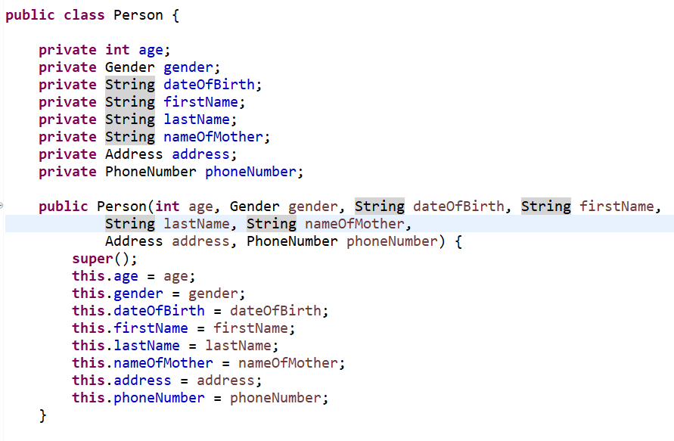
Builder Pattern
builder pattern is maybe the #1 desing pattern in software engineering
what is the motivation behind builder pattern?
LARGE NUMBER OF
VARIABLES
there may be a large
amount of parameters
in a constructor
because there may be
several instance variables
in a given class
EASY TO CONFUSE THE PARAMETERS

Slide 84
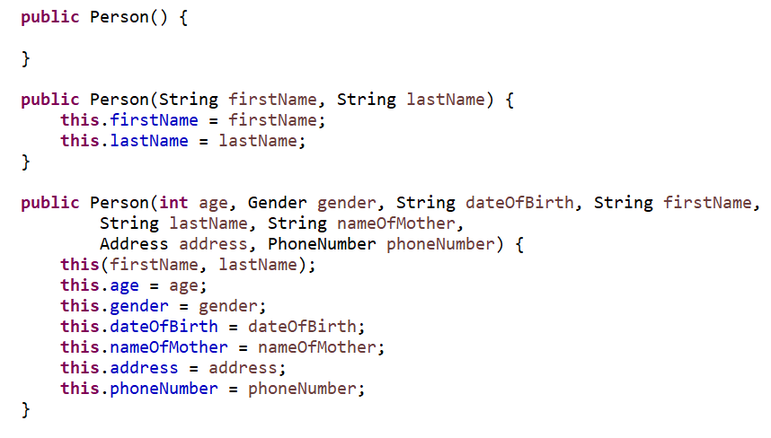
Builder Pattern
using several parameters in the constructor and getters / setters
THESE ARE NOT EXTENSIBLE SOLUTIONS
if we want to add another optional parameter then we have to add another contructor
„telescoping constructors”
we just have to add
a single method
IF WE USE BUILDER PATTERN

Slide 85
Builder Pattern
using several parameters in the constructor and getters / setters
THESE ARE NOT EXTENSIBLE SOLUTIONS
if we want to add another optional parameter then we have to add another contructor
„telescoping constructors”
we just have to add
a single method
IF WE USE BUILDER PATTERN

Slide 86
Builder Pattern
the builder pattern satisfies the immutable property
here we create the object itself at the last step
Person p = new Person.Builder().setAge(12).setName(„Kevin”).build();
there can not be any problem because of
concurrent updates – when dealing with
multiple threads or processes
WE CONSTRUCT THE OBJECT AS THE LAST STEP OF THE PROCESS
- BUILDER PATTERN -

Slide 87
Prototype Pattern
(Design Patterns)

Slide 88
Prototype Pattern
what is the motivation behind prototype pattern?
the aim is to be able to copy existing objects without depending on those given classes
we can consider all the variables of the given object and copy the value one by one ...
THERE MAY BE PRIVATE VARIABLES AND THERE
MAY BE ABSTRACT LAYERS AS WELL

Slide 89
Prototype Pattern
usually we program to an interface or a supertype – it is a good object-oriented design principle
Animal dog = new Dog();
Animal dog = new Dog()
in these cases (when we have the interface) we have
access to the methods and variabes that
are defined in the interface
THIS IS THE DRAWBACK OF ABSTRACTION

Slide 90
Prototype Pattern
the solution is that we have to delegate the object creation problem to the object itself
THIS OPERATION IS CALLED CLONING
the clone method creates a new instance with all the field values
an object that supports the cloning operation is called a prototype
in Java we have to implement the Cloneable interface and define the clone() method

Slide 91
Prototype Pattern
sometimes we can eliminate inheritance with prototype pattern
especially when dealing with complex objects – do not want to bother with configuration issues

Slide 92
Command Pattern
(Design Patterns)

Slide 93
Command Pattern
what is the motivation behind command pattern?
the aim is to achieve separation of concerns
APPLICATION
(business logic
and the model)
SAVE BUTTON
UPDATE BUTTON
DELETE BUTTON

Slide 94
Command Pattern
what is the motivation behind command pattern?
the aim is to achieve separation of concerns
APPLICATION
(business logic
and the model)
C
O
M
M
A
N
D
SAVE BUTTON
UPDATE BUTTON
DELETE BUTTON

Slide 95
Command Pattern
because of the abstract layer we can achieve loosely coupled design
the user interface components know nothing about the underlying business logic or the model
and we can change the sender’s behavior at run-time

Slide 96
Command Pattern
so we can encapsulate method invocations – encapsulating requests as objects basically
the method invoking the computations knows nothing about about the implementation
LOOSELY COUPLED SOFTWARE DESIGN
there are usually 4 components of the command pattern
command, receiver, invoker and client

Slide 97
Command Pattern
COMMAND
it knows about receiver and invokes a method of the receiver. The values for parameters
of the receiver method are stored in the command

Slide 98
Command Pattern
COMMAND
it knows about receiver and invokes a method of the receiver. The values for parameters
of the receiver method are stored in the command
RECEIVER
it does the work itself

Slide 99
Command Pattern
COMMAND
it knows about receiver and invokes a method of the receiver. The values for parameters
of the receiver method are stored in the command
RECEIVER
it does the work itself
INVOKER
knows how to execute a command and optionally does bookkeeping about the command execution. The invoker does not know anything about a concrete command it knows only about command interface

Slide 100
Command Pattern
COMMAND
it knows about receiver and invokes a method of the receiver. The values for parameters
of the receiver method are stored in the command
RECEIVER
it does the work itself
INVOKER
knows how to execute a command and optionally does bookkeeping about the command execution. The invoker does not know anything about a concrete command it knows only about command interface
CLIENT
the client decides which commands to execute. To execute a command it passes the
command object to the invoker object.

Slide 101
Advantages of Command Pattern
We can decouple classes that invoke the operations and the classes that will execute these operation
LOOSELY COPULED DESIGN + SINGLE RESPONSIBILITY

Slide 102
Advantages of Command Pattern
We can add further commands without modifying existing code
OPEN/CLOSED PRINCIPLE

Slide 103
Advantages of Command Pattern
We do not have to execute the commands immediately – we can store
these commands in a data structure
WE CAN IMPLEMENT UNDO / REDO OPERATIONS

Slide 104
Template Pattern
(Design Patterns)

Slide 105
Template Pattern
what is the motivation behind template pattern?
there are several operations and procedure in software engineering that are very similar to each other
subclasses will override the specific steps and decide the concrete behaviors of the modules
FOOTBALL
initialize();
startGame();
finishGame()
BASKETBALL
initialize();
startGame();
finishGame()

Slide 106
Template Pattern
what is the motivation behind template pattern?
there are several operations and procedure in software engineering that are very similar to each other
subclasses will override the specific steps and decide the concrete behaviors of the modules
FOOTBALL
initialize();
startGame();
finishGame()
BASKETBALL
initialize();
startGame();
finishGame()

Slide 107
Template Pattern
TEMPLATE PATTERN
STRATEGY PATTERN
template pattern is based
in inheritance usually
it operates on class level
which means it is static
strategy pattern is based
on composition instead
+ it operates on object level which
seans it is dynamic
(we can change behavior at run-time)
USUALLY STRATEGY PATTERN IS MORE FLEXIBLE !!!

Slide 108
Visitor Pattern
(Design Patterns)

Slide 109
Visitor Pattern
what is the motivation behind visitor pattern?
we would like to do some specific operation (saving the data) on different entities ...
Photoshop or Ilustrator
we may have several
geometric shapes on the
canvas
WHAT IF WE WANT TO SAVE ALL OF THESE
GEOMETRIC SHAPES INTO A FILE?

Slide 110
Visitor Pattern
we have to consider the shapes one by one and save them accordingly ...
BUT IT IS NOT A FLEXIBLE SOLUTION
violates the single responsibility principle
these shapes have nothing to do with how to save them
it may violates the open / closed principle as well
what if we want to change the way we save the shapes? We have to change the code we have already implemented

Slide 111
Visitor Pattern
„The visitor design pattern is a way of separating an algorithm from an object structure on which it operates”

Slide 112
Visitor Pattern
so we have a visitor class that will do the save operations
but again there is a problem: we need different save operations for different shapes
we know that we can use
the visitor pattern but
how to call these
different methods?
THE DOUBLE DISPATCH TECHNIQUE
CAN SOLVE THIS PROBLEM !!!
we delegate the problem to the object
because the object knows exactly
how to save the shape
(ok we have to change the class but just once!!!)
ExportVisitor
saveRectangel(Rectange object);
saveCircle(Circle object);
saveTriangle(Triangle object);

Slide 113
Decorator Pattern
(Design Patterns)

Slide 114
Decorator Pattern
what is the motivation behind decorator pattern?
we would like to add one or more behaviors dynamically

Slide 115
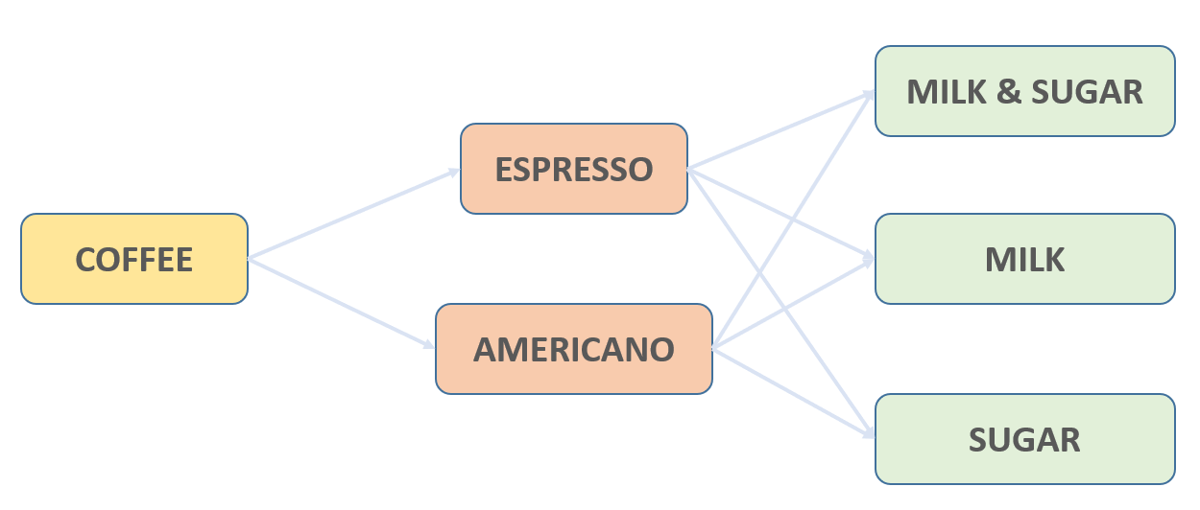
Decorator Pattern
what is the motivation behind decorator pattern?
we would like to add one or more behaviors dynamically

Slide 116
Decorator Pattern
we can use inheritance to change the behavior of a given component
the main problem with inheritance is that it is static
INHERITANCE IS UNFORTUNATELY STATIC !!!
we can not change the behaviors at run-time
the second disadvantage is that in several programming laguages every class may have just a single parent class
this is why we should favor composition over inheritance

Slide 117
Decorator Pattern
we the decorator pattern we can attach additional responsibilities to an object dynamically
decorators provide a flexible alternative to subclassing and for extending functionality
new LineNumberInputStream(new BufferedInputStream(new FileInputStream()));

Slide 118
Façade Pattern
(Design Patterns)

Slide 119
Façade Pattern
what is the motivation behind facade pattern?
we would like to deal with a complicated library or framework ...
for example external libraries such as TensorFlow or SkLearn
extremely useful when using APIs
we have to initialize the framework related classes and handle all the dependencies
the problem is that our classes may become tightly coupled to the implementation of the framework or library

Slide 120
Façade Pattern
„The facade pattern can provide a relatively
easy to understant interface to a rather complex system”

Slide 121
Façade Pattern
CLUSTERING
APPLICATION
DIMENSIONALITY
REDUCTION
CLASSIFICATION
DEEP LEARNING
NEURAL NETWORKS

Slide 122
Façade Pattern
F
A
C
A
D
E
CLUSTERING
APPLICATION
DIMENSIONALITY
REDUCTION
CLASSIFICATION
DEEP LEARNING
NEURAL NETWORKS
facede pattern provides a simple interface
to the complicated framework or system
it has limited functionality but this is
exactly the main advantage
IT ONLY PROVIDES THE FEATURES THE CLIENT NEEDS

Slide 123
Façade Pattern
the facade pattern can be transformed into a singleton pattern
usually there is just a single facade interface

Slide 124
Flyweight Pattern
(Design Patterns)

Slide 125
Flyweight Pattern
what is the motivation behind flyweight pattern?
we would like to minimizes memory usage by sharing as much data as possible with similar objects
for example in a document every single character share the same features – font metrics etc.
we create a flyweight object and every single character refers to it

Slide 126
Flyweight Pattern
4 MB
4 MB
4 MB
4 MB
6 MB
6 MB
6 MB
6 MB
10 MB
10 MB
10 MB
10 MB

Slide 127
Flyweight Pattern
4 MB
6 MB
6 MB
6 MB
6 MB
7 MB
7 MB
7 MB
7 MB

Slide 128

Flyweight Pattern
GAME DEVELOPMENT
in a computer game there are a large
number of similar objects
(bullets, enemy ships etc.)
WE DON’T WANT TO USE
DIFFERENT OBJECTS
WHEN DEALING WITH
THE SAME PARTICLE
flyweight pattern is
extremely useful !!!

Slide 129
Flyweight Pattern
„A flyweight is an object that minimizes memory usage by sharing as much data as possible with other similar objects”

Slide 130
Flyweight Pattern
texture of the particles
(image)
width and height
there are features and parameters
of objects that are the same
the constant data associated with
a class or object is the intrinsic state
speed and position
of the particles
there are parameters
of objects that are unique
these are called extrinsic state

Slide 131
Flyweight Pattern
texture of the particles
(image)
width and height
there are features and parameters
of objects that are the same
the constant data associated with
a class or object is the intrinsic state
speed and position
of the particles
FLYWEIGHT PATTERN SUGGESTS
NOT TO STORE THESE FEATURES
IN THE GIVEN OBJECT !!!

Slide 132
Flyweight Pattern
texture of the particles
(image)
width and height
objects storing the instrinsic
states exclusively
are called flyweights

Slide 133
Flyweight Pattern
texture of the particles
(image)
width and height
objects storing the instrinsic
states exclusively
are called flyweights

Slide 134
Flyweight Pattern
what will happen to the extrinsic states?
we store them in a data structure – usually a simple one-dimensional array data structure
the items will be delegated to the draw() method to paint the entitites to the canvas

Slide 135
Adapter Pattern
(Design Patterns)

Slide 136
Adapter Pattern
what is the motivation behind adapter pattern?
there are several incompatible classes and interfaces in software engineering
because of legacy code and frequently changing APIs

Slide 137
Adapter Pattern
„The adapter pattern allows objects with incompatible interfaces to collaborate and work together. It is often used to make existing classes work with others without modifying their source code.”

Slide 138
Adapter Pattern
APPLICATION
API or framework
using XML
there are several applictions out there
relying heavily on legacy code
there may be several features that can
not be used in the exact same way
WE NEED ADAPTER PATTERN TO MAKE THESE COMPATIBLE
LEGACY CODE
WITH CSV

Slide 139
Adapter Pattern
A
D
A
P
T
E
R
APPLICATION
API or framework
using XML
there are several applictions out there
relying heavily on legacy code
there may be several features that can
not be used in the exact same way
WE NEED ADAPTER PATTERN TO MAKE THESE COMPATIBLE
LEGACY CODE
WITH CSV

Slide 140
MVC Pattern
(Design Patterns)

Slide 141
Model-View-Controller (MVC) Pattern
the model-view-controller (MVC) pattern was first introduced back in 1987 in the Smalltalk programming language
it was used for desktop applications with user interface components
but it is still popular for designing web applications as well ...

Slide 142
Model-View-Controller (MVC) Pattern
- MODEL -
it includes all the data and its related logic
(data access objects, model classes, databases etc.)

Slide 143
Model-View-Controller (MVC) Pattern
- MODEL -
it includes all the data and its related logic
(data access objects, model classes, databases etc.)
- VIEW -
handles user interactions (GUI) and presents the data to the user
(user interface related components: buttons, text fields etc.)

Slide 144
Model-View-Controller (MVC) Pattern
- MODEL -
it includes all the data and its related logic
(data access objects, model classes, databases etc.)
- VIEW -
handles user interactions (GUI) and presents the data to the user
(user interface related components: buttons, text fields etc.)
- CONTROLLER -
an abstract layer between the view and the model

Slide 145
Model-View-Controller (MVC) Pattern
APPLICATION
(business logic
and the model)
SAVE BUTTON
UPDATE BUTTON
DELETE BUTTON

Slide 146
Model-View-Controller (MVC) Pattern
C
O
N
T
R
O
L
L
E
R
MODEL
SAVE BUTTON
UPDATE BUTTON
DELETE BUTTON

Slide 147
Model-View-Controller (MVC) Pattern
the model-view-controller (MVC) system is easy to test
we can decouple the model from the view – we can achieve loosely coupled software systems
it provides a clear separation of logic

Slide 148
Disadvantages of the MVC Pattern
the model and the view are decoupled but they are not independent
when the model changes frequently – we have to update the views a well
BUT THE VIEW (GRAPHICAL DISPLAY) TAKES SOME TIME TO RENDER
in modern web applications or smartphone applications there are an enormous number of interactions
this is why MVVM architecture is more and more popular – this is the case with AngularJS

