Slide 1
Does estimated need match food shelf activity?
QUESTION 1
Feeding America's Map the Meal Gap vs. The Food Group's food shelf reports · 87 counties · 2022–2024
Notes:
[~10 sec]
Question 1 asks whether Feeding America's estimates of food insecurity tell the same story as The Food Group's food shelf data. We compared them for all 87 counties, 2022 to 2024.

Slide 2
Same story? Only partly
✓
County size
ρ ≈ 0.9, but population alone does as well
✓
Direction over time
Need +25%, visits +46%
✗
Per resident
Higher need rate ≠ more visits (ρ ≈ 0)
Notes:
[~30 sec]
Short answer: only partly.
On totals they agree, with a correlation of about 0.9. But plain population predicts food shelf activity just as well, so that agreement is mostly county size.
Over time, both went up. Need rose 25%, visits 46%.
But per resident, there's no relationship. Counties with a higher food insecurity rate don't have more food shelf use per person.

Slide 3
Pounds tracks need best, by a small margin
+0.02
Pounds' lead on totals: consistent every year, but small
0.9 → 0.1
Totals vs. per resident: the real gap
Notes:
[~25 sec]
Of the three metrics, pounds distributed tracks need best and individuals least. But pounds' lead is small, about 0.02, even though it's consistent every year.
The bigger lesson: whether you adjust for county size matters far more than which metric you pick.

Slide 4
12 counties break the pattern
LIVE MAP
≥2× or ≤½
of what similar-need counties record
2+ metrics
in 2+ of 3 years, checked two ways, fully reported
← less than expected
more than expected →
Notes:
[~40 sec, LIVE DEMO]
[Alt+Tab to the map. Tab 1 'Which counties?' opens at 2x]
To find where the relationship breaks down, we compared each county with counties that have a similar number of food-insecure people.
12 counties record at least twice, or half or less, what similar counties record, on at least two metrics, in at least two of three years.
Five record less: Nicollet, Pope, Lac qui Parle, Norman and Roseau. Seven record more, led by Steele at four times expected.
[drag the slider to 3x, then back to 2x]
And this isn't down to the cutoff: Steele, Washington and Rice stay on the list even at three times.
[Alt+Tab back to the slides]

Slide 5
Access explains the gaps. Hardship doesn't
ρ = −0.33
nearest food shelf across the line · p = 0.002
None
of the hardship measures (poverty, no car, SNAP) predicted the gaps
Notes:
[~30 sec]
So why? We tested county characteristics.
Poverty, car access, SNAP participation, rural share: none of them predicted the gaps.
What did is access. The strongest factor is the share of residents whose nearest food shelf is in another county.

Slide 6
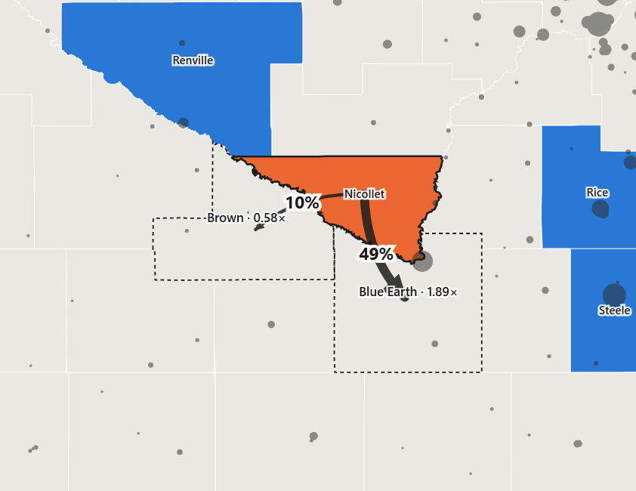
Activity is counted where the food shelf is
LIVE MAP
49%
of Nicollet residents are closer to a Blue Earth food shelf
Nicollet 0.29× → Blue Earth 1.89×
6 of 9
Wilkin helpline callers referred to a food shelf, though Wilkin has none
Notes:
[~40 sec, LIVE DEMO]
That's because activity is counted where the food shelf is, not where people live.
[Alt+Tab to the map, press 2 for 'Cross-county', click NICOLLET]
In Nicollet, half the residents are closer to a food shelf in Blue Earth. Nicollet records 0.29 times what's expected; Blue Earth records almost twice.
[click WILKIN]
Wilkin has no food shelf at all, yet the helpline referred six of its nine callers to one.
Nicollet is our clearest case. We don't claim this explains every county.

Slide 7
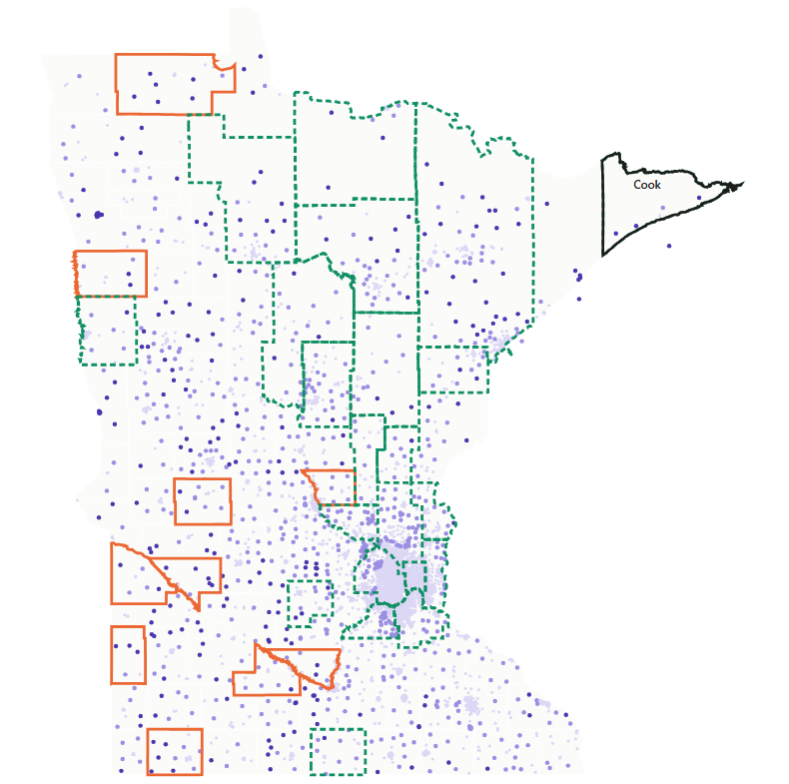
Distance matters; mobile pantries may help
LIVE MAP
25% vs 9%
0 of 10
residents >10 mi away: lower counties vs. the rest
lower counties with a mobile pantry
2.4×
1.23×
Cook: remote, but 64% of visits from mobile pantries
far-away counties with a mobile pantry (0.80× without)
Mobile pantry results are suggestive (p ≈ 0.05–0.10).
Notes:
[~35 sec, LIVE DEMO]
Distance matters too.
[press 3 for 'Distance', tick 'Outline counties with a mobile pantry']
In the lower-than-expected counties, typically a quarter of residents live more than 10 miles from a food shelf, versus 9% elsewhere. And none of those 10 counties has a mobile pantry.
[click COOK]
Cook is just as remote, but most of its visits come from mobile pantries, and it records 2.4 times expected.
The mobile pantry result is suggestive, not proven.
[Alt+Tab back to slides]

Slide 8
The supply network and site size matter too
0.22 → 0.34
share of the gaps explained once the food bank is added
~1,750
visits per site per month in Washington, the busiest in MN
Notes:
[~25 sec]
Two more things matter.
First, the food bank that supplies a county. North Country counties record less; Channel One and Second Harvest Northland counties record more. Adding this raises how much of the gaps we explain from 22% to 34%. Each food bank covers a region, so this is a lead to explore, not a verdict.
Second, site size. The biggest 'higher' counties have a few very busy sites close to people. Washington averages about 1,750 visits per site per month.

Slide 9
Where food shelves are matters as much as how much need there is
TAKEAWAY
1
Collect client ZIP codes
2
Send mobile pantries
3
Compare food banks
to see cross-county use directly
to Lac qui Parle, Norman, Roseau
supply and how visits are recorded
Notes:
[~20 sec]
So: where food shelves are matters as much as how much need there is.
We recommend three things: collect client ZIP codes to see cross-county use directly, send mobile pantries to Lac qui Parle, Norman and Roseau, and compare practices across food banks.

