Slide 1
Customer Churn Prediction as a Data Product
From Machine Learning Model to Deployable Retention Solution — Hungarian Telecom Company
Presented by Mukhammad Azim · Móger Máté · Jose Ocoro

Slide 2
BUSINESS PROBLEM
The Retention Crisis Facing Telecom
In a market defined by fierce competition and commoditized offerings, customer churn has become one of the most pressing financial threats for telecom operators. When customers leave, they take recurring revenue with them — and winning them back costs far more than keeping them.
The Core Challenge
The Strategic Shift
Intense competitive pressure accelerates customer switching
Churn erodes revenue, shrinks the customer base, and reduces lifetime value
Traditional retention is reactive — acting only after customers have already decided to leave
The goal is clear: move from reactive damage control to proactive, data-driven retention. By predicting churn before it happens, telecom companies can intervene at the right moment — with the right offer — and protect revenue at scale.

Slide 3
SCALE OF THE PROBLEM
$54M in Annual Revenue at Risk
The financial stakes of unmanaged churn are significant. Across a base of one million customers, even a modest annual churn rate compounds into a massive revenue exposure — making predictive retention not just a strategic priority, but a financial imperative.
1M
18%
Total Customer Base
Annual Churn Rate
Active subscribers across the telecom network
Proportion of customers lost each year
180K
$54M
Customers Lost Per Year
Revenue at Risk
At current churn levels without intervention
Based on $300 ARPU annually ($25/month)

Slide 4
PROJECT OBJECTIVE
Four Goals That Drive This Project
This initiative is designed to bridge the gap between raw data and real business action. The ambition goes beyond building a model — it's about creating an end-to-end system that generates reliable predictions and translates them into targeted, measurable retention strategies.
Predict Churn Probability
Identify High-Risk Customers
Score every customer with a churn likelihood score, updated on a regular cadence using the latest behavioral data.
Surface the customers most likely to leave so retention teams can prioritize their outreach effectively.
Enable Targeted Retention
Drive Business Decisions
Match each risk segment to an appropriate intervention — from loyalty rewards to direct retention calls.
Transform ML predictions into structured, actionable outputs that marketing and CRM teams can act on immediately.

Slide 5
DATA FOUNDATION
Dataset Overview
Dataset at a Glance
Feature Categories
The dataset captures a comprehensive view of each customer across four key dimensions:
7,043
Unique customer records
Demographics
Services Subscribed
Binary
Age, gender, senior citizen status, dependents
Internet, phone, streaming, tech support
Target: Churn (Yes / No)
Billing & Payments
Contract Type
Monthly charges, total charges, payment method
Month-to-month, one-year, or two-year contracts

Slide 6




EXPLORATORY ANALYSIS
Key Drivers of Customer Churn
Exploratory data analysis revealed four dominant behavioral and contractual patterns that consistently correlate with higher churn rates. Understanding these drivers is essential for both model feature selection and downstream retention strategy design.
Short Tenure
Month-to-Month Contracts
New customers churn at significantly higher rates — early engagement is critical
Flexible contracts remove switching friction, making these customers the highest-risk segment
High Monthly Charges
Fewer Services
Customers with elevated bills are more likely to seek lower-cost alternatives elsewhere
Low service adoption reduces switching costs and weakens the customer's connection to the provider

Slide 7

BASELINE RESULTS
Initial Model Performance
The baseline model delivered reasonable overall accuracy but revealed a critical weakness: low recall. With only 55% of actual churners detected, the model would have missed nearly half of at-risk customers — rendering it insufficient for a high-stakes retention use case where missed detections translate directly to lost revenue.
Baseline Metrics
Core Limitation A recall of 55% means 45% of churners go undetected. In a base of 180,000 churning customers, that's over 80,000 missed retention opportunities annually. This is the problem the improved model must solve.
1
2
Accuracy
Precision
80% — Strong overall classification rate
65% — Moderate reliability in positive predictions
3
4
Recall
F1-Score
55% — ⚠️ Critical gap: too many churners missed
60% — Reflects the recall weakness

Slide 8
MODEL IMPROVEMENTS
Engineering a Better Model
Improving recall required a systematic, multi-layered approach. The team addressed root causes at each stage of the ML pipeline — from data representation to decision boundary optimization — ensuring the final model was genuinely fit for a business-critical retention use case.
01
02
Feature Engineering
Class Imbalance Handling
New behavioral indicators were constructed — such as charge-per-tenure ratios and service bundling scores — to capture nuanced churn signals not visible in raw features.
Applied SMOTE (Synthetic Minority Oversampling Technique) and class weighting to correct the imbalance between churn and non-churn records in the training data.
03
04
Multi-Model Evaluation
Threshold Optimization
Multiple algorithms were evaluated — including Logistic Regression, Random Forest, XGBoost, and Gradient Boosting — using recall, F1-score, and ROC-AUC as selection criteria.
Rather than using the default 0.5 decision threshold, the team tuned the probability cutoff to maximize recall while maintaining an acceptable precision trade-off.

Slide 9

FINAL MODEL
Optimized Model Performance
After applying all improvements, the final model — using an optimized decision threshold of 0.55 — delivered a significant uplift in recall while maintaining strong overall discriminative power. The +19 percentage point gain in recall is the defining business outcome of the modeling work.
76%
F1-Score: 0.62
Accuracy
The F1-score held steady at 0.62 — confirming that the recall gain did not come at the cost of overall model balance.
54%
Key Win: +19% Recall The model now detects 74% of all actual churners — up from 55% — enabling the retention system to act on far more at-risk customers each cycle.
Precision
74%
Recall ▲ +19pp
84%
ROC-AUC

Slide 10

BUSINESS LOGIC
Why Recall Is the Right Metric to Optimize
Missing a churner is far more costly than reaching out to a customer who was going to stay anyway.
The Cost of a False Negative
The Cost of a False Positive
A missed churner (false negative) means a customer leaves uncontacted. The company loses their full annual revenue — $300 per customer — with no opportunity to intervene.
A wrongly targeted non-churner (false positive) receives an unnecessary retention offer. The marginal cost is limited to the campaign spend — typically a fraction of the revenue risk.
Strategic Implication: In a retention context, maximizing recall — even at the expense of some precision — is the economically rational choice. The asymmetry in costs justifies accepting more false positives to dramatically reduce false negatives.

Slide 11
FROM MODEL TO PRODUCT
Transforming Predictions into Actionable Outputs
A machine learning model alone is not a product. The real value is unlocked when predictions are structured, enriched, and delivered in a format that operational teams can act on immediately. The system generates three key outputs for every scored customer.
Churn Probability
Risk Segment
Recommended Action
A continuous score from 0 to 1 representing the likelihood that a customer will churn within the next billing cycle — the foundation for all downstream decisions.
Each customer is classified into one of four risk tiers — Low, Medium, High, or Very High — enabling prioritized, tiered campaign execution.
A prescriptive action mapped to each risk tier — from a loyalty program invite for medium-risk customers to an immediate retention call for critical cases.

Slide 12
RISK SEGMENTATION
Four-Tier Customer Risk Framework
Segmentation ensures that retention resources are allocated efficiently — not uniformly. The framework focuses investment on segments where intervention has the highest expected ROI: medium and high-risk customers who are still recoverable.
1
Low Risk — Below 0.40
No action required. These customers show stable behavior and are unlikely to churn in the near term.
2
Medium Risk — 0.40 to 0.60
Salvageable customers. Proactive engagement through loyalty programs or personalized offers can prevent churn.
3
High Risk — 0.60 to 0.75
Priority targets. Requires a compelling retention offer or upgrade incentive delivered promptly.
Very High Risk — Above 0.75
4
Critical intervention required. Immediate outreach — typically a direct retention call — is the recommended action.

Slide 13
OUTPUT EXAMPLE
Customer Targeting Output in Practice
The system's output is a structured, ready-to-use targeting list that integrates directly with CRM workflows. Each row gives the marketing team everything they need to take the right action with the right customer — without any manual interpretation required.
Customer ID
Churn Probability
Risk Segment
Recommended Action
7590
0.82
Very High
Immediate retention call — priority escalation
5575
0.65
High
Offer targeted promotion or service upgrade
3668
0.50
Medium
Enroll in loyalty program with personalized touchpoint
1042
0.31
Low
No action — standard service experience
This output format is designed for immediate ingestion by CRM systems and marketing automation platforms, minimizing the time between prediction and action.

Slide 14
TARGETING STRATEGY
Maximizing Retention ROI Through Smart Targeting
Targeting every customer equally is neither efficient nor effective. The strategy concentrates resources where they generate the greatest return: the top 20% of highest-risk customers represent a disproportionate share of recoverable revenue.
Who to Target
Who Not to Target
Very low-risk customers should be excluded from active campaigns. Unnecessary outreach inflates costs, dilutes campaign effectiveness, and can create friction for satisfied customers.
Top 20% Highest-Risk Customers
Medium and High Risk Segments
Statistically, this group accounts for the majority of actual churn events — concentrating effort here maximizes detection efficiency.
These customers have a meaningful probability of churning but are still engaged enough to be influenced by a well-timed retention offer.
Very high-risk customers with declining engagement may require specialized win-back tactics beyond standard retention.

Slide 15
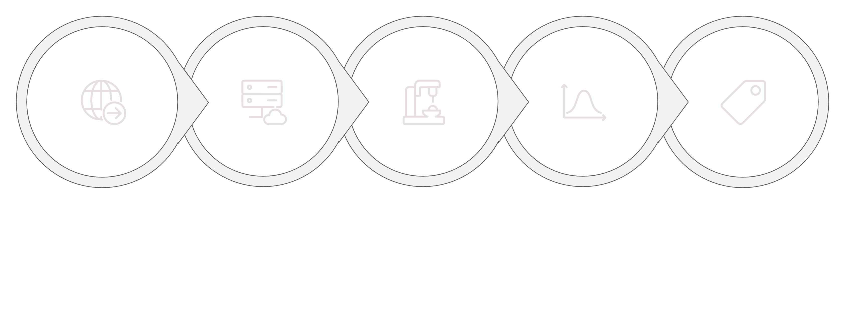
SYSTEM ARCHITECTURE
End-to-End Pipeline Architecture
The data product operates as a fully automated pipeline — from raw CRM data to actionable targeting lists — running on a weekly scoring cadence with monthly model retraining to maintain predictive accuracy as customer behavior evolves.
Score Customers
Calculate Churn
CRM Extract
Preprocess
Assign Risk
The closed-loop design ensures continuous improvement: customer outcomes from each campaign cycle are fed back into the training data, enabling the model to adapt to shifting churn patterns over time.

Slide 16
INFRASTRUCTURE
Dockerized, Scalable, and Production-Ready
The entire pipeline is containerized using Docker, making it portable, reproducible, and easy to deploy across environments — from local development to cloud infrastructure — without configuration drift or dependency conflicts.
Why Docker?
Scheduled Jobs
Reproducibility
Weekly — Prediction Job
Monthly — Retraining Job
Identical behavior across dev, staging, and production environments
Scores the full customer base every week using the latest available data, producing a refreshed targeting list for the marketing team.
Retrains the model on cumulative outcome data to prevent model drift and maintain recall performance over time.
Scalability
Effortlessly handles larger customer volumes as the business grows
Easy Deployment
Single container deployment — no manual environment setup required

Slide 17

CRM INTEGRATION
Seamless CRM Integration for Campaign Execution
The data product is designed for zero-friction integration with existing CRM platforms. Predictions are exported in standard formats — JSON or CSV — enabling immediate ingestion by marketing automation tools and CRM dashboards without custom engineering work on the business side.
Output Fields Per Customer Record
How It Works in Practice
The weekly export file is automatically uploaded to the CRM. Campaign managers use the risk segment and recommended action fields to configure automated outreach workflows — assigning customers to call queues, email campaigns, or loyalty program invitations with no manual segmentation required.
CustomerID
Churn Probability
Unique identifier linking predictions to CRM records
Continuous score for custom filtering or ranking
The CRM dashboard provides a real-time view of campaign progress, customer responses, and retention outcomes — closing the feedback loop for model improvement.
Risk Segment
Recommended Action
Categorical tier for campaign routing logic
Prescriptive guidance for the retention agent

Slide 18
BUSINESS IMPACT
Measurable Revenue Impact at Scale
The deployed system is projected to reduce annual churn from 18% to approximately 15–16%, representing a meaningful and measurable shift in the company's retention trajectory. Across a one-million-customer base, that improvement translates directly to protected revenue.
18%→15%
27K
$8.1M
Churn Rate Reduction
Customers Retained
Annual Revenue Saved
From current baseline to projected post-deployment rate
Estimated number of churners successfully prevented annually
Based on $300 ARPU per retained customer
These projections assume the retention campaign achieves a 15% success rate on targeted customers — a conservative estimate consistent with industry benchmarks for proactive telecom retention programs.

Slide 19
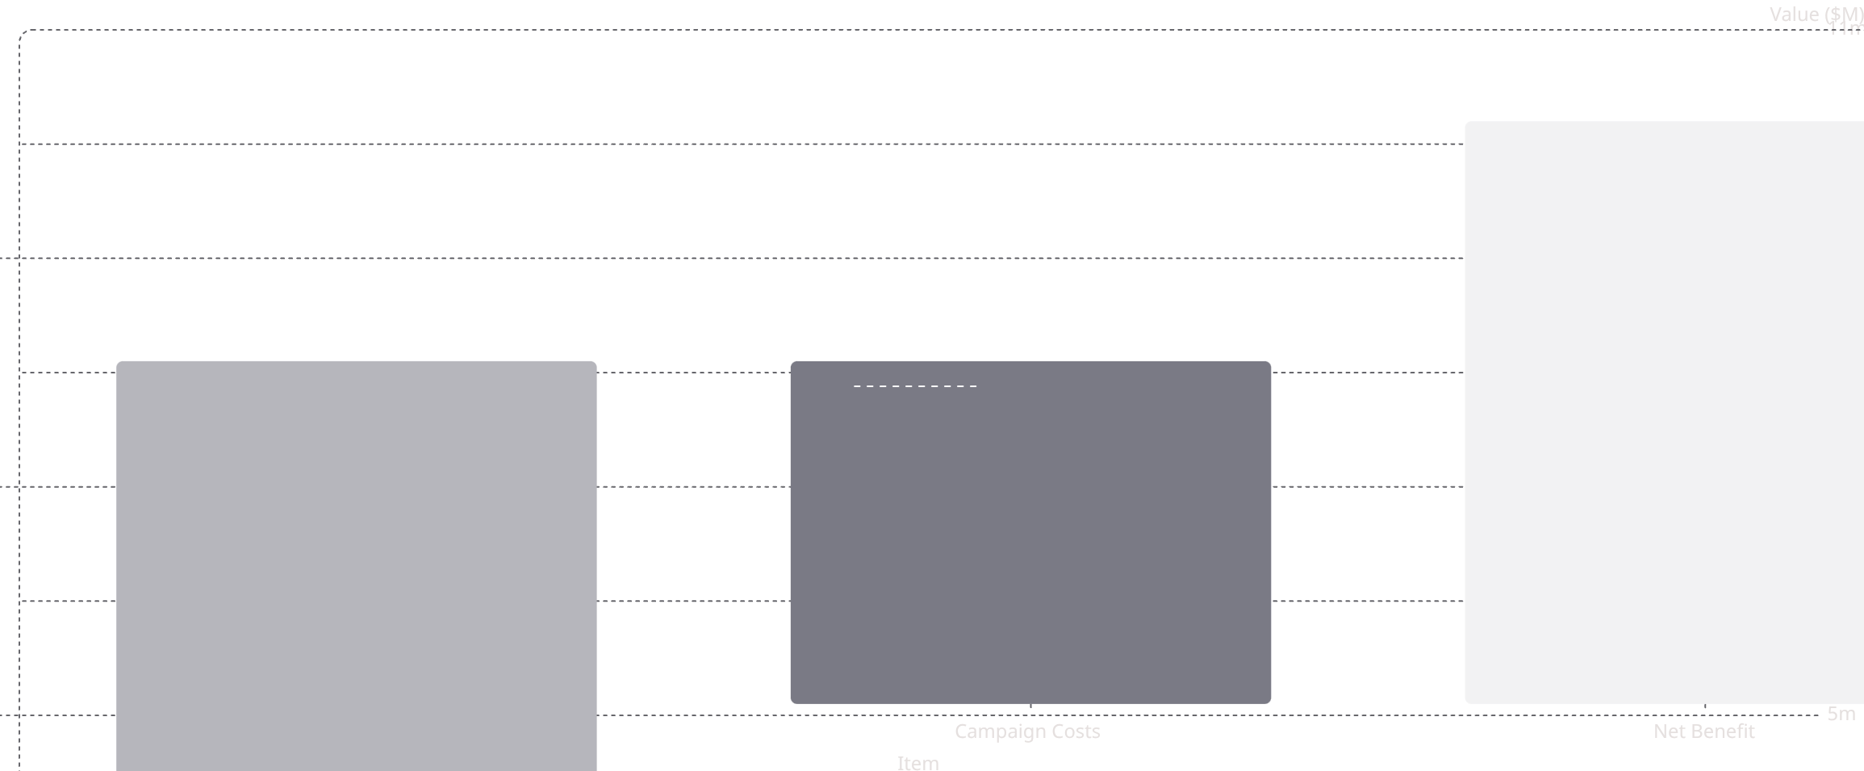
FINANCIAL CASE
ROI: 170% Return in Under One Year
The business case for this data product is compelling. With a retention campaign investment of approximately $3M, the system generates a net financial benefit of $5.1M — delivering a 170% return on investment and paying back the full deployment cost within the first year of operation.
+5.1m
-3,000,000
10.2m
8.1m
~$3M
~$5.1M
Beyond the direct financial return, the system also delivers compounding value over time: each monthly retraining cycle improves model accuracy, and CRM integration enables increasingly personalized and effective retention campaigns.
Total retention campaign cost (outreach, offers, tooling)
Net financial benefit after campaign costs
~170%
< 1 Year
Return on investment
Full payback period

Slide 20
CONCLUSION
From Experiment to Enterprise Data Product
What began as a machine learning model evolved into a production-ready, business-integrated data product — one that delivers measurable retention value every week. The system embodies the full journey from raw data to strategic business impact.
What We Built
Future Roadmap
Proactive retention — intervene before customers decide to leave
Marketing efficiency — focus spend on the highest-value targets
01
Real-Time Scoring
Move from weekly batch scoring to event-triggered real-time predictions for faster intervention.
Measurable ROI — $5.1M net benefit, 170% return, sub-year payback
Scalable infrastructure — Dockerized, automated, CRM-integrated
02
Behavioral Data Integration
Enrich the model with app usage, call patterns, and support ticket history for greater predictive depth.
03
Retention Dashboard
Build an interactive BI dashboard for campaign monitoring, model performance tracking, and executive reporting.

