Slide 1

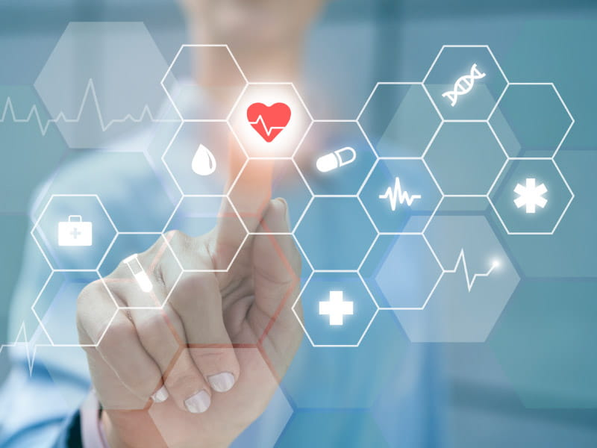

Why Health Prediction?
In a world where every heartbeat hides a story, we asked: can machines listen close enough to warn us before the storm hits?
Machine Learning for Smarter Health
Presented by: MuhammadAyyub
Heart disease = the first global killer
Early prediction saves lives
ML models are the modern stethoscope

Slide 2
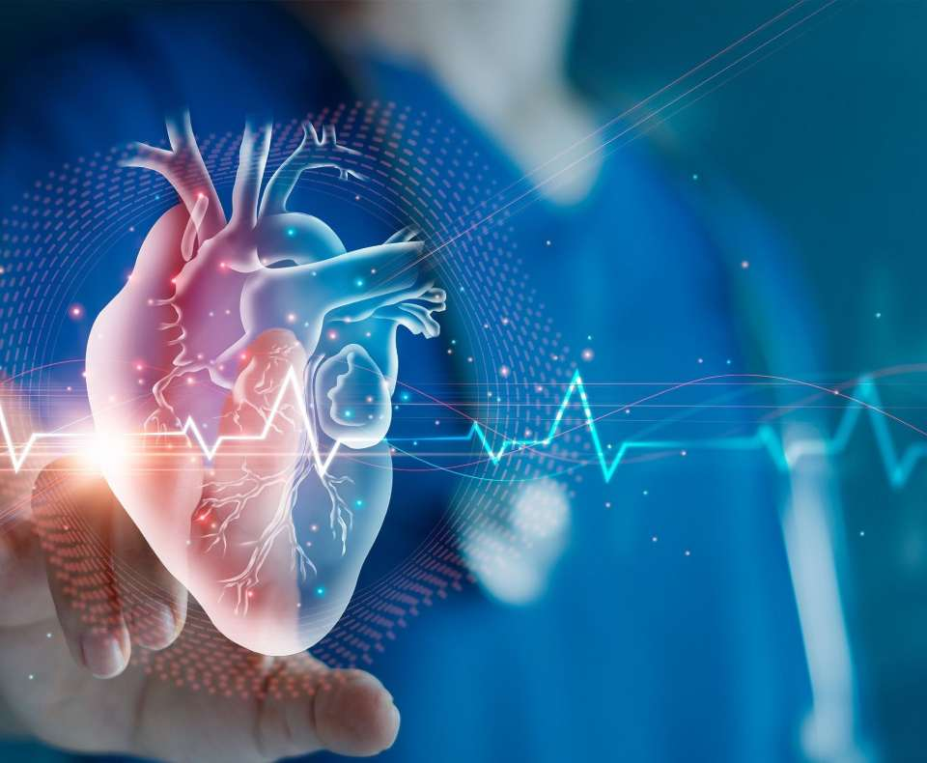
The Enemy We Can’t See – Until It’s Too Late
Why Health Prediction?
In a world where every heartbeat hides a story, we asked: can machines listen close enough to warn us before the storm hits?
Symptoms whisper, not scream. Our mission? Amplify the whispers.
Heart disease = the first global killer
Early prediction saves lives
ML models are the modern stethoscope
Patients often unaware of risk
Doctors need fast, reliable screening tools
Goal: Predict risk of heart disease using vital signs

Slide 3

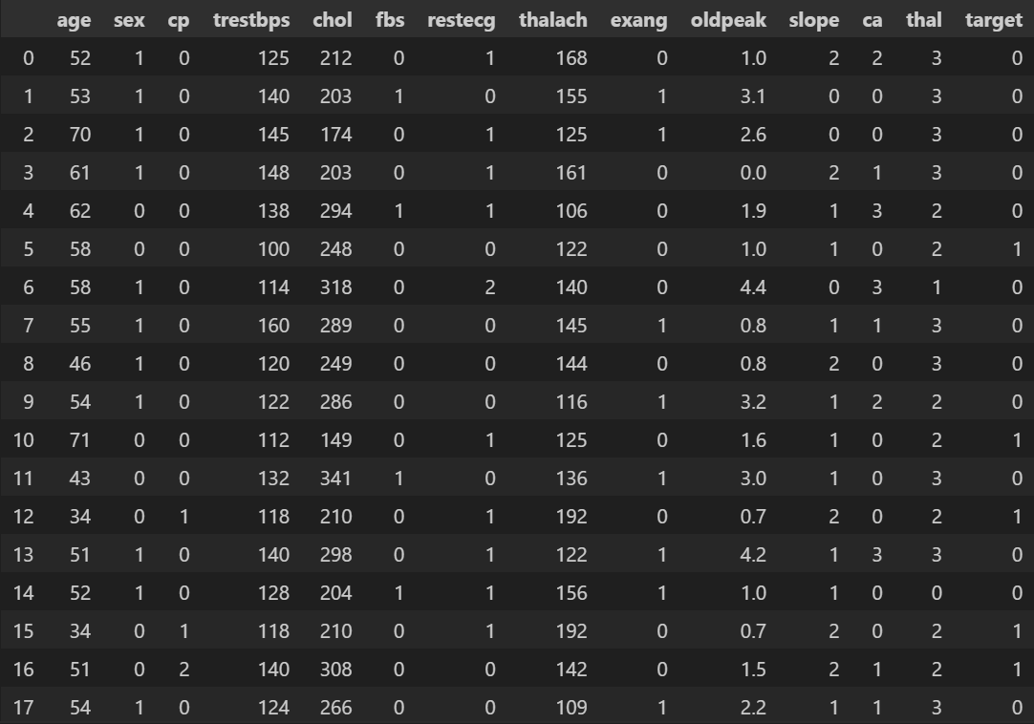
The Pulse Beneath the Data
The Enemy We Can’t See – Until It’s Too Late
Data is the new DNA—clean it, understand it, and it speaks life.
Symptoms whisper, not scream. Our mission? Amplify the whispers.
Patients often unaware of risk
Doctors need fast, reliable screening tools
Goal: Predict risk of heart disease using vital signs
UCI Heart Disease dataset
Key features:
Age, Gender, Blood Pressure, Cholesterol, Chest Pain, Max Heart Rate
Fasting Blood Sugar, Exercise-induced Angina, etc.

Slide 4
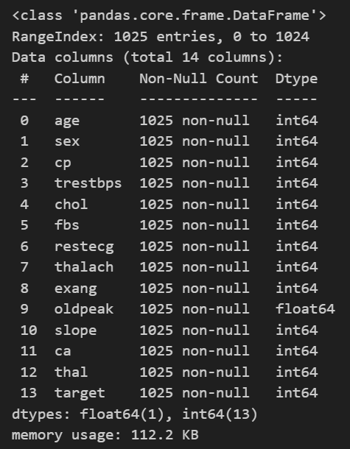
Data Preprocessing
Dataset & Features
Garbage in, garbage out. We don’t just feed data—we refine it.
Data is the new DNA—clean it, understand it, and it speaks life.
UCI Heart Disease dataset
Key features:
Age, Gender, Blood Pressure, Cholesterol, Chest Pain, Max Heart Rate
Fasting Blood Sugar, Exercise-induced Angina, etc.
Handled missing values
Label encoding for categorical features
Feature scaling for model fairness
Visualized correlations (heatmaps, histograms)

Slide 5
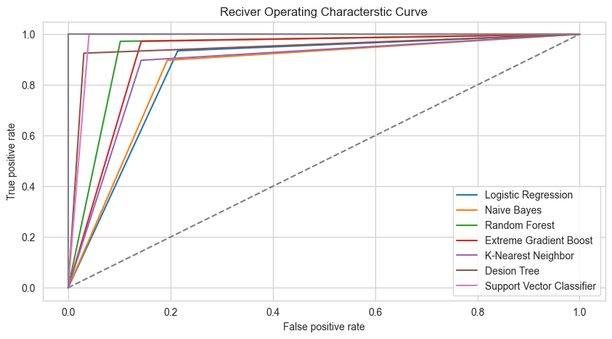
ML Models Used
Data Preprocessing
Garbage in, garbage out. We don’t just feed data—we refine it.
Each model is a doctor, trained in silence, tested in storms.
Handled missing values
Label encoding for categorical features
Feature scaling for model fairness
Visualized correlations (heatmaps, histograms)
Logistic Regression
Random Forest
K-Nearest Neighbors
Support Vector Machine
XGBoost (optional if you used it)

Slide 6
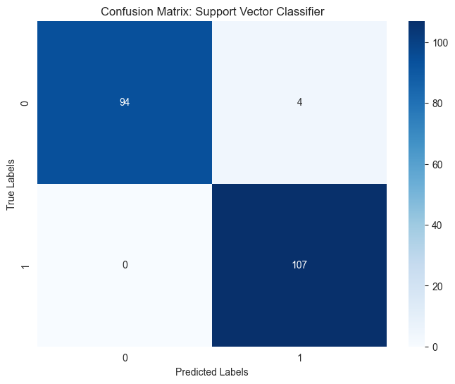
Model Evaluation
ML Models Used
Accuracy, Precision, Recall – The Diagnosis
A model is only as good as its decisions under pressure
Each model is a doctor, trained in silence, tested in storms.
Logistic Regression
Random Forest
K-Nearest Neighbors
Support Vector Machine
XGBoost (optional if you used it)
Confusion matrix
ROC-AUC curve
Accuracy scores (compare models)
Final model selection based on best metrics

Slide 7
Model Evaluation
Accuracy, Precision, Recall – The Diagnosis
A model is only as good as its decisions under pressure
Confusion matrix
ROC-AUC curve
Accuracy scores (compare models)
Final model selection based on best metrics

Slide 8
Ethics & Privacy
Health Isn’t Just Data – It’s Sacred
With great data comes great responsibility.
No storage of sensitive data
Data anonymized
Used only for academic/clinical demo purposes

Slide 9
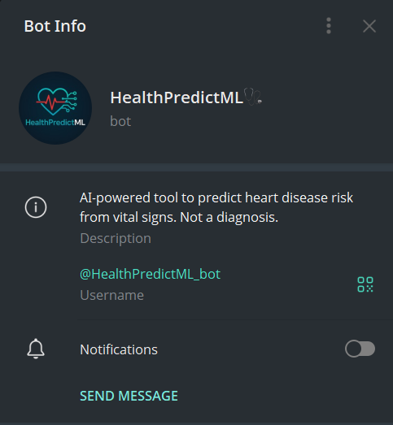
Health Prediction in Your Pocket
Future Work
This Is Just the Beginning
Today we predict. Tomorrow we prevent.
Expand dataset with real-world clinical data
Add more health conditions (diabetes, stroke)
Deploy as full-scale web or mobile app
Integrate with wearable devices
AI at Your Fingertips – Predictive Care via Telegram Bot
Why wait in a clinic line, when you can check your vitals and fate—right from your phone?

Slide 10
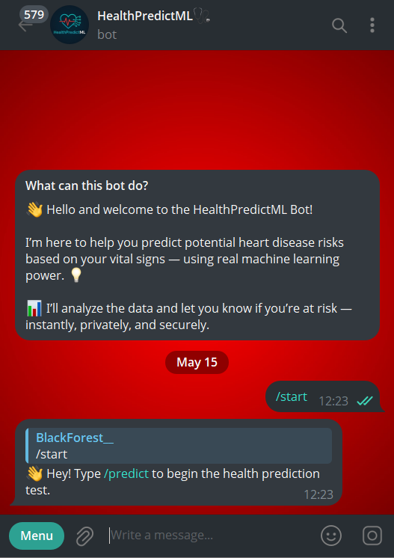
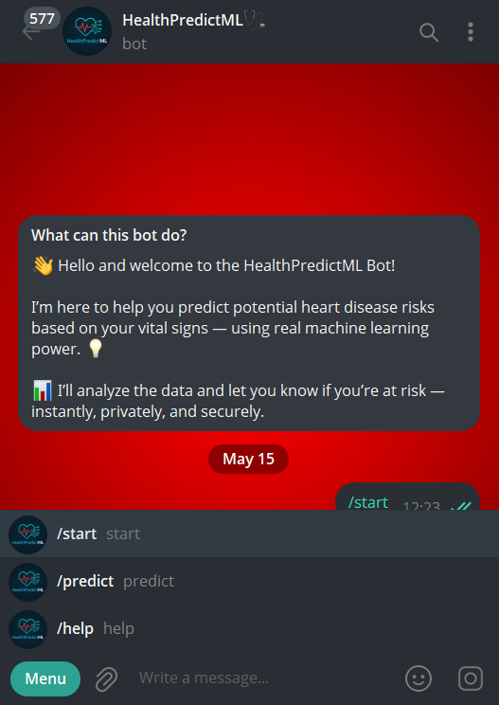
Health Prediction in Your Pocket
AI at Your Fingertips – Predictive Care via Telegram Bot
Why wait in a clinic line, when you can check your vitals and fate—right from your phone?
@HealthPredictML_bot
No data stored. All predictions are local to session. Your health, your privacy.

Slide 11
Thank You
Not just code, not just numbers — this is care, calculated.
Any questions?

