Slide 1

Note: The data and information in this document is reflective of a hypothetical situation and client. This document is to be used for KPMG Virtual Internship purposes only.
Sprocket Central Pty Ltd
Data analytics approach
[Data science intern ] - [KPMG virtual intern], [Mukhar Jain]

Slide 2
Note: The data and information in this document is reflective of a hypothetical situation and client. This document is to be used for KPMG Virtual Internship purposes only.
Agenda
Introduction
Data Exploration
Model Development
Interpretation

Slide 3
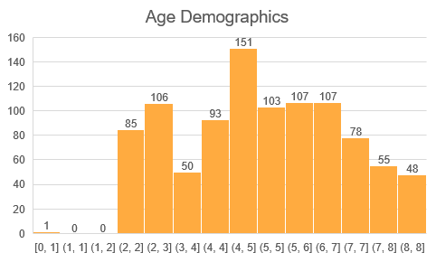
Note: The data and information in this document is reflective of a hypothetical situation and client. This document is to be used for KPMG Virtual Internship purposes only.
Introduction
New customer analysis
Age Distribution
Wealth segmentations
Job Industry
Number of bikes purchased in past 3 years
Number of cars owned
X scaled by 10

Slide 4
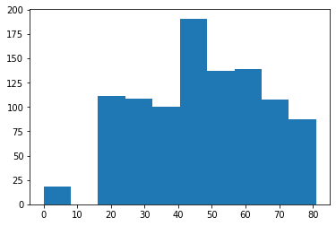
Note: The data and information in this document is reflective of a hypothetical situation and client. This document is to be used for KPMG Virtual Internship purposes only.
Data Exploration
Age Distribution
As we can see most of our new customers are in the age bracket of 18-47 years
There is a slightly increase in number of customers over 59 years old in term of percentages
Place any supporting images, graphs, data or extra text here.

Slide 5
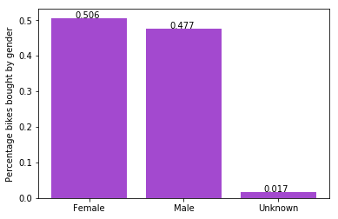
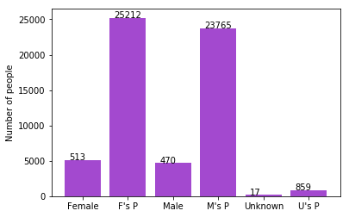
Note: The data and information in this document is reflective of a hypothetical situation and client. This document is to be used for KPMG Virtual Internship purposes only.
Model Development
Bike purchases last 3 years
As we can see, our new customers mostly Female with 50.6% purchases with total of 25,212 bikes
The contribution of males was 47.7% purchases with 23,765 bikes
So we should focus on sales conversion of Female customers a bit more than Male customers

Slide 6
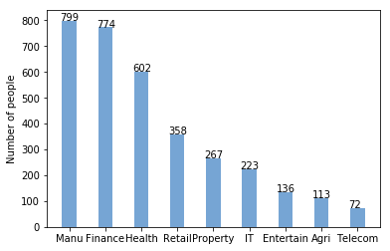
Note: The data and information in this document is reflective of a hypothetical situation and client. This document is to be used for KPMG Virtual Internship purposes only.
Interpretation
Job industry category.
Mostly our new customers are on Finance industry and our Manufacturing customers are still on top 2.
We should focus more on people from these sectors

Slide 7
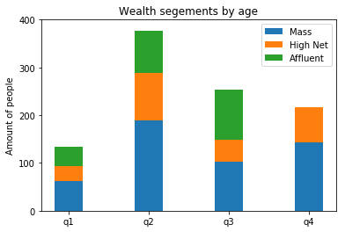
Note: The data and information in this document is reflective of a hypothetical situation and client. This document is to be used for KPMG Virtual Internship purposes only.
Interpretation
Wealth segments
In all these cases the number of mass customer type in maximum and there for focus should be on these
After that, we should focus on High Net Customer.
Then Affluent Customers but in second and third bar block.
Q1- age less than 25
Q2- age 25 – 48
Q3- age 48-59
Q4- age more than 59

Slide 8
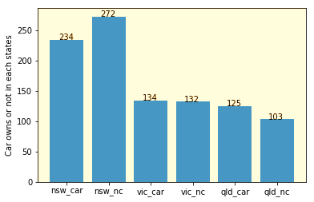
Note: The data and information in this document is reflective of a hypothetical situation and client. This document is to be used for KPMG Virtual Internship purposes only.
Interpretation
Numbers of cars owned
NSW should be considered the most since numbers of customers don’t own cars is significantly larger than that own.
VIC and QLD has more customers that own car than who does not have but we should further track mass customers in this region and focus on them

Slide 9
Note: The data and information in this document is reflective of a hypothetical situation and client. This document is to be used for KPMG Virtual Internship purposes only.
Appendix

Slide 10
Note: The data and information in this document is reflective of a hypothetical situation and client. This document is to be used for KPMG Virtual Internship purposes only.
Appendix
The address data was analysed and the people from less posh areas were qualifying candidacy criteria for buying bikes therefore they should be targeted

