Slide 1
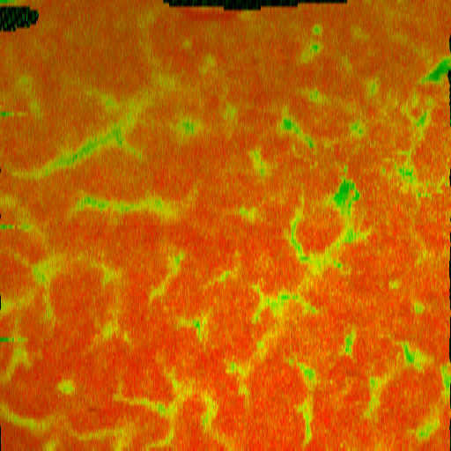
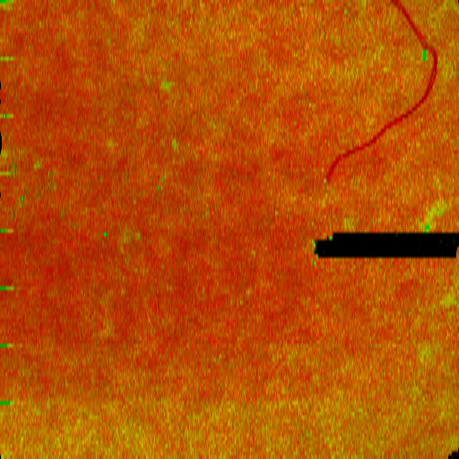
Non-obstructed
Obstructed
Renal Tubule
High
Nephron
UUO model
Renal tubule
Proximal
convoluted tubule
Distal
convoluted tubule
Non-obstructed
✘
Obstructed
1mm
Low
Glomerulus

Slide 2
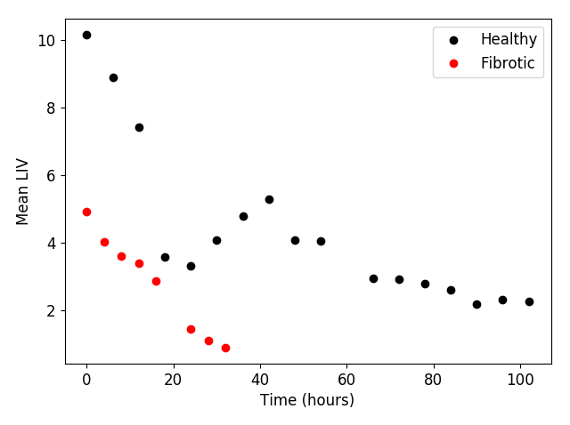
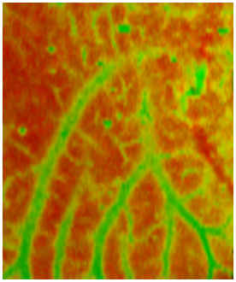
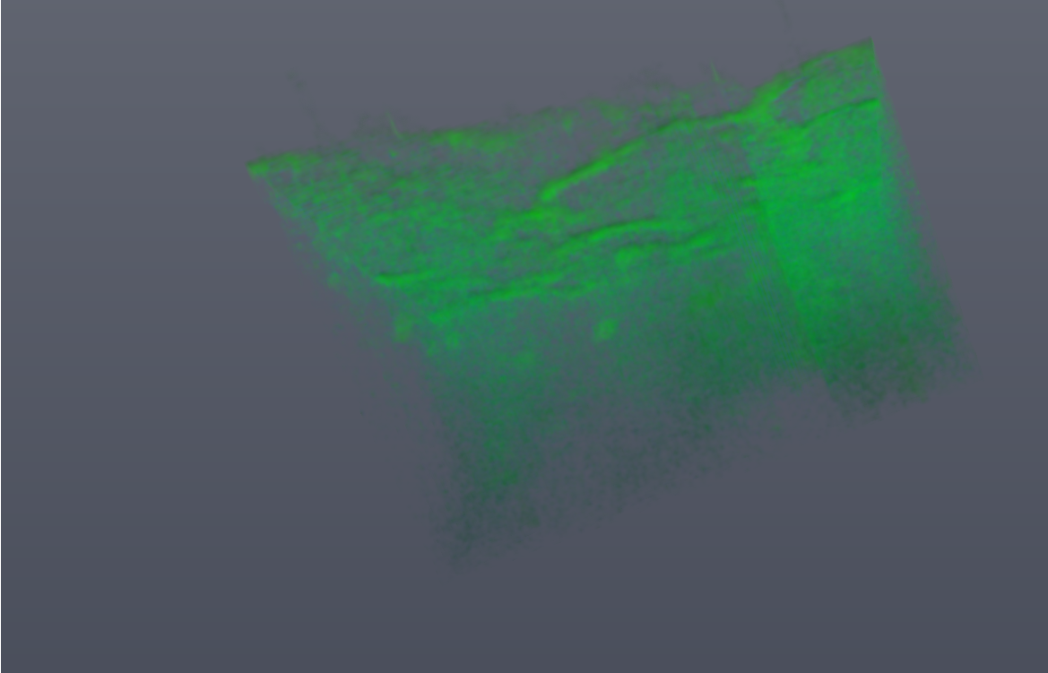
Healthy liver
Fibrotic liver
Longitudinal quantitative activity
36-hr
Healthy
Mean Dynamic OCT (dB²)
Fibrotic
Time (hours)

Slide 3
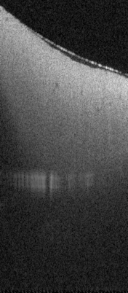
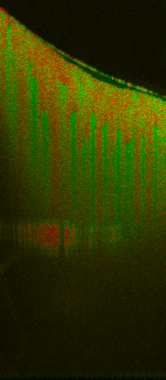
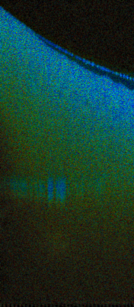
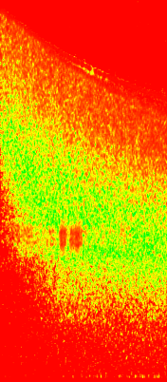
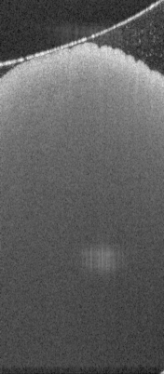
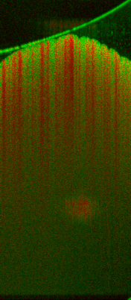
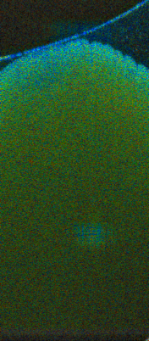
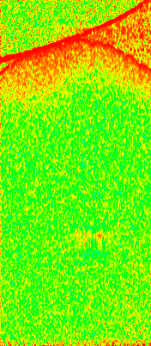
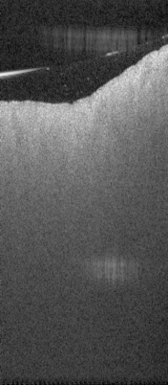
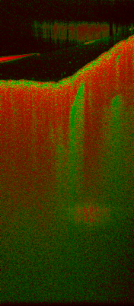
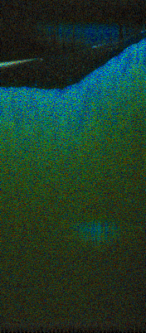
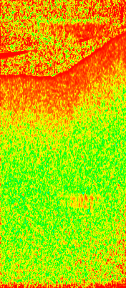

OCT
Tissue dynamics
Birefringence
DOPU
Normal
liver
1-week
NAFLD
2-week
NAFLD
-5
55
0
10
0
0.006
0
1
dB
dB²

Slide 4

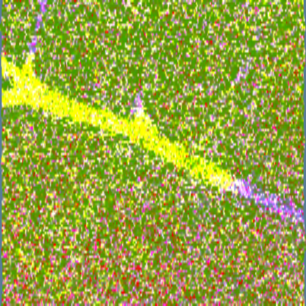
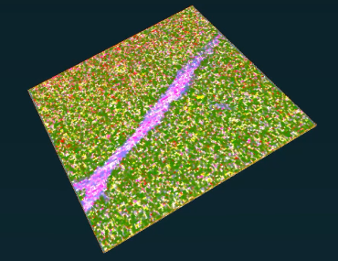
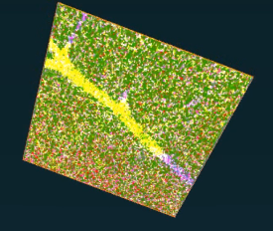
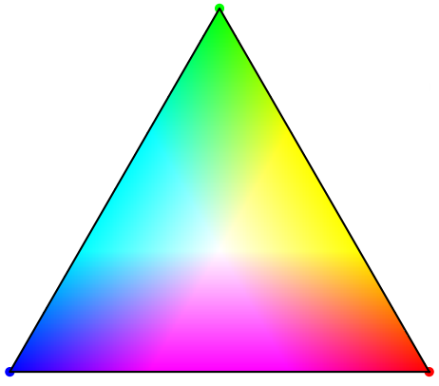

Cross-section
En face
Volume rendering
Composite
principal component (PC)
PC2
250 $μ$m
PC1
PC3

