Slide 1
DOW JONES INDEX Decomposition
Yunsup Jung
DSCI6001

Slide 2
Summary
Goal: Petition *Dow Jones Index into two groups with linear algebra technique and statistical theory.
There is three major steps; Clean data, SVD and K-MEAN Clustering, and prdict stock price from OLS model.
* Dow Jones Index consisted 30 companies which is in traditional heavy industry. The average of market capitalization is 175bilion dollar. Apple, Disney, Goldman Sachs, Nike, Verizon, Pfizer, Exxon and 23 other companies in this list.

Slide 3
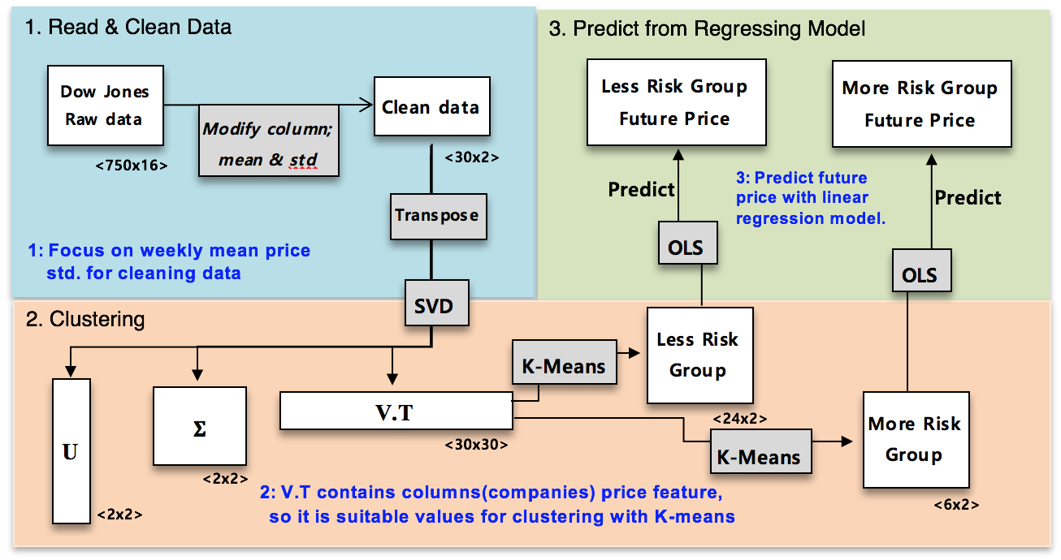
Work Flow

Slide 4
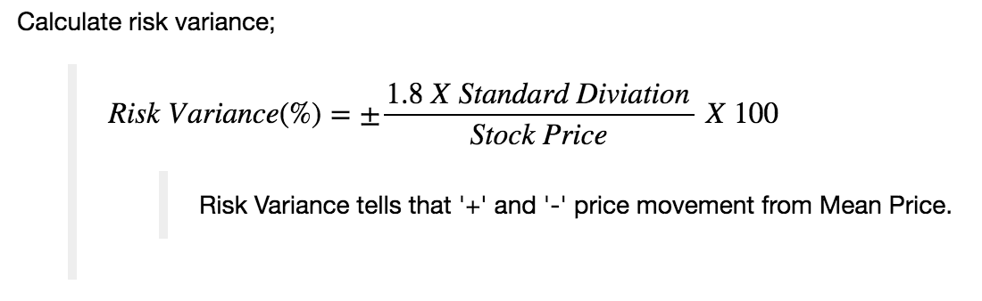
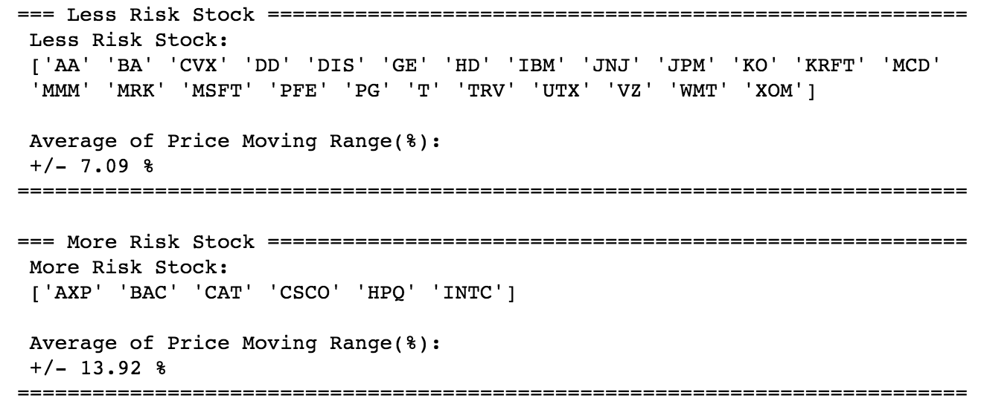
Result

Slide 5
Price Pridict
Less Risk Stock :
More Risk Stock :

