Slide 1
DOW JONES INDEX Decomposition
Yunsup Jung
DSCI6001

Slide 2
Summary
Goal: Petition *Dow Jones Index into two groups with linear algebra technique and statistical theory.
There is three major steps; Clean data, SVD and K-MEAN Clustering, and predict stock price from OLS model.
* Dow Jones Index consisted of 30 companies which is in traditional heavy industry. The average of market capitalization is 175bilion dollar. Apple, Disney, Goldman Sachs, Nike, Verizon, Pfizer, Exxon and 23 other companies in this list.

Slide 3
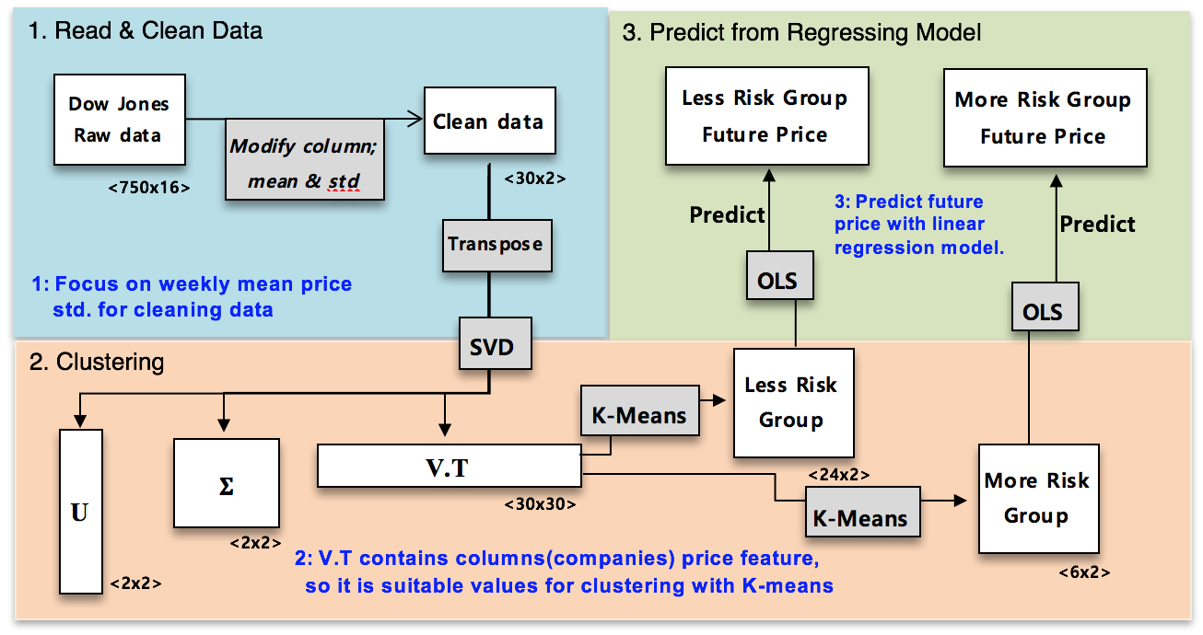
Work Flow

Slide 4
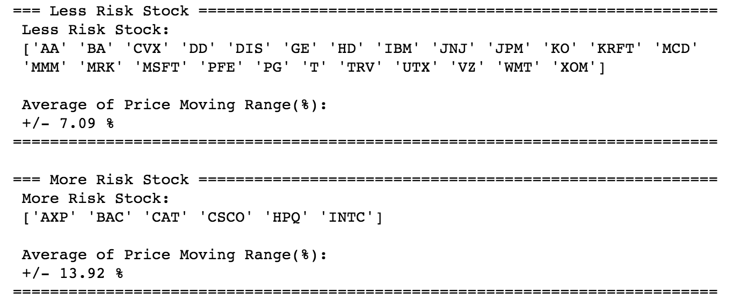
Result

Slide 5
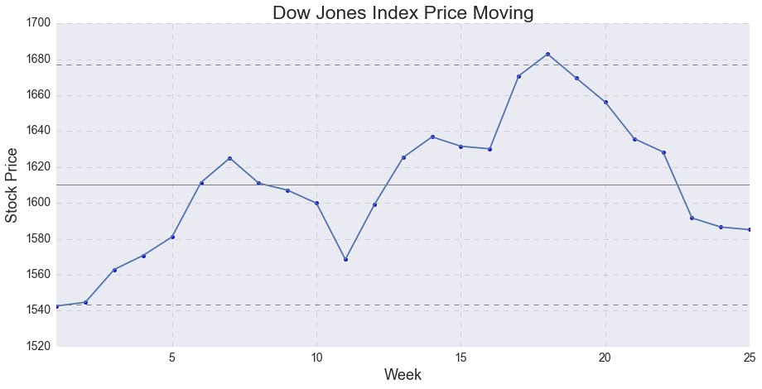
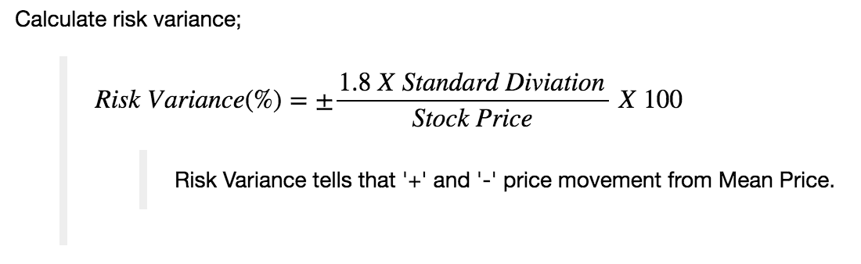
Test Result

Slide 6
Price Predict
Less Risk Stock :
More Risk Stock :

