Slide 1
Python Programming
Complete course slides, arranged by the course schedule
Training programme for CAPF and IB officials
Indian Institute of Space Science and Technology, Thiruvananthapuram
Department of Avionics · 28 September to 10 October 2026

Slide 2
Contents
Day 1: Inauguration, Introduction to Computing and Python Setup
Day 2: Python Fundamentals I; Input, Output and Basic Programming
Day 3: Python Fundamentals II; Loops and Repetition
Day 4: Data Structures in Python; Functions and Modular Programming
Day 5: Project Discussion and Doubt Clarification
Day 6: Python Environment and Libraries; File and Folder Management
Day 7: Introduction to Data Processing (NumPy); Pandas and Tabular Data
Day 8: Data Cleaning and Filtering; Data Analysis with Pandas
Day 9: Data Visualization and Multimodal Data; Working with Images
Day 10: Doubt Clearing, Project Guidance and Student Project Presentations
Supplementary material (see the notebook and the repository)

Slide 3
Day 1: Inauguration, Introduction to Computing and Python Setup
Monday 28 September 2026
Instructors: Mukhilan Lenin, Shazma M A
• Inauguration
• Introduction to Computing and Python Setup; hands-on installing and verifying the Python environment

Slide 4
Inauguration
No slides or notebooks were used in this session.

Slide 5
Introduction to Computing and Python Setup; hands-on installing and verifying the Python environment
Slides: Anaconda, Conda and Jupyter project environment setup guide

Slide 6
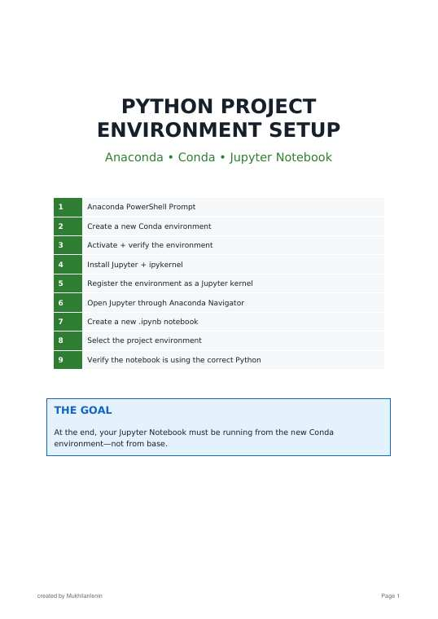
Notes:
Source: Anaconda_Conda_Jupyter_Project_Setup_Guide.pdf, page/slide 1 of 17. Section: Day 1: Inauguration, Introduction to Computing and Python Setup.

Slide 7
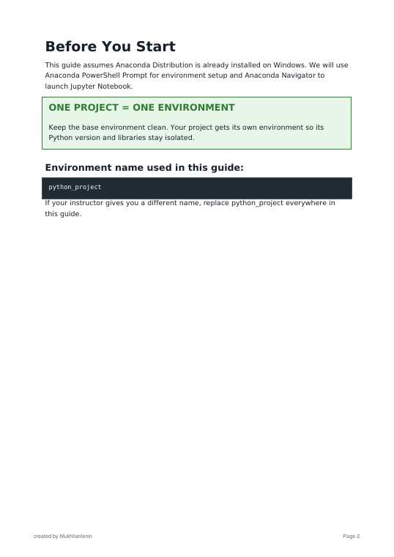
Notes:
Source: Anaconda_Conda_Jupyter_Project_Setup_Guide.pdf, page/slide 2 of 17. Section: Day 1: Inauguration, Introduction to Computing and Python Setup.

Slide 8
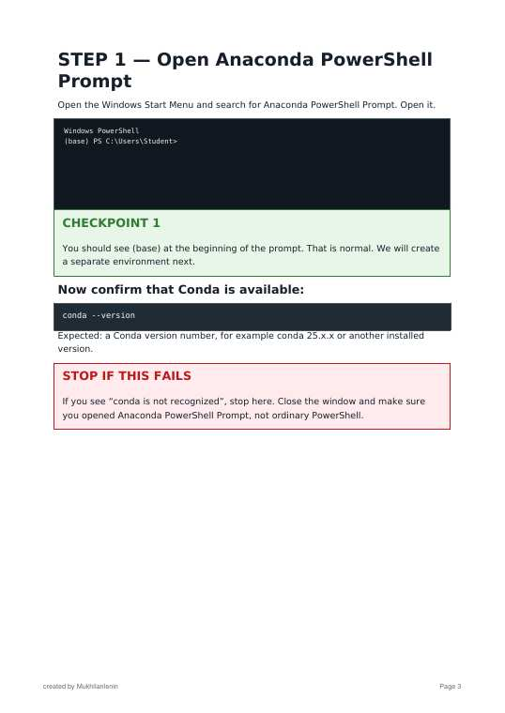
Notes:
Source: Anaconda_Conda_Jupyter_Project_Setup_Guide.pdf, page/slide 3 of 17. Section: Day 1: Inauguration, Introduction to Computing and Python Setup.

Slide 9
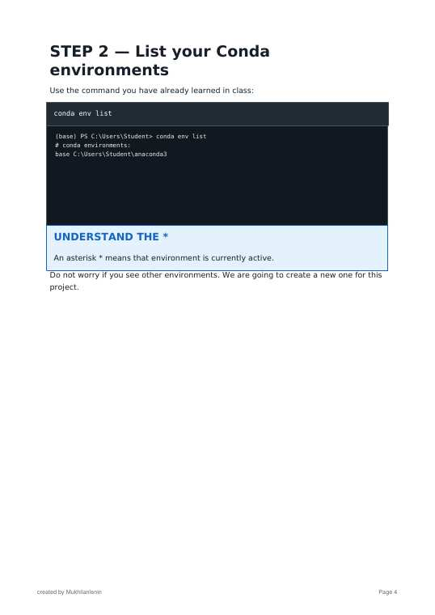
Notes:
Source: Anaconda_Conda_Jupyter_Project_Setup_Guide.pdf, page/slide 4 of 17. Section: Day 1: Inauguration, Introduction to Computing and Python Setup.

Slide 10
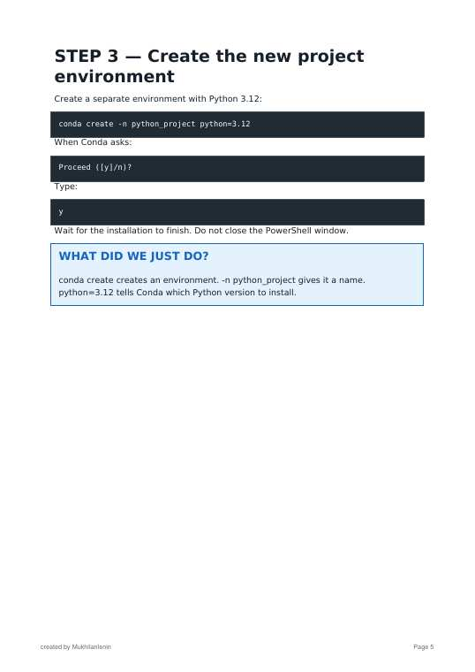
Notes:
Source: Anaconda_Conda_Jupyter_Project_Setup_Guide.pdf, page/slide 5 of 17. Section: Day 1: Inauguration, Introduction to Computing and Python Setup.

Slide 11
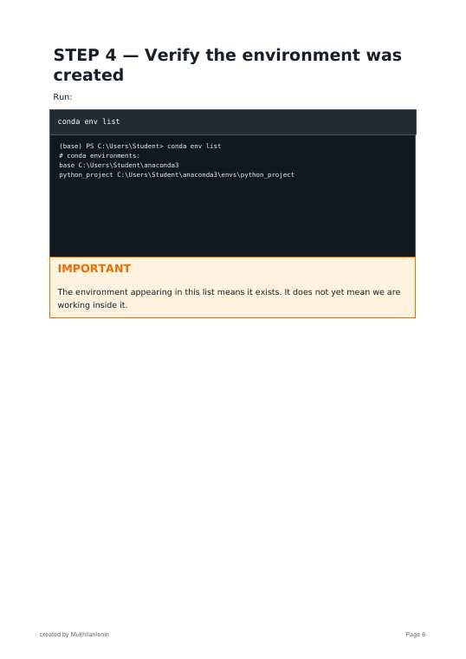
Notes:
Source: Anaconda_Conda_Jupyter_Project_Setup_Guide.pdf, page/slide 6 of 17. Section: Day 1: Inauguration, Introduction to Computing and Python Setup.

Slide 12
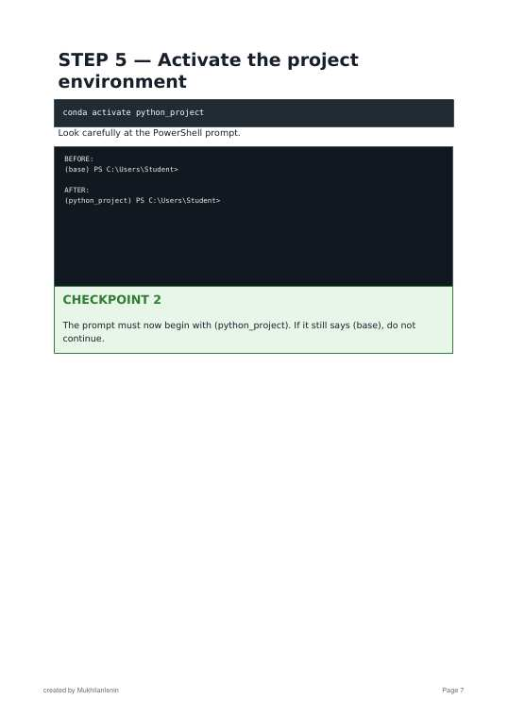
Notes:
Source: Anaconda_Conda_Jupyter_Project_Setup_Guide.pdf, page/slide 7 of 17. Section: Day 1: Inauguration, Introduction to Computing and Python Setup.

Slide 13
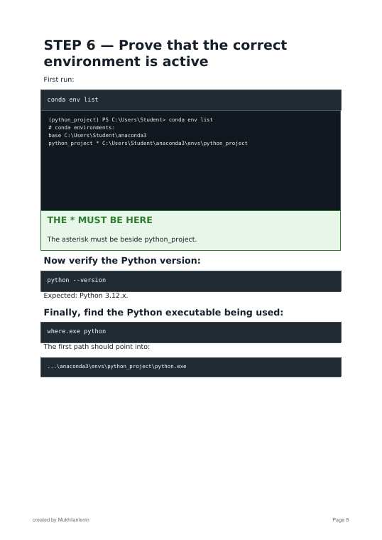
Notes:
Source: Anaconda_Conda_Jupyter_Project_Setup_Guide.pdf, page/slide 8 of 17. Section: Day 1: Inauguration, Introduction to Computing and Python Setup.

Slide 14
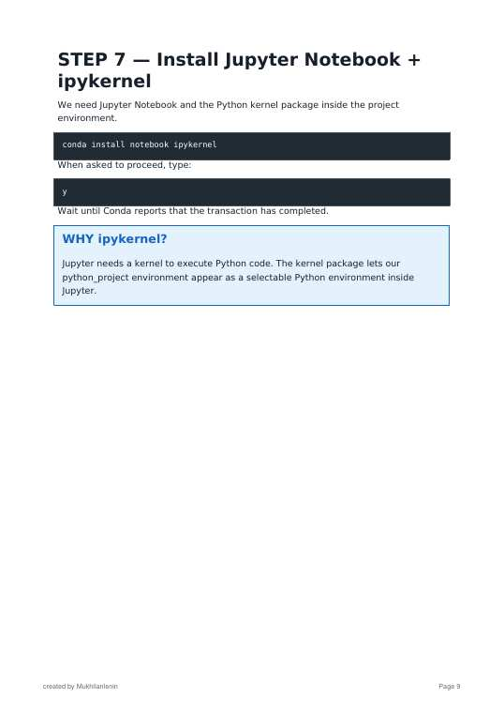
Notes:
Source: Anaconda_Conda_Jupyter_Project_Setup_Guide.pdf, page/slide 9 of 17. Section: Day 1: Inauguration, Introduction to Computing and Python Setup.

Slide 15
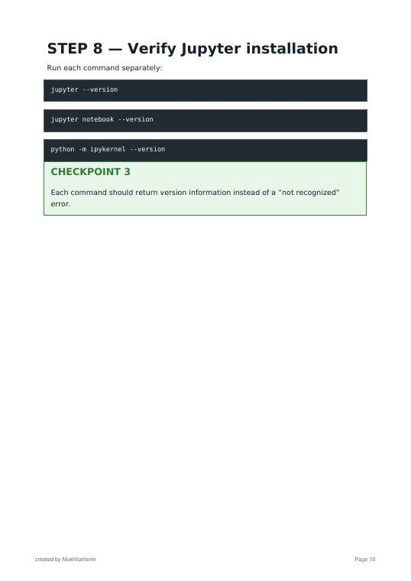
Notes:
Source: Anaconda_Conda_Jupyter_Project_Setup_Guide.pdf, page/slide 10 of 17. Section: Day 1: Inauguration, Introduction to Computing and Python Setup.

Slide 16
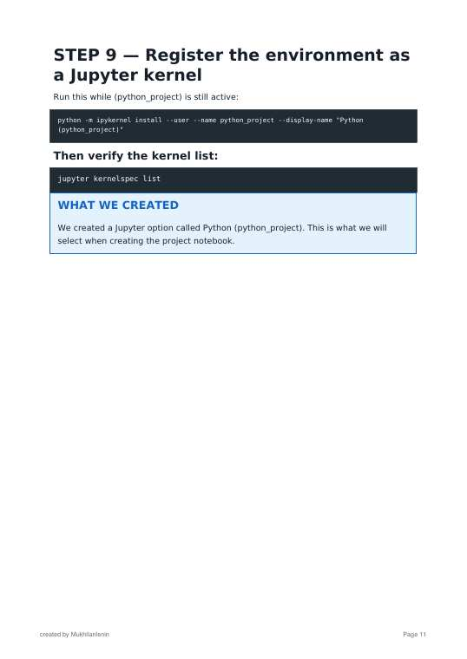
Notes:
Source: Anaconda_Conda_Jupyter_Project_Setup_Guide.pdf, page/slide 11 of 17. Section: Day 1: Inauguration, Introduction to Computing and Python Setup.

Slide 17
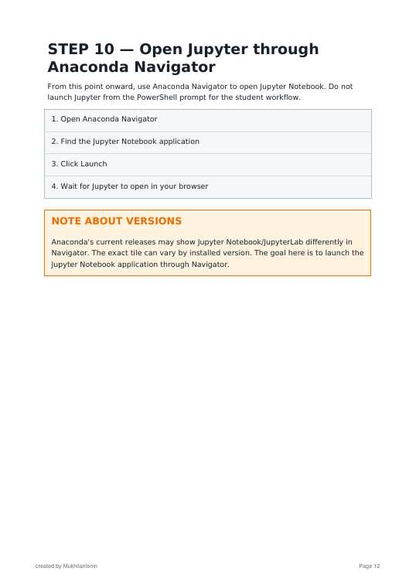
Notes:
Source: Anaconda_Conda_Jupyter_Project_Setup_Guide.pdf, page/slide 12 of 17. Section: Day 1: Inauguration, Introduction to Computing and Python Setup.

Slide 18
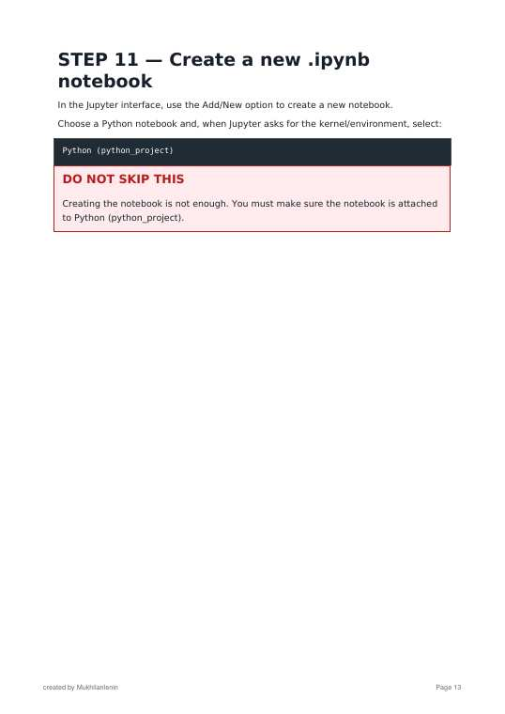
Notes:
Source: Anaconda_Conda_Jupyter_Project_Setup_Guide.pdf, page/slide 13 of 17. Section: Day 1: Inauguration, Introduction to Computing and Python Setup.

Slide 19
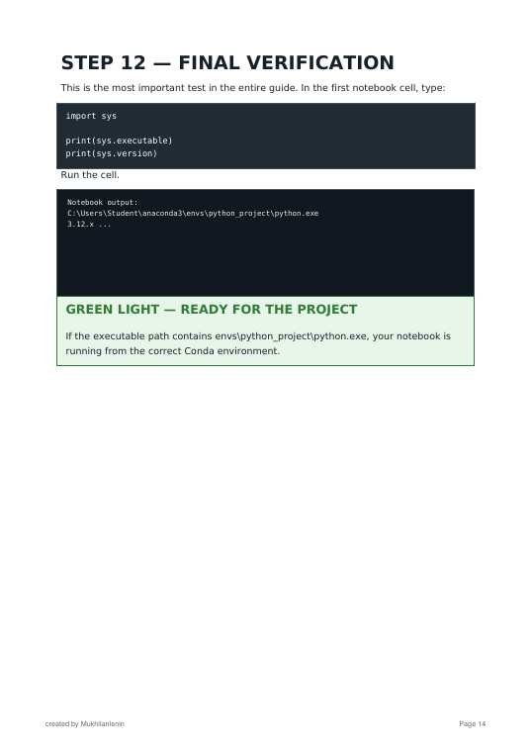
Notes:
Source: Anaconda_Conda_Jupyter_Project_Setup_Guide.pdf, page/slide 14 of 17. Section: Day 1: Inauguration, Introduction to Computing and Python Setup.

Slide 20
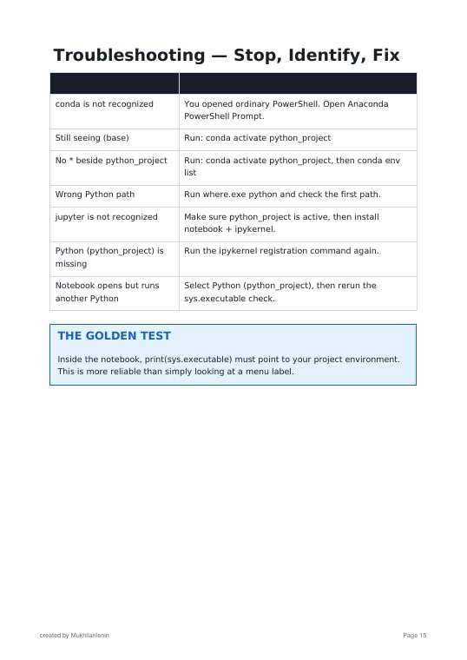
Notes:
Source: Anaconda_Conda_Jupyter_Project_Setup_Guide.pdf, page/slide 15 of 17. Section: Day 1: Inauguration, Introduction to Computing and Python Setup.

Slide 21
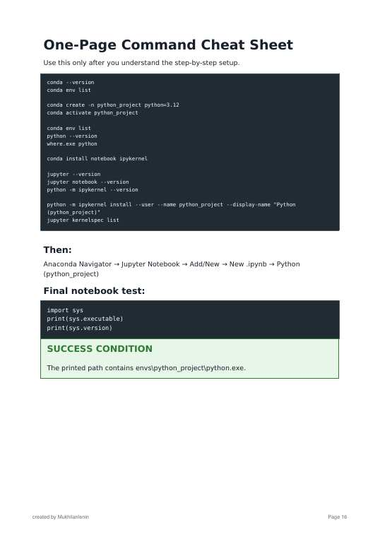
Notes:
Source: Anaconda_Conda_Jupyter_Project_Setup_Guide.pdf, page/slide 16 of 17. Section: Day 1: Inauguration, Introduction to Computing and Python Setup.

Slide 22
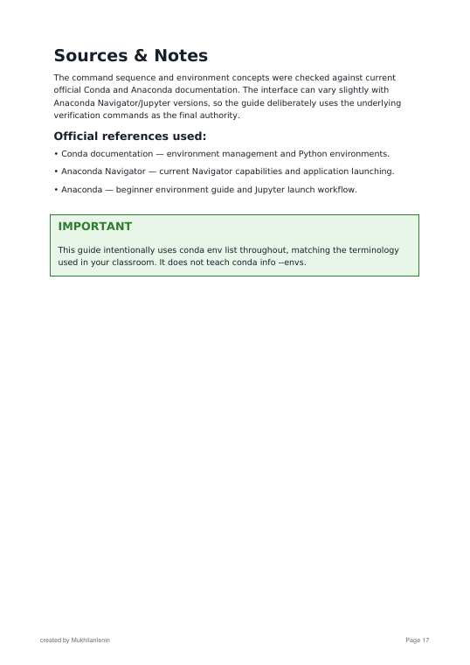
Notes:
Source: Anaconda_Conda_Jupyter_Project_Setup_Guide.pdf, page/slide 17 of 17. Section: Day 1: Inauguration, Introduction to Computing and Python Setup.

Slide 23
Day 2: Python Fundamentals I; Input, Output and Basic Programming
Tuesday 29 September 2026
Instructors: Dhevamathi C, Diya P M
• Python Fundamentals I (variables, constants, data types, operators)
• Input, Output and Basic Programming (print, input, type conversion, expressions)
• Hands-on: calculator, unit converter, personal information system, basic numerical programs

Slide 24
Python Fundamentals I (variables, constants, data types, operators)
Slides: Day 2, Session 1 slides (Diya P M)

Slide 25
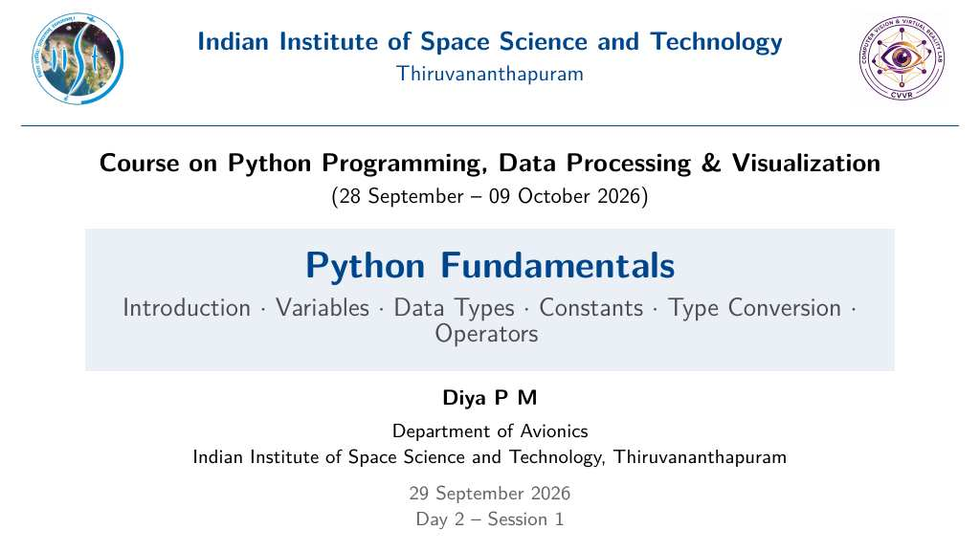
Notes:
Source: Day2_Session1_Python_Fundamentals_Slides.pdf, page/slide 1 of 84. Section: Day 2: Python Fundamentals I; Input, Output and Basic Programming.

Slide 26
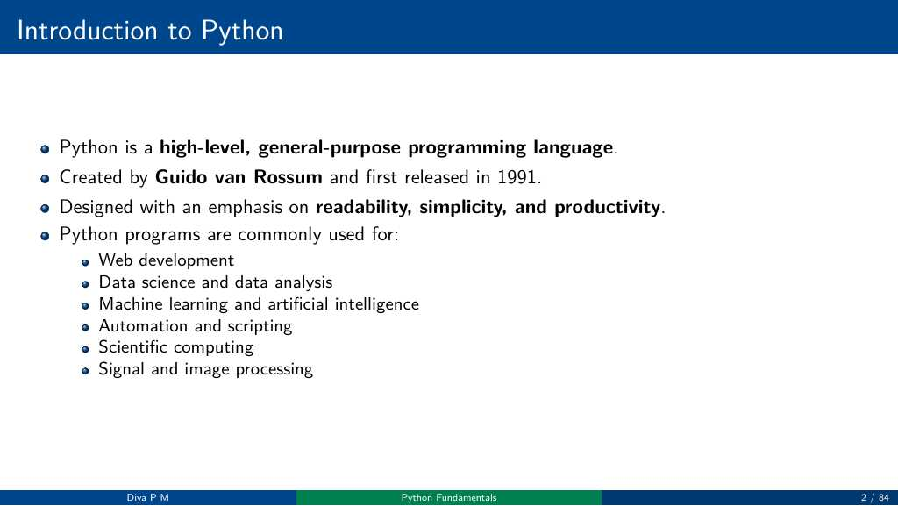
Notes:
Source: Day2_Session1_Python_Fundamentals_Slides.pdf, page/slide 2 of 84. Section: Day 2: Python Fundamentals I; Input, Output and Basic Programming.

Slide 27
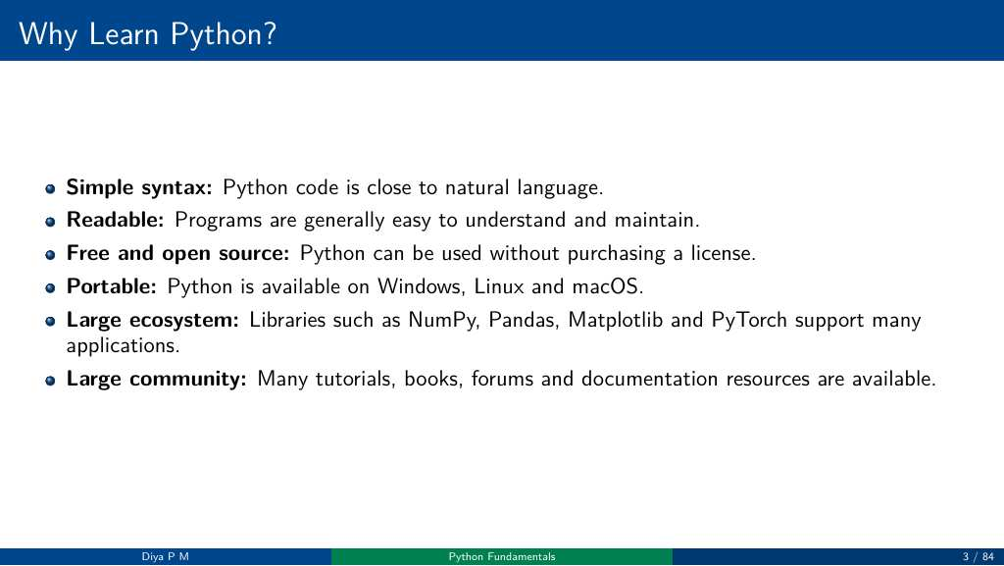
Notes:
Source: Day2_Session1_Python_Fundamentals_Slides.pdf, page/slide 3 of 84. Section: Day 2: Python Fundamentals I; Input, Output and Basic Programming.

Slide 28
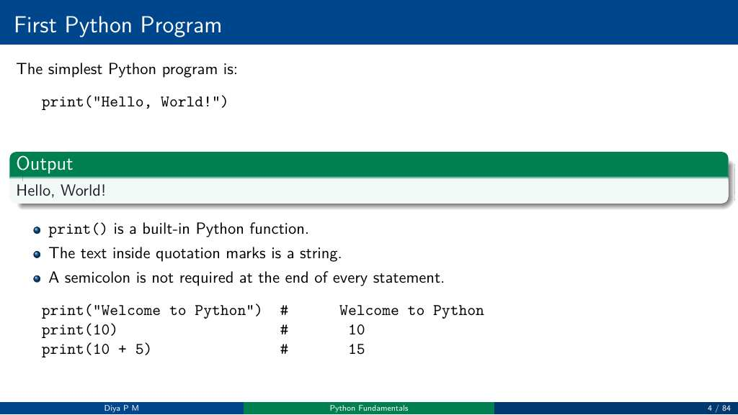
Notes:
Source: Day2_Session1_Python_Fundamentals_Slides.pdf, page/slide 4 of 84. Section: Day 2: Python Fundamentals I; Input, Output and Basic Programming.

Slide 29
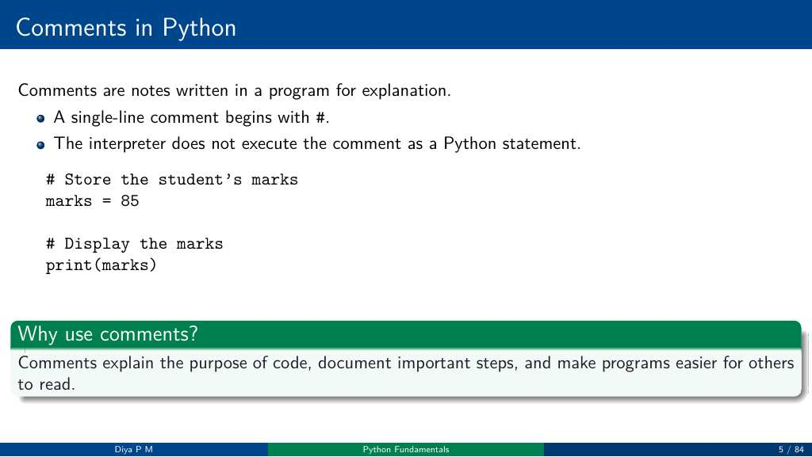
Notes:
Source: Day2_Session1_Python_Fundamentals_Slides.pdf, page/slide 5 of 84. Section: Day 2: Python Fundamentals I; Input, Output and Basic Programming.

Slide 30
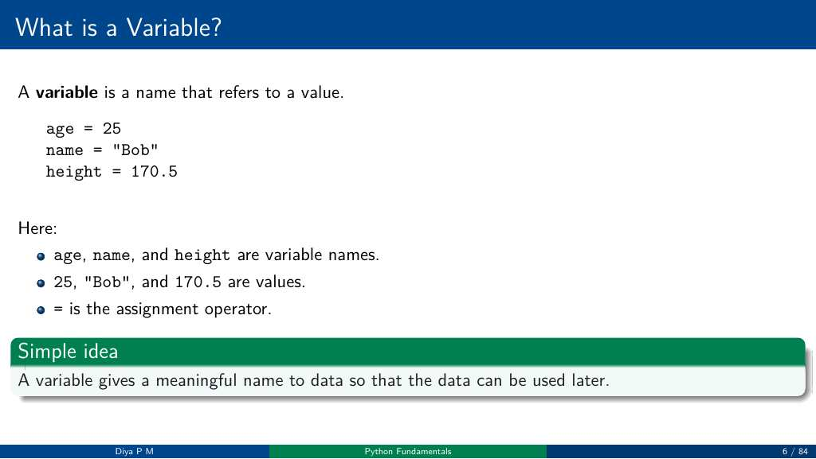
Notes:
Source: Day2_Session1_Python_Fundamentals_Slides.pdf, page/slide 6 of 84. Section: Day 2: Python Fundamentals I; Input, Output and Basic Programming.

Slide 31
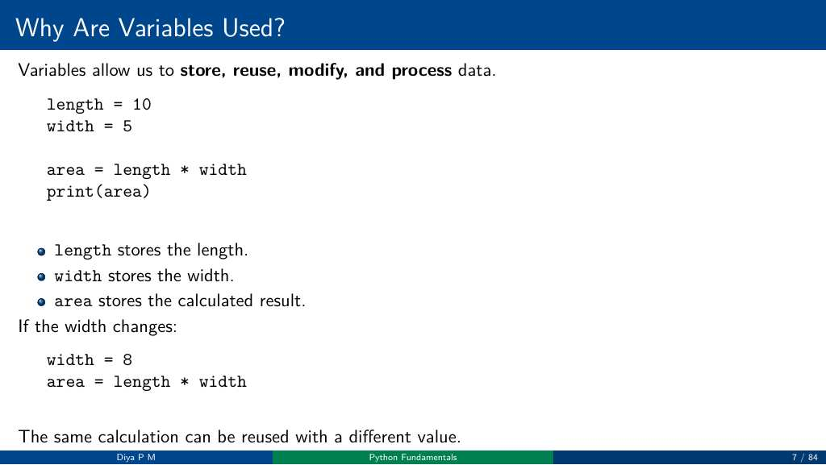
Notes:
Source: Day2_Session1_Python_Fundamentals_Slides.pdf, page/slide 7 of 84. Section: Day 2: Python Fundamentals I; Input, Output and Basic Programming.

Slide 32
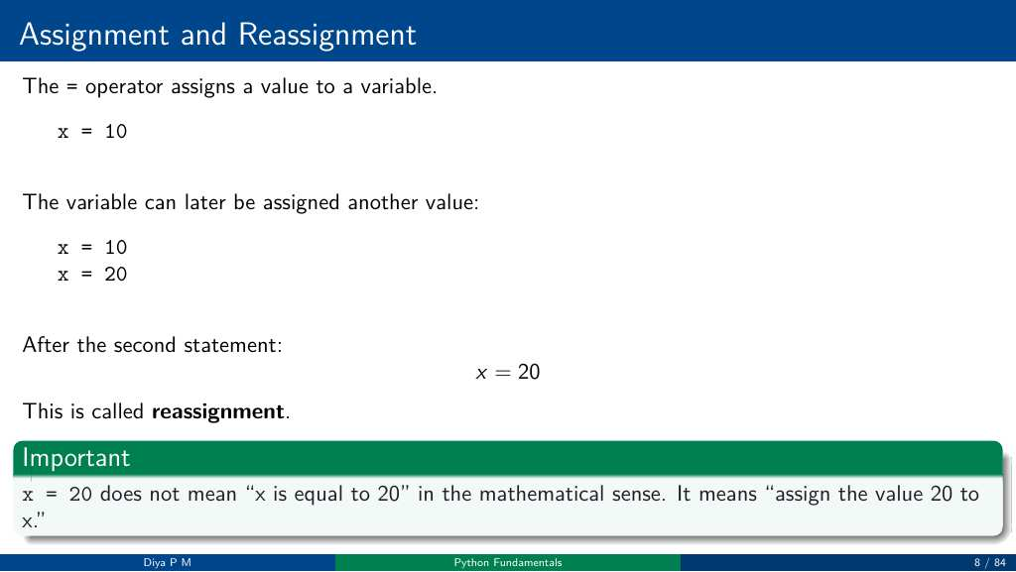
Notes:
Source: Day2_Session1_Python_Fundamentals_Slides.pdf, page/slide 8 of 84. Section: Day 2: Python Fundamentals I; Input, Output and Basic Programming.

Slide 33
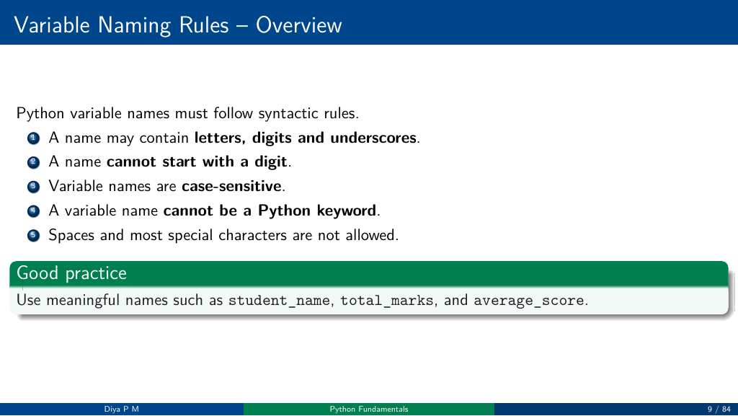
Notes:
Source: Day2_Session1_Python_Fundamentals_Slides.pdf, page/slide 9 of 84. Section: Day 2: Python Fundamentals I; Input, Output and Basic Programming.

Slide 34
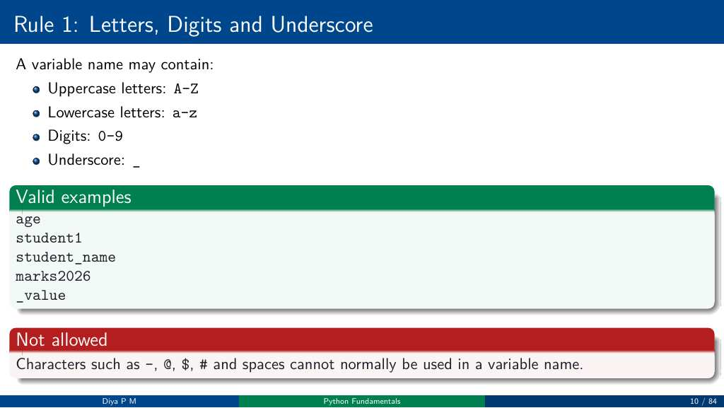
Notes:
Source: Day2_Session1_Python_Fundamentals_Slides.pdf, page/slide 10 of 84. Section: Day 2: Python Fundamentals I; Input, Output and Basic Programming.

Slide 35
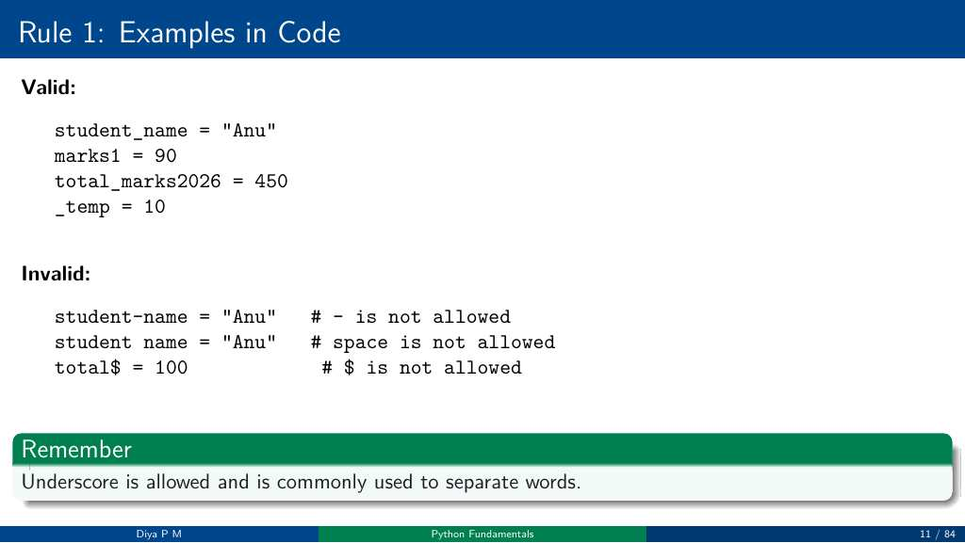
Notes:
Source: Day2_Session1_Python_Fundamentals_Slides.pdf, page/slide 11 of 84. Section: Day 2: Python Fundamentals I; Input, Output and Basic Programming.

Slide 36
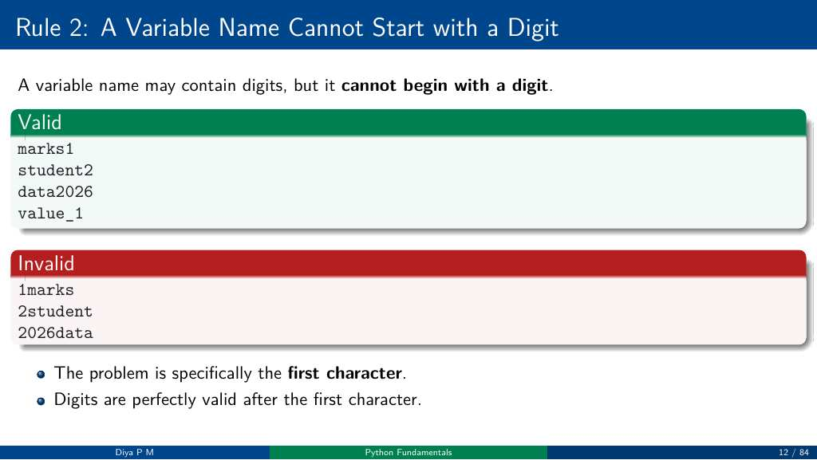
Notes:
Source: Day2_Session1_Python_Fundamentals_Slides.pdf, page/slide 12 of 84. Section: Day 2: Python Fundamentals I; Input, Output and Basic Programming.

Slide 37
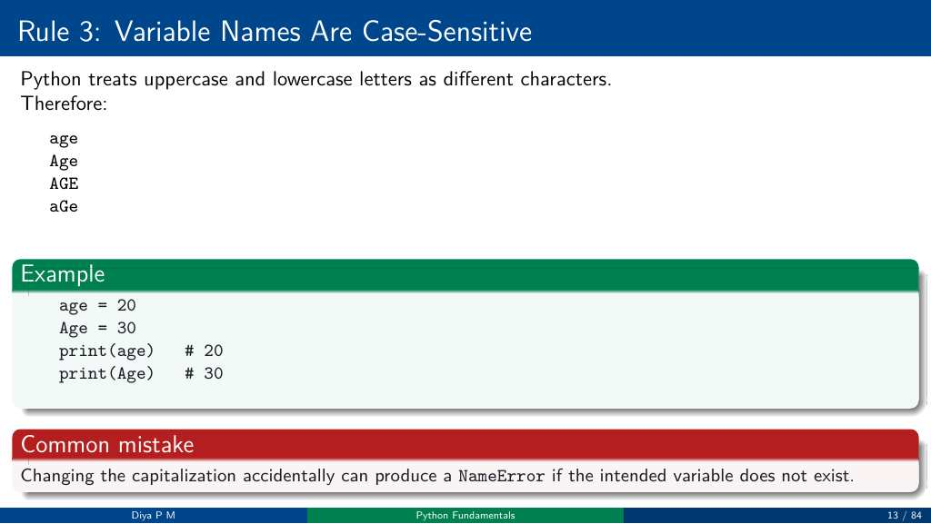
Notes:
Source: Day2_Session1_Python_Fundamentals_Slides.pdf, page/slide 13 of 84. Section: Day 2: Python Fundamentals I; Input, Output and Basic Programming.

Slide 38
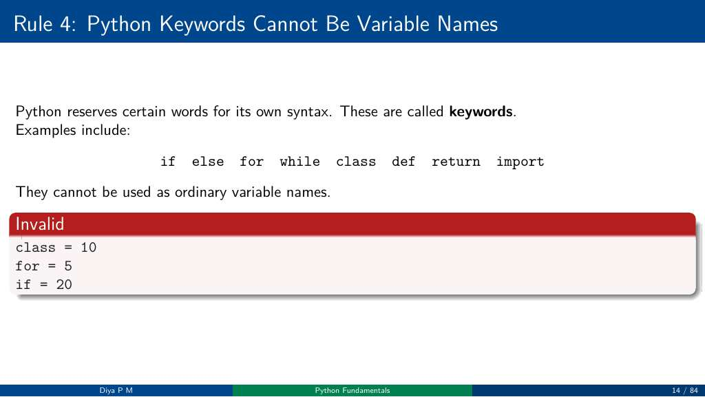
Notes:
Source: Day2_Session1_Python_Fundamentals_Slides.pdf, page/slide 14 of 84. Section: Day 2: Python Fundamentals I; Input, Output and Basic Programming.

Slide 39
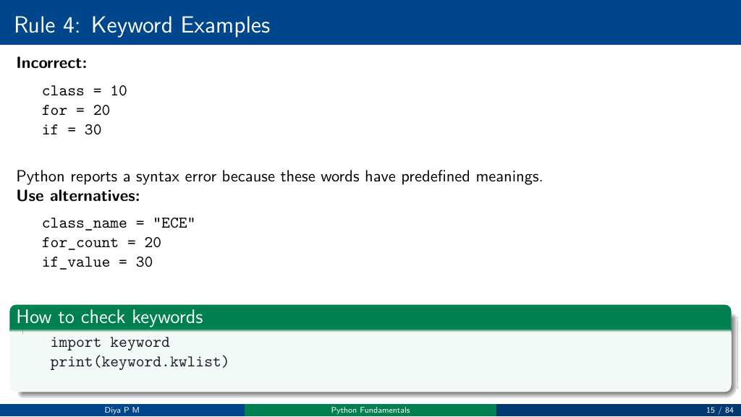
Notes:
Source: Day2_Session1_Python_Fundamentals_Slides.pdf, page/slide 15 of 84. Section: Day 2: Python Fundamentals I; Input, Output and Basic Programming.

Slide 40
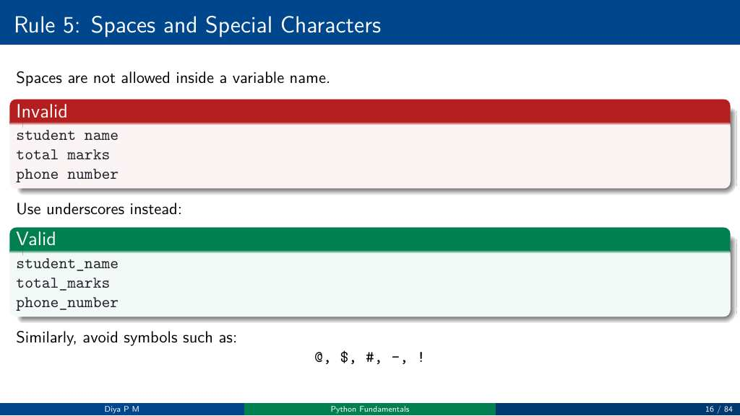
Notes:
Source: Day2_Session1_Python_Fundamentals_Slides.pdf, page/slide 16 of 84. Section: Day 2: Python Fundamentals I; Input, Output and Basic Programming.

Slide 41
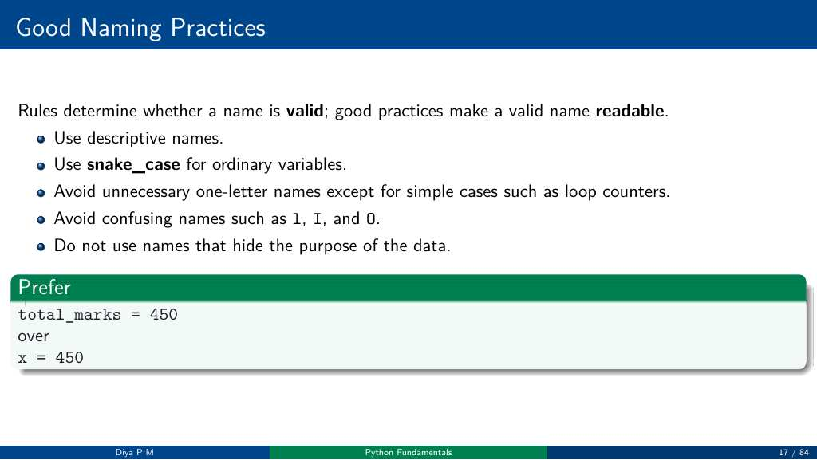
Notes:
Source: Day2_Session1_Python_Fundamentals_Slides.pdf, page/slide 17 of 84. Section: Day 2: Python Fundamentals I; Input, Output and Basic Programming.

Slide 42
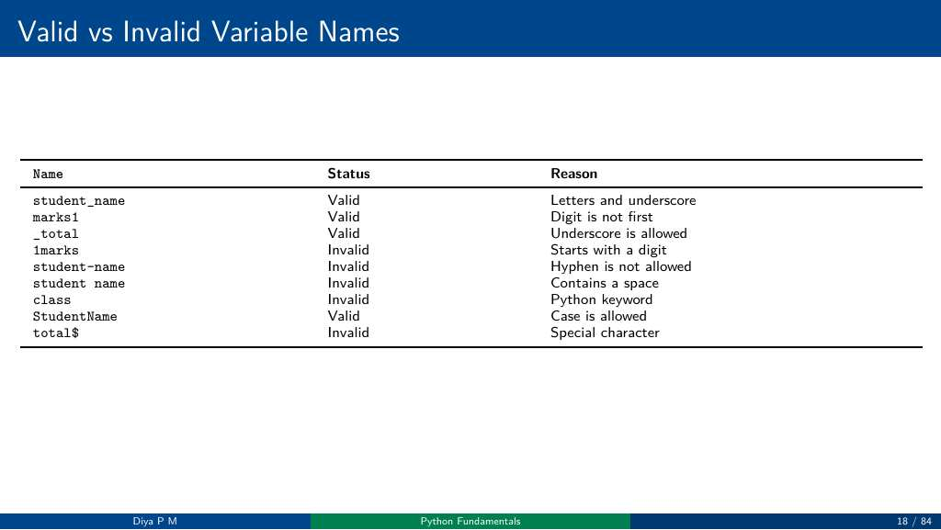
Notes:
Source: Day2_Session1_Python_Fundamentals_Slides.pdf, page/slide 18 of 84. Section: Day 2: Python Fundamentals I; Input, Output and Basic Programming.

Slide 43
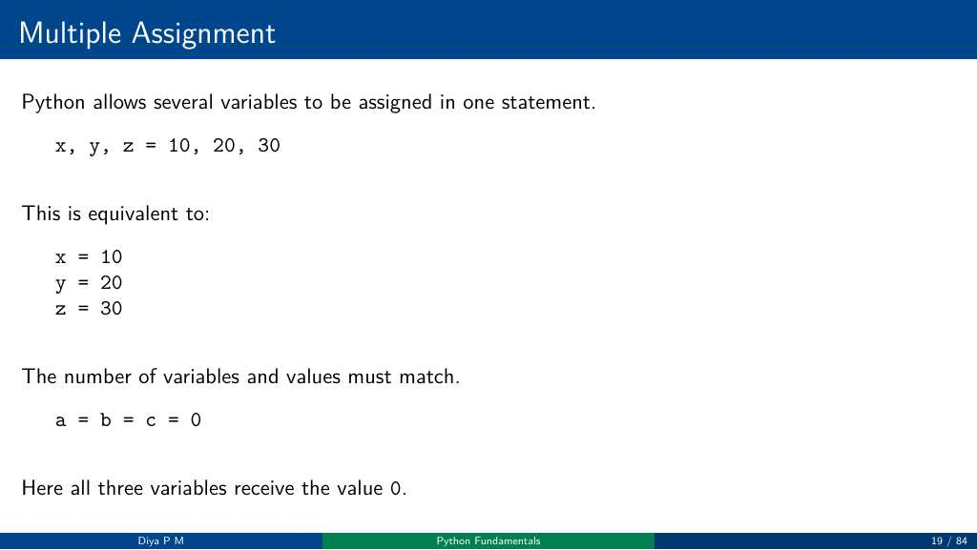
Notes:
Source: Day2_Session1_Python_Fundamentals_Slides.pdf, page/slide 19 of 84. Section: Day 2: Python Fundamentals I; Input, Output and Basic Programming.

Slide 44
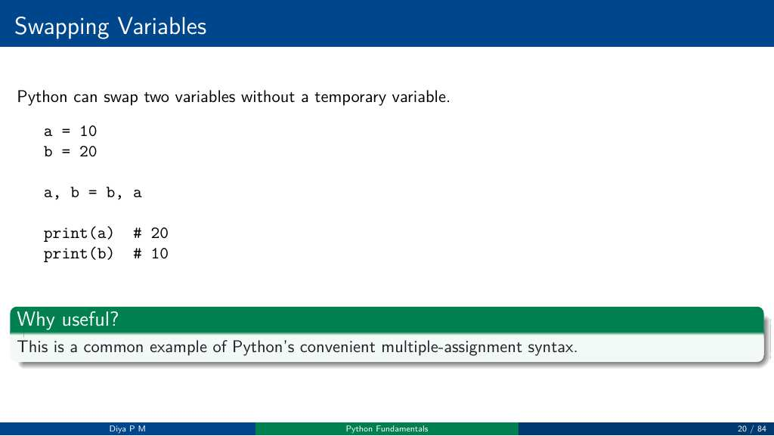
Notes:
Source: Day2_Session1_Python_Fundamentals_Slides.pdf, page/slide 20 of 84. Section: Day 2: Python Fundamentals I; Input, Output and Basic Programming.

Slide 45
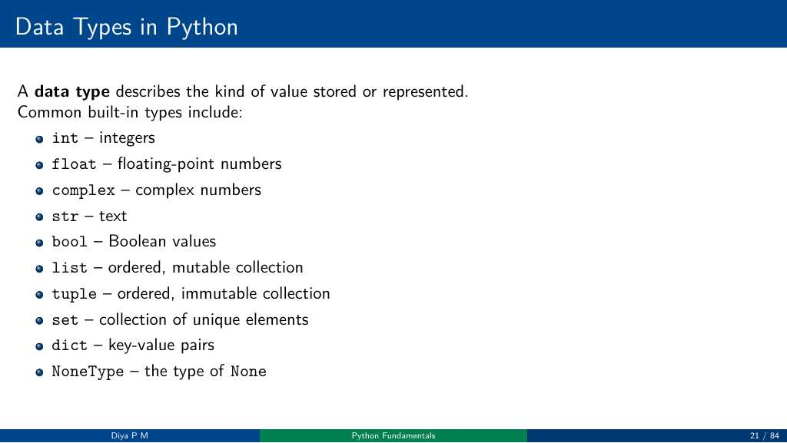
Notes:
Source: Day2_Session1_Python_Fundamentals_Slides.pdf, page/slide 21 of 84. Section: Day 2: Python Fundamentals I; Input, Output and Basic Programming.

Slide 46
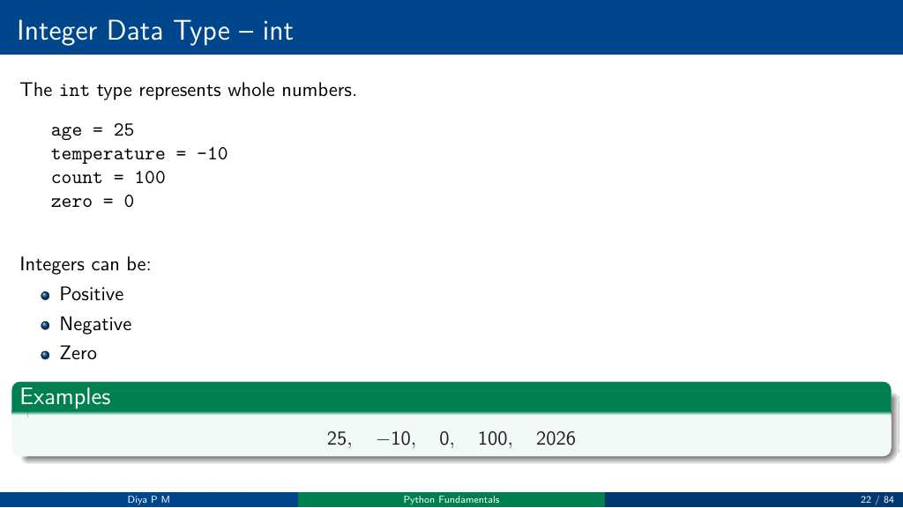
Notes:
Source: Day2_Session1_Python_Fundamentals_Slides.pdf, page/slide 22 of 84. Section: Day 2: Python Fundamentals I; Input, Output and Basic Programming.

Slide 47
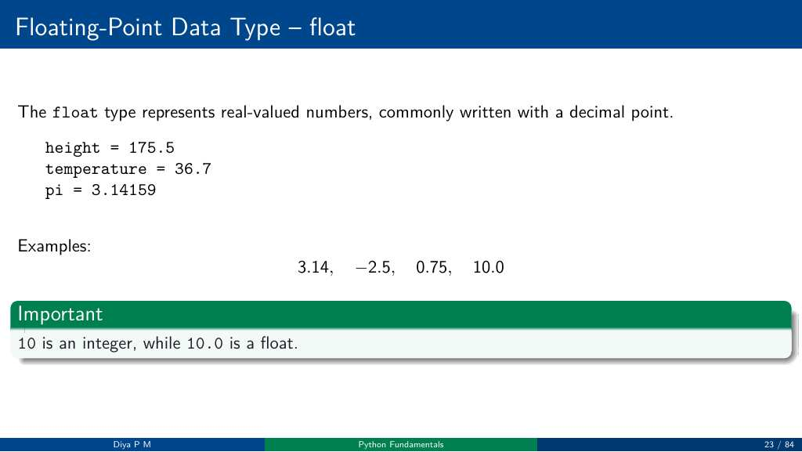
Notes:
Source: Day2_Session1_Python_Fundamentals_Slides.pdf, page/slide 23 of 84. Section: Day 2: Python Fundamentals I; Input, Output and Basic Programming.

Slide 48
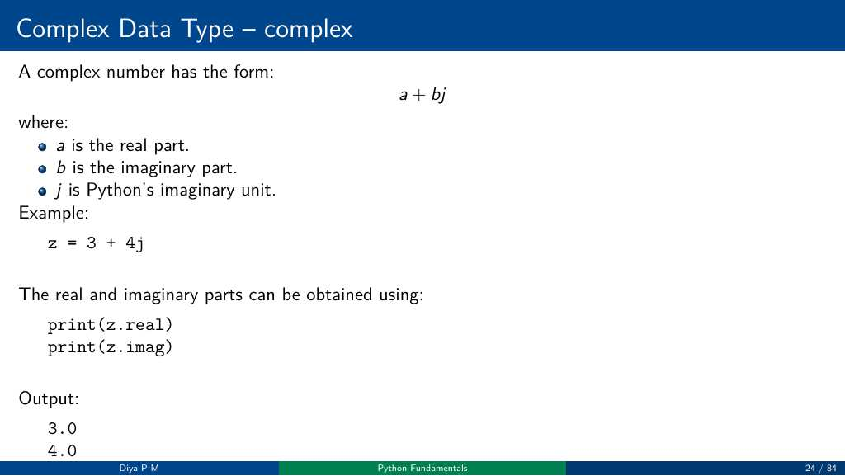
Notes:
Source: Day2_Session1_Python_Fundamentals_Slides.pdf, page/slide 24 of 84. Section: Day 2: Python Fundamentals I; Input, Output and Basic Programming.

Slide 49
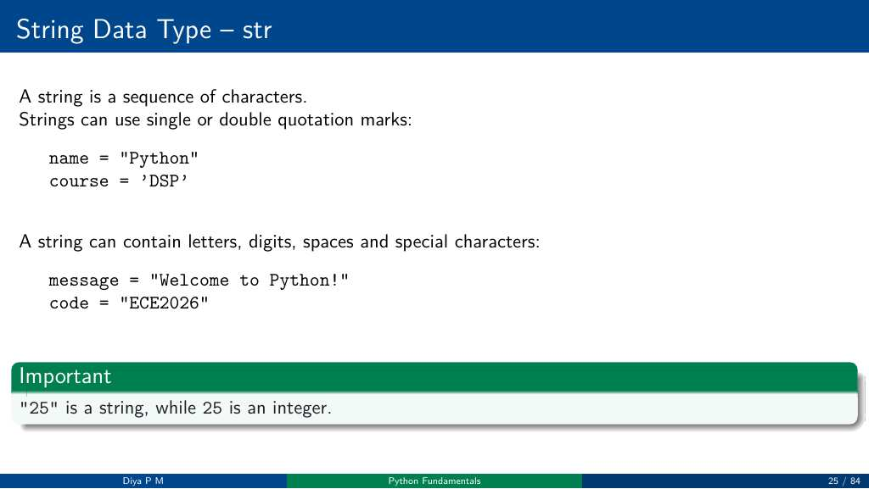
Notes:
Source: Day2_Session1_Python_Fundamentals_Slides.pdf, page/slide 25 of 84. Section: Day 2: Python Fundamentals I; Input, Output and Basic Programming.

Slide 50
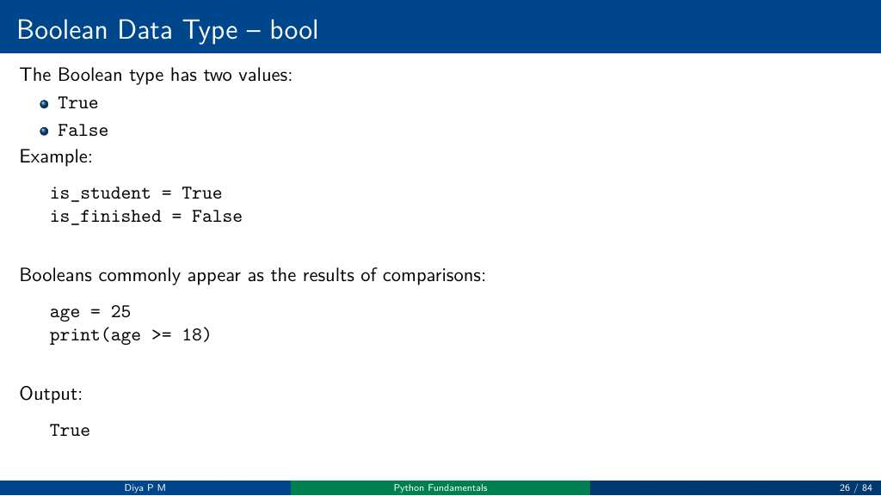
Notes:
Source: Day2_Session1_Python_Fundamentals_Slides.pdf, page/slide 26 of 84. Section: Day 2: Python Fundamentals I; Input, Output and Basic Programming.

Slide 51
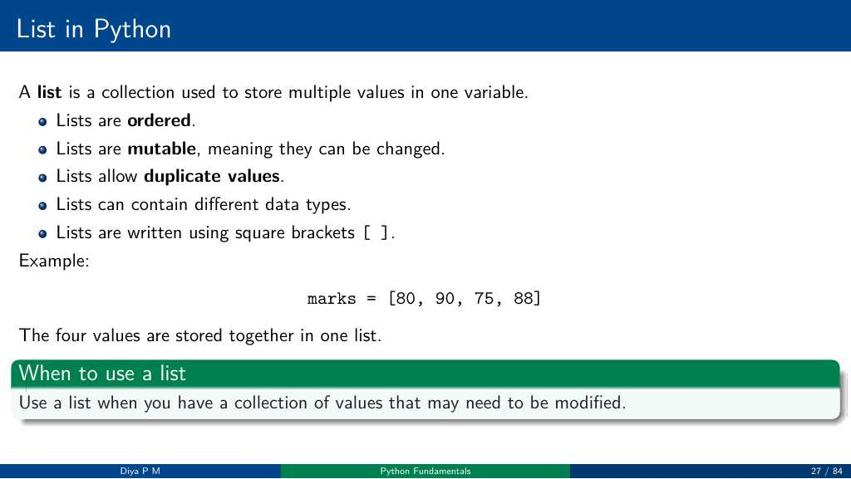
Notes:
Source: Day2_Session1_Python_Fundamentals_Slides.pdf, page/slide 27 of 84. Section: Day 2: Python Fundamentals I; Input, Output and Basic Programming.

Slide 52
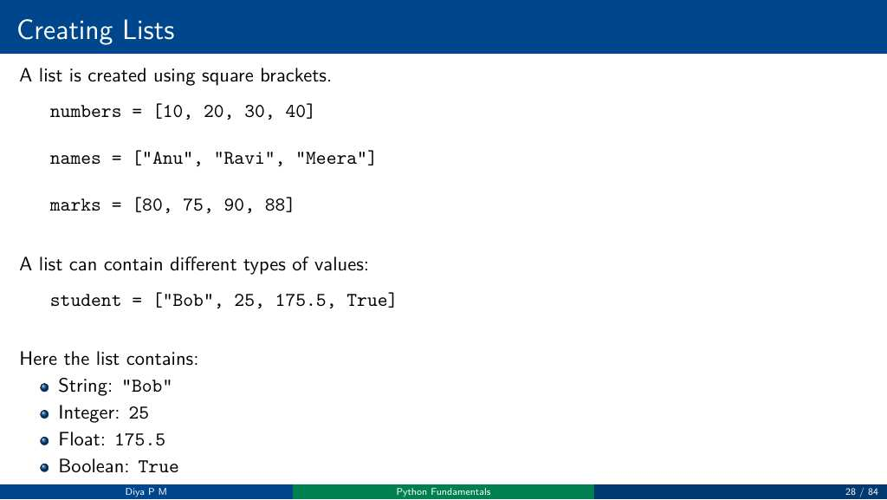
Notes:
Source: Day2_Session1_Python_Fundamentals_Slides.pdf, page/slide 28 of 84. Section: Day 2: Python Fundamentals I; Input, Output and Basic Programming.

Slide 53
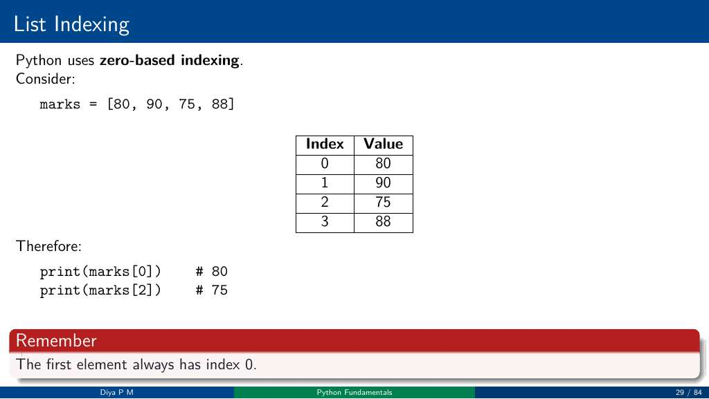
Notes:
Source: Day2_Session1_Python_Fundamentals_Slides.pdf, page/slide 29 of 84. Section: Day 2: Python Fundamentals I; Input, Output and Basic Programming.

Slide 54
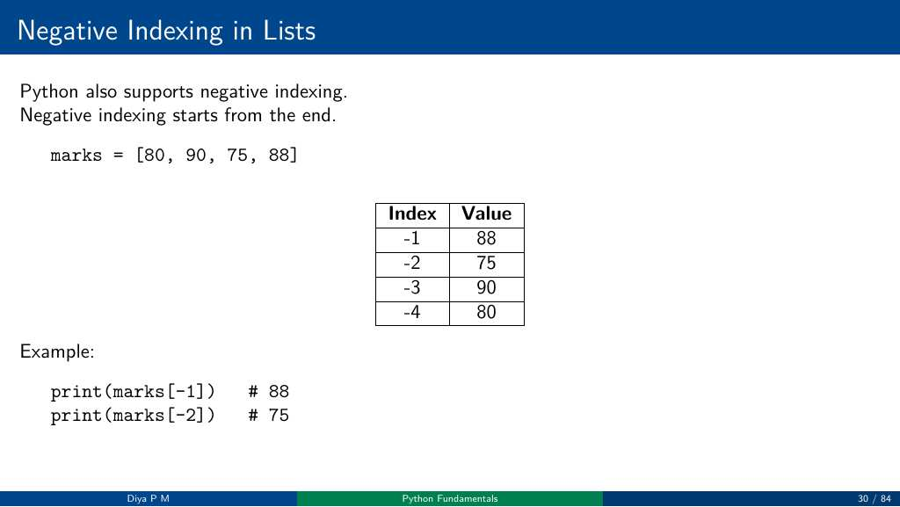
Notes:
Source: Day2_Session1_Python_Fundamentals_Slides.pdf, page/slide 30 of 84. Section: Day 2: Python Fundamentals I; Input, Output and Basic Programming.

Slide 55
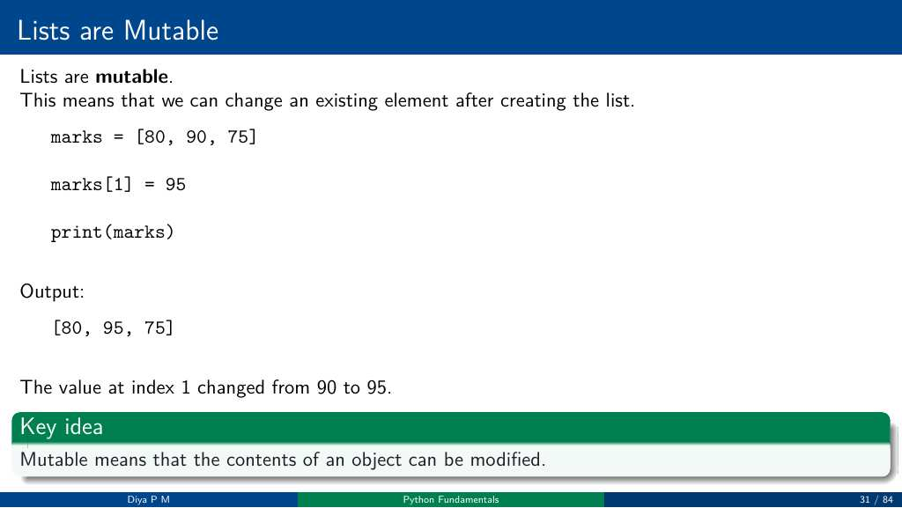
Notes:
Source: Day2_Session1_Python_Fundamentals_Slides.pdf, page/slide 31 of 84. Section: Day 2: Python Fundamentals I; Input, Output and Basic Programming.

Slide 56
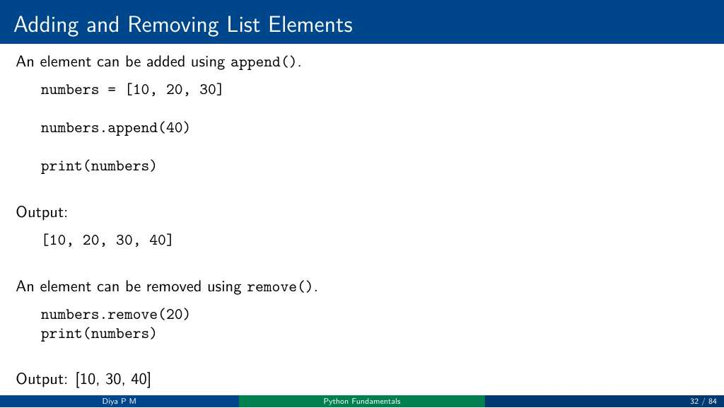
Notes:
Source: Day2_Session1_Python_Fundamentals_Slides.pdf, page/slide 32 of 84. Section: Day 2: Python Fundamentals I; Input, Output and Basic Programming.

Slide 57
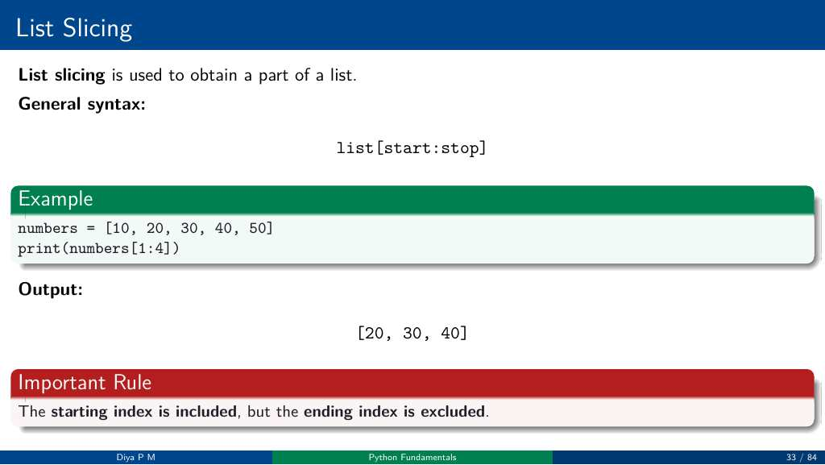
Notes:
Source: Day2_Session1_Python_Fundamentals_Slides.pdf, page/slide 33 of 84. Section: Day 2: Python Fundamentals I; Input, Output and Basic Programming.

Slide 58

Notes:
Source: Day2_Session1_Python_Fundamentals_Slides.pdf, page/slide 34 of 84. Section: Day 2: Python Fundamentals I; Input, Output and Basic Programming.

Slide 59

Notes:
Source: Day2_Session1_Python_Fundamentals_Slides.pdf, page/slide 35 of 84. Section: Day 2: Python Fundamentals I; Input, Output and Basic Programming.

Slide 60

Notes:
Source: Day2_Session1_Python_Fundamentals_Slides.pdf, page/slide 36 of 84. Section: Day 2: Python Fundamentals I; Input, Output and Basic Programming.

Slide 61

Notes:
Source: Day2_Session1_Python_Fundamentals_Slides.pdf, page/slide 37 of 84. Section: Day 2: Python Fundamentals I; Input, Output and Basic Programming.

Slide 62

Notes:
Source: Day2_Session1_Python_Fundamentals_Slides.pdf, page/slide 38 of 84. Section: Day 2: Python Fundamentals I; Input, Output and Basic Programming.

Slide 63

Notes:
Source: Day2_Session1_Python_Fundamentals_Slides.pdf, page/slide 39 of 84. Section: Day 2: Python Fundamentals I; Input, Output and Basic Programming.

Slide 64

Notes:
Source: Day2_Session1_Python_Fundamentals_Slides.pdf, page/slide 40 of 84. Section: Day 2: Python Fundamentals I; Input, Output and Basic Programming.

Slide 65

Notes:
Source: Day2_Session1_Python_Fundamentals_Slides.pdf, page/slide 41 of 84. Section: Day 2: Python Fundamentals I; Input, Output and Basic Programming.

Slide 66

Notes:
Source: Day2_Session1_Python_Fundamentals_Slides.pdf, page/slide 42 of 84. Section: Day 2: Python Fundamentals I; Input, Output and Basic Programming.

Slide 67

Notes:
Source: Day2_Session1_Python_Fundamentals_Slides.pdf, page/slide 43 of 84. Section: Day 2: Python Fundamentals I; Input, Output and Basic Programming.

Slide 68

Notes:
Source: Day2_Session1_Python_Fundamentals_Slides.pdf, page/slide 44 of 84. Section: Day 2: Python Fundamentals I; Input, Output and Basic Programming.

Slide 69

Notes:
Source: Day2_Session1_Python_Fundamentals_Slides.pdf, page/slide 45 of 84. Section: Day 2: Python Fundamentals I; Input, Output and Basic Programming.

Slide 70

Notes:
Source: Day2_Session1_Python_Fundamentals_Slides.pdf, page/slide 46 of 84. Section: Day 2: Python Fundamentals I; Input, Output and Basic Programming.

Slide 71

Notes:
Source: Day2_Session1_Python_Fundamentals_Slides.pdf, page/slide 47 of 84. Section: Day 2: Python Fundamentals I; Input, Output and Basic Programming.

Slide 72

Notes:
Source: Day2_Session1_Python_Fundamentals_Slides.pdf, page/slide 48 of 84. Section: Day 2: Python Fundamentals I; Input, Output and Basic Programming.

Slide 73

Notes:
Source: Day2_Session1_Python_Fundamentals_Slides.pdf, page/slide 49 of 84. Section: Day 2: Python Fundamentals I; Input, Output and Basic Programming.

Slide 74

Notes:
Source: Day2_Session1_Python_Fundamentals_Slides.pdf, page/slide 50 of 84. Section: Day 2: Python Fundamentals I; Input, Output and Basic Programming.

Slide 75

Notes:
Source: Day2_Session1_Python_Fundamentals_Slides.pdf, page/slide 51 of 84. Section: Day 2: Python Fundamentals I; Input, Output and Basic Programming.

Slide 76

Notes:
Source: Day2_Session1_Python_Fundamentals_Slides.pdf, page/slide 52 of 84. Section: Day 2: Python Fundamentals I; Input, Output and Basic Programming.

Slide 77

Notes:
Source: Day2_Session1_Python_Fundamentals_Slides.pdf, page/slide 53 of 84. Section: Day 2: Python Fundamentals I; Input, Output and Basic Programming.

Slide 78

Notes:
Source: Day2_Session1_Python_Fundamentals_Slides.pdf, page/slide 54 of 84. Section: Day 2: Python Fundamentals I; Input, Output and Basic Programming.

Slide 79

Notes:
Source: Day2_Session1_Python_Fundamentals_Slides.pdf, page/slide 55 of 84. Section: Day 2: Python Fundamentals I; Input, Output and Basic Programming.

Slide 80

Notes:
Source: Day2_Session1_Python_Fundamentals_Slides.pdf, page/slide 56 of 84. Section: Day 2: Python Fundamentals I; Input, Output and Basic Programming.

Slide 81

Notes:
Source: Day2_Session1_Python_Fundamentals_Slides.pdf, page/slide 57 of 84. Section: Day 2: Python Fundamentals I; Input, Output and Basic Programming.

Slide 82

Notes:
Source: Day2_Session1_Python_Fundamentals_Slides.pdf, page/slide 58 of 84. Section: Day 2: Python Fundamentals I; Input, Output and Basic Programming.

Slide 83

Notes:
Source: Day2_Session1_Python_Fundamentals_Slides.pdf, page/slide 59 of 84. Section: Day 2: Python Fundamentals I; Input, Output and Basic Programming.

Slide 84

Notes:
Source: Day2_Session1_Python_Fundamentals_Slides.pdf, page/slide 60 of 84. Section: Day 2: Python Fundamentals I; Input, Output and Basic Programming.

Slide 85

Notes:
Source: Day2_Session1_Python_Fundamentals_Slides.pdf, page/slide 61 of 84. Section: Day 2: Python Fundamentals I; Input, Output and Basic Programming.

Slide 86

Notes:
Source: Day2_Session1_Python_Fundamentals_Slides.pdf, page/slide 62 of 84. Section: Day 2: Python Fundamentals I; Input, Output and Basic Programming.

Slide 87

Notes:
Source: Day2_Session1_Python_Fundamentals_Slides.pdf, page/slide 63 of 84. Section: Day 2: Python Fundamentals I; Input, Output and Basic Programming.

Slide 88

Notes:
Source: Day2_Session1_Python_Fundamentals_Slides.pdf, page/slide 64 of 84. Section: Day 2: Python Fundamentals I; Input, Output and Basic Programming.

Slide 89

Notes:
Source: Day2_Session1_Python_Fundamentals_Slides.pdf, page/slide 65 of 84. Section: Day 2: Python Fundamentals I; Input, Output and Basic Programming.

Slide 90

Notes:
Source: Day2_Session1_Python_Fundamentals_Slides.pdf, page/slide 66 of 84. Section: Day 2: Python Fundamentals I; Input, Output and Basic Programming.

Slide 91

Notes:
Source: Day2_Session1_Python_Fundamentals_Slides.pdf, page/slide 67 of 84. Section: Day 2: Python Fundamentals I; Input, Output and Basic Programming.

Slide 92

Notes:
Source: Day2_Session1_Python_Fundamentals_Slides.pdf, page/slide 68 of 84. Section: Day 2: Python Fundamentals I; Input, Output and Basic Programming.

Slide 93

Notes:
Source: Day2_Session1_Python_Fundamentals_Slides.pdf, page/slide 69 of 84. Section: Day 2: Python Fundamentals I; Input, Output and Basic Programming.

Slide 94

Notes:
Source: Day2_Session1_Python_Fundamentals_Slides.pdf, page/slide 70 of 84. Section: Day 2: Python Fundamentals I; Input, Output and Basic Programming.

Slide 95

Notes:
Source: Day2_Session1_Python_Fundamentals_Slides.pdf, page/slide 71 of 84. Section: Day 2: Python Fundamentals I; Input, Output and Basic Programming.

Slide 96

Notes:
Source: Day2_Session1_Python_Fundamentals_Slides.pdf, page/slide 72 of 84. Section: Day 2: Python Fundamentals I; Input, Output and Basic Programming.

Slide 97

Notes:
Source: Day2_Session1_Python_Fundamentals_Slides.pdf, page/slide 73 of 84. Section: Day 2: Python Fundamentals I; Input, Output and Basic Programming.

Slide 98

Notes:
Source: Day2_Session1_Python_Fundamentals_Slides.pdf, page/slide 74 of 84. Section: Day 2: Python Fundamentals I; Input, Output and Basic Programming.

Slide 99

Notes:
Source: Day2_Session1_Python_Fundamentals_Slides.pdf, page/slide 75 of 84. Section: Day 2: Python Fundamentals I; Input, Output and Basic Programming.

Slide 100

Notes:
Source: Day2_Session1_Python_Fundamentals_Slides.pdf, page/slide 76 of 84. Section: Day 2: Python Fundamentals I; Input, Output and Basic Programming.

Slide 101

Notes:
Source: Day2_Session1_Python_Fundamentals_Slides.pdf, page/slide 77 of 84. Section: Day 2: Python Fundamentals I; Input, Output and Basic Programming.

Slide 102

Notes:
Source: Day2_Session1_Python_Fundamentals_Slides.pdf, page/slide 78 of 84. Section: Day 2: Python Fundamentals I; Input, Output and Basic Programming.

Slide 103

Notes:
Source: Day2_Session1_Python_Fundamentals_Slides.pdf, page/slide 79 of 84. Section: Day 2: Python Fundamentals I; Input, Output and Basic Programming.

Slide 104

Notes:
Source: Day2_Session1_Python_Fundamentals_Slides.pdf, page/slide 80 of 84. Section: Day 2: Python Fundamentals I; Input, Output and Basic Programming.

Slide 105

Notes:
Source: Day2_Session1_Python_Fundamentals_Slides.pdf, page/slide 81 of 84. Section: Day 2: Python Fundamentals I; Input, Output and Basic Programming.

Slide 106

Notes:
Source: Day2_Session1_Python_Fundamentals_Slides.pdf, page/slide 82 of 84. Section: Day 2: Python Fundamentals I; Input, Output and Basic Programming.

Slide 107

Notes:
Source: Day2_Session1_Python_Fundamentals_Slides.pdf, page/slide 83 of 84. Section: Day 2: Python Fundamentals I; Input, Output and Basic Programming.

Slide 108

Notes:
Source: Day2_Session1_Python_Fundamentals_Slides.pdf, page/slide 84 of 84. Section: Day 2: Python Fundamentals I; Input, Output and Basic Programming.

Slide 109
Input, Output and Basic Programming (print, input, type conversion, expressions)
Slides: Day 2, Session 2 slides (Dhevamathi C)

Slide 110

Notes:
Source: Day2_Session2_Input_Output_Basic_Programming_Slides.pdf, page/slide 1 of 133. Section: Day 2: Python Fundamentals I; Input, Output and Basic Programming.

Slide 111

Notes:
Source: Day2_Session2_Input_Output_Basic_Programming_Slides.pdf, page/slide 2 of 133. Section: Day 2: Python Fundamentals I; Input, Output and Basic Programming.

Slide 112

Notes:
Source: Day2_Session2_Input_Output_Basic_Programming_Slides.pdf, page/slide 3 of 133. Section: Day 2: Python Fundamentals I; Input, Output and Basic Programming.

Slide 113

Notes:
Source: Day2_Session2_Input_Output_Basic_Programming_Slides.pdf, page/slide 4 of 133. Section: Day 2: Python Fundamentals I; Input, Output and Basic Programming.

Slide 114

Notes:
Source: Day2_Session2_Input_Output_Basic_Programming_Slides.pdf, page/slide 5 of 133. Section: Day 2: Python Fundamentals I; Input, Output and Basic Programming.

Slide 115

Notes:
Source: Day2_Session2_Input_Output_Basic_Programming_Slides.pdf, page/slide 6 of 133. Section: Day 2: Python Fundamentals I; Input, Output and Basic Programming.

Slide 116

Notes:
Source: Day2_Session2_Input_Output_Basic_Programming_Slides.pdf, page/slide 7 of 133. Section: Day 2: Python Fundamentals I; Input, Output and Basic Programming.

Slide 117

Notes:
Source: Day2_Session2_Input_Output_Basic_Programming_Slides.pdf, page/slide 8 of 133. Section: Day 2: Python Fundamentals I; Input, Output and Basic Programming.

Slide 118

Notes:
Source: Day2_Session2_Input_Output_Basic_Programming_Slides.pdf, page/slide 9 of 133. Section: Day 2: Python Fundamentals I; Input, Output and Basic Programming.

Slide 119

Notes:
Source: Day2_Session2_Input_Output_Basic_Programming_Slides.pdf, page/slide 10 of 133. Section: Day 2: Python Fundamentals I; Input, Output and Basic Programming.

Slide 120

Notes:
Source: Day2_Session2_Input_Output_Basic_Programming_Slides.pdf, page/slide 11 of 133. Section: Day 2: Python Fundamentals I; Input, Output and Basic Programming.

Slide 121

Notes:
Source: Day2_Session2_Input_Output_Basic_Programming_Slides.pdf, page/slide 12 of 133. Section: Day 2: Python Fundamentals I; Input, Output and Basic Programming.

Slide 122

Notes:
Source: Day2_Session2_Input_Output_Basic_Programming_Slides.pdf, page/slide 13 of 133. Section: Day 2: Python Fundamentals I; Input, Output and Basic Programming.

Slide 123

Notes:
Source: Day2_Session2_Input_Output_Basic_Programming_Slides.pdf, page/slide 14 of 133. Section: Day 2: Python Fundamentals I; Input, Output and Basic Programming.

Slide 124

Notes:
Source: Day2_Session2_Input_Output_Basic_Programming_Slides.pdf, page/slide 15 of 133. Section: Day 2: Python Fundamentals I; Input, Output and Basic Programming.

Slide 125

Notes:
Source: Day2_Session2_Input_Output_Basic_Programming_Slides.pdf, page/slide 16 of 133. Section: Day 2: Python Fundamentals I; Input, Output and Basic Programming.

Slide 126

Notes:
Source: Day2_Session2_Input_Output_Basic_Programming_Slides.pdf, page/slide 17 of 133. Section: Day 2: Python Fundamentals I; Input, Output and Basic Programming.

Slide 127

Notes:
Source: Day2_Session2_Input_Output_Basic_Programming_Slides.pdf, page/slide 18 of 133. Section: Day 2: Python Fundamentals I; Input, Output and Basic Programming.

Slide 128

Notes:
Source: Day2_Session2_Input_Output_Basic_Programming_Slides.pdf, page/slide 19 of 133. Section: Day 2: Python Fundamentals I; Input, Output and Basic Programming.

Slide 129

Notes:
Source: Day2_Session2_Input_Output_Basic_Programming_Slides.pdf, page/slide 20 of 133. Section: Day 2: Python Fundamentals I; Input, Output and Basic Programming.

Slide 130

Notes:
Source: Day2_Session2_Input_Output_Basic_Programming_Slides.pdf, page/slide 21 of 133. Section: Day 2: Python Fundamentals I; Input, Output and Basic Programming.

Slide 131

Notes:
Source: Day2_Session2_Input_Output_Basic_Programming_Slides.pdf, page/slide 22 of 133. Section: Day 2: Python Fundamentals I; Input, Output and Basic Programming.

Slide 132

Notes:
Source: Day2_Session2_Input_Output_Basic_Programming_Slides.pdf, page/slide 23 of 133. Section: Day 2: Python Fundamentals I; Input, Output and Basic Programming.

Slide 133

Notes:
Source: Day2_Session2_Input_Output_Basic_Programming_Slides.pdf, page/slide 24 of 133. Section: Day 2: Python Fundamentals I; Input, Output and Basic Programming.

Slide 134

Notes:
Source: Day2_Session2_Input_Output_Basic_Programming_Slides.pdf, page/slide 25 of 133. Section: Day 2: Python Fundamentals I; Input, Output and Basic Programming.

Slide 135

Notes:
Source: Day2_Session2_Input_Output_Basic_Programming_Slides.pdf, page/slide 26 of 133. Section: Day 2: Python Fundamentals I; Input, Output and Basic Programming.

Slide 136

Notes:
Source: Day2_Session2_Input_Output_Basic_Programming_Slides.pdf, page/slide 27 of 133. Section: Day 2: Python Fundamentals I; Input, Output and Basic Programming.

Slide 137

Notes:
Source: Day2_Session2_Input_Output_Basic_Programming_Slides.pdf, page/slide 28 of 133. Section: Day 2: Python Fundamentals I; Input, Output and Basic Programming.

Slide 138

Notes:
Source: Day2_Session2_Input_Output_Basic_Programming_Slides.pdf, page/slide 29 of 133. Section: Day 2: Python Fundamentals I; Input, Output and Basic Programming.

Slide 139

Notes:
Source: Day2_Session2_Input_Output_Basic_Programming_Slides.pdf, page/slide 30 of 133. Section: Day 2: Python Fundamentals I; Input, Output and Basic Programming.

Slide 140

Notes:
Source: Day2_Session2_Input_Output_Basic_Programming_Slides.pdf, page/slide 31 of 133. Section: Day 2: Python Fundamentals I; Input, Output and Basic Programming.

Slide 141

Notes:
Source: Day2_Session2_Input_Output_Basic_Programming_Slides.pdf, page/slide 32 of 133. Section: Day 2: Python Fundamentals I; Input, Output and Basic Programming.

Slide 142

Notes:
Source: Day2_Session2_Input_Output_Basic_Programming_Slides.pdf, page/slide 33 of 133. Section: Day 2: Python Fundamentals I; Input, Output and Basic Programming.

Slide 143

Notes:
Source: Day2_Session2_Input_Output_Basic_Programming_Slides.pdf, page/slide 34 of 133. Section: Day 2: Python Fundamentals I; Input, Output and Basic Programming.

Slide 144

Notes:
Source: Day2_Session2_Input_Output_Basic_Programming_Slides.pdf, page/slide 35 of 133. Section: Day 2: Python Fundamentals I; Input, Output and Basic Programming.

Slide 145

Notes:
Source: Day2_Session2_Input_Output_Basic_Programming_Slides.pdf, page/slide 36 of 133. Section: Day 2: Python Fundamentals I; Input, Output and Basic Programming.

Slide 146

Notes:
Source: Day2_Session2_Input_Output_Basic_Programming_Slides.pdf, page/slide 37 of 133. Section: Day 2: Python Fundamentals I; Input, Output and Basic Programming.

Slide 147

Notes:
Source: Day2_Session2_Input_Output_Basic_Programming_Slides.pdf, page/slide 38 of 133. Section: Day 2: Python Fundamentals I; Input, Output and Basic Programming.

Slide 148

Notes:
Source: Day2_Session2_Input_Output_Basic_Programming_Slides.pdf, page/slide 39 of 133. Section: Day 2: Python Fundamentals I; Input, Output and Basic Programming.

Slide 149

Notes:
Source: Day2_Session2_Input_Output_Basic_Programming_Slides.pdf, page/slide 40 of 133. Section: Day 2: Python Fundamentals I; Input, Output and Basic Programming.

Slide 150

Notes:
Source: Day2_Session2_Input_Output_Basic_Programming_Slides.pdf, page/slide 41 of 133. Section: Day 2: Python Fundamentals I; Input, Output and Basic Programming.

Slide 151

Notes:
Source: Day2_Session2_Input_Output_Basic_Programming_Slides.pdf, page/slide 42 of 133. Section: Day 2: Python Fundamentals I; Input, Output and Basic Programming.

Slide 152

Notes:
Source: Day2_Session2_Input_Output_Basic_Programming_Slides.pdf, page/slide 43 of 133. Section: Day 2: Python Fundamentals I; Input, Output and Basic Programming.

Slide 153

Notes:
Source: Day2_Session2_Input_Output_Basic_Programming_Slides.pdf, page/slide 44 of 133. Section: Day 2: Python Fundamentals I; Input, Output and Basic Programming.

Slide 154

Notes:
Source: Day2_Session2_Input_Output_Basic_Programming_Slides.pdf, page/slide 45 of 133. Section: Day 2: Python Fundamentals I; Input, Output and Basic Programming.

Slide 155

Notes:
Source: Day2_Session2_Input_Output_Basic_Programming_Slides.pdf, page/slide 46 of 133. Section: Day 2: Python Fundamentals I; Input, Output and Basic Programming.

Slide 156

Notes:
Source: Day2_Session2_Input_Output_Basic_Programming_Slides.pdf, page/slide 47 of 133. Section: Day 2: Python Fundamentals I; Input, Output and Basic Programming.

Slide 157

Notes:
Source: Day2_Session2_Input_Output_Basic_Programming_Slides.pdf, page/slide 48 of 133. Section: Day 2: Python Fundamentals I; Input, Output and Basic Programming.

Slide 158

Notes:
Source: Day2_Session2_Input_Output_Basic_Programming_Slides.pdf, page/slide 49 of 133. Section: Day 2: Python Fundamentals I; Input, Output and Basic Programming.

Slide 159

Notes:
Source: Day2_Session2_Input_Output_Basic_Programming_Slides.pdf, page/slide 50 of 133. Section: Day 2: Python Fundamentals I; Input, Output and Basic Programming.

Slide 160

Notes:
Source: Day2_Session2_Input_Output_Basic_Programming_Slides.pdf, page/slide 51 of 133. Section: Day 2: Python Fundamentals I; Input, Output and Basic Programming.

Slide 161

Notes:
Source: Day2_Session2_Input_Output_Basic_Programming_Slides.pdf, page/slide 52 of 133. Section: Day 2: Python Fundamentals I; Input, Output and Basic Programming.

Slide 162

Notes:
Source: Day2_Session2_Input_Output_Basic_Programming_Slides.pdf, page/slide 53 of 133. Section: Day 2: Python Fundamentals I; Input, Output and Basic Programming.

Slide 163

Notes:
Source: Day2_Session2_Input_Output_Basic_Programming_Slides.pdf, page/slide 54 of 133. Section: Day 2: Python Fundamentals I; Input, Output and Basic Programming.

Slide 164

Notes:
Source: Day2_Session2_Input_Output_Basic_Programming_Slides.pdf, page/slide 55 of 133. Section: Day 2: Python Fundamentals I; Input, Output and Basic Programming.

Slide 165

Notes:
Source: Day2_Session2_Input_Output_Basic_Programming_Slides.pdf, page/slide 56 of 133. Section: Day 2: Python Fundamentals I; Input, Output and Basic Programming.

Slide 166

Notes:
Source: Day2_Session2_Input_Output_Basic_Programming_Slides.pdf, page/slide 57 of 133. Section: Day 2: Python Fundamentals I; Input, Output and Basic Programming.

Slide 167

Notes:
Source: Day2_Session2_Input_Output_Basic_Programming_Slides.pdf, page/slide 58 of 133. Section: Day 2: Python Fundamentals I; Input, Output and Basic Programming.

Slide 168

Notes:
Source: Day2_Session2_Input_Output_Basic_Programming_Slides.pdf, page/slide 59 of 133. Section: Day 2: Python Fundamentals I; Input, Output and Basic Programming.

Slide 169

Notes:
Source: Day2_Session2_Input_Output_Basic_Programming_Slides.pdf, page/slide 60 of 133. Section: Day 2: Python Fundamentals I; Input, Output and Basic Programming.

Slide 170

Notes:
Source: Day2_Session2_Input_Output_Basic_Programming_Slides.pdf, page/slide 61 of 133. Section: Day 2: Python Fundamentals I; Input, Output and Basic Programming.

Slide 171

Notes:
Source: Day2_Session2_Input_Output_Basic_Programming_Slides.pdf, page/slide 62 of 133. Section: Day 2: Python Fundamentals I; Input, Output and Basic Programming.

Slide 172

Notes:
Source: Day2_Session2_Input_Output_Basic_Programming_Slides.pdf, page/slide 63 of 133. Section: Day 2: Python Fundamentals I; Input, Output and Basic Programming.

Slide 173

Notes:
Source: Day2_Session2_Input_Output_Basic_Programming_Slides.pdf, page/slide 64 of 133. Section: Day 2: Python Fundamentals I; Input, Output and Basic Programming.

Slide 174

Notes:
Source: Day2_Session2_Input_Output_Basic_Programming_Slides.pdf, page/slide 65 of 133. Section: Day 2: Python Fundamentals I; Input, Output and Basic Programming.

Slide 175

Notes:
Source: Day2_Session2_Input_Output_Basic_Programming_Slides.pdf, page/slide 66 of 133. Section: Day 2: Python Fundamentals I; Input, Output and Basic Programming.

Slide 176

Notes:
Source: Day2_Session2_Input_Output_Basic_Programming_Slides.pdf, page/slide 67 of 133. Section: Day 2: Python Fundamentals I; Input, Output and Basic Programming.

Slide 177

Notes:
Source: Day2_Session2_Input_Output_Basic_Programming_Slides.pdf, page/slide 68 of 133. Section: Day 2: Python Fundamentals I; Input, Output and Basic Programming.

Slide 178

Notes:
Source: Day2_Session2_Input_Output_Basic_Programming_Slides.pdf, page/slide 69 of 133. Section: Day 2: Python Fundamentals I; Input, Output and Basic Programming.

Slide 179

Notes:
Source: Day2_Session2_Input_Output_Basic_Programming_Slides.pdf, page/slide 70 of 133. Section: Day 2: Python Fundamentals I; Input, Output and Basic Programming.

Slide 180

Notes:
Source: Day2_Session2_Input_Output_Basic_Programming_Slides.pdf, page/slide 71 of 133. Section: Day 2: Python Fundamentals I; Input, Output and Basic Programming.

Slide 181

Notes:
Source: Day2_Session2_Input_Output_Basic_Programming_Slides.pdf, page/slide 72 of 133. Section: Day 2: Python Fundamentals I; Input, Output and Basic Programming.

Slide 182

Notes:
Source: Day2_Session2_Input_Output_Basic_Programming_Slides.pdf, page/slide 73 of 133. Section: Day 2: Python Fundamentals I; Input, Output and Basic Programming.

Slide 183

Notes:
Source: Day2_Session2_Input_Output_Basic_Programming_Slides.pdf, page/slide 74 of 133. Section: Day 2: Python Fundamentals I; Input, Output and Basic Programming.

Slide 184

Notes:
Source: Day2_Session2_Input_Output_Basic_Programming_Slides.pdf, page/slide 75 of 133. Section: Day 2: Python Fundamentals I; Input, Output and Basic Programming.

Slide 185

Notes:
Source: Day2_Session2_Input_Output_Basic_Programming_Slides.pdf, page/slide 76 of 133. Section: Day 2: Python Fundamentals I; Input, Output and Basic Programming.

Slide 186

Notes:
Source: Day2_Session2_Input_Output_Basic_Programming_Slides.pdf, page/slide 77 of 133. Section: Day 2: Python Fundamentals I; Input, Output and Basic Programming.

Slide 187

Notes:
Source: Day2_Session2_Input_Output_Basic_Programming_Slides.pdf, page/slide 78 of 133. Section: Day 2: Python Fundamentals I; Input, Output and Basic Programming.

Slide 188

Notes:
Source: Day2_Session2_Input_Output_Basic_Programming_Slides.pdf, page/slide 79 of 133. Section: Day 2: Python Fundamentals I; Input, Output and Basic Programming.

Slide 189

Notes:
Source: Day2_Session2_Input_Output_Basic_Programming_Slides.pdf, page/slide 80 of 133. Section: Day 2: Python Fundamentals I; Input, Output and Basic Programming.

Slide 190

Notes:
Source: Day2_Session2_Input_Output_Basic_Programming_Slides.pdf, page/slide 81 of 133. Section: Day 2: Python Fundamentals I; Input, Output and Basic Programming.

Slide 191

Notes:
Source: Day2_Session2_Input_Output_Basic_Programming_Slides.pdf, page/slide 82 of 133. Section: Day 2: Python Fundamentals I; Input, Output and Basic Programming.

Slide 192

Notes:
Source: Day2_Session2_Input_Output_Basic_Programming_Slides.pdf, page/slide 83 of 133. Section: Day 2: Python Fundamentals I; Input, Output and Basic Programming.

Slide 193

Notes:
Source: Day2_Session2_Input_Output_Basic_Programming_Slides.pdf, page/slide 84 of 133. Section: Day 2: Python Fundamentals I; Input, Output and Basic Programming.

Slide 194

Notes:
Source: Day2_Session2_Input_Output_Basic_Programming_Slides.pdf, page/slide 85 of 133. Section: Day 2: Python Fundamentals I; Input, Output and Basic Programming.

Slide 195

Notes:
Source: Day2_Session2_Input_Output_Basic_Programming_Slides.pdf, page/slide 86 of 133. Section: Day 2: Python Fundamentals I; Input, Output and Basic Programming.

Slide 196

Notes:
Source: Day2_Session2_Input_Output_Basic_Programming_Slides.pdf, page/slide 87 of 133. Section: Day 2: Python Fundamentals I; Input, Output and Basic Programming.

Slide 197

Notes:
Source: Day2_Session2_Input_Output_Basic_Programming_Slides.pdf, page/slide 88 of 133. Section: Day 2: Python Fundamentals I; Input, Output and Basic Programming.

Slide 198

Notes:
Source: Day2_Session2_Input_Output_Basic_Programming_Slides.pdf, page/slide 89 of 133. Section: Day 2: Python Fundamentals I; Input, Output and Basic Programming.

Slide 199

Notes:
Source: Day2_Session2_Input_Output_Basic_Programming_Slides.pdf, page/slide 90 of 133. Section: Day 2: Python Fundamentals I; Input, Output and Basic Programming.

Slide 200

Notes:
Source: Day2_Session2_Input_Output_Basic_Programming_Slides.pdf, page/slide 91 of 133. Section: Day 2: Python Fundamentals I; Input, Output and Basic Programming.

Slide 201

Notes:
Source: Day2_Session2_Input_Output_Basic_Programming_Slides.pdf, page/slide 92 of 133. Section: Day 2: Python Fundamentals I; Input, Output and Basic Programming.

Slide 202

Notes:
Source: Day2_Session2_Input_Output_Basic_Programming_Slides.pdf, page/slide 93 of 133. Section: Day 2: Python Fundamentals I; Input, Output and Basic Programming.

Slide 203

Notes:
Source: Day2_Session2_Input_Output_Basic_Programming_Slides.pdf, page/slide 94 of 133. Section: Day 2: Python Fundamentals I; Input, Output and Basic Programming.

Slide 204

Notes:
Source: Day2_Session2_Input_Output_Basic_Programming_Slides.pdf, page/slide 95 of 133. Section: Day 2: Python Fundamentals I; Input, Output and Basic Programming.

Slide 205

Notes:
Source: Day2_Session2_Input_Output_Basic_Programming_Slides.pdf, page/slide 96 of 133. Section: Day 2: Python Fundamentals I; Input, Output and Basic Programming.

Slide 206

Notes:
Source: Day2_Session2_Input_Output_Basic_Programming_Slides.pdf, page/slide 97 of 133. Section: Day 2: Python Fundamentals I; Input, Output and Basic Programming.

Slide 207

Notes:
Source: Day2_Session2_Input_Output_Basic_Programming_Slides.pdf, page/slide 98 of 133. Section: Day 2: Python Fundamentals I; Input, Output and Basic Programming.

Slide 208

Notes:
Source: Day2_Session2_Input_Output_Basic_Programming_Slides.pdf, page/slide 99 of 133. Section: Day 2: Python Fundamentals I; Input, Output and Basic Programming.

Slide 209

Notes:
Source: Day2_Session2_Input_Output_Basic_Programming_Slides.pdf, page/slide 100 of 133. Section: Day 2: Python Fundamentals I; Input, Output and Basic Programming.

Slide 210

Notes:
Source: Day2_Session2_Input_Output_Basic_Programming_Slides.pdf, page/slide 101 of 133. Section: Day 2: Python Fundamentals I; Input, Output and Basic Programming.

Slide 211

Notes:
Source: Day2_Session2_Input_Output_Basic_Programming_Slides.pdf, page/slide 102 of 133. Section: Day 2: Python Fundamentals I; Input, Output and Basic Programming.

Slide 212

Notes:
Source: Day2_Session2_Input_Output_Basic_Programming_Slides.pdf, page/slide 103 of 133. Section: Day 2: Python Fundamentals I; Input, Output and Basic Programming.

Slide 213

Notes:
Source: Day2_Session2_Input_Output_Basic_Programming_Slides.pdf, page/slide 104 of 133. Section: Day 2: Python Fundamentals I; Input, Output and Basic Programming.

Slide 214

Notes:
Source: Day2_Session2_Input_Output_Basic_Programming_Slides.pdf, page/slide 105 of 133. Section: Day 2: Python Fundamentals I; Input, Output and Basic Programming.

Slide 215

Notes:
Source: Day2_Session2_Input_Output_Basic_Programming_Slides.pdf, page/slide 106 of 133. Section: Day 2: Python Fundamentals I; Input, Output and Basic Programming.

Slide 216

Notes:
Source: Day2_Session2_Input_Output_Basic_Programming_Slides.pdf, page/slide 107 of 133. Section: Day 2: Python Fundamentals I; Input, Output and Basic Programming.

Slide 217

Notes:
Source: Day2_Session2_Input_Output_Basic_Programming_Slides.pdf, page/slide 108 of 133. Section: Day 2: Python Fundamentals I; Input, Output and Basic Programming.

Slide 218

Notes:
Source: Day2_Session2_Input_Output_Basic_Programming_Slides.pdf, page/slide 109 of 133. Section: Day 2: Python Fundamentals I; Input, Output and Basic Programming.

Slide 219

Notes:
Source: Day2_Session2_Input_Output_Basic_Programming_Slides.pdf, page/slide 110 of 133. Section: Day 2: Python Fundamentals I; Input, Output and Basic Programming.

Slide 220

Notes:
Source: Day2_Session2_Input_Output_Basic_Programming_Slides.pdf, page/slide 111 of 133. Section: Day 2: Python Fundamentals I; Input, Output and Basic Programming.

Slide 221

Notes:
Source: Day2_Session2_Input_Output_Basic_Programming_Slides.pdf, page/slide 112 of 133. Section: Day 2: Python Fundamentals I; Input, Output and Basic Programming.

Slide 222

Notes:
Source: Day2_Session2_Input_Output_Basic_Programming_Slides.pdf, page/slide 113 of 133. Section: Day 2: Python Fundamentals I; Input, Output and Basic Programming.

Slide 223

Notes:
Source: Day2_Session2_Input_Output_Basic_Programming_Slides.pdf, page/slide 114 of 133. Section: Day 2: Python Fundamentals I; Input, Output and Basic Programming.

Slide 224

Notes:
Source: Day2_Session2_Input_Output_Basic_Programming_Slides.pdf, page/slide 115 of 133. Section: Day 2: Python Fundamentals I; Input, Output and Basic Programming.

Slide 225

Notes:
Source: Day2_Session2_Input_Output_Basic_Programming_Slides.pdf, page/slide 116 of 133. Section: Day 2: Python Fundamentals I; Input, Output and Basic Programming.

Slide 226

Notes:
Source: Day2_Session2_Input_Output_Basic_Programming_Slides.pdf, page/slide 117 of 133. Section: Day 2: Python Fundamentals I; Input, Output and Basic Programming.

Slide 227

Notes:
Source: Day2_Session2_Input_Output_Basic_Programming_Slides.pdf, page/slide 118 of 133. Section: Day 2: Python Fundamentals I; Input, Output and Basic Programming.

Slide 228

Notes:
Source: Day2_Session2_Input_Output_Basic_Programming_Slides.pdf, page/slide 119 of 133. Section: Day 2: Python Fundamentals I; Input, Output and Basic Programming.

Slide 229

Notes:
Source: Day2_Session2_Input_Output_Basic_Programming_Slides.pdf, page/slide 120 of 133. Section: Day 2: Python Fundamentals I; Input, Output and Basic Programming.

Slide 230

Notes:
Source: Day2_Session2_Input_Output_Basic_Programming_Slides.pdf, page/slide 121 of 133. Section: Day 2: Python Fundamentals I; Input, Output and Basic Programming.

Slide 231

Notes:
Source: Day2_Session2_Input_Output_Basic_Programming_Slides.pdf, page/slide 122 of 133. Section: Day 2: Python Fundamentals I; Input, Output and Basic Programming.

Slide 232

Notes:
Source: Day2_Session2_Input_Output_Basic_Programming_Slides.pdf, page/slide 123 of 133. Section: Day 2: Python Fundamentals I; Input, Output and Basic Programming.

Slide 233

Notes:
Source: Day2_Session2_Input_Output_Basic_Programming_Slides.pdf, page/slide 124 of 133. Section: Day 2: Python Fundamentals I; Input, Output and Basic Programming.

Slide 234

Notes:
Source: Day2_Session2_Input_Output_Basic_Programming_Slides.pdf, page/slide 125 of 133. Section: Day 2: Python Fundamentals I; Input, Output and Basic Programming.

Slide 235

Notes:
Source: Day2_Session2_Input_Output_Basic_Programming_Slides.pdf, page/slide 126 of 133. Section: Day 2: Python Fundamentals I; Input, Output and Basic Programming.

Slide 236

Notes:
Source: Day2_Session2_Input_Output_Basic_Programming_Slides.pdf, page/slide 127 of 133. Section: Day 2: Python Fundamentals I; Input, Output and Basic Programming.

Slide 237

Notes:
Source: Day2_Session2_Input_Output_Basic_Programming_Slides.pdf, page/slide 128 of 133. Section: Day 2: Python Fundamentals I; Input, Output and Basic Programming.

Slide 238

Notes:
Source: Day2_Session2_Input_Output_Basic_Programming_Slides.pdf, page/slide 129 of 133. Section: Day 2: Python Fundamentals I; Input, Output and Basic Programming.

Slide 239

Notes:
Source: Day2_Session2_Input_Output_Basic_Programming_Slides.pdf, page/slide 130 of 133. Section: Day 2: Python Fundamentals I; Input, Output and Basic Programming.

Slide 240

Notes:
Source: Day2_Session2_Input_Output_Basic_Programming_Slides.pdf, page/slide 131 of 133. Section: Day 2: Python Fundamentals I; Input, Output and Basic Programming.

Slide 241

Notes:
Source: Day2_Session2_Input_Output_Basic_Programming_Slides.pdf, page/slide 132 of 133. Section: Day 2: Python Fundamentals I; Input, Output and Basic Programming.

Slide 242

Notes:
Source: Day2_Session2_Input_Output_Basic_Programming_Slides.pdf, page/slide 133 of 133. Section: Day 2: Python Fundamentals I; Input, Output and Basic Programming.

Slide 243
Hands-on: calculator, unit converter, personal information system, basic numerical programs
Slides: Day 2 practice questions (Dhevamathi C and Diya P M)

Slide 244

Notes:
Source: Day2_Practice_Questions.pdf, page/slide 1 of 42. Section: Day 2: Python Fundamentals I; Input, Output and Basic Programming.

Slide 245

Notes:
Source: Day2_Practice_Questions.pdf, page/slide 2 of 42. Section: Day 2: Python Fundamentals I; Input, Output and Basic Programming.

Slide 246

Notes:
Source: Day2_Practice_Questions.pdf, page/slide 3 of 42. Section: Day 2: Python Fundamentals I; Input, Output and Basic Programming.

Slide 247

Notes:
Source: Day2_Practice_Questions.pdf, page/slide 4 of 42. Section: Day 2: Python Fundamentals I; Input, Output and Basic Programming.

Slide 248

Notes:
Source: Day2_Practice_Questions.pdf, page/slide 5 of 42. Section: Day 2: Python Fundamentals I; Input, Output and Basic Programming.

Slide 249

Notes:
Source: Day2_Practice_Questions.pdf, page/slide 6 of 42. Section: Day 2: Python Fundamentals I; Input, Output and Basic Programming.

Slide 250

Notes:
Source: Day2_Practice_Questions.pdf, page/slide 7 of 42. Section: Day 2: Python Fundamentals I; Input, Output and Basic Programming.

Slide 251

Notes:
Source: Day2_Practice_Questions.pdf, page/slide 8 of 42. Section: Day 2: Python Fundamentals I; Input, Output and Basic Programming.

Slide 252

Notes:
Source: Day2_Practice_Questions.pdf, page/slide 9 of 42. Section: Day 2: Python Fundamentals I; Input, Output and Basic Programming.

Slide 253

Notes:
Source: Day2_Practice_Questions.pdf, page/slide 10 of 42. Section: Day 2: Python Fundamentals I; Input, Output and Basic Programming.

Slide 254

Notes:
Source: Day2_Practice_Questions.pdf, page/slide 11 of 42. Section: Day 2: Python Fundamentals I; Input, Output and Basic Programming.

Slide 255

Notes:
Source: Day2_Practice_Questions.pdf, page/slide 12 of 42. Section: Day 2: Python Fundamentals I; Input, Output and Basic Programming.

Slide 256

Notes:
Source: Day2_Practice_Questions.pdf, page/slide 13 of 42. Section: Day 2: Python Fundamentals I; Input, Output and Basic Programming.

Slide 257

Notes:
Source: Day2_Practice_Questions.pdf, page/slide 14 of 42. Section: Day 2: Python Fundamentals I; Input, Output and Basic Programming.

Slide 258

Notes:
Source: Day2_Practice_Questions.pdf, page/slide 15 of 42. Section: Day 2: Python Fundamentals I; Input, Output and Basic Programming.

Slide 259

Notes:
Source: Day2_Practice_Questions.pdf, page/slide 16 of 42. Section: Day 2: Python Fundamentals I; Input, Output and Basic Programming.

Slide 260

Notes:
Source: Day2_Practice_Questions.pdf, page/slide 17 of 42. Section: Day 2: Python Fundamentals I; Input, Output and Basic Programming.

Slide 261

Notes:
Source: Day2_Practice_Questions.pdf, page/slide 18 of 42. Section: Day 2: Python Fundamentals I; Input, Output and Basic Programming.

Slide 262

Notes:
Source: Day2_Practice_Questions.pdf, page/slide 19 of 42. Section: Day 2: Python Fundamentals I; Input, Output and Basic Programming.

Slide 263

Notes:
Source: Day2_Practice_Questions.pdf, page/slide 20 of 42. Section: Day 2: Python Fundamentals I; Input, Output and Basic Programming.

Slide 264

Notes:
Source: Day2_Practice_Questions.pdf, page/slide 21 of 42. Section: Day 2: Python Fundamentals I; Input, Output and Basic Programming.

Slide 265

Notes:
Source: Day2_Practice_Questions.pdf, page/slide 22 of 42. Section: Day 2: Python Fundamentals I; Input, Output and Basic Programming.

Slide 266

Notes:
Source: Day2_Practice_Questions.pdf, page/slide 23 of 42. Section: Day 2: Python Fundamentals I; Input, Output and Basic Programming.

Slide 267

Notes:
Source: Day2_Practice_Questions.pdf, page/slide 24 of 42. Section: Day 2: Python Fundamentals I; Input, Output and Basic Programming.

Slide 268

Notes:
Source: Day2_Practice_Questions.pdf, page/slide 25 of 42. Section: Day 2: Python Fundamentals I; Input, Output and Basic Programming.

Slide 269

Notes:
Source: Day2_Practice_Questions.pdf, page/slide 26 of 42. Section: Day 2: Python Fundamentals I; Input, Output and Basic Programming.

Slide 270

Notes:
Source: Day2_Practice_Questions.pdf, page/slide 27 of 42. Section: Day 2: Python Fundamentals I; Input, Output and Basic Programming.

Slide 271

Notes:
Source: Day2_Practice_Questions.pdf, page/slide 28 of 42. Section: Day 2: Python Fundamentals I; Input, Output and Basic Programming.

Slide 272

Notes:
Source: Day2_Practice_Questions.pdf, page/slide 29 of 42. Section: Day 2: Python Fundamentals I; Input, Output and Basic Programming.

Slide 273

Notes:
Source: Day2_Practice_Questions.pdf, page/slide 30 of 42. Section: Day 2: Python Fundamentals I; Input, Output and Basic Programming.

Slide 274

Notes:
Source: Day2_Practice_Questions.pdf, page/slide 31 of 42. Section: Day 2: Python Fundamentals I; Input, Output and Basic Programming.

Slide 275

Notes:
Source: Day2_Practice_Questions.pdf, page/slide 32 of 42. Section: Day 2: Python Fundamentals I; Input, Output and Basic Programming.

Slide 276

Notes:
Source: Day2_Practice_Questions.pdf, page/slide 33 of 42. Section: Day 2: Python Fundamentals I; Input, Output and Basic Programming.

Slide 277

Notes:
Source: Day2_Practice_Questions.pdf, page/slide 34 of 42. Section: Day 2: Python Fundamentals I; Input, Output and Basic Programming.

Slide 278

Notes:
Source: Day2_Practice_Questions.pdf, page/slide 35 of 42. Section: Day 2: Python Fundamentals I; Input, Output and Basic Programming.

Slide 279

Notes:
Source: Day2_Practice_Questions.pdf, page/slide 36 of 42. Section: Day 2: Python Fundamentals I; Input, Output and Basic Programming.

Slide 280

Notes:
Source: Day2_Practice_Questions.pdf, page/slide 37 of 42. Section: Day 2: Python Fundamentals I; Input, Output and Basic Programming.

Slide 281

Notes:
Source: Day2_Practice_Questions.pdf, page/slide 38 of 42. Section: Day 2: Python Fundamentals I; Input, Output and Basic Programming.

Slide 282

Notes:
Source: Day2_Practice_Questions.pdf, page/slide 39 of 42. Section: Day 2: Python Fundamentals I; Input, Output and Basic Programming.

Slide 283

Notes:
Source: Day2_Practice_Questions.pdf, page/slide 40 of 42. Section: Day 2: Python Fundamentals I; Input, Output and Basic Programming.

Slide 284

Notes:
Source: Day2_Practice_Questions.pdf, page/slide 41 of 42. Section: Day 2: Python Fundamentals I; Input, Output and Basic Programming.

Slide 285

Notes:
Source: Day2_Practice_Questions.pdf, page/slide 42 of 42. Section: Day 2: Python Fundamentals I; Input, Output and Basic Programming.

Slide 286
Day 3: Python Fundamentals II; Loops and Repetition
Wednesday 30 September 2026
Instructors: Arish M, Jintu Johnson, Shreya Som
• Python Fundamentals II (conditionals, Boolean logic) and Loops and Repetition; hands-on lab

Slide 287
Python Fundamentals II (conditionals, Boolean logic) and Loops and Repetition; hands-on lab
Notebook: Class notebook: Python Fundamentals II (latest version) (see the same section in the combined notebook)

Slide 288
Day 4: Data Structures in Python; Functions and Modular Programming
Thursday 1 October 2026
Instructors: Prateek Rathore, Ramzan Basheer, Lt. Col. Neeraj Sharma
• Data Structures in Python (lists, tuples, dictionaries, sets)
• Functions and Modular Programming
• Hands-on: function-based mini applications
• Additional session: Python Classes, Objects, Functions and Methods

Slide 289
Data Structures in Python (lists, tuples, dictionaries, sets)
Slides: Data Structures in Python slides

Slide 290

Notes:
Source: Data_Structures_in_Python_Slides.pptx, page/slide 1 of 16. Section: Day 4: Data Structures in Python; Functions and Modular Programming.

Slide 291

Notes:
Source: Data_Structures_in_Python_Slides.pptx, page/slide 2 of 16. Section: Day 4: Data Structures in Python; Functions and Modular Programming.

Slide 292

Notes:
Source: Data_Structures_in_Python_Slides.pptx, page/slide 3 of 16. Section: Day 4: Data Structures in Python; Functions and Modular Programming.

Slide 293

Notes:
Source: Data_Structures_in_Python_Slides.pptx, page/slide 4 of 16. Section: Day 4: Data Structures in Python; Functions and Modular Programming.

Slide 294

Notes:
Source: Data_Structures_in_Python_Slides.pptx, page/slide 5 of 16. Section: Day 4: Data Structures in Python; Functions and Modular Programming.

Slide 295

Notes:
Source: Data_Structures_in_Python_Slides.pptx, page/slide 6 of 16. Section: Day 4: Data Structures in Python; Functions and Modular Programming.

Slide 296

Notes:
Source: Data_Structures_in_Python_Slides.pptx, page/slide 7 of 16. Section: Day 4: Data Structures in Python; Functions and Modular Programming.

Slide 297

Notes:
Source: Data_Structures_in_Python_Slides.pptx, page/slide 8 of 16. Section: Day 4: Data Structures in Python; Functions and Modular Programming.

Slide 298

Notes:
Source: Data_Structures_in_Python_Slides.pptx, page/slide 9 of 16. Section: Day 4: Data Structures in Python; Functions and Modular Programming.

Slide 299

Notes:
Source: Data_Structures_in_Python_Slides.pptx, page/slide 10 of 16. Section: Day 4: Data Structures in Python; Functions and Modular Programming.

Slide 300

Notes:
Source: Data_Structures_in_Python_Slides.pptx, page/slide 11 of 16. Section: Day 4: Data Structures in Python; Functions and Modular Programming.

Slide 301

Notes:
Source: Data_Structures_in_Python_Slides.pptx, page/slide 12 of 16. Section: Day 4: Data Structures in Python; Functions and Modular Programming.

Slide 302

Notes:
Source: Data_Structures_in_Python_Slides.pptx, page/slide 13 of 16. Section: Day 4: Data Structures in Python; Functions and Modular Programming.

Slide 303

Notes:
Source: Data_Structures_in_Python_Slides.pptx, page/slide 14 of 16. Section: Day 4: Data Structures in Python; Functions and Modular Programming.

Slide 304

Notes:
Source: Data_Structures_in_Python_Slides.pptx, page/slide 15 of 16. Section: Day 4: Data Structures in Python; Functions and Modular Programming.

Slide 305

Notes:
Source: Data_Structures_in_Python_Slides.pptx, page/slide 16 of 16. Section: Day 4: Data Structures in Python; Functions and Modular Programming.

Slide 306
Functions and Modular Programming
Slides: Functions and Modular Programming slides

Slide 307

Notes:
Source: Functions_and_Modular_Programming_Slides.pptx, page/slide 1 of 28. Section: Day 4: Data Structures in Python; Functions and Modular Programming.

Slide 308

Notes:
Source: Functions_and_Modular_Programming_Slides.pptx, page/slide 2 of 28. Section: Day 4: Data Structures in Python; Functions and Modular Programming.

Slide 309

Notes:
Source: Functions_and_Modular_Programming_Slides.pptx, page/slide 3 of 28. Section: Day 4: Data Structures in Python; Functions and Modular Programming.

Slide 310

Notes:
Source: Functions_and_Modular_Programming_Slides.pptx, page/slide 4 of 28. Section: Day 4: Data Structures in Python; Functions and Modular Programming.

Slide 311

Notes:
Source: Functions_and_Modular_Programming_Slides.pptx, page/slide 5 of 28. Section: Day 4: Data Structures in Python; Functions and Modular Programming.

Slide 312

Notes:
Source: Functions_and_Modular_Programming_Slides.pptx, page/slide 6 of 28. Section: Day 4: Data Structures in Python; Functions and Modular Programming.

Slide 313

Notes:
Source: Functions_and_Modular_Programming_Slides.pptx, page/slide 7 of 28. Section: Day 4: Data Structures in Python; Functions and Modular Programming.

Slide 314

Notes:
Source: Functions_and_Modular_Programming_Slides.pptx, page/slide 8 of 28. Section: Day 4: Data Structures in Python; Functions and Modular Programming.

Slide 315

Notes:
Source: Functions_and_Modular_Programming_Slides.pptx, page/slide 9 of 28. Section: Day 4: Data Structures in Python; Functions and Modular Programming.

Slide 316

Notes:
Source: Functions_and_Modular_Programming_Slides.pptx, page/slide 10 of 28. Section: Day 4: Data Structures in Python; Functions and Modular Programming.

Slide 317

Notes:
Source: Functions_and_Modular_Programming_Slides.pptx, page/slide 11 of 28. Section: Day 4: Data Structures in Python; Functions and Modular Programming.

Slide 318

Notes:
Source: Functions_and_Modular_Programming_Slides.pptx, page/slide 12 of 28. Section: Day 4: Data Structures in Python; Functions and Modular Programming.

Slide 319

Notes:
Source: Functions_and_Modular_Programming_Slides.pptx, page/slide 13 of 28. Section: Day 4: Data Structures in Python; Functions and Modular Programming.

Slide 320

Notes:
Source: Functions_and_Modular_Programming_Slides.pptx, page/slide 14 of 28. Section: Day 4: Data Structures in Python; Functions and Modular Programming.

Slide 321

Notes:
Source: Functions_and_Modular_Programming_Slides.pptx, page/slide 15 of 28. Section: Day 4: Data Structures in Python; Functions and Modular Programming.

Slide 322

Notes:
Source: Functions_and_Modular_Programming_Slides.pptx, page/slide 16 of 28. Section: Day 4: Data Structures in Python; Functions and Modular Programming.

Slide 323

Notes:
Source: Functions_and_Modular_Programming_Slides.pptx, page/slide 17 of 28. Section: Day 4: Data Structures in Python; Functions and Modular Programming.

Slide 324

Notes:
Source: Functions_and_Modular_Programming_Slides.pptx, page/slide 18 of 28. Section: Day 4: Data Structures in Python; Functions and Modular Programming.

Slide 325

Notes:
Source: Functions_and_Modular_Programming_Slides.pptx, page/slide 19 of 28. Section: Day 4: Data Structures in Python; Functions and Modular Programming.

Slide 326

Notes:
Source: Functions_and_Modular_Programming_Slides.pptx, page/slide 20 of 28. Section: Day 4: Data Structures in Python; Functions and Modular Programming.

Slide 327

Notes:
Source: Functions_and_Modular_Programming_Slides.pptx, page/slide 21 of 28. Section: Day 4: Data Structures in Python; Functions and Modular Programming.

Slide 328

Notes:
Source: Functions_and_Modular_Programming_Slides.pptx, page/slide 22 of 28. Section: Day 4: Data Structures in Python; Functions and Modular Programming.

Slide 329

Notes:
Source: Functions_and_Modular_Programming_Slides.pptx, page/slide 23 of 28. Section: Day 4: Data Structures in Python; Functions and Modular Programming.

Slide 330

Notes:
Source: Functions_and_Modular_Programming_Slides.pptx, page/slide 24 of 28. Section: Day 4: Data Structures in Python; Functions and Modular Programming.

Slide 331

Notes:
Source: Functions_and_Modular_Programming_Slides.pptx, page/slide 25 of 28. Section: Day 4: Data Structures in Python; Functions and Modular Programming.

Slide 332

Notes:
Source: Functions_and_Modular_Programming_Slides.pptx, page/slide 26 of 28. Section: Day 4: Data Structures in Python; Functions and Modular Programming.

Slide 333

Notes:
Source: Functions_and_Modular_Programming_Slides.pptx, page/slide 27 of 28. Section: Day 4: Data Structures in Python; Functions and Modular Programming.

Slide 334

Notes:
Source: Functions_and_Modular_Programming_Slides.pptx, page/slide 28 of 28. Section: Day 4: Data Structures in Python; Functions and Modular Programming.

Slide 335
Hands-on: function-based mini applications
Notebook: Lab: Functions in Practice (student version) (see the same section in the combined notebook)
Notebook: Lab: Functions in Practice (instructor solutions) (see the same section in the combined notebook)

Slide 336
Additional session: Python Classes, Objects, Functions and Methods
Slides: Python Classes slides (Ramzan Basheer, 1 October 2026)

Slide 337

Notes:
Source: Python_Classes_Objects_and_Methods_Slides.pdf, page/slide 1 of 71. Section: Day 4: Data Structures in Python; Functions and Modular Programming.

Slide 338

Notes:
Source: Python_Classes_Objects_and_Methods_Slides.pdf, page/slide 2 of 71. Section: Day 4: Data Structures in Python; Functions and Modular Programming.

Slide 339

Notes:
Source: Python_Classes_Objects_and_Methods_Slides.pdf, page/slide 3 of 71. Section: Day 4: Data Structures in Python; Functions and Modular Programming.

Slide 340

Notes:
Source: Python_Classes_Objects_and_Methods_Slides.pdf, page/slide 4 of 71. Section: Day 4: Data Structures in Python; Functions and Modular Programming.

Slide 341

Notes:
Source: Python_Classes_Objects_and_Methods_Slides.pdf, page/slide 5 of 71. Section: Day 4: Data Structures in Python; Functions and Modular Programming.

Slide 342

Notes:
Source: Python_Classes_Objects_and_Methods_Slides.pdf, page/slide 6 of 71. Section: Day 4: Data Structures in Python; Functions and Modular Programming.

Slide 343

Notes:
Source: Python_Classes_Objects_and_Methods_Slides.pdf, page/slide 7 of 71. Section: Day 4: Data Structures in Python; Functions and Modular Programming.

Slide 344

Notes:
Source: Python_Classes_Objects_and_Methods_Slides.pdf, page/slide 8 of 71. Section: Day 4: Data Structures in Python; Functions and Modular Programming.

Slide 345

Notes:
Source: Python_Classes_Objects_and_Methods_Slides.pdf, page/slide 9 of 71. Section: Day 4: Data Structures in Python; Functions and Modular Programming.

Slide 346

Notes:
Source: Python_Classes_Objects_and_Methods_Slides.pdf, page/slide 10 of 71. Section: Day 4: Data Structures in Python; Functions and Modular Programming.

Slide 347

Notes:
Source: Python_Classes_Objects_and_Methods_Slides.pdf, page/slide 11 of 71. Section: Day 4: Data Structures in Python; Functions and Modular Programming.

Slide 348

Notes:
Source: Python_Classes_Objects_and_Methods_Slides.pdf, page/slide 12 of 71. Section: Day 4: Data Structures in Python; Functions and Modular Programming.

Slide 349

Notes:
Source: Python_Classes_Objects_and_Methods_Slides.pdf, page/slide 13 of 71. Section: Day 4: Data Structures in Python; Functions and Modular Programming.

Slide 350

Notes:
Source: Python_Classes_Objects_and_Methods_Slides.pdf, page/slide 14 of 71. Section: Day 4: Data Structures in Python; Functions and Modular Programming.

Slide 351

Notes:
Source: Python_Classes_Objects_and_Methods_Slides.pdf, page/slide 15 of 71. Section: Day 4: Data Structures in Python; Functions and Modular Programming.

Slide 352

Notes:
Source: Python_Classes_Objects_and_Methods_Slides.pdf, page/slide 16 of 71. Section: Day 4: Data Structures in Python; Functions and Modular Programming.

Slide 353

Notes:
Source: Python_Classes_Objects_and_Methods_Slides.pdf, page/slide 17 of 71. Section: Day 4: Data Structures in Python; Functions and Modular Programming.

Slide 354

Notes:
Source: Python_Classes_Objects_and_Methods_Slides.pdf, page/slide 18 of 71. Section: Day 4: Data Structures in Python; Functions and Modular Programming.

Slide 355

Notes:
Source: Python_Classes_Objects_and_Methods_Slides.pdf, page/slide 19 of 71. Section: Day 4: Data Structures in Python; Functions and Modular Programming.

Slide 356

Notes:
Source: Python_Classes_Objects_and_Methods_Slides.pdf, page/slide 20 of 71. Section: Day 4: Data Structures in Python; Functions and Modular Programming.

Slide 357

Notes:
Source: Python_Classes_Objects_and_Methods_Slides.pdf, page/slide 21 of 71. Section: Day 4: Data Structures in Python; Functions and Modular Programming.

Slide 358

Notes:
Source: Python_Classes_Objects_and_Methods_Slides.pdf, page/slide 22 of 71. Section: Day 4: Data Structures in Python; Functions and Modular Programming.

Slide 359

Notes:
Source: Python_Classes_Objects_and_Methods_Slides.pdf, page/slide 23 of 71. Section: Day 4: Data Structures in Python; Functions and Modular Programming.

Slide 360

Notes:
Source: Python_Classes_Objects_and_Methods_Slides.pdf, page/slide 24 of 71. Section: Day 4: Data Structures in Python; Functions and Modular Programming.

Slide 361

Notes:
Source: Python_Classes_Objects_and_Methods_Slides.pdf, page/slide 25 of 71. Section: Day 4: Data Structures in Python; Functions and Modular Programming.

Slide 362

Notes:
Source: Python_Classes_Objects_and_Methods_Slides.pdf, page/slide 26 of 71. Section: Day 4: Data Structures in Python; Functions and Modular Programming.

Slide 363

Notes:
Source: Python_Classes_Objects_and_Methods_Slides.pdf, page/slide 27 of 71. Section: Day 4: Data Structures in Python; Functions and Modular Programming.

Slide 364

Notes:
Source: Python_Classes_Objects_and_Methods_Slides.pdf, page/slide 28 of 71. Section: Day 4: Data Structures in Python; Functions and Modular Programming.

Slide 365

Notes:
Source: Python_Classes_Objects_and_Methods_Slides.pdf, page/slide 29 of 71. Section: Day 4: Data Structures in Python; Functions and Modular Programming.

Slide 366

Notes:
Source: Python_Classes_Objects_and_Methods_Slides.pdf, page/slide 30 of 71. Section: Day 4: Data Structures in Python; Functions and Modular Programming.

Slide 367

Notes:
Source: Python_Classes_Objects_and_Methods_Slides.pdf, page/slide 31 of 71. Section: Day 4: Data Structures in Python; Functions and Modular Programming.

Slide 368

Notes:
Source: Python_Classes_Objects_and_Methods_Slides.pdf, page/slide 32 of 71. Section: Day 4: Data Structures in Python; Functions and Modular Programming.

Slide 369

Notes:
Source: Python_Classes_Objects_and_Methods_Slides.pdf, page/slide 33 of 71. Section: Day 4: Data Structures in Python; Functions and Modular Programming.

Slide 370

Notes:
Source: Python_Classes_Objects_and_Methods_Slides.pdf, page/slide 34 of 71. Section: Day 4: Data Structures in Python; Functions and Modular Programming.

Slide 371

Notes:
Source: Python_Classes_Objects_and_Methods_Slides.pdf, page/slide 35 of 71. Section: Day 4: Data Structures in Python; Functions and Modular Programming.

Slide 372

Notes:
Source: Python_Classes_Objects_and_Methods_Slides.pdf, page/slide 36 of 71. Section: Day 4: Data Structures in Python; Functions and Modular Programming.

Slide 373

Notes:
Source: Python_Classes_Objects_and_Methods_Slides.pdf, page/slide 37 of 71. Section: Day 4: Data Structures in Python; Functions and Modular Programming.

Slide 374

Notes:
Source: Python_Classes_Objects_and_Methods_Slides.pdf, page/slide 38 of 71. Section: Day 4: Data Structures in Python; Functions and Modular Programming.

Slide 375

Notes:
Source: Python_Classes_Objects_and_Methods_Slides.pdf, page/slide 39 of 71. Section: Day 4: Data Structures in Python; Functions and Modular Programming.

Slide 376

Notes:
Source: Python_Classes_Objects_and_Methods_Slides.pdf, page/slide 40 of 71. Section: Day 4: Data Structures in Python; Functions and Modular Programming.

Slide 377

Notes:
Source: Python_Classes_Objects_and_Methods_Slides.pdf, page/slide 41 of 71. Section: Day 4: Data Structures in Python; Functions and Modular Programming.

Slide 378

Notes:
Source: Python_Classes_Objects_and_Methods_Slides.pdf, page/slide 42 of 71. Section: Day 4: Data Structures in Python; Functions and Modular Programming.

Slide 379

Notes:
Source: Python_Classes_Objects_and_Methods_Slides.pdf, page/slide 43 of 71. Section: Day 4: Data Structures in Python; Functions and Modular Programming.

Slide 380

Notes:
Source: Python_Classes_Objects_and_Methods_Slides.pdf, page/slide 44 of 71. Section: Day 4: Data Structures in Python; Functions and Modular Programming.

Slide 381

Notes:
Source: Python_Classes_Objects_and_Methods_Slides.pdf, page/slide 45 of 71. Section: Day 4: Data Structures in Python; Functions and Modular Programming.

Slide 382

Notes:
Source: Python_Classes_Objects_and_Methods_Slides.pdf, page/slide 46 of 71. Section: Day 4: Data Structures in Python; Functions and Modular Programming.

Slide 383

Notes:
Source: Python_Classes_Objects_and_Methods_Slides.pdf, page/slide 47 of 71. Section: Day 4: Data Structures in Python; Functions and Modular Programming.

Slide 384

Notes:
Source: Python_Classes_Objects_and_Methods_Slides.pdf, page/slide 48 of 71. Section: Day 4: Data Structures in Python; Functions and Modular Programming.

Slide 385

Notes:
Source: Python_Classes_Objects_and_Methods_Slides.pdf, page/slide 49 of 71. Section: Day 4: Data Structures in Python; Functions and Modular Programming.

Slide 386

Notes:
Source: Python_Classes_Objects_and_Methods_Slides.pdf, page/slide 50 of 71. Section: Day 4: Data Structures in Python; Functions and Modular Programming.

Slide 387

Notes:
Source: Python_Classes_Objects_and_Methods_Slides.pdf, page/slide 51 of 71. Section: Day 4: Data Structures in Python; Functions and Modular Programming.

Slide 388

Notes:
Source: Python_Classes_Objects_and_Methods_Slides.pdf, page/slide 52 of 71. Section: Day 4: Data Structures in Python; Functions and Modular Programming.

Slide 389

Notes:
Source: Python_Classes_Objects_and_Methods_Slides.pdf, page/slide 53 of 71. Section: Day 4: Data Structures in Python; Functions and Modular Programming.

Slide 390

Notes:
Source: Python_Classes_Objects_and_Methods_Slides.pdf, page/slide 54 of 71. Section: Day 4: Data Structures in Python; Functions and Modular Programming.

Slide 391

Notes:
Source: Python_Classes_Objects_and_Methods_Slides.pdf, page/slide 55 of 71. Section: Day 4: Data Structures in Python; Functions and Modular Programming.

Slide 392

Notes:
Source: Python_Classes_Objects_and_Methods_Slides.pdf, page/slide 56 of 71. Section: Day 4: Data Structures in Python; Functions and Modular Programming.

Slide 393

Notes:
Source: Python_Classes_Objects_and_Methods_Slides.pdf, page/slide 57 of 71. Section: Day 4: Data Structures in Python; Functions and Modular Programming.

Slide 394

Notes:
Source: Python_Classes_Objects_and_Methods_Slides.pdf, page/slide 58 of 71. Section: Day 4: Data Structures in Python; Functions and Modular Programming.

Slide 395

Notes:
Source: Python_Classes_Objects_and_Methods_Slides.pdf, page/slide 59 of 71. Section: Day 4: Data Structures in Python; Functions and Modular Programming.

Slide 396

Notes:
Source: Python_Classes_Objects_and_Methods_Slides.pdf, page/slide 60 of 71. Section: Day 4: Data Structures in Python; Functions and Modular Programming.

Slide 397

Notes:
Source: Python_Classes_Objects_and_Methods_Slides.pdf, page/slide 61 of 71. Section: Day 4: Data Structures in Python; Functions and Modular Programming.

Slide 398

Notes:
Source: Python_Classes_Objects_and_Methods_Slides.pdf, page/slide 62 of 71. Section: Day 4: Data Structures in Python; Functions and Modular Programming.

Slide 399

Notes:
Source: Python_Classes_Objects_and_Methods_Slides.pdf, page/slide 63 of 71. Section: Day 4: Data Structures in Python; Functions and Modular Programming.

Slide 400
Notes:
Source: Python_Classes_Objects_and_Methods_Slides.pdf, page/slide 64 of 71. Section: Day 4: Data Structures in Python; Functions and Modular Programming.

Slide 401
Notes:
Source: Python_Classes_Objects_and_Methods_Slides.pdf, page/slide 65 of 71. Section: Day 4: Data Structures in Python; Functions and Modular Programming.

Slide 402
Notes:
Source: Python_Classes_Objects_and_Methods_Slides.pdf, page/slide 66 of 71. Section: Day 4: Data Structures in Python; Functions and Modular Programming.

Slide 403
Notes:
Source: Python_Classes_Objects_and_Methods_Slides.pdf, page/slide 67 of 71. Section: Day 4: Data Structures in Python; Functions and Modular Programming.

Slide 404
Notes:
Source: Python_Classes_Objects_and_Methods_Slides.pdf, page/slide 68 of 71. Section: Day 4: Data Structures in Python; Functions and Modular Programming.

Slide 405
Notes:
Source: Python_Classes_Objects_and_Methods_Slides.pdf, page/slide 69 of 71. Section: Day 4: Data Structures in Python; Functions and Modular Programming.

Slide 406
Notes:
Source: Python_Classes_Objects_and_Methods_Slides.pdf, page/slide 70 of 71. Section: Day 4: Data Structures in Python; Functions and Modular Programming.

Slide 407
Notes:
Source: Python_Classes_Objects_and_Methods_Slides.pdf, page/slide 71 of 71. Section: Day 4: Data Structures in Python; Functions and Modular Programming.

Slide 408
Day 5: Project Discussion and Doubt Clarification
Friday 2 October 2026
Instructors: All faculty, MTech students and PhD scholars
• Project discussion and doubt clarification (no new slides or notebooks)

Slide 409
Project discussion and doubt clarification (no new slides or notebooks)
No slides or notebooks were used in this session.

Slide 410
Day 6: Python Environment and Libraries; File and Folder Management
Monday 5 October 2026
Instructors: Dr. Sourav Bhowmick, Devesvar Naidu, Manish Kumar
• Python Environment and Libraries; File and Folder Management using Python

Slide 411
Python Environment and Libraries; File and Folder Management using Python
Slides: Python Environments, Libraries and Files theory slides

Slide 412
Notes:
Source: Python_Environments_Libraries_and_Files_Slides.pdf, page/slide 1 of 15. Section: Day 6: Python Environment and Libraries; File and Folder Management.

Slide 413
Notes:
Source: Python_Environments_Libraries_and_Files_Slides.pdf, page/slide 2 of 15. Section: Day 6: Python Environment and Libraries; File and Folder Management.

Slide 414
Notes:
Source: Python_Environments_Libraries_and_Files_Slides.pdf, page/slide 3 of 15. Section: Day 6: Python Environment and Libraries; File and Folder Management.

Slide 415
Notes:
Source: Python_Environments_Libraries_and_Files_Slides.pdf, page/slide 4 of 15. Section: Day 6: Python Environment and Libraries; File and Folder Management.

Slide 416
Notes:
Source: Python_Environments_Libraries_and_Files_Slides.pdf, page/slide 5 of 15. Section: Day 6: Python Environment and Libraries; File and Folder Management.

Slide 417
Notes:
Source: Python_Environments_Libraries_and_Files_Slides.pdf, page/slide 6 of 15. Section: Day 6: Python Environment and Libraries; File and Folder Management.

Slide 418
Notes:
Source: Python_Environments_Libraries_and_Files_Slides.pdf, page/slide 7 of 15. Section: Day 6: Python Environment and Libraries; File and Folder Management.

Slide 419
Notes:
Source: Python_Environments_Libraries_and_Files_Slides.pdf, page/slide 8 of 15. Section: Day 6: Python Environment and Libraries; File and Folder Management.

Slide 420
Notes:
Source: Python_Environments_Libraries_and_Files_Slides.pdf, page/slide 9 of 15. Section: Day 6: Python Environment and Libraries; File and Folder Management.

Slide 421
Notes:
Source: Python_Environments_Libraries_and_Files_Slides.pdf, page/slide 10 of 15. Section: Day 6: Python Environment and Libraries; File and Folder Management.

Slide 422
Notes:
Source: Python_Environments_Libraries_and_Files_Slides.pdf, page/slide 11 of 15. Section: Day 6: Python Environment and Libraries; File and Folder Management.

Slide 423
Notes:
Source: Python_Environments_Libraries_and_Files_Slides.pdf, page/slide 12 of 15. Section: Day 6: Python Environment and Libraries; File and Folder Management.

Slide 424
Notes:
Source: Python_Environments_Libraries_and_Files_Slides.pdf, page/slide 13 of 15. Section: Day 6: Python Environment and Libraries; File and Folder Management.

Slide 425
Notes:
Source: Python_Environments_Libraries_and_Files_Slides.pdf, page/slide 14 of 15. Section: Day 6: Python Environment and Libraries; File and Folder Management.

Slide 426
Notes:
Source: Python_Environments_Libraries_and_Files_Slides.pdf, page/slide 15 of 15. Section: Day 6: Python Environment and Libraries; File and Folder Management.

Slide 427
Day 7: Introduction to Data Processing (NumPy); Pandas and Tabular Data
Tuesday 6 October 2026
Instructors: Dr. Vineeth B S, Manish Kumar, Suganya M S
• Introduction to Data Processing with Python: NumPy
• Pandas and Tabular Data (Series, DataFrames, reading CSV/Excel, inspecting datasets)

Slide 428
Introduction to Data Processing with Python: NumPy
Slides: NumPy lecture slides (6 October 2026)

Slide 429
Notes:
Source: NumPy_Lecture_Slides.pdf, page/slide 1 of 31. Section: Day 7: Introduction to Data Processing (NumPy); Pandas and Tabular Data.

Slide 430
Notes:
Source: NumPy_Lecture_Slides.pdf, page/slide 2 of 31. Section: Day 7: Introduction to Data Processing (NumPy); Pandas and Tabular Data.

Slide 431
Notes:
Source: NumPy_Lecture_Slides.pdf, page/slide 3 of 31. Section: Day 7: Introduction to Data Processing (NumPy); Pandas and Tabular Data.

Slide 432
Notes:
Source: NumPy_Lecture_Slides.pdf, page/slide 4 of 31. Section: Day 7: Introduction to Data Processing (NumPy); Pandas and Tabular Data.

Slide 433
Notes:
Source: NumPy_Lecture_Slides.pdf, page/slide 5 of 31. Section: Day 7: Introduction to Data Processing (NumPy); Pandas and Tabular Data.

Slide 434
Notes:
Source: NumPy_Lecture_Slides.pdf, page/slide 6 of 31. Section: Day 7: Introduction to Data Processing (NumPy); Pandas and Tabular Data.

Slide 435
Notes:
Source: NumPy_Lecture_Slides.pdf, page/slide 7 of 31. Section: Day 7: Introduction to Data Processing (NumPy); Pandas and Tabular Data.

Slide 436
Notes:
Source: NumPy_Lecture_Slides.pdf, page/slide 8 of 31. Section: Day 7: Introduction to Data Processing (NumPy); Pandas and Tabular Data.

Slide 437
Notes:
Source: NumPy_Lecture_Slides.pdf, page/slide 9 of 31. Section: Day 7: Introduction to Data Processing (NumPy); Pandas and Tabular Data.

Slide 438
Notes:
Source: NumPy_Lecture_Slides.pdf, page/slide 10 of 31. Section: Day 7: Introduction to Data Processing (NumPy); Pandas and Tabular Data.

Slide 439
Notes:
Source: NumPy_Lecture_Slides.pdf, page/slide 11 of 31. Section: Day 7: Introduction to Data Processing (NumPy); Pandas and Tabular Data.

Slide 440
Notes:
Source: NumPy_Lecture_Slides.pdf, page/slide 12 of 31. Section: Day 7: Introduction to Data Processing (NumPy); Pandas and Tabular Data.

Slide 441
Notes:
Source: NumPy_Lecture_Slides.pdf, page/slide 13 of 31. Section: Day 7: Introduction to Data Processing (NumPy); Pandas and Tabular Data.

Slide 442
Notes:
Source: NumPy_Lecture_Slides.pdf, page/slide 14 of 31. Section: Day 7: Introduction to Data Processing (NumPy); Pandas and Tabular Data.

Slide 443
Notes:
Source: NumPy_Lecture_Slides.pdf, page/slide 15 of 31. Section: Day 7: Introduction to Data Processing (NumPy); Pandas and Tabular Data.

Slide 444
Notes:
Source: NumPy_Lecture_Slides.pdf, page/slide 16 of 31. Section: Day 7: Introduction to Data Processing (NumPy); Pandas and Tabular Data.

Slide 445
Notes:
Source: NumPy_Lecture_Slides.pdf, page/slide 17 of 31. Section: Day 7: Introduction to Data Processing (NumPy); Pandas and Tabular Data.

Slide 446
Notes:
Source: NumPy_Lecture_Slides.pdf, page/slide 18 of 31. Section: Day 7: Introduction to Data Processing (NumPy); Pandas and Tabular Data.

Slide 447
Notes:
Source: NumPy_Lecture_Slides.pdf, page/slide 19 of 31. Section: Day 7: Introduction to Data Processing (NumPy); Pandas and Tabular Data.

Slide 448
Notes:
Source: NumPy_Lecture_Slides.pdf, page/slide 20 of 31. Section: Day 7: Introduction to Data Processing (NumPy); Pandas and Tabular Data.

Slide 449
Notes:
Source: NumPy_Lecture_Slides.pdf, page/slide 21 of 31. Section: Day 7: Introduction to Data Processing (NumPy); Pandas and Tabular Data.

Slide 450
Notes:
Source: NumPy_Lecture_Slides.pdf, page/slide 22 of 31. Section: Day 7: Introduction to Data Processing (NumPy); Pandas and Tabular Data.

Slide 451
Notes:
Source: NumPy_Lecture_Slides.pdf, page/slide 23 of 31. Section: Day 7: Introduction to Data Processing (NumPy); Pandas and Tabular Data.

Slide 452
Notes:
Source: NumPy_Lecture_Slides.pdf, page/slide 24 of 31. Section: Day 7: Introduction to Data Processing (NumPy); Pandas and Tabular Data.

Slide 453
Notes:
Source: NumPy_Lecture_Slides.pdf, page/slide 25 of 31. Section: Day 7: Introduction to Data Processing (NumPy); Pandas and Tabular Data.

Slide 454
Notes:
Source: NumPy_Lecture_Slides.pdf, page/slide 26 of 31. Section: Day 7: Introduction to Data Processing (NumPy); Pandas and Tabular Data.

Slide 455
Notes:
Source: NumPy_Lecture_Slides.pdf, page/slide 27 of 31. Section: Day 7: Introduction to Data Processing (NumPy); Pandas and Tabular Data.

Slide 456
Notes:
Source: NumPy_Lecture_Slides.pdf, page/slide 28 of 31. Section: Day 7: Introduction to Data Processing (NumPy); Pandas and Tabular Data.

Slide 457
Notes:
Source: NumPy_Lecture_Slides.pdf, page/slide 29 of 31. Section: Day 7: Introduction to Data Processing (NumPy); Pandas and Tabular Data.

Slide 458
Notes:
Source: NumPy_Lecture_Slides.pdf, page/slide 30 of 31. Section: Day 7: Introduction to Data Processing (NumPy); Pandas and Tabular Data.

Slide 459
Notes:
Source: NumPy_Lecture_Slides.pdf, page/slide 31 of 31. Section: Day 7: Introduction to Data Processing (NumPy); Pandas and Tabular Data.

Slide 460
Pandas and Tabular Data (Series, DataFrames, reading CSV/Excel, inspecting datasets)
Slides: Data Processing with Python slides, first part (slides 1-21)

Slide 461
Notes:
Source: Pandas_Data_Processing_Slides.pptx, page/slide 1 of 77. Section: Day 7: Introduction to Data Processing (NumPy); Pandas and Tabular Data.

Slide 462
Notes:
Source: Pandas_Data_Processing_Slides.pptx, page/slide 2 of 77. Section: Day 7: Introduction to Data Processing (NumPy); Pandas and Tabular Data.

Slide 463
Notes:
Source: Pandas_Data_Processing_Slides.pptx, page/slide 3 of 77. Section: Day 7: Introduction to Data Processing (NumPy); Pandas and Tabular Data.

Slide 464
Notes:
Source: Pandas_Data_Processing_Slides.pptx, page/slide 4 of 77. Section: Day 7: Introduction to Data Processing (NumPy); Pandas and Tabular Data.

Slide 465
Notes:
Source: Pandas_Data_Processing_Slides.pptx, page/slide 5 of 77. Section: Day 7: Introduction to Data Processing (NumPy); Pandas and Tabular Data.

Slide 466
Notes:
Source: Pandas_Data_Processing_Slides.pptx, page/slide 6 of 77. Section: Day 7: Introduction to Data Processing (NumPy); Pandas and Tabular Data.

Slide 467
Notes:
Source: Pandas_Data_Processing_Slides.pptx, page/slide 7 of 77. Section: Day 7: Introduction to Data Processing (NumPy); Pandas and Tabular Data.

Slide 468
Notes:
Source: Pandas_Data_Processing_Slides.pptx, page/slide 8 of 77. Section: Day 7: Introduction to Data Processing (NumPy); Pandas and Tabular Data.

Slide 469
Notes:
Source: Pandas_Data_Processing_Slides.pptx, page/slide 9 of 77. Section: Day 7: Introduction to Data Processing (NumPy); Pandas and Tabular Data.

Slide 470
Notes:
Source: Pandas_Data_Processing_Slides.pptx, page/slide 10 of 77. Section: Day 7: Introduction to Data Processing (NumPy); Pandas and Tabular Data.

Slide 471
Notes:
Source: Pandas_Data_Processing_Slides.pptx, page/slide 11 of 77. Section: Day 7: Introduction to Data Processing (NumPy); Pandas and Tabular Data.

Slide 472
Notes:
Source: Pandas_Data_Processing_Slides.pptx, page/slide 12 of 77. Section: Day 7: Introduction to Data Processing (NumPy); Pandas and Tabular Data.

Slide 473
Notes:
Source: Pandas_Data_Processing_Slides.pptx, page/slide 13 of 77. Section: Day 7: Introduction to Data Processing (NumPy); Pandas and Tabular Data.

Slide 474
Notes:
Source: Pandas_Data_Processing_Slides.pptx, page/slide 14 of 77. Section: Day 7: Introduction to Data Processing (NumPy); Pandas and Tabular Data.

Slide 475
Notes:
Source: Pandas_Data_Processing_Slides.pptx, page/slide 15 of 77. Section: Day 7: Introduction to Data Processing (NumPy); Pandas and Tabular Data.

Slide 476
Notes:
Source: Pandas_Data_Processing_Slides.pptx, page/slide 16 of 77. Section: Day 7: Introduction to Data Processing (NumPy); Pandas and Tabular Data.

Slide 477
Notes:
Source: Pandas_Data_Processing_Slides.pptx, page/slide 17 of 77. Section: Day 7: Introduction to Data Processing (NumPy); Pandas and Tabular Data.

Slide 478
Notes:
Source: Pandas_Data_Processing_Slides.pptx, page/slide 18 of 77. Section: Day 7: Introduction to Data Processing (NumPy); Pandas and Tabular Data.

Slide 479
Notes:
Source: Pandas_Data_Processing_Slides.pptx, page/slide 19 of 77. Section: Day 7: Introduction to Data Processing (NumPy); Pandas and Tabular Data.

Slide 480
Notes:
Source: Pandas_Data_Processing_Slides.pptx, page/slide 20 of 77. Section: Day 7: Introduction to Data Processing (NumPy); Pandas and Tabular Data.

Slide 481
Notes:
Source: Pandas_Data_Processing_Slides.pptx, page/slide 21 of 77. Section: Day 7: Introduction to Data Processing (NumPy); Pandas and Tabular Data.

Slide 482
Day 8: Data Cleaning and Filtering; Data Analysis with Pandas
Wednesday 7 October 2026
Instructors: Dr. Sheeba Rani, Biji Joy, Nissu George
• Data Cleaning and Filtering (missing data, duplicates, data types, filtering)
• Data Analysis with Pandas (grouping, aggregation, merging, new columns)
• Hands-on: clean and analyse a deliberately messy dataset

Slide 483
Data Cleaning and Filtering (missing data, duplicates, data types, filtering)
Slides: Data Processing with Python slides, cleaning and filtering (slides 22-58)

Slide 484
Notes:
Source: Pandas_Data_Processing_Slides.pptx, page/slide 22 of 77. Section: Day 8: Data Cleaning and Filtering; Data Analysis with Pandas.

Slide 485
Notes:
Source: Pandas_Data_Processing_Slides.pptx, page/slide 23 of 77. Section: Day 8: Data Cleaning and Filtering; Data Analysis with Pandas.

Slide 486
Notes:
Source: Pandas_Data_Processing_Slides.pptx, page/slide 24 of 77. Section: Day 8: Data Cleaning and Filtering; Data Analysis with Pandas.

Slide 487
Notes:
Source: Pandas_Data_Processing_Slides.pptx, page/slide 25 of 77. Section: Day 8: Data Cleaning and Filtering; Data Analysis with Pandas.

Slide 488
Notes:
Source: Pandas_Data_Processing_Slides.pptx, page/slide 26 of 77. Section: Day 8: Data Cleaning and Filtering; Data Analysis with Pandas.

Slide 489
Notes:
Source: Pandas_Data_Processing_Slides.pptx, page/slide 27 of 77. Section: Day 8: Data Cleaning and Filtering; Data Analysis with Pandas.

Slide 490
Notes:
Source: Pandas_Data_Processing_Slides.pptx, page/slide 28 of 77. Section: Day 8: Data Cleaning and Filtering; Data Analysis with Pandas.

Slide 491
Notes:
Source: Pandas_Data_Processing_Slides.pptx, page/slide 29 of 77. Section: Day 8: Data Cleaning and Filtering; Data Analysis with Pandas.

Slide 492
Notes:
Source: Pandas_Data_Processing_Slides.pptx, page/slide 30 of 77. Section: Day 8: Data Cleaning and Filtering; Data Analysis with Pandas.

Slide 493
Notes:
Source: Pandas_Data_Processing_Slides.pptx, page/slide 31 of 77. Section: Day 8: Data Cleaning and Filtering; Data Analysis with Pandas.

Slide 494
Notes:
Source: Pandas_Data_Processing_Slides.pptx, page/slide 32 of 77. Section: Day 8: Data Cleaning and Filtering; Data Analysis with Pandas.

Slide 495
Notes:
Source: Pandas_Data_Processing_Slides.pptx, page/slide 33 of 77. Section: Day 8: Data Cleaning and Filtering; Data Analysis with Pandas.

Slide 496
Notes:
Source: Pandas_Data_Processing_Slides.pptx, page/slide 34 of 77. Section: Day 8: Data Cleaning and Filtering; Data Analysis with Pandas.

Slide 497
Notes:
Source: Pandas_Data_Processing_Slides.pptx, page/slide 35 of 77. Section: Day 8: Data Cleaning and Filtering; Data Analysis with Pandas.

Slide 498
Notes:
Source: Pandas_Data_Processing_Slides.pptx, page/slide 36 of 77. Section: Day 8: Data Cleaning and Filtering; Data Analysis with Pandas.

Slide 499
Notes:
Source: Pandas_Data_Processing_Slides.pptx, page/slide 37 of 77. Section: Day 8: Data Cleaning and Filtering; Data Analysis with Pandas.

Slide 500
Notes:
Source: Pandas_Data_Processing_Slides.pptx, page/slide 38 of 77. Section: Day 8: Data Cleaning and Filtering; Data Analysis with Pandas.

Slide 501
Notes:
Source: Pandas_Data_Processing_Slides.pptx, page/slide 39 of 77. Section: Day 8: Data Cleaning and Filtering; Data Analysis with Pandas.

Slide 502
Notes:
Source: Pandas_Data_Processing_Slides.pptx, page/slide 40 of 77. Section: Day 8: Data Cleaning and Filtering; Data Analysis with Pandas.

Slide 503
Notes:
Source: Pandas_Data_Processing_Slides.pptx, page/slide 41 of 77. Section: Day 8: Data Cleaning and Filtering; Data Analysis with Pandas.

Slide 504
Notes:
Source: Pandas_Data_Processing_Slides.pptx, page/slide 42 of 77. Section: Day 8: Data Cleaning and Filtering; Data Analysis with Pandas.

Slide 505
Notes:
Source: Pandas_Data_Processing_Slides.pptx, page/slide 43 of 77. Section: Day 8: Data Cleaning and Filtering; Data Analysis with Pandas.

Slide 506
Notes:
Source: Pandas_Data_Processing_Slides.pptx, page/slide 44 of 77. Section: Day 8: Data Cleaning and Filtering; Data Analysis with Pandas.

Slide 507
Notes:
Source: Pandas_Data_Processing_Slides.pptx, page/slide 45 of 77. Section: Day 8: Data Cleaning and Filtering; Data Analysis with Pandas.

Slide 508
Notes:
Source: Pandas_Data_Processing_Slides.pptx, page/slide 46 of 77. Section: Day 8: Data Cleaning and Filtering; Data Analysis with Pandas.

Slide 509
Notes:
Source: Pandas_Data_Processing_Slides.pptx, page/slide 47 of 77. Section: Day 8: Data Cleaning and Filtering; Data Analysis with Pandas.

Slide 510
Notes:
Source: Pandas_Data_Processing_Slides.pptx, page/slide 48 of 77. Section: Day 8: Data Cleaning and Filtering; Data Analysis with Pandas.

Slide 511
Notes:
Source: Pandas_Data_Processing_Slides.pptx, page/slide 49 of 77. Section: Day 8: Data Cleaning and Filtering; Data Analysis with Pandas.

Slide 512
Notes:
Source: Pandas_Data_Processing_Slides.pptx, page/slide 50 of 77. Section: Day 8: Data Cleaning and Filtering; Data Analysis with Pandas.

Slide 513
Notes:
Source: Pandas_Data_Processing_Slides.pptx, page/slide 51 of 77. Section: Day 8: Data Cleaning and Filtering; Data Analysis with Pandas.

Slide 514
Notes:
Source: Pandas_Data_Processing_Slides.pptx, page/slide 52 of 77. Section: Day 8: Data Cleaning and Filtering; Data Analysis with Pandas.

Slide 515
Notes:
Source: Pandas_Data_Processing_Slides.pptx, page/slide 53 of 77. Section: Day 8: Data Cleaning and Filtering; Data Analysis with Pandas.

Slide 516
Notes:
Source: Pandas_Data_Processing_Slides.pptx, page/slide 54 of 77. Section: Day 8: Data Cleaning and Filtering; Data Analysis with Pandas.

Slide 517
Notes:
Source: Pandas_Data_Processing_Slides.pptx, page/slide 55 of 77. Section: Day 8: Data Cleaning and Filtering; Data Analysis with Pandas.

Slide 518
Notes:
Source: Pandas_Data_Processing_Slides.pptx, page/slide 56 of 77. Section: Day 8: Data Cleaning and Filtering; Data Analysis with Pandas.

Slide 519
Notes:
Source: Pandas_Data_Processing_Slides.pptx, page/slide 57 of 77. Section: Day 8: Data Cleaning and Filtering; Data Analysis with Pandas.

Slide 520
Notes:
Source: Pandas_Data_Processing_Slides.pptx, page/slide 58 of 77. Section: Day 8: Data Cleaning and Filtering; Data Analysis with Pandas.

Slide 521
Data Analysis with Pandas (grouping, aggregation, merging, new columns)
Slides: Data Processing with Python slides, analysis (slides 59-77)

Slide 522
Notes:
Source: Pandas_Data_Processing_Slides.pptx, page/slide 59 of 77. Section: Day 8: Data Cleaning and Filtering; Data Analysis with Pandas.

Slide 523
Notes:
Source: Pandas_Data_Processing_Slides.pptx, page/slide 60 of 77. Section: Day 8: Data Cleaning and Filtering; Data Analysis with Pandas.

Slide 524
Notes:
Source: Pandas_Data_Processing_Slides.pptx, page/slide 61 of 77. Section: Day 8: Data Cleaning and Filtering; Data Analysis with Pandas.

Slide 525
Notes:
Source: Pandas_Data_Processing_Slides.pptx, page/slide 62 of 77. Section: Day 8: Data Cleaning and Filtering; Data Analysis with Pandas.

Slide 526
Notes:
Source: Pandas_Data_Processing_Slides.pptx, page/slide 63 of 77. Section: Day 8: Data Cleaning and Filtering; Data Analysis with Pandas.

Slide 527
Notes:
Source: Pandas_Data_Processing_Slides.pptx, page/slide 64 of 77. Section: Day 8: Data Cleaning and Filtering; Data Analysis with Pandas.

Slide 528
Notes:
Source: Pandas_Data_Processing_Slides.pptx, page/slide 65 of 77. Section: Day 8: Data Cleaning and Filtering; Data Analysis with Pandas.

Slide 529
Notes:
Source: Pandas_Data_Processing_Slides.pptx, page/slide 66 of 77. Section: Day 8: Data Cleaning and Filtering; Data Analysis with Pandas.

Slide 530
Notes:
Source: Pandas_Data_Processing_Slides.pptx, page/slide 67 of 77. Section: Day 8: Data Cleaning and Filtering; Data Analysis with Pandas.

Slide 531
Notes:
Source: Pandas_Data_Processing_Slides.pptx, page/slide 68 of 77. Section: Day 8: Data Cleaning and Filtering; Data Analysis with Pandas.

Slide 532
Notes:
Source: Pandas_Data_Processing_Slides.pptx, page/slide 69 of 77. Section: Day 8: Data Cleaning and Filtering; Data Analysis with Pandas.

Slide 533
Notes:
Source: Pandas_Data_Processing_Slides.pptx, page/slide 70 of 77. Section: Day 8: Data Cleaning and Filtering; Data Analysis with Pandas.

Slide 534
Notes:
Source: Pandas_Data_Processing_Slides.pptx, page/slide 71 of 77. Section: Day 8: Data Cleaning and Filtering; Data Analysis with Pandas.

Slide 535
Notes:
Source: Pandas_Data_Processing_Slides.pptx, page/slide 72 of 77. Section: Day 8: Data Cleaning and Filtering; Data Analysis with Pandas.

Slide 536
Notes:
Source: Pandas_Data_Processing_Slides.pptx, page/slide 73 of 77. Section: Day 8: Data Cleaning and Filtering; Data Analysis with Pandas.

Slide 537
Notes:
Source: Pandas_Data_Processing_Slides.pptx, page/slide 74 of 77. Section: Day 8: Data Cleaning and Filtering; Data Analysis with Pandas.

Slide 538
Notes:
Source: Pandas_Data_Processing_Slides.pptx, page/slide 75 of 77. Section: Day 8: Data Cleaning and Filtering; Data Analysis with Pandas.

Slide 539
Notes:
Source: Pandas_Data_Processing_Slides.pptx, page/slide 76 of 77. Section: Day 8: Data Cleaning and Filtering; Data Analysis with Pandas.

Slide 540
Notes:
Source: Pandas_Data_Processing_Slides.pptx, page/slide 77 of 77. Section: Day 8: Data Cleaning and Filtering; Data Analysis with Pandas.

Slide 541
Hands-on: clean and analyse a deliberately messy dataset
Notebook: Demo notebook (see the same section in the combined notebook)
Notebook: Hands-on exercises (see the same section in the combined notebook)
Notebook: Exercise solutions (see the same section in the combined notebook)

Slide 542
Day 9: Data Visualization and Multimodal Data; Working with Images
Thursday 8 October 2026
Instructors: Dr. Deepak Mishra, Krishnendhu, Zoya Fatima
• Data Visualization and Multimodal Data (Matplotlib, Seaborn, graphical interpretation)
• Working with Images and Multiple Data Types (Pillow, image properties)
• Hands-on: analytical plots, image processing

Slide 543
Data Visualization and Multimodal Data (Matplotlib, Seaborn, graphical interpretation)
Slides: Data Visualization and Multimodal Data slides (dated 7 October 2026)
Notebook: Matplotlib tutorial with FIFA and gas-price data (see the same section in the combined notebook)
Notebook: Matplotlib tutorial: learn Matplotlib in 30 minutes (see the same section in the combined notebook)

Slide 544
Notes:
Source: Data_Visualization_and_Multimodal_Data_Slides.pdf, page/slide 1 of 45. Section: Day 9: Data Visualization and Multimodal Data; Working with Images.

Slide 545
Notes:
Source: Data_Visualization_and_Multimodal_Data_Slides.pdf, page/slide 2 of 45. Section: Day 9: Data Visualization and Multimodal Data; Working with Images.

Slide 546
Notes:
Source: Data_Visualization_and_Multimodal_Data_Slides.pdf, page/slide 3 of 45. Section: Day 9: Data Visualization and Multimodal Data; Working with Images.

Slide 547
Notes:
Source: Data_Visualization_and_Multimodal_Data_Slides.pdf, page/slide 4 of 45. Section: Day 9: Data Visualization and Multimodal Data; Working with Images.

Slide 548
Notes:
Source: Data_Visualization_and_Multimodal_Data_Slides.pdf, page/slide 5 of 45. Section: Day 9: Data Visualization and Multimodal Data; Working with Images.

Slide 549
Notes:
Source: Data_Visualization_and_Multimodal_Data_Slides.pdf, page/slide 6 of 45. Section: Day 9: Data Visualization and Multimodal Data; Working with Images.

Slide 550
Notes:
Source: Data_Visualization_and_Multimodal_Data_Slides.pdf, page/slide 7 of 45. Section: Day 9: Data Visualization and Multimodal Data; Working with Images.

Slide 551
Notes:
Source: Data_Visualization_and_Multimodal_Data_Slides.pdf, page/slide 8 of 45. Section: Day 9: Data Visualization and Multimodal Data; Working with Images.

Slide 552
Notes:
Source: Data_Visualization_and_Multimodal_Data_Slides.pdf, page/slide 9 of 45. Section: Day 9: Data Visualization and Multimodal Data; Working with Images.

Slide 553
Notes:
Source: Data_Visualization_and_Multimodal_Data_Slides.pdf, page/slide 10 of 45. Section: Day 9: Data Visualization and Multimodal Data; Working with Images.

Slide 554
Notes:
Source: Data_Visualization_and_Multimodal_Data_Slides.pdf, page/slide 11 of 45. Section: Day 9: Data Visualization and Multimodal Data; Working with Images.

Slide 555
Notes:
Source: Data_Visualization_and_Multimodal_Data_Slides.pdf, page/slide 12 of 45. Section: Day 9: Data Visualization and Multimodal Data; Working with Images.

Slide 556
Notes:
Source: Data_Visualization_and_Multimodal_Data_Slides.pdf, page/slide 13 of 45. Section: Day 9: Data Visualization and Multimodal Data; Working with Images.

Slide 557
Notes:
Source: Data_Visualization_and_Multimodal_Data_Slides.pdf, page/slide 14 of 45. Section: Day 9: Data Visualization and Multimodal Data; Working with Images.

Slide 558
Notes:
Source: Data_Visualization_and_Multimodal_Data_Slides.pdf, page/slide 15 of 45. Section: Day 9: Data Visualization and Multimodal Data; Working with Images.

Slide 559
Notes:
Source: Data_Visualization_and_Multimodal_Data_Slides.pdf, page/slide 16 of 45. Section: Day 9: Data Visualization and Multimodal Data; Working with Images.

Slide 560
Notes:
Source: Data_Visualization_and_Multimodal_Data_Slides.pdf, page/slide 17 of 45. Section: Day 9: Data Visualization and Multimodal Data; Working with Images.

Slide 561
Notes:
Source: Data_Visualization_and_Multimodal_Data_Slides.pdf, page/slide 18 of 45. Section: Day 9: Data Visualization and Multimodal Data; Working with Images.

Slide 562
Notes:
Source: Data_Visualization_and_Multimodal_Data_Slides.pdf, page/slide 19 of 45. Section: Day 9: Data Visualization and Multimodal Data; Working with Images.

Slide 563
Notes:
Source: Data_Visualization_and_Multimodal_Data_Slides.pdf, page/slide 20 of 45. Section: Day 9: Data Visualization and Multimodal Data; Working with Images.

Slide 564
Notes:
Source: Data_Visualization_and_Multimodal_Data_Slides.pdf, page/slide 21 of 45. Section: Day 9: Data Visualization and Multimodal Data; Working with Images.

Slide 565
Notes:
Source: Data_Visualization_and_Multimodal_Data_Slides.pdf, page/slide 22 of 45. Section: Day 9: Data Visualization and Multimodal Data; Working with Images.

Slide 566
Notes:
Source: Data_Visualization_and_Multimodal_Data_Slides.pdf, page/slide 23 of 45. Section: Day 9: Data Visualization and Multimodal Data; Working with Images.

Slide 567
Notes:
Source: Data_Visualization_and_Multimodal_Data_Slides.pdf, page/slide 24 of 45. Section: Day 9: Data Visualization and Multimodal Data; Working with Images.

Slide 568
Notes:
Source: Data_Visualization_and_Multimodal_Data_Slides.pdf, page/slide 25 of 45. Section: Day 9: Data Visualization and Multimodal Data; Working with Images.

Slide 569
Notes:
Source: Data_Visualization_and_Multimodal_Data_Slides.pdf, page/slide 26 of 45. Section: Day 9: Data Visualization and Multimodal Data; Working with Images.

Slide 570
Notes:
Source: Data_Visualization_and_Multimodal_Data_Slides.pdf, page/slide 27 of 45. Section: Day 9: Data Visualization and Multimodal Data; Working with Images.

Slide 571
Notes:
Source: Data_Visualization_and_Multimodal_Data_Slides.pdf, page/slide 28 of 45. Section: Day 9: Data Visualization and Multimodal Data; Working with Images.

Slide 572
Notes:
Source: Data_Visualization_and_Multimodal_Data_Slides.pdf, page/slide 29 of 45. Section: Day 9: Data Visualization and Multimodal Data; Working with Images.

Slide 573
Notes:
Source: Data_Visualization_and_Multimodal_Data_Slides.pdf, page/slide 30 of 45. Section: Day 9: Data Visualization and Multimodal Data; Working with Images.

Slide 574
Notes:
Source: Data_Visualization_and_Multimodal_Data_Slides.pdf, page/slide 31 of 45. Section: Day 9: Data Visualization and Multimodal Data; Working with Images.

Slide 575
Notes:
Source: Data_Visualization_and_Multimodal_Data_Slides.pdf, page/slide 32 of 45. Section: Day 9: Data Visualization and Multimodal Data; Working with Images.

Slide 576
Notes:
Source: Data_Visualization_and_Multimodal_Data_Slides.pdf, page/slide 33 of 45. Section: Day 9: Data Visualization and Multimodal Data; Working with Images.

Slide 577
Notes:
Source: Data_Visualization_and_Multimodal_Data_Slides.pdf, page/slide 34 of 45. Section: Day 9: Data Visualization and Multimodal Data; Working with Images.

Slide 578
Notes:
Source: Data_Visualization_and_Multimodal_Data_Slides.pdf, page/slide 35 of 45. Section: Day 9: Data Visualization and Multimodal Data; Working with Images.

Slide 579
Notes:
Source: Data_Visualization_and_Multimodal_Data_Slides.pdf, page/slide 36 of 45. Section: Day 9: Data Visualization and Multimodal Data; Working with Images.

Slide 580
Notes:
Source: Data_Visualization_and_Multimodal_Data_Slides.pdf, page/slide 37 of 45. Section: Day 9: Data Visualization and Multimodal Data; Working with Images.

Slide 581
Notes:
Source: Data_Visualization_and_Multimodal_Data_Slides.pdf, page/slide 38 of 45. Section: Day 9: Data Visualization and Multimodal Data; Working with Images.

Slide 582
Notes:
Source: Data_Visualization_and_Multimodal_Data_Slides.pdf, page/slide 39 of 45. Section: Day 9: Data Visualization and Multimodal Data; Working with Images.

Slide 583
Notes:
Source: Data_Visualization_and_Multimodal_Data_Slides.pdf, page/slide 40 of 45. Section: Day 9: Data Visualization and Multimodal Data; Working with Images.

Slide 584
Notes:
Source: Data_Visualization_and_Multimodal_Data_Slides.pdf, page/slide 41 of 45. Section: Day 9: Data Visualization and Multimodal Data; Working with Images.

Slide 585
Notes:
Source: Data_Visualization_and_Multimodal_Data_Slides.pdf, page/slide 42 of 45. Section: Day 9: Data Visualization and Multimodal Data; Working with Images.

Slide 586
Notes:
Source: Data_Visualization_and_Multimodal_Data_Slides.pdf, page/slide 43 of 45. Section: Day 9: Data Visualization and Multimodal Data; Working with Images.

Slide 587
Notes:
Source: Data_Visualization_and_Multimodal_Data_Slides.pdf, page/slide 44 of 45. Section: Day 9: Data Visualization and Multimodal Data; Working with Images.

Slide 588
Notes:
Source: Data_Visualization_and_Multimodal_Data_Slides.pdf, page/slide 45 of 45. Section: Day 9: Data Visualization and Multimodal Data; Working with Images.

Slide 589
Working with Images and Multiple Data Types (Pillow, image properties)
Slides: Images and Multiple Data Types theory slides (Mr. Jayakumar T V)
Slides: Images lab slides (Mr. Jayakumar T V)

Slide 590
Notes:
Source: Images_Pillow_Theory_Slides.pdf, page/slide 1 of 42. Section: Day 9: Data Visualization and Multimodal Data; Working with Images.

Slide 591
Notes:
Source: Images_Pillow_Theory_Slides.pdf, page/slide 2 of 42. Section: Day 9: Data Visualization and Multimodal Data; Working with Images.

Slide 592
Notes:
Source: Images_Pillow_Theory_Slides.pdf, page/slide 3 of 42. Section: Day 9: Data Visualization and Multimodal Data; Working with Images.

Slide 593
Notes:
Source: Images_Pillow_Theory_Slides.pdf, page/slide 4 of 42. Section: Day 9: Data Visualization and Multimodal Data; Working with Images.

Slide 594
Notes:
Source: Images_Pillow_Theory_Slides.pdf, page/slide 5 of 42. Section: Day 9: Data Visualization and Multimodal Data; Working with Images.

Slide 595
Notes:
Source: Images_Pillow_Theory_Slides.pdf, page/slide 6 of 42. Section: Day 9: Data Visualization and Multimodal Data; Working with Images.

Slide 596
Notes:
Source: Images_Pillow_Theory_Slides.pdf, page/slide 7 of 42. Section: Day 9: Data Visualization and Multimodal Data; Working with Images.

Slide 597
Notes:
Source: Images_Pillow_Theory_Slides.pdf, page/slide 8 of 42. Section: Day 9: Data Visualization and Multimodal Data; Working with Images.

Slide 598
Notes:
Source: Images_Pillow_Theory_Slides.pdf, page/slide 9 of 42. Section: Day 9: Data Visualization and Multimodal Data; Working with Images.

Slide 599
Notes:
Source: Images_Pillow_Theory_Slides.pdf, page/slide 10 of 42. Section: Day 9: Data Visualization and Multimodal Data; Working with Images.

Slide 600
Notes:
Source: Images_Pillow_Theory_Slides.pdf, page/slide 11 of 42. Section: Day 9: Data Visualization and Multimodal Data; Working with Images.

Slide 601
Notes:
Source: Images_Pillow_Theory_Slides.pdf, page/slide 12 of 42. Section: Day 9: Data Visualization and Multimodal Data; Working with Images.

Slide 602
Notes:
Source: Images_Pillow_Theory_Slides.pdf, page/slide 13 of 42. Section: Day 9: Data Visualization and Multimodal Data; Working with Images.

Slide 603
Notes:
Source: Images_Pillow_Theory_Slides.pdf, page/slide 14 of 42. Section: Day 9: Data Visualization and Multimodal Data; Working with Images.

Slide 604
Notes:
Source: Images_Pillow_Theory_Slides.pdf, page/slide 15 of 42. Section: Day 9: Data Visualization and Multimodal Data; Working with Images.

Slide 605
Notes:
Source: Images_Pillow_Theory_Slides.pdf, page/slide 16 of 42. Section: Day 9: Data Visualization and Multimodal Data; Working with Images.

Slide 606
Notes:
Source: Images_Pillow_Theory_Slides.pdf, page/slide 17 of 42. Section: Day 9: Data Visualization and Multimodal Data; Working with Images.

Slide 607
Notes:
Source: Images_Pillow_Theory_Slides.pdf, page/slide 18 of 42. Section: Day 9: Data Visualization and Multimodal Data; Working with Images.

Slide 608
Notes:
Source: Images_Pillow_Theory_Slides.pdf, page/slide 19 of 42. Section: Day 9: Data Visualization and Multimodal Data; Working with Images.

Slide 609
Notes:
Source: Images_Pillow_Theory_Slides.pdf, page/slide 20 of 42. Section: Day 9: Data Visualization and Multimodal Data; Working with Images.

Slide 610
Notes:
Source: Images_Pillow_Theory_Slides.pdf, page/slide 21 of 42. Section: Day 9: Data Visualization and Multimodal Data; Working with Images.

Slide 611
Notes:
Source: Images_Pillow_Theory_Slides.pdf, page/slide 22 of 42. Section: Day 9: Data Visualization and Multimodal Data; Working with Images.

Slide 612
Notes:
Source: Images_Pillow_Theory_Slides.pdf, page/slide 23 of 42. Section: Day 9: Data Visualization and Multimodal Data; Working with Images.

Slide 613
Notes:
Source: Images_Pillow_Theory_Slides.pdf, page/slide 24 of 42. Section: Day 9: Data Visualization and Multimodal Data; Working with Images.

Slide 614
Notes:
Source: Images_Pillow_Theory_Slides.pdf, page/slide 25 of 42. Section: Day 9: Data Visualization and Multimodal Data; Working with Images.

Slide 615
Notes:
Source: Images_Pillow_Theory_Slides.pdf, page/slide 26 of 42. Section: Day 9: Data Visualization and Multimodal Data; Working with Images.

Slide 616
Notes:
Source: Images_Pillow_Theory_Slides.pdf, page/slide 27 of 42. Section: Day 9: Data Visualization and Multimodal Data; Working with Images.

Slide 617
Notes:
Source: Images_Pillow_Theory_Slides.pdf, page/slide 28 of 42. Section: Day 9: Data Visualization and Multimodal Data; Working with Images.

Slide 618
Notes:
Source: Images_Pillow_Theory_Slides.pdf, page/slide 29 of 42. Section: Day 9: Data Visualization and Multimodal Data; Working with Images.

Slide 619
Notes:
Source: Images_Pillow_Theory_Slides.pdf, page/slide 30 of 42. Section: Day 9: Data Visualization and Multimodal Data; Working with Images.

Slide 620
Notes:
Source: Images_Pillow_Theory_Slides.pdf, page/slide 31 of 42. Section: Day 9: Data Visualization and Multimodal Data; Working with Images.

Slide 621
Notes:
Source: Images_Pillow_Theory_Slides.pdf, page/slide 32 of 42. Section: Day 9: Data Visualization and Multimodal Data; Working with Images.

Slide 622
Notes:
Source: Images_Pillow_Theory_Slides.pdf, page/slide 33 of 42. Section: Day 9: Data Visualization and Multimodal Data; Working with Images.

Slide 623
Notes:
Source: Images_Pillow_Theory_Slides.pdf, page/slide 34 of 42. Section: Day 9: Data Visualization and Multimodal Data; Working with Images.

Slide 624
Notes:
Source: Images_Pillow_Theory_Slides.pdf, page/slide 35 of 42. Section: Day 9: Data Visualization and Multimodal Data; Working with Images.

Slide 625
Notes:
Source: Images_Pillow_Theory_Slides.pdf, page/slide 36 of 42. Section: Day 9: Data Visualization and Multimodal Data; Working with Images.

Slide 626
Notes:
Source: Images_Pillow_Theory_Slides.pdf, page/slide 37 of 42. Section: Day 9: Data Visualization and Multimodal Data; Working with Images.

Slide 627
Notes:
Source: Images_Pillow_Theory_Slides.pdf, page/slide 38 of 42. Section: Day 9: Data Visualization and Multimodal Data; Working with Images.

Slide 628
Notes:
Source: Images_Pillow_Theory_Slides.pdf, page/slide 39 of 42. Section: Day 9: Data Visualization and Multimodal Data; Working with Images.

Slide 629
Notes:
Source: Images_Pillow_Theory_Slides.pdf, page/slide 40 of 42. Section: Day 9: Data Visualization and Multimodal Data; Working with Images.

Slide 630
Notes:
Source: Images_Pillow_Theory_Slides.pdf, page/slide 41 of 42. Section: Day 9: Data Visualization and Multimodal Data; Working with Images.

Slide 631
Notes:
Source: Images_Pillow_Theory_Slides.pdf, page/slide 42 of 42. Section: Day 9: Data Visualization and Multimodal Data; Working with Images.

Slide 632
Notes:
Source: Images_Pillow_Lab_Slides.pdf, page/slide 1 of 13. Section: Day 9: Data Visualization and Multimodal Data; Working with Images.

Slide 633
Notes:
Source: Images_Pillow_Lab_Slides.pdf, page/slide 2 of 13. Section: Day 9: Data Visualization and Multimodal Data; Working with Images.

Slide 634
Notes:
Source: Images_Pillow_Lab_Slides.pdf, page/slide 3 of 13. Section: Day 9: Data Visualization and Multimodal Data; Working with Images.

Slide 635
Notes:
Source: Images_Pillow_Lab_Slides.pdf, page/slide 4 of 13. Section: Day 9: Data Visualization and Multimodal Data; Working with Images.

Slide 636
Notes:
Source: Images_Pillow_Lab_Slides.pdf, page/slide 5 of 13. Section: Day 9: Data Visualization and Multimodal Data; Working with Images.

Slide 637
Notes:
Source: Images_Pillow_Lab_Slides.pdf, page/slide 6 of 13. Section: Day 9: Data Visualization and Multimodal Data; Working with Images.

Slide 638
Notes:
Source: Images_Pillow_Lab_Slides.pdf, page/slide 7 of 13. Section: Day 9: Data Visualization and Multimodal Data; Working with Images.

Slide 639
Notes:
Source: Images_Pillow_Lab_Slides.pdf, page/slide 8 of 13. Section: Day 9: Data Visualization and Multimodal Data; Working with Images.

Slide 640
Notes:
Source: Images_Pillow_Lab_Slides.pdf, page/slide 9 of 13. Section: Day 9: Data Visualization and Multimodal Data; Working with Images.

Slide 641
Notes:
Source: Images_Pillow_Lab_Slides.pdf, page/slide 10 of 13. Section: Day 9: Data Visualization and Multimodal Data; Working with Images.

Slide 642
Notes:
Source: Images_Pillow_Lab_Slides.pdf, page/slide 11 of 13. Section: Day 9: Data Visualization and Multimodal Data; Working with Images.

Slide 643
Notes:
Source: Images_Pillow_Lab_Slides.pdf, page/slide 12 of 13. Section: Day 9: Data Visualization and Multimodal Data; Working with Images.

Slide 644
Notes:
Source: Images_Pillow_Lab_Slides.pdf, page/slide 13 of 13. Section: Day 9: Data Visualization and Multimodal Data; Working with Images.

Slide 645
Hands-on: analytical plots, image processing
Notebook: Hands-on session: data visualization (student version) (see the same section in the combined notebook)
Notebook: Pillow lab exercise (see the same section in the combined notebook)

Slide 646
Day 10: Doubt Clearing, Project Guidance and Student Project Presentations
Friday 9 October 2026
Instructors: All faculty and MTech student instructors
• Student project presentations (no slides or notebooks)

Slide 647
Student project presentations (no slides or notebooks)
No slides or notebooks were used in this session.

