Slide 1
STRINGS
A string is a sequence of letters (called characters).
In Python, strings start and end with single or double quotes.
>>> “foo”
‘foo’
>>> ‘foo’
‘foo’

Slide 2
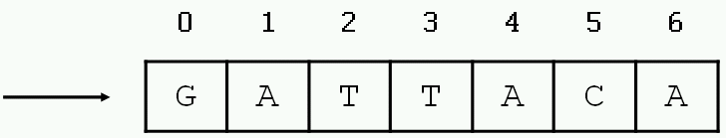
DEFINING STRINGS
Each string is stored in the computer’s memory as a list of characters.
>>> myString = “GATTACA”
myString

Slide 3
ACCESSING SINGLE CHARACTERS
You can access individual characters by using indices in square brackets.
>>> myString = “GATTACA”
>>> myString[0]
‘G’
>>> myString[1]
‘A’
>>> myString[-1]
‘A’
>>> myString[-2]
‘C’
>>> myString[7]
Traceback (most recent call last):
File "<stdin>", line 1, in ?
IndexError: string index out of range
Negative indices start at the end of the string and move left.

Slide 4
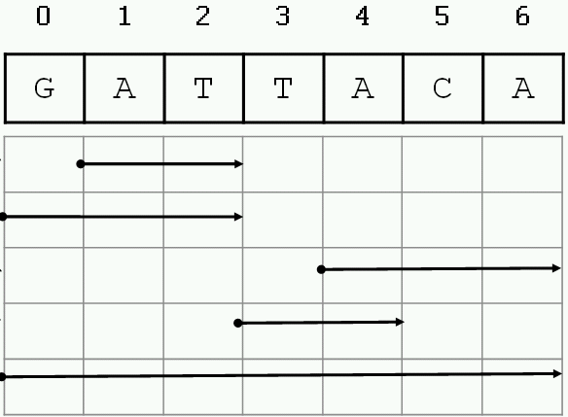
ACCESSING SUBSTRINGS
>>> myString = “GATTACA”
>>> myString[1:3]
‘AT’
>>> myString[:3]
‘GAT’
>>> myString[4:]
‘ACA’
>>> myString[3:5]
‘TA’
>>> myString[:]
‘GATTACA’

Slide 5
SPECIAL CHARACTERS
The backslash is used to introduce a special character.
>>> "He said, "Wow!""
File "<stdin>", line 1
"He said, "Wow!""
^
SyntaxError: invalid syntax
>>> "He said, 'Wow!'"
"He said, 'Wow!'"
>>> "He said, \"Wow!\""
'He said, "Wow!"'
Escape sequence | Meaning
\\ | Backslash
\’ | Single quote
\” | Double quote
\n | Newline
\t | Tab

Slide 6
MORE STRING FUNCTIONALITY
>>> len(“GATTACA”)
7
>>> “GAT” + “TACA”
‘GATTACA’
>>> “A” * 10
‘AAAAAAAAAA
>>> “GAT” in “GATTACA”
True
>>> “AGT” in “GATTACA”
False
Length
Concatenation
Repeat
Substring test

Slide 7
STRING METHODS
>>> "GATTACA".find("ATT")
1
>>> "GATTACA".count("T")
2
>>> "GATTACA".lower()
'gattaca'
>>> "gattaca".upper()
'GATTACA'
>>> "GATTACA".replace("G", "U")
'UATTACA‘
>>> "GATTACA".replace("C", "U")
'GATTAUA'
>>> "GATTACA".replace("AT", "**")
'G**TACA'
>>> "GATTACA".startswith("G")
True
>>> "GATTACA".startswith("g")
False

Slide 8
STRINGS ARE IMMUTABLE
Strings cannot be modified; instead, create a new one.
>>> s = "GATTACA"
>>> s[3] = "C"
Traceback (most recent call last):
File "<stdin>", line 1, in ?
TypeError: object doesn't support item assignment
>>> s = s[:3] + "C" + s[4:]
>>> s
'GATCACA'
>>> s = s.replace("G","U")
>>> s
'UATCACA'

Slide 9
STRINGS ARE IMMUTABLE
String methods do not modify the string; they return a new string.
>>> sequence = “ACGT”
>>> sequence.replace(“A”, “G”)
‘GCGT’
>>> print sequence
ACGT
>>> sequence = “ACGT”
>>> new_sequence = sequence.replace(“A”, “G”)
>>> print new_sequence
GCGT

Slide 10
STRING SUMMARY
Basic string operations:
S = "AATTGG" # assignment - or use single quotes ' '
s1 + s2 # concatenate
s2 * 3 # repeat string
s2[i] # index character at position 'i'
s2[x:y] # index a substring
len(S) # get length of string
int(S) # or use float(S) # turn a string into an integer or floating point decimal
Methods:
S.upper()
S.lower()
S.count(substring)
S.replace(old,new)
S.find(substring)
S.startswith(substring), S. endswith(substring)
Printing:
print (var1,var2,var3) # print multiple variables
print ("text",var1,"text“) # print a combination of explicit text (strings) and variables

