Slide 1
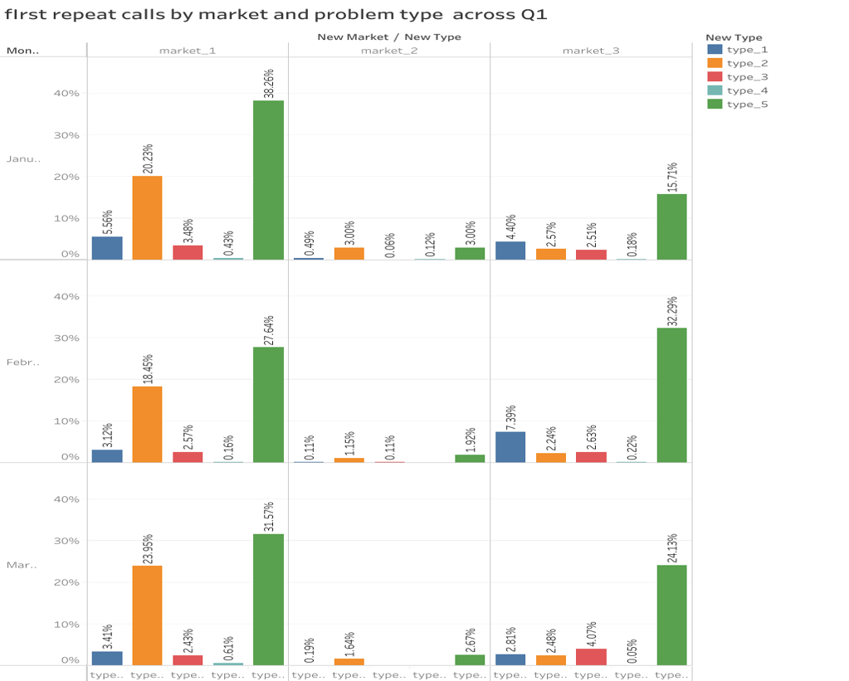
Google Fiber Project Executive Summary
Overview
The project involved analyzing a fictional dataset provided by the Google Fiber Customer Service team, covering customer service calls from January 2022 to March 2022.
The team’s ultimate goal is to communicate with the customers to reduce the call volume and increase customer satisfaction and improve operational optimization. Primary questions are:
How often are customers repeatedly contacting the customer service team?
What problem types generate the most repeat calls?
Which market city’s customer service team receives the most repeat calls?
The Problem
The Solution
reduced call volume by increasing customer satisfaction and improving operational optimization. Created a dashboard that demonstrate an understanding of the project’s goal and provide the stakeholders with insights about repeat caller volumes in different markets and the types of problems they represent.
Details
Keys to success
Understand how often customers are calling customer support after their first inquiry; this will help leaders understand how effectively the team is able to answer customer questions the first time.
Provide insights into the types of customer issues that seem to generate more repeat calls.
Design charts so that stakeholders can view trends by week, month, quarter, and year.
first repeat calls by market and problem type across Q1
Results Summary
The customer service team receives an average of 25% repeat calls within seven days of the initial contact, and Internet and Wi-Fi (Type5) and technician troubleshooting (Type2) issues account for 80.24% of repeat calls. In addition, Market1 generates the highest percentage of repeat calls, followed by market3 and market2.
Reflections/
Next Steps
Allocate more resources and staff to market_1 to address the higher volume of repeat calls.
Provide additional training and support for handling technician troubleshooting and internet and Wi-Fi issues..

