Slide 1

AVD.NET (Automated Websites Vulnerabilites Detector Using C# 2008)
Syrian International University for science & technology
Faculty of information engineering
تقديم :
مُـخـتـار سيـِّـــد صـالح
مـحمود الـحاج عـلـي
بإشراف :
د.وسام الخطيب

Slide 2
What is AVD.NET ?
AVD.NET is program which communicates with a website through the web front-end (web browser like) in order to identify potential security vulnerabilities in the website.
It performs a black-box test.
Unlike source code scanners, website scanners don't have access to the source code and therefore detect vulnerabilities by actually performing attacks.

Slide 3
Who will benefit from AVD.NET?
Web developers.
Web security staff.
Websites administrators.
White-Hat Hackers.

Slide 4
What is the special thing about AVD.NET ?
Similar projects are uncountable but all of them are espiciallized if one type of vulnerabilities.
the special thing about AVD.NET that it's developed from scratch to scan web application against “Most" types of vulnerabilities.
AVD.NET will be an open-source project for the first time in the Arabic world at least

Slide 5
AVD supported types of vulnerabilities
AVD.NET scans websites among these types of vulnerabilites :
Cross-Site Scripting (XSS):
The concept of XSS is to manipulate client-side markup (and scripts) of a website to execute in the manner desired by the malicious user.
SQL injection:
is the hacking technique which attempts to pass SQL commands (statements) through a website for execution by the backend database.
Remote File Inclusion (RFI) :
Allows the malicious user to download file without having the right to do that.

Slide 6
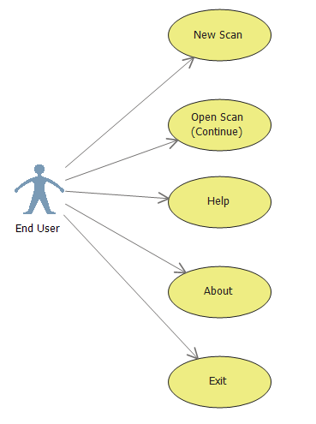
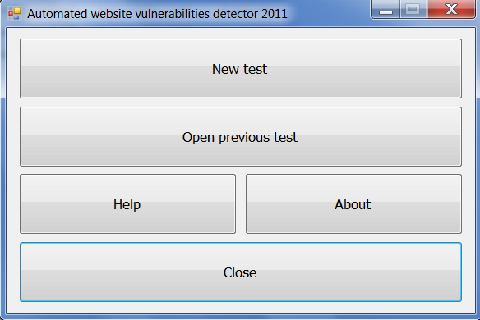
AVD.NET Usecase Diagram

Slide 7
AVD.NET Architecture
AVD.NET
Database
Web Crawler
AVD.NET
DBManager
WWW
(TargetSite)
HTML
Parser
XSS Attacker
SQL Injection Attacker
RFI Attacker

Slide 8
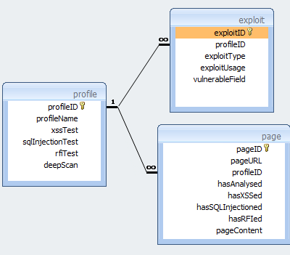
AVD.NET Database Diagram
We have choosen MS-Access in order to make AVD.NET a “portable” software Because MS-Access database is a “File” and does not need a DB server.
We make a “profile” for each test in order to allow AVD.NET users to “Pause” and “Continue” the scanning later and this is very important in the large websites.
We will save the vulnerable pages in the “exploit” table in order to offer some statistical information about the website to the user.

Slide 9
AVD.NET Database Diagram
We will save the website pages with its contents in the “page” table in order to analyse its content by the crawler for more links , in addition of offer website map to the user after a successfully crawling.

Slide 10
AVD.NET Web Crawler
AVD.NET WebCrawler use a special socket class in .NET framework (WebClient class) to fetch pages.
When AVD.NET WebCrawler fetch a page , the page is saved the it will be parsed by AVD.NET HTML Parser.
The parser will find every new link in the page and again the crawler will fetch it , save it , and pass it to the parser which will repeat the same steps for each page until.
Crawling finishes when there is no more “new” links to download.
WWW
Downloaded page markup
Downloader
HTML
Parser
Links with no content
Downloaded page content
AVD.NET
Database
Links with no content

Slide 11
AVD.NET Web HTML Parser
Our HTML Parser uses regular expressions to parse :
URLs and its query strings.
Forms and its input fields.
Our HTML Parser take care of :
Base elements <base>
Converting the relative urls into absolute urls.
Ignoring urls that refers to “external” pages.
Ignoring urls that refers to javascript functions or e-mail address or ... Etc.
WWW
Downloaded page markup
Downloader
HTML
Parser
Links with no content
Downloaded page content
AVD.NET
Database
Links with no content

Slide 12
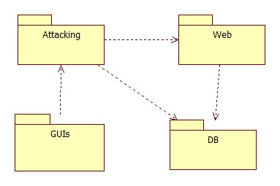
AVD.NET Packages diagram
We decided to split AVD.NET classes into 4 packages :
1 - GUIs : classes which renderd as the forms that the end-user will interact with.
2 - DB : classes which communicates with AVD.NET database directly , other packages will communicate with AVD.NET DB via this package classes.
3 - WEB : classes which communicates with the WWW directly such as crawler and indirectly like parser.

Slide 13
AVD.NET Packages diagram
4 - Attacking: classes which will do the real attacks , this package classes depends on WEB package classes.
On the next slides we will go inside each package of AVD.NET 4 packages.

Slide 14
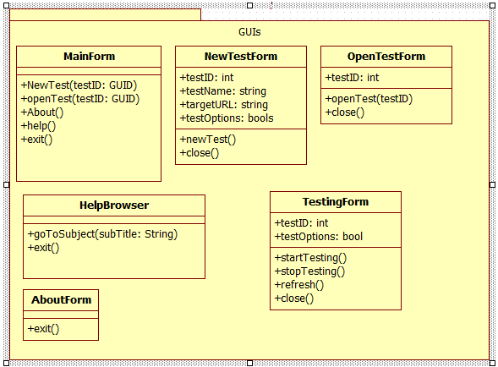
GUIs Package

Slide 15
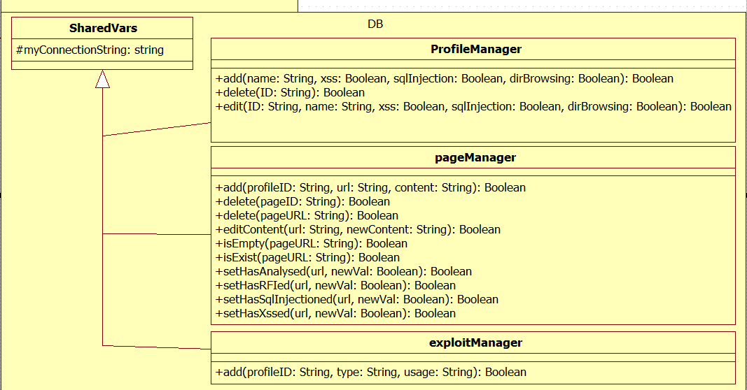
DB Package

Slide 16
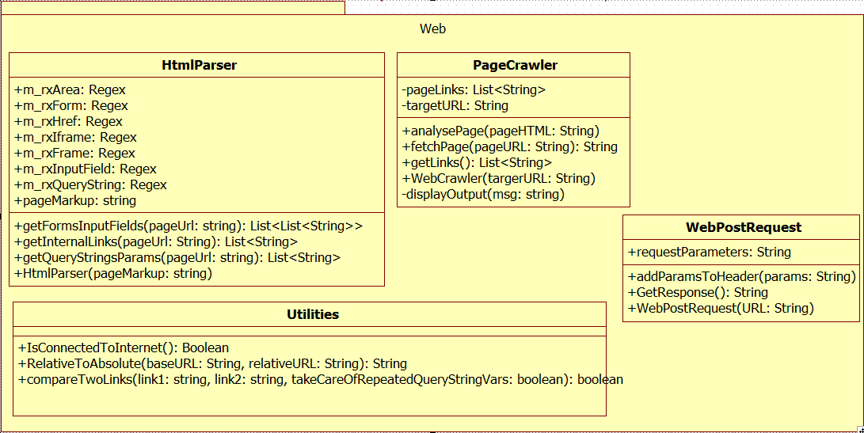
WEB Package

Slide 17
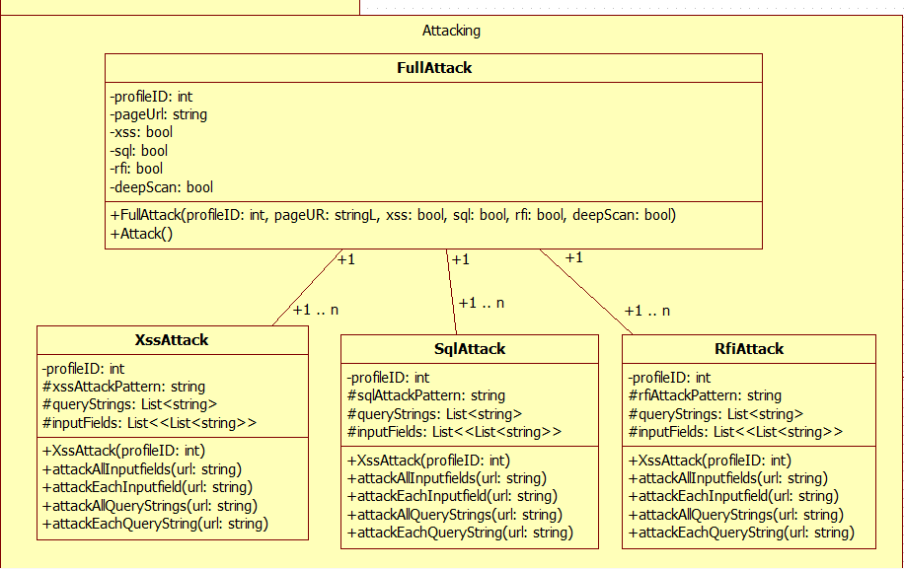
Attacking Package

Slide 18
AVD.NET Threading
AVD.NET scans each page through 3 scanning cycle steps :
A – fetch cycle :
AVD.NET crawler download the page markup.
B – analyse cycle :
AVD.NET parser parses the markup in order to find out its links , forms & input fields and its link qurey string parameters.
C – attack cycle :
Using the information which was produced by analyse cycle AVD.NET attacks the page.
Fetch cycle
Analyse cycle
Attack (Scan) cycle

Slide 19
AVD.NET Threading
AVD.NET use two threads as following :
1 – GUI thread : to displays scanning results simultaneously with the other thread.
2 – scanning thread : to perform the three cycles of scan in background.
Note :
If the user interrupt AVD.NET scan by click (stop) for example AVD.NET will NOT stop until it finishes the three cycles of the current page being attacked for the reasons of data consistancy.
Fetch cycle
Analyse cycle
Attack (Scan) cycle

Slide 20
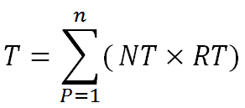
Scan modes – normal mode
AVD.NET offers two modes of scan:
Normal mode (default) : in this mode the scan will be done for the whole block of parameters at a time , that’s mean AVD.NET in this mode will try to attack all query strings patameters at the same time with the same malicios input , which will reflect at the end as “this page has this vulnerability” no matter where exactly the vulnerability is.
This mode is used when you need to perform a speed scan and the time of scan can be calculated by the equation :
Where :
n : number of profile (site) web pages.
NT : number of tests (xss only ? , xss and rfi ? , ... Etc).
RT : time for the web request to be done.

Slide 21
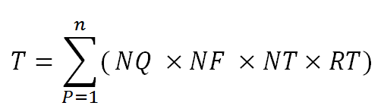
Scan modes – deep scan mode
AVD.NET offers two modes of scan:
Deep Scan mode : on the other hand , in “Deep Scan” mode the scan will be done for one parameter only at a time , meaning that you will know exactly which page parameter is vulnerable and which one is not.
This mode need more time because AVD.NET will send a new web request for each parameters meaning the final time for scanning T is equal :
Where :
n : number of profile (site) web pages.
NQ : number of page query strings parameters.
NF : number of page form input fields.
NT : number of tests (xss only ? , xss and rfi ? , ... Etc).
RT : time for the web request to be done.

Slide 22
Questions

