Slide 1

NLP
CAU | Toxic Challenge
Neural Mavericks
Munira Rakhmatova
Mukhtor Eshimov
Jasurbek Ergashev

Slide 2

Description of the task
What problem are we solving?
binary text classification of toxic tweets (0 or 1)
control harmful and offensive comments in online environment
main goal -> to build a model that can accurately identify toxic comments

Slide 3
Description of the task
What should we pay attention to first when making a decision?
Analyzing the training data
determining whether the dataset is balanced (equal distribution)
identifying outliers (numerical values or links in the dataset)

Slide 4
Description of the task
What nuances are there in the problem?
presence of cultural and regional variations
certain topics related to gender, religion, race, or physical and mental disabilities
if so, then we will have to include a diverse range of cultural perspectives and regional contexts in the training data

Slide 5
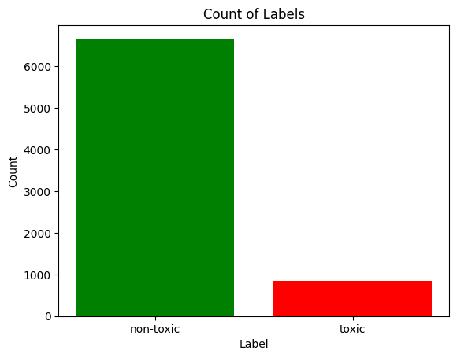
Data analysis
Distribution of train data labels

Slide 6
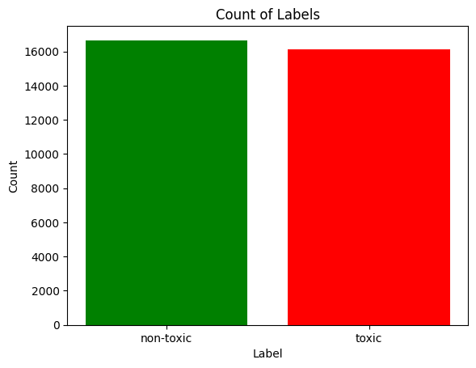
Data analysis
Get more than 15 000 toxic comments from external dataset
Get 10 000 non-toxic comments from external dataset

Slide 7
Text Cleaning
Lowercase
Expanding contradictions
Removing URLs
Removing special characters (symbols & emojis)
Removing HTML
Removing stop words

Slide 8
Solution
BERT
Transformer architecture
Pre-trained on a large corpus of text
Fine-tuning

Slide 9
Difficulties with BERT
Computationally expensive
Requires high-performance GPUs & substantial memory capacity
Accessibility is limited researchers and organizations with access to such resources

Slide 10
DistilBERT - distilled version of BERT
Smaller and more lightweight
Efficient in terms of memory usage and computational resources
Neural network model architecture based on DistilBERT
~ 90%

Slide 11
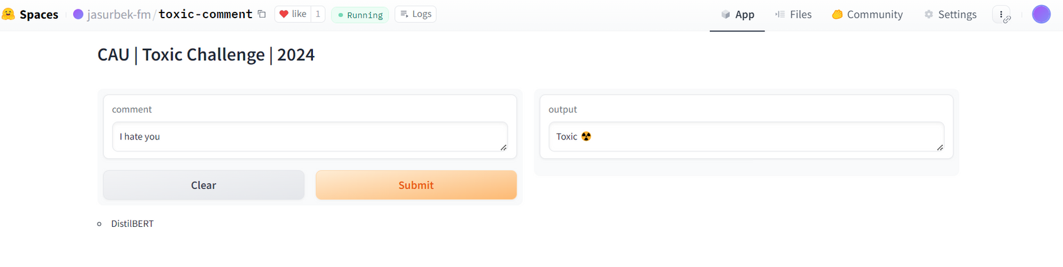
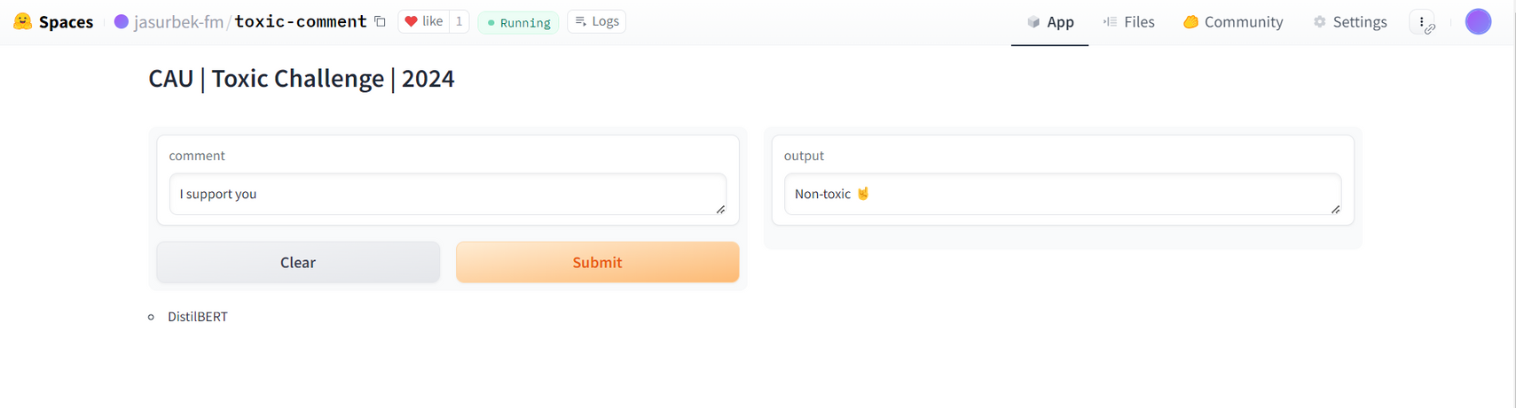
Model deployment
https://huggingface.co/spaces/jasurbek-fm/toxic-comment

Slide 12
Economic effect
What will be the economic effect of implementing such a model?
it can be integrated into the platform's moderation system:
Cost Savings (platforms can reduce the manual effort required for moderation)
Improved User Experience (creating a safer and more welcoming online environment - increased user engagement, retention, and potentially attract new users to the platform. )
Reduced risks (legally) - Preventing the spread of toxic content can help mitigate legal risks related to harmful speech and protect the platform's reputation.

Slide 13
Thank you

