Slide 1


Smart Helmet based Accident Detection and Notification System for Two-Wheeler Motor Cycles
B. Tech (ECE )
Done By:
MUKIL S (22BEC0480)
School of Electronics Engineering, Vellore Institute of Technology.

Slide 2
Outline:
Novelty of the work
Functional Block Diagrams
Implementation Detail
Development Status
Hardware/Software Details
Photos/Screenshots
Results
Timeline plans
References

Slide 3
Novelty of the work
1) HOLISTIC SAFETY SYSTEM
Unlike existing works that address only one feature such as accident detection or helmet enforcement, this project develops a single, integrated solution that combines helmet use verification, alcohol detection, navigation assistance, and accident response.
2) DUAL PRE-RIDE SAFETY ENFORCEMENT
Most studies focus on either helmet enforcement or alcohol detection.
This project is unique in making both checks mandatory before ignition, ensuring maximum rider safety right from the start.
3) ENHANCED EMERGENCY RESPONSE & NAVIGATION
The system not only detects accidents in real time and sends precise GPS-based alerts to emergency contacts, but also provides distraction-free navigation cues via helmet LEDs, improving both post-accident response and on-road safety.

Slide 4
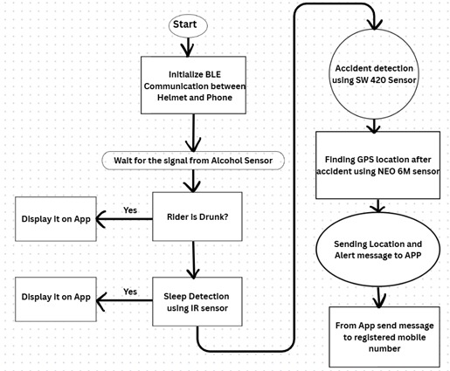
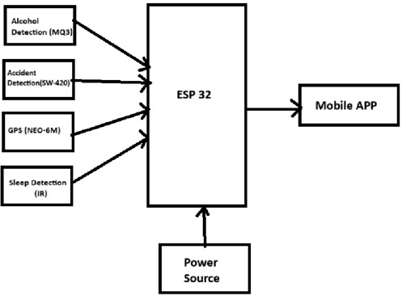
Functional Block Diagram:

Slide 5
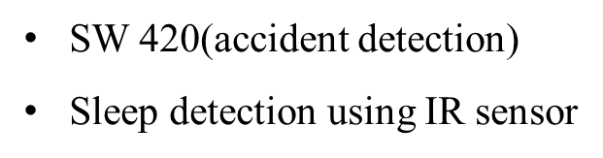
Implementation details
Components used:
ESP32-Microprocessor
Neo6m-Sensor (Finds Location of rider)
MQ3- Sensor (Alcohol detection)
Software Platforms:
Arduino IDE
Android studio

Slide 6
Development Status:
A prototype Smart Helmet has been developed using the ESP32 microcontroller, integrating alcohol detection, sleep detection, accident detection, and GPS tracking.
The MQ-3 sensor measures alcohol levels in the rider’s breath with dynamic threshold calibration for reliable detection under different conditions.
The eye blink sensor monitors the rider’s eye activity to detect drowsiness or sleep while riding.
The SW-420 vibration sensor detects sudden impacts or crashes, triggering accident alerts for emergency response.
When alcohol consumption or an accident is detected, the system generates alerts such as “DRUNK” or “ACCIDENT” and records the rider’s GPS location using the GPS module.
This setup supports real-time monitoring and location-based reporting to enhance rider safety and alerts the respected person with the coordinates of the accident location.
The prototype successfully demonstrates the core safety features of the Smart Helmet system.
Future improvements will include continuous monitoring, IoT/SMS-based alert transmission, and integration with an ignition interlock to prevent vehicle start under unsafe conditions.

Slide 7
Hardware/Software Details:
Hardware
ESP 32
MQ3(alcohol sensor)
SW 420(accident detection)
Sleep detection using IR sensor
Neo-6m(GPS coordinates)
Software
Arduino IDE
Android Studio

Slide 8
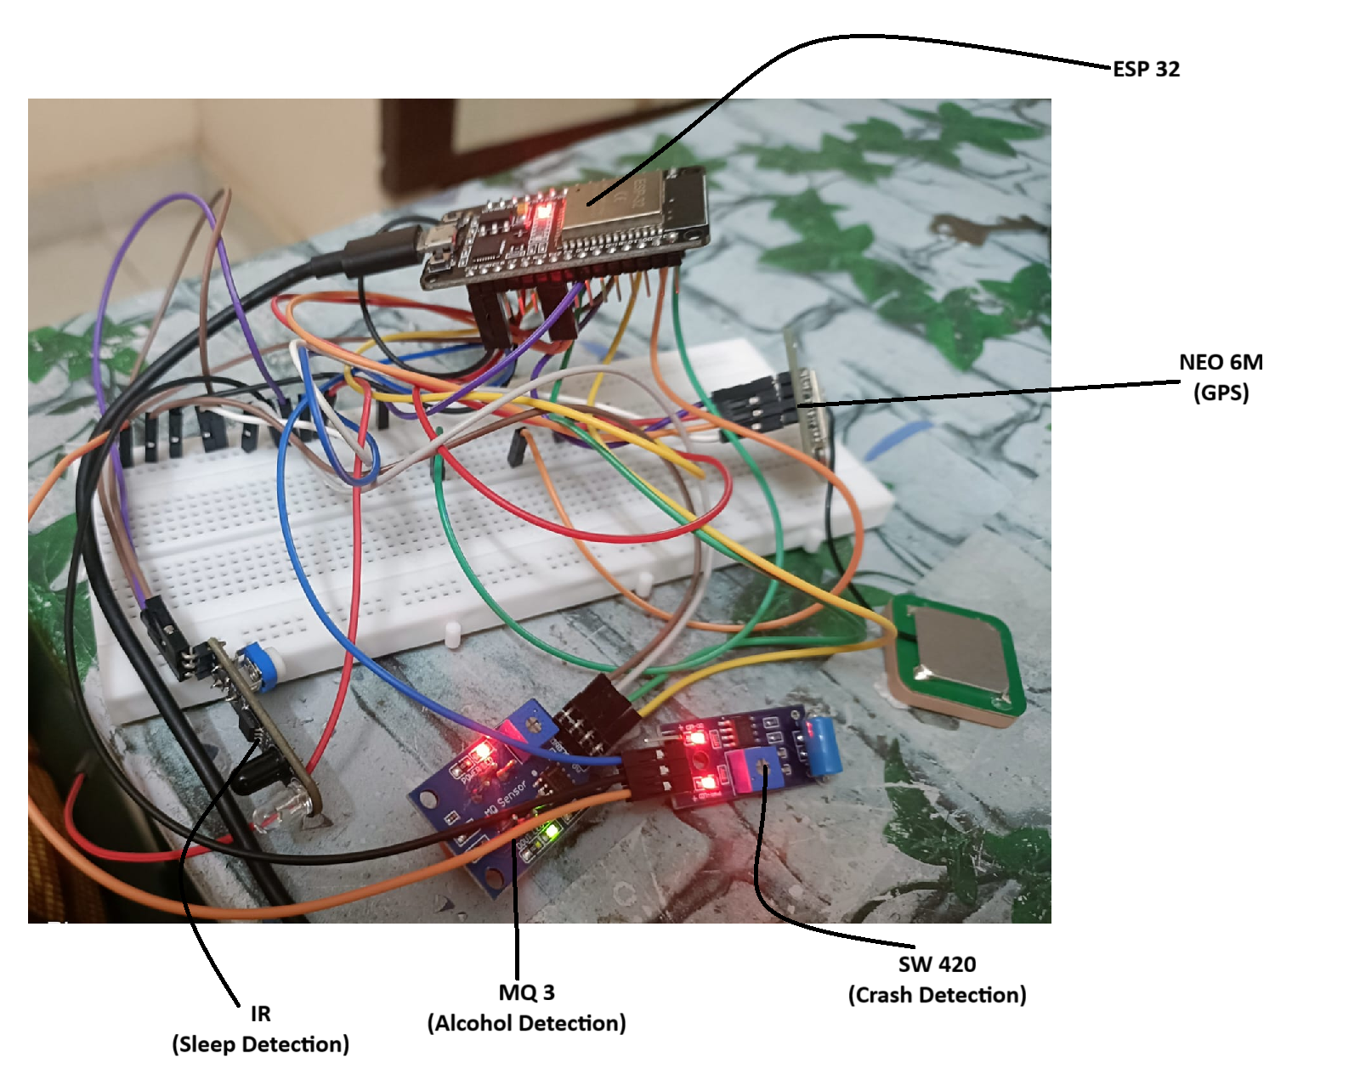
Photographs/Screenshots

Slide 9
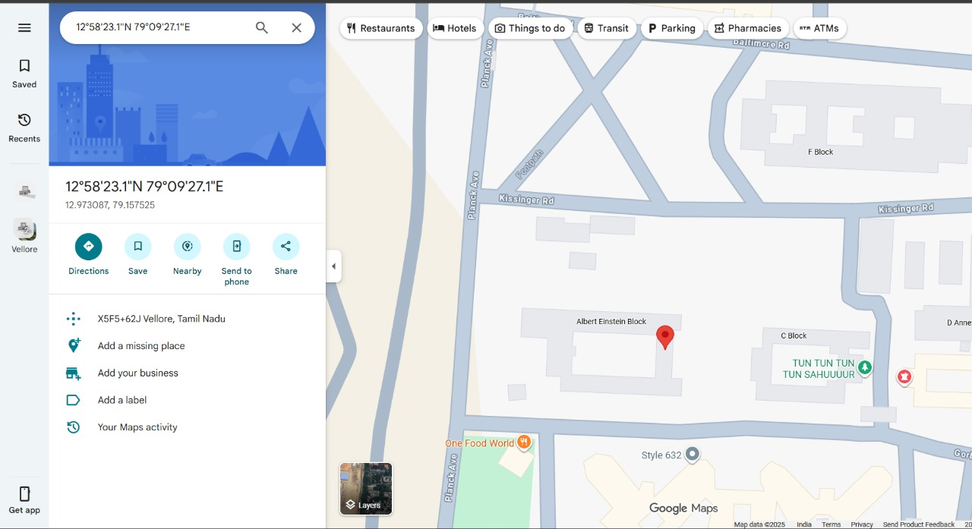
Photographs/Screenshots

Slide 10
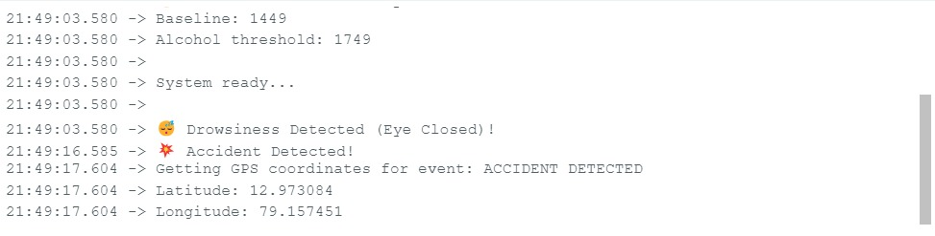
Results
Results

Slide 11
Timeline: (Mid July to Mid November)
S.No | Task Description | Time schedule of the progress
 |  | 1-4 Weeks | 5-8 Weeks | 9-12 Weeks | 13-16 Weeks
1 | Planning & Setup: Selected and tested MQ-3, SW-420, Eye Blink, GPS, and ESP32 modules
2 | Integration: Connected all sensors to ESP32 with alcohol detection and GPS tracking.
3 | Feature Expansion: Added sleep and accident detection with alert and location logging
4 | Testing & Upgrades: Tested prototype, improved accuracy, and planned IoT/SMS and ignition interlock features.
Note: The Timeline mentioned in this presentation can be customized based on the phases of your project.

Slide 12
References:
1. Alcantara, A. D. T., Balbuena, R. B. H., Catapang, V. B., Catchillar, J. P. M., De Leon, R. E. P., Sanone,
S. N. A., Juarizo, C. G., Sison, C. C., & Garcia, E. A. (2023). Internet of Things-Based Smart Helmet with
Accident Identification and Logistics Monitoring for Delivery Riders. Engineering Proceedings, 58(1), 58.
2. Azeez, B., Sathyan, D., Kathoon, A., Sebastian, R., Sunil, F., & Varughese, I. R. (2024). Integrated Smart Bike
Safety System with Accident Detection. International Journal of Engineering Research & Technology
(IJERT), 13(4), 1–4.
3. J., A., S., A., & Akkasali, K. (2018). Smart Helmet With Message Alert System. International Journal of
Engineering Research & Technology (IJERT), 7(13), 1–4.
4. Kiran Kumar, M., Balbudhe, A., & Karthikeya, C. S. (2023). Smart Helmet based Accident Detection and
Notification System for Two-Wheeler Motor Cycles. E3S Web of Conferences, 391, 01149.
5. Karthick, L., Stephen leon, J., Ravi, R., Michel, J., & Jagadish, C. A. (2021). Vehicle safety system for
two wheeler - A critical review. Materials Today: Proceedings.
6. Sasirekha, S., Paul, I. J. L., Swamynathan, S., Gokul, Y., & Kirthana, P. (2016). Smart Helmet with Emergency
Notification System-A Prototype. In 3rd International Conference on Wireless Communication and Sensor
Network (WCSN 2016) (pp. 209-214). Atlantis Press.
7. Chouhan, S. S., Kathuria, A., & Chalumuri, R. S. (2024). Powered two-wheeler riding behavior and strategies
to improve safety: A review. Journal of Traffic and Transportation Engineering (English Edition), 11(6),
1378-1400.
8. Pedapati, P. R. and Chidambaram, R. K., “A Review on Control Momentum Gyroscopic Stabilization for Intelligent Balance
Assistance in Electric Two-Wheeler,” Results in Engineering, vol. 26, p. 105069, Jun. 2025. doi:10.1016/j.rineng.2025.105069

Slide 13
Thank You

