Slide 1
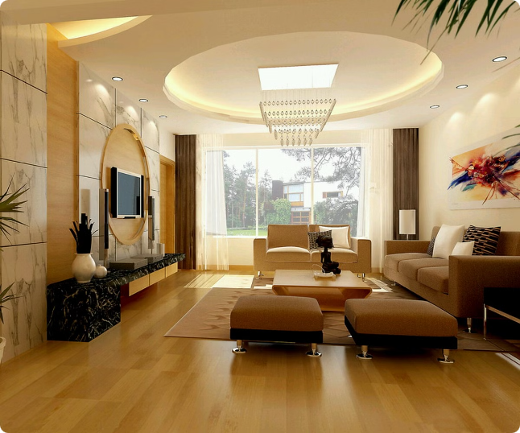
Livspace Analysis: A Deep Dive
Welcome to this presentation where we will explore a strategic analysis of Livspace, a leading online home design and renovation platform.
by Mukilarasan

Slide 2

Introduction to Livspace
Livspace is a leading online platform that offers end-to-end home design and renovation solutions. They provide a seamless experience for customers, from planning and design to execution and completion. Livspace operates in several major cities across India and Southeast Asia.
Services
Technology
Livspace offers a wide range of services, including interior design, home renovation, and furniture selection.
They leverage technology to simplify the home renovation process, offering virtual reality design tools, online project management, and customer support.
Partnerships
Livspace collaborates with a network of trusted designers, contractors, and material suppliers.

Slide 3
Porter's Five Forces Analysis of Livspace
Porter's Five Forces framework analyzes the competitive landscape of an industry. Livspace faces competition from traditional interior design firms, local contractors, and other online platforms.
Threat of New Entrants
Bargaining Power of Suppliers
Threat of Substitutes
The barrier to entry in the home renovation market is relatively high due to the need for specialized skills and infrastructure.
Livspace has a large network of suppliers, which gives them some bargaining power. However, they rely on these suppliers for materials and services.
Consumers can opt for DIY home renovations or hire individual contractors instead of using Livspace's services.

Slide 4
PESTLE Analysis for Livspace
PESTLE analysis is a tool used to analyze the macro-environmental factors that impact an organization. It stands for Political, Economic, Social, Technological, Legal, and Environmental factors. Here's a PESTLE analysis for Livspace:
1.Political
Government regulations related to construction, interior design, and real estate can impact Livspace’s operations. Changes in building codes, safety standards, and zoning laws can affect project timelines and costs.
2.Economic
Economic Growth: The overall economic health of the countries Livspace operates in influences consumer spending on home renovations and interior design.
Disposable Income: Higher disposable income levels can lead to increased spending on home improvement projects, benefiting Livspace.
Interest Rates: Fluctuations in interest rates affect the housing market, as higher rates can lead to reduced borrowing and spending on renovations.
Inflation Rates: Rising inflation can increase the costs of materials and labor, impacting Livspace’s pricing strategies and profit margins.

Slide 5
3. Social Factors
Demographic Changes: Changes in demographics, such as an aging population or urbanization, can influence demand for different types of interior design and renovation services.
Lifestyle Trends: Increasing interest in home improvement, DIY culture, and the desire for personalized living spaces drive demand for Livspace’s services.
Consumer Preferences: Shifts in consumer preferences towards eco-friendly and sustainable designs can influence Livspace’s service offerings and material choices.
4. Technological Factors
Digital Transformation: Advancements in digital tools and platforms enable Livspace to offer virtual consultations, 3D visualizations, and augmented reality experiences, enhancing customer engagement.

Slide 6
5. Legal Factors
Intellectual Property: Protecting design copyrights and patents is crucial in maintaining a competitive edge and preventing imitation by competitors.
Labor Laws: Compliance with labor laws and regulations, including fair wages, working conditions, and health and safety standards, is essential.
Contractual Obligations: Adherence to contractual obligations with clients and suppliers ensures legal compliance and builds trust.
6. Environmental Factors
Sustainability: Growing awareness and demand for sustainable and eco-friendly designs require Livspace to incorporate green practices and materials in their projects.
Waste Management: Efficient waste management practices during renovation projects are essential to minimize environmental impact.

Slide 7

SWOT Analysis of Livspace
A SWOT analysis identifies the internal strengths and weaknesses and external opportunities and threats of a business. Livspace has a strong brand reputation and a technology-driven approach, but they face competition from traditional players and potential market volatility.
Strengths
Weaknesses
Strong brand reputation, technology-driven platform, diverse service offerings, and a network of trusted partners.
Limited geographic reach in some regions, potential for operational challenges in managing complex projects, and reliance on a skilled workforce.
Opportunities
Threats
Expanding into new geographic markets, offering specialized services like smart home integration, and leveraging data analytics to personalize customer experiences.
Increased competition from traditional players and emerging online platforms, economic fluctuations, and potential regulatory changes.

Slide 8
The 3 C's Framework for Livspace
The 3 C's framework analyzes a business's customers, competitors, and company capabilities. Understanding the 3 C's is crucial for formulating effective strategies.
Customers
Livspace targets homeowners, including millennials, young professionals, and families, seeking modern and stylish home designs.
Competitors
Livspace faces competition from traditional interior design firms, local contractors, and other online platforms.
Company Capabilities
Livspace possesses a technology-driven platform, a skilled workforce, and a strong brand reputation.

Slide 9
Thank You
Thank you for your attention. I hope this presentation has provided
insights into applying strategic frameworks to analyze Livspace.

