Slide 1
PULSE LINK

Slide 2
INTRODUCTION
Pulse Link is an innovative health monitoring system.
It measures your heartbeat in real-time using smart sensors.
The data is sent to a web interface, allowing live monitoring.
Designed to enhance personal health tracking and remote healthcare

Slide 3
Objective
To develop a system that can:
Accurately measure heart rate in real-time.
Transmit data wirelessly to a live web dashboard.
Allow remote monitoring by doctors or family members.
Promote early detection of health issues

Slide 4
Working Principle
1. The pulse sensor captures analog heartbeats.
2. The microcontroller converts signals into digital data.
3. Data is transmitted to a web server via the internet.
4. The web interface updates in real time, showing pulse rate trends and alerts.

Slide 5
HARDWARE

Slide 6
Components
Pulse Sensor (e.g., Pulse Sensor Amped)
Detects heartbeat via changes in blood flow. Outputs analog voltage signal.
Microcontroller (ESP32 / NodeMCU / Arduino + ESP8266)
Reads sensor data and transmits it via Wi-Fi.
Power Source (5V/3.3V)
Powers the circuit. Could be USB or battery.
Resistors & Jumper Wires
For proper connections.
Breadboard / PCB
To build and test the circuit.

Slide 7
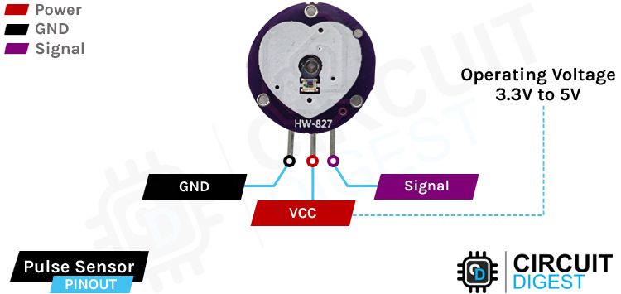
Parts of Pulse Sensor
VCC- It is the power supply pin of the sensor module.
GND - It is the ground pin of the sensor module.
Signal - It is the Analog Output Signal Pin of the sensor module.
At the front of the heartbeat sensor we have the photodiode and the IR Leds to detect the heartbeat.
VCC → 3.3V
GND → GND
Signal → A0 (Analog Pin of ESP32)

Slide 8
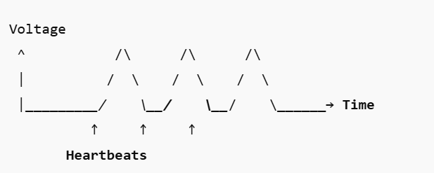
Working of Pulse Sensor
When your heart pumps blood:
Blood volume in your finger increases → more light is absorbed → less light reflected → signal drops.
Between beats → less blood volume → more light reflected → signal rises.
So the sensor produces a wave-like voltage output that looks like this:
Each peak in the waveform corresponds to one heartbeat, from which BPM (Beats Per Minute) is calculated.

Slide 9
WORKING OF A PULSE SENSOR

Slide 10
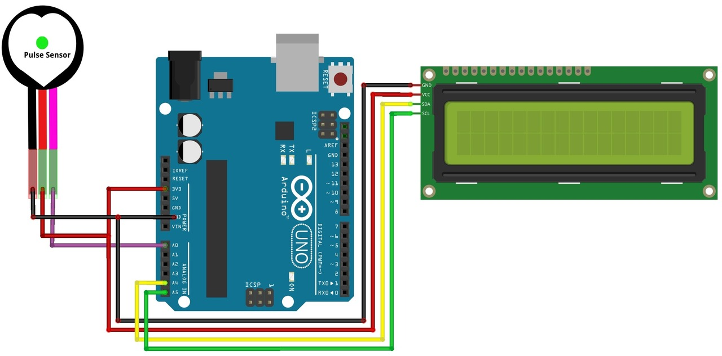
CIRCUIT DIAGRAM

Slide 11
How It All Comes Together
Pulse sensor generates analog signal → changing voltage based on blood flow.
ESP32 reads the analog values.
ESP32 detects the peaks (each beat).
ESP32 calculates BPM using timing between peaks.
BPM is then sent via Wi-Fi to your web dashboard for display.

Slide 12
SOFTWARE

Slide 13
Front-End Architecture
The PulseLink web interface forms the core of user interaction, built using modern web technologies like HTML, CSS, and JavaScript.
It provides a responsive, clean layout designed for real-time health monitoring.

Slide 14
Real-Time Data Handling
Heartbeat data from the microcontroller is sent to a web server.
The front end implements asynchronous communication—such as AJAX or WebSocket—to fetch data in real time.
This ensures a fast user experience with minimal delay between measurement and display.

Slide 15
Data Visualization
Incoming heartbeat readings are visualized on the webpage through dynamic graphs, charts, and updated numeric displays.
Graphical representation allows users to interpret their health data instantly and track changes over time.
The interface supports continuous live updates as new sensor data arrives.

Slide 16
User Experience and Accessibility
The layout is designed for accessibility, allowing seamless monitoring from PCs, tablets, or smartphones.
Emphasis on user-friendly controls and clear organization of information enables quick adoption—even for non-technical users.

Slide 17
Synchronization and Accuracy
The system uses robust data synchronization between backend and frontend, maintaining real-time accuracy.
Validation routines and error-handling mechanisms are in place—ensuring the reliability and correctness of displayed data.

Slide 18
Benefits & Advantages

Slide 19
Real-Time Heartbeat Monitoring
•Measures heartbeat continuously and displays real-time readings.
•Helps in immediate detection of irregular heartbeat patterns.
•Ensures users are aware of sudden cardiac fluctuations.

Slide 20
Remote Monitoring and Accessibility
•Data can be accessed through a live web interface from anywhere.
•Supports patient monitoring in remote or rural areas.
•Facilitates telemedicine and home-based healthcare.

Slide 21
Data Logging and Analysis
•Stores heartbeat data for long-term health tracking.
•Enables users to visualize heartbeat trends and patterns.
•Helps doctors analyze and make informed medical decisions.

Slide 22
Cost-Effective and Scalable Solution
•Uses low-cost components like pulse sensors and microcontrollers.
•Affordable for personal and institutional use.
•Can easily be scaled for multiple users or hospital setups.

Slide 23
User-Friendly Interface
•Simple and interactive dashboard to display health data.
•Clear graphs and visuals improve understanding of heartbeat patterns.
•Minimal setup and easy-to-use design for all age groups.

Slide 24
Real-Time Alerts and Notifications
•Triggers alerts when heartbeat crosses safe thresholds.
•Supports safety measures for patients with heart conditions.
•Improves response time in emergencies.

Slide 25
Integration with Other Health Systems
•Can be combined with SpO₂, temperature, and ECG sensors.
•Expands to a complete health monitoring ecosystem.
•Supports IoT-based healthcare research and innovation.

Slide 26
Applications of PulseLink
•Remote patient monitoring.
•Fitness and athletic performance tracking.
•Elderly care and post-surgery follow-ups.
•Health data collection for research purposes.

Slide 27
Conclusion
•PulseLink offers accurate and continuous heart monitoring.
•Enhances healthcare accessibility and user awareness.
•A smart, affordable step toward real-time digital health.

