Slide 1
Clipping

Slide 2
Clipping
Clipping is a process of dividing an object into visible and invisible portions and displaying the visible portion and discarding the invisible portion.
Types of Clipping:
Generally we have Clipping algorithm for the following primitive type:
Point Clipping
Line Clipping
Area Clipping (Polygon)
Curve Clipping
Text Clipping

Slide 3
Point Clipping
The Clip window is a rectangle to the standard position, we save a point P=(x,y) for display if the following inequalities are satisfied:
Where the edges of the clip window (xwmin ,xwmax) and (ywmin, ywmax), can be either the coordinate window boundaries. If any one of these four inequalities is not satisfied , the point is clipped.
xwmin<=x<=xwmax
ywmin<=y<=ywmax

Slide 4
ywmax
P( x, y)
ywmin
xwmin
xwmax
Figure: Point Clipping

Slide 5
Line Clipping
Line that do not intersect the clipping window are either completely inside the window or completely outside the window. In the case of line clipping , four different cases are possible.
p4
p9
p3
ywmax
p2
p10
p1
p6
Window
p7
p5
ywmin
p8
xwmin
xwmax

Slide 6
Line clipping
For the clipping procedure it is important to know whether an intersection point lies between or outside the two endpoints of the line segment.
All lines fall into one of the following clipping categories:
1. Visible(category 1):
y
ywmax
window
(x2,y2)
(x1,y1)
ywmin
xwmin
x
xwmax

Slide 7
Conti…..
2. Not Visible(Category 2):
(x2,y2)
y
window
(x1,y1)
ywmax
ywmin
xwmin
xwmax
x

Slide 8
Conti…..
3.Clipping Candidate:-When the line segment is in neither category1 nor 2and should be considered for clipping.
window
y
(x2,y2)
ywmax
(x1,y1)
ywmin
xwmin
x
xwmax

Slide 9
COHEN-SUTHERLAND LINE CLIPPING ALGORITHM
This algorithm divides a 2D space into 9parts,of which only the middle part is
visible.
Cohen- Sutherland subdivision line clipping algorithm was developed by Dan Cohen and lvan Sutherland.
Cohen Sutherland performs line clipping in two phases:
Phase1: Find visibility of line.
Phase2: clip the line falling in category 3 (candidate for Clipping).

Slide 10
COHEN-SUTHERLAND LINE CLIPPING ALGORITHM
Every line end point in a picture is assigned a four bit binary code, called a region code, that identify the location of the point relative to the boundaries of the clipping rectangle. Region are set up in reference as shown in figure:
Figure :Bit Code for Cohen- Sutherland clipping
LEFT
RIGHT
y
1010
1001
1000
ywmax
TOP
window
0001
0000
0010
ywmin
BOTTOM
0101
0100
0110
xwmin
xwmax
x

Slide 11
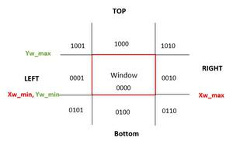
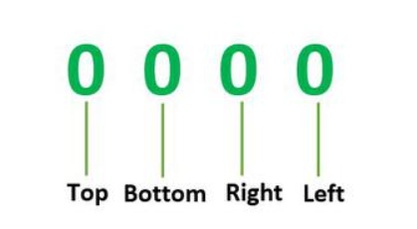
COHEN-SUTHERLAND LINE CLIPPING ALGORITHM
we are given 9 regions on the screen. Out of which one region is of the window and the rest 8 regions are around it given by 4 digit binary. The division of the regions are based on (x_max, y_max) and (x_min, y_min).
The central part is the viewing region or window, all the lines which lie within this region are completely visible. A region code is always assigned to the endpoints of the given line. This rule is also called TBRL code(Top-Bottom-Right-Left).

Slide 12
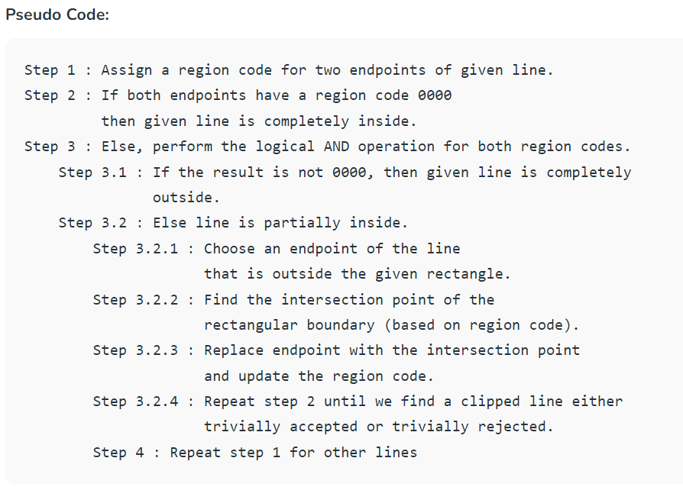

Slide 13
If the line is partially inside the window, then we find the intersection with the boundary of the window. By using the following formula:-
Slope:- m= (y2-y1)/(x2-x1)
a) If the line passes through top or the line intersects with the top boundary of the window.
x = x + (y_wmax – y)/m
y = y_wmax
b) If the line passes through the bottom or the line intersects with the bottom boundary of the window.
x = x + (y_wmin – y)/m
y = y_wmin
c) If the line passes through the left region or the line intersects with the left boundary of the window.
y = y+ (x_wmin – x)*m
x = x_wmin
d) If the line passes through the right region or the line intersects with the right boundary of the window.
y = y + (x_wmax -x)*m
x = x_wmax
Where (x,y) → endpoint that is outside the region

Slide 14
Input : Rectangular area of interest (Defined by below four values which are coordinates of bottom left and top right)
x_min = 4, y_min = 4, x_max = 10, y_max = 8
A set of lines
line 1 : x1 = 5, y1 = 5, x2 = 7, y2 = 7
Line 2 : x1 = 7, y1 = 9, x2 = 11, y2 = 4
Line 3 : x1 = 1, y1 = 5, x2 = 4, y2 = 1
Findout region code and check whether accepted or rejected.
Also findout intersection point

Slide 15
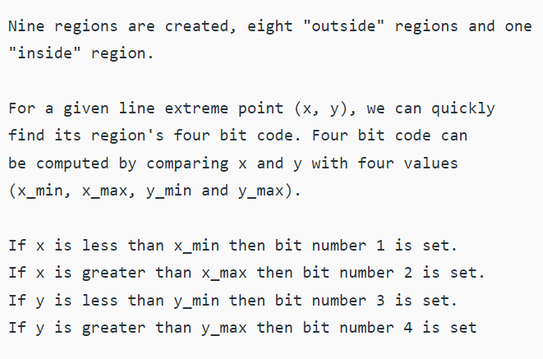
Bit1 →Left
Bit2→Right
Bit3→Bottom
Bit4→Top

Slide 16
Answer :
Line 1 : Accepted from (5, 5) to (7, 7)
Line 2 : Accepted from (7.8, 8) to (10, 5.25)
Line 3 : Rejected

Slide 17
COHEN-SUTHERLAND LINE CLIPPING ALGORITHM
Advantage and Disadvantages:
Will do unnecessary clipping.
Not the most efficient.
Clipping and testing are done in fixed order.
Easy to program.
Efficient when most of lines to be clipped are either rejected or accepted.

Slide 18
Intersection, Calculation and Clipping
Line that can not be identified as completely inside a clip window by these test are checked for intersection with the window boundaries.We begin the clipping process for a line by comparing an outside endpoint to a window boundary to determine how much of the line can be discard . Then the remaining part of the line is checked against the other boundaries,and we continue until either the line is totally discard or a section is found inside the window.We set up our algorithm to check line endpoints against clipping boundaries in the order left,right,bottom,top.
TO ilustrate the specific step in clipping line against rectangular boundary using the Cohen-Suterland algorithm,We show the linein figure could be processed.

Slide 19
Intersection Calculation and Clipping
Starting with the bottom endpoints of the line from p1 to p2, we check p1 against the left right bottom boundaries in turn and find that this point is below the window. We then find the intersection point p1’ with the window boundary and discard the line section from p1 to p1’.The line now be reduced to the section from p1’ to p2.
Since P2 is outside the clip window. We check these end points against the boundary. find that it is to the left of the window. Intersection point p2’ is calculated . But this point is outside the window. So the final intersection calculation is p2” and the line from P1’ to p2” is saved. This complete processing for these line . So we save this part and go on to the next line.
Point P3 is the next line is to the left of the clipping window, so we determine the intersection point P3 and eliminate the line from P3 to P3’.By checking region code for the line section from P3’ to P4. We find the remainder of the line is below the clip window and can be discarded also.

Slide 20
Intersection Calculation and Clipping
P2
LEFT
y
RIGHT
1001
P2’
1000
1010
ywmax
P2”
TOP
window
0000
0001
0010
ywmin
P1’
BOTTOM
P3
0100
0101
P3’
0110
P1
P4
x
xwmin
xwmax
Figure : lines extending from one coordinate region to another may pass through the
Clip window, or they may intersect clipping boundaries without entering the window.

Slide 21
Intersection and calculation clipping
Q.Intersection point with a clipping boundary can be calculated using the slope intersect for the line of equation.
X min=2,X max=8, y min=2 y max=8
EF:E(3,10) & F(6,12)
GH:G(4,1) &H (10,6)
Formula:
M=Y2-Y1/X2-X1
Xi=X1+1/m(Yi-Y1)
Where the x value is set to either Xmin or to a x max
Yi=Y1+m(Xi-X1)

Slide 22
Mid point subdivision algorithm
This method divide the line into three category:
Category 1: Visible line
Category 2: not visible line
Category 3: candidate for Clipping.
An alternative way to process a line in category 3 is based on binary search.The line is divided at its midpoints into two shorter line segments. Each line in a category three is divided again into shorter segments and categorized.This bisection and categorization process continue until each line segment that spans across a window boundary reaches a threshold for line size and all other segments are either in a category 1 (visible) or in category 2 (Not visible.)

Slide 23
Mid-point subdivision algorithm
The mid points coordinates are (x m, y m) of a line joining the points(X1,Y1)and (X2,Y2) are given by:
X m= X1+X2/2 and
Y M= Y1+Y2/2
Q
I2
3
4
2
1
I1
5
8
7
6
P
Figure: illustrates how midpoint subdivision is used to zoom in onto the two Intersection points I1 and I2 with 10 bisection.

Slide 24
Comparison b/w Cohen-Sutherland and Mid-point subdivision clipping Algorithm
Midpoint subdivision algorithm is a special case of Cohen-sutherland algorithm,
where the intersection is not computed by equation solving. It is computed by a
midpoint approximation method, which is suitable for hardware and it is very
fast and efficient.
The maximum time is consume in the clipping process is to do intersection calculation
with the window boundaries.
The Cohen-sutherland algorithm reduces these calculation by first discarding that lines
those can be trivially accepted or rejected.

Slide 25
Polygon Clipping
The simplest curve is a line segment or simply a line. A sequence of line where the following line starts where the previous one ends is called a polyline. If the last line segment of the polyline ends where the first line segment started, the polyline is called a polygon. A polygon is defined by n number of sides in the polygon. We can divide polygon into two classes.
A convex polygon is a polygon such that for any two points inside the polygon , all the point of the line segment connecting them are also inside the polygon. A triangle is always a convex one.
Polygon
Convex Polygon
Concave
Polygon
Q
P

Slide 26
Conti…
A Concave polygon is one which is not convex.. A polygon is said to be a concave if the line joining any two interior points of the polygon does not lies completely inside the polygon.
There are four possible cases when processes vertices in sequence around the parameter of the polygon. As each pair of adjacent polygon vertices is passed to a window boundary clipper. We make the following test.
P
Q

Slide 27
Conti…
Case 1: If the first vertex is outside the window boundary and second vertex is inside the window boundary then both the intersection point of a polygon edge with the window boundary and second vertex are added to the output vertex list.
Case 2: If both input vertices are inside the window boundary. Only the second vertex is added to the Vertex list
Case3: If the first vertex is inside the window boundary and the second vertex is outside the window boundary then only the edge intersection with the window boundary is added to the output vertex list.
Case 4: If both the input vertices are outside the window boundary then nothing is save to the output list.

Slide 28
SUTHERLAND AND HODGEMAN ALGORITHM(Polygon clipping)
Polygon clipping is a process of clipping a polygon by considering the edge of that as different line segments. If a polygon is clipped against a rectangular window then it is possible that we get various unconnected edges of a polygon. To get a closed polygon of unconnected edges we connect theses edges along the side of a clipping window to form a closed polygon.
The Sutherland –Hodgeman polygon clipping algorithm clips polygon against convex clipping windows. The Sutherland Hodgeman Polygon clipping algorithm may produce connecting lines that were not in the original polygon. When the subject polygon is concave theses connecting lines may be undesirable artifacts.
There are four situation to save vertices in output vertex list.

Slide 29
Conti……
1. If the first vertex is outside the window boundary and second vertex is inside the window boundary then both the intersection point of a polygon edge with the window boundary and second vertex are added to the output vertex list.Ex:save v1’,v2.
POLYGON
WINDOW(W)
2. If both input vertices are inside the window boundary. Only the second vertex is added to the Vertex list
POLYGON
WINDOW(w)
V1
V1’
V2
V1
V2

Slide 30
Cont…..
3. If the first vertex is inside the window boundary and the second vertex is outside the window boundary then only the edge intersection with the window boundary is added to the output vertex list.Ex: v1’, v1.
POLYGON
WINDOW(W)
4. If both the input vertices are outside the window boundary then nothing is save to the output list.
POLYGON
WINDOW(W)
V1
V1’
V2
V2
V1
’

Slide 31
Weiler-Atherton Polygon Clipping
The Weiler- Atherton Algorithm is capable of clipping a concave polygon and in the case the vertex processing procedure for window boundaries are modified so that concave polygon are displayed correctly. The polygon to be clipped is called the Subject Polygon (SP) and the clipping region is called Clip Polygon(CP).The new boundary creating by clipping the SP against the Cp are identical to portion of the CP. No new edge are created. Hence the number of resulting polygon are minimized.
The basic idea in the algorithm is that instead of always proceeding around the polygon edges are vertices are processed, We sometime want to follow the window boundaries . Which path we follow depends on the polygon processing direction(Clock wise or counterclockwise)We have the following rule for this:
For an outside to inside pair of vertices, follow the polygon boundary.
For an inside to outside pair of vertices, follow the window boundary in the clock wise direction.

Slide 32
Let us start with an arbitrary vertex of the subject polygon and trace around its border in the clockwise direction until an intersection with the clip polygon is in countered.
Determine the intersection of the subject and clip polygon :- If the edge enters the clip polygon , record the intersection point and continue to trace the subject polygon.
Process nonintersecting polygon borders:-Establish two holding list : one for boundaries which lies inside the clip polygon and one for boundaries which lies outside the subject polygon.
Create Two Intersection Vertex List:- One the entering list , contain only the intersection for the subject polygon edge entering the inside of the clip region. The other the leaving list contain only the intersection for the subject polygon edge leaving the inside of the subject polygon edge leaving the inside of the clip polygon. The intersection type will alternate inside the boundary. Thus only one determination is required for each pair of intersection.

Slide 33
10
13
11
12
9
1
5
6
7
8
4
2
3
(a) Clip polygon
5
8
6
7
2
4
3
(b) Clipped polygon
Figure: Weiler-Atherton Polygon Clipping Process.

Slide 34
Curve Clipping
Curve clipping procedure will invoke nonlinear equation.
The boundary rectangle for a circle or other curved object can be used first to test for overlap with a rectangular boundary window. If the bounding rectangle for the object is completely inside the window , we save the object. If the rectangle is determined to be completely outside the window , we discard the object.

Slide 35
Text Clipping
Text clipping can be of two types:
All or none string -clipping : In this clipping if all the string is inside a clip window, we keep it. Otherwise, the string is discarded.
window
STRING1
STRING2
Before Clipping
Figure: text clipping using bounding about the entire string.

Slide 36
Text Clipping
2. All or none character -clipping: in this clipping we discard only those characters that are not completely inside the window
Before Clipping After Clipping
window
STRING2
window
STRING1
STR
ING1
STRING1
STRING4
TRING1
STRING4
Figure: Discard only those characters that are not complete inside the window.

Slide 37
Exterior clipping
In exterior clipping, the picture parts are to be saved are those that are outside the region. This is referred to as exterior clipping.
Applications
Multiple window systems
The design of page layouts in advertising or publishing.
Adding labels or design patterns to a picture

Slide 38
V2
P2
V1
P1
V3
V5
window
V2
(a)
V4
P2’
P2
V1
P1’
V3
P1
V1
(b) Interior Clipping
V4
P2’
P2’’
P1’
V5
(c) Exterior Clipping
V4

Slide 39
Thank YOU………….

