Slide 1
ML · #11
Predicting Metabolic Cost
During Human-in-the-Loop Optimisation
Replacing a slow, lab-only face-mask measurement with wearable EMG and gait sensors, for exoskeletons that tune themselves outside the lab
Team: Mukil Skanda A (PES1UG24CS281) · Likhith M (PES1UG24CS282)
UE24CS352A Machine Learning · Mini-Project Review · October 2026
Notes:
Introduce the team. One line: we predict how much energy a person burns while walking in an exoskeleton, from sensors they could wear anywhere, instead of from a lab-only breathing mask.

Slide 2
THE PROBLEM
Exoskeleton tuning is bottlenecked by a breathing mask
CMA-ES optimiser
Exoskeleton
Human walks
Metabolic cost
proposes new torque profile
applies it for 2 min
body adapts
measured via face mask
↻ repeated 36× per 72-min session, feedback = metabolic cost
~1 min
≈ 5 %
Lab only
to settle after every change in control law, so it is slow feedback
irreducible noise in the measurement (MSE floor ≈ 0.0025)
needs a face mask, a metabolic cart and fasting subjects
Our goal: learn f(EMG, gait, controls) → metabolic cost so the mask can eventually be replaced by sensors a person could wear anywhere.
MetaCost · Predicting metabolic cost during HILO
2
Notes:
Explain HILO: CMA-ES proposes a torque profile every 2 min and keeps those with the lowest metabolic cost (Zhang et al., Science 2017). Metabolic cost comes from a mask (indirect calorimetry): slow, noisy, lab-only. If we can predict it from wearable signals, HILO becomes faster and portable.

Slide 3
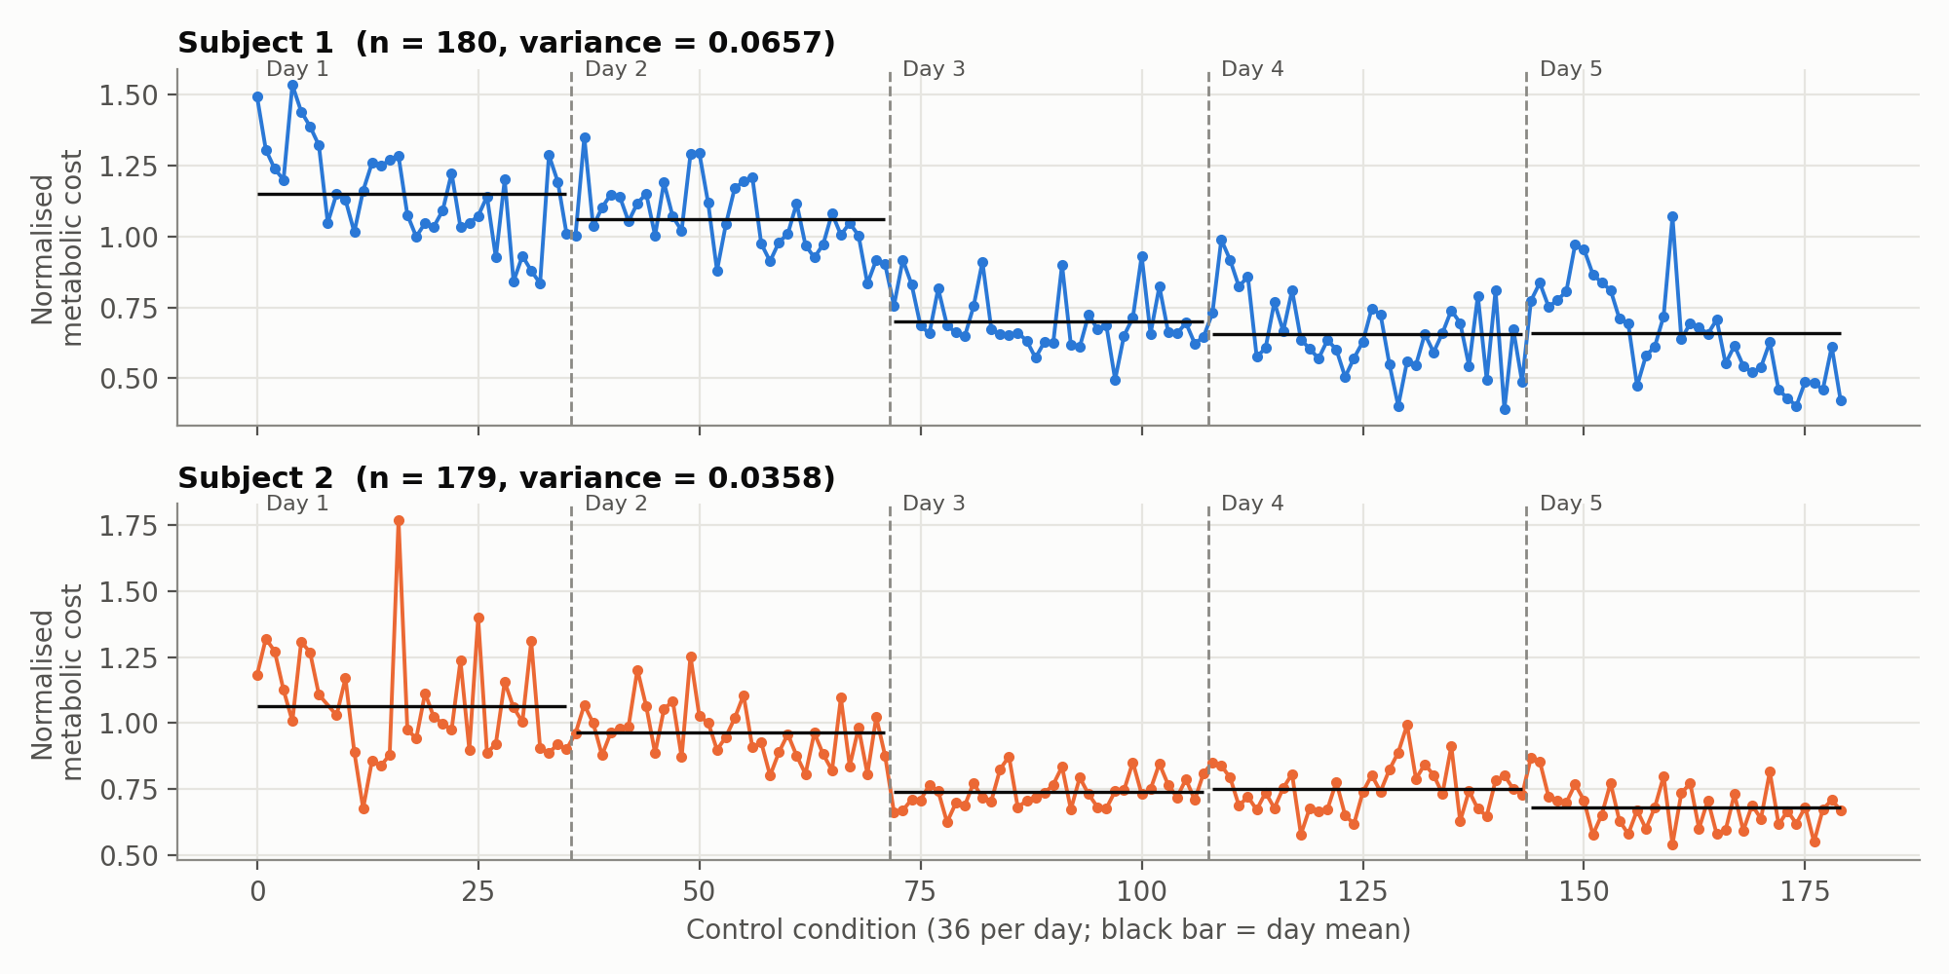
DATASET
Real lab data: 2 people, 5 days, 36 assistance conditions per day
359
29
0.0025
samples
(180 + 179)
features per
sample
noise-floor
MSE
16 EMG
8 muscles per leg; band-pass → rectify → RMS, normalised each day
9 Step / gait
peak ground force, ankle dorsi/plantar-flexion, step time, step width
4 Control
exo torque profile: peak torque, peak time, rise time, fall time
1 Target
metabolic rate - standing baseline, ÷ normal walking (1.0 = no exo)
MetaCost · Predicting metabolic cost during HILO
3
Notes:
Data from the Stanford Biomechatronics Lab HILO study, as released with the CS229 paper we were given. Each row is the last 30 s of a 2-min condition. One Subject-2 row had a negative (impossible) metabolic rate and is removed, as in the original. Point at the plot: cost drops ~40% across days because the user learns to walk with the exo. The data are non-stationary, which matters later.

Slide 4
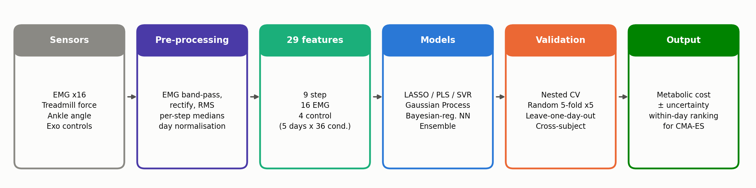
METHODOLOGY
End-to-end pipeline
1
Leakage-free
2
Two protocols
3
Two layers
Scaling and every hyper-parameter search happen inside training folds (nested CV). The paper tuned λ on its test folds.
Random 5-fold ×5 (the paper's, for comparison) and leave-one-day-out (predict a whole new session, the realistic case).
A faithful 1:1 Python port of the paper's MATLAB scripts (baseline), plus the extended study: 12 experiments, 16 figures, 10 unit tests.
MetaCost · Predicting metabolic cost during HILO
4
Notes:
Walk through left to right. Pre-processing was done by the lab: EMG filtering and day normalisation. Our contribution starts at the feature matrix: a leakage-free model zoo, two validation protocols and analyses aimed at what the optimiser actually needs.

Slide 5
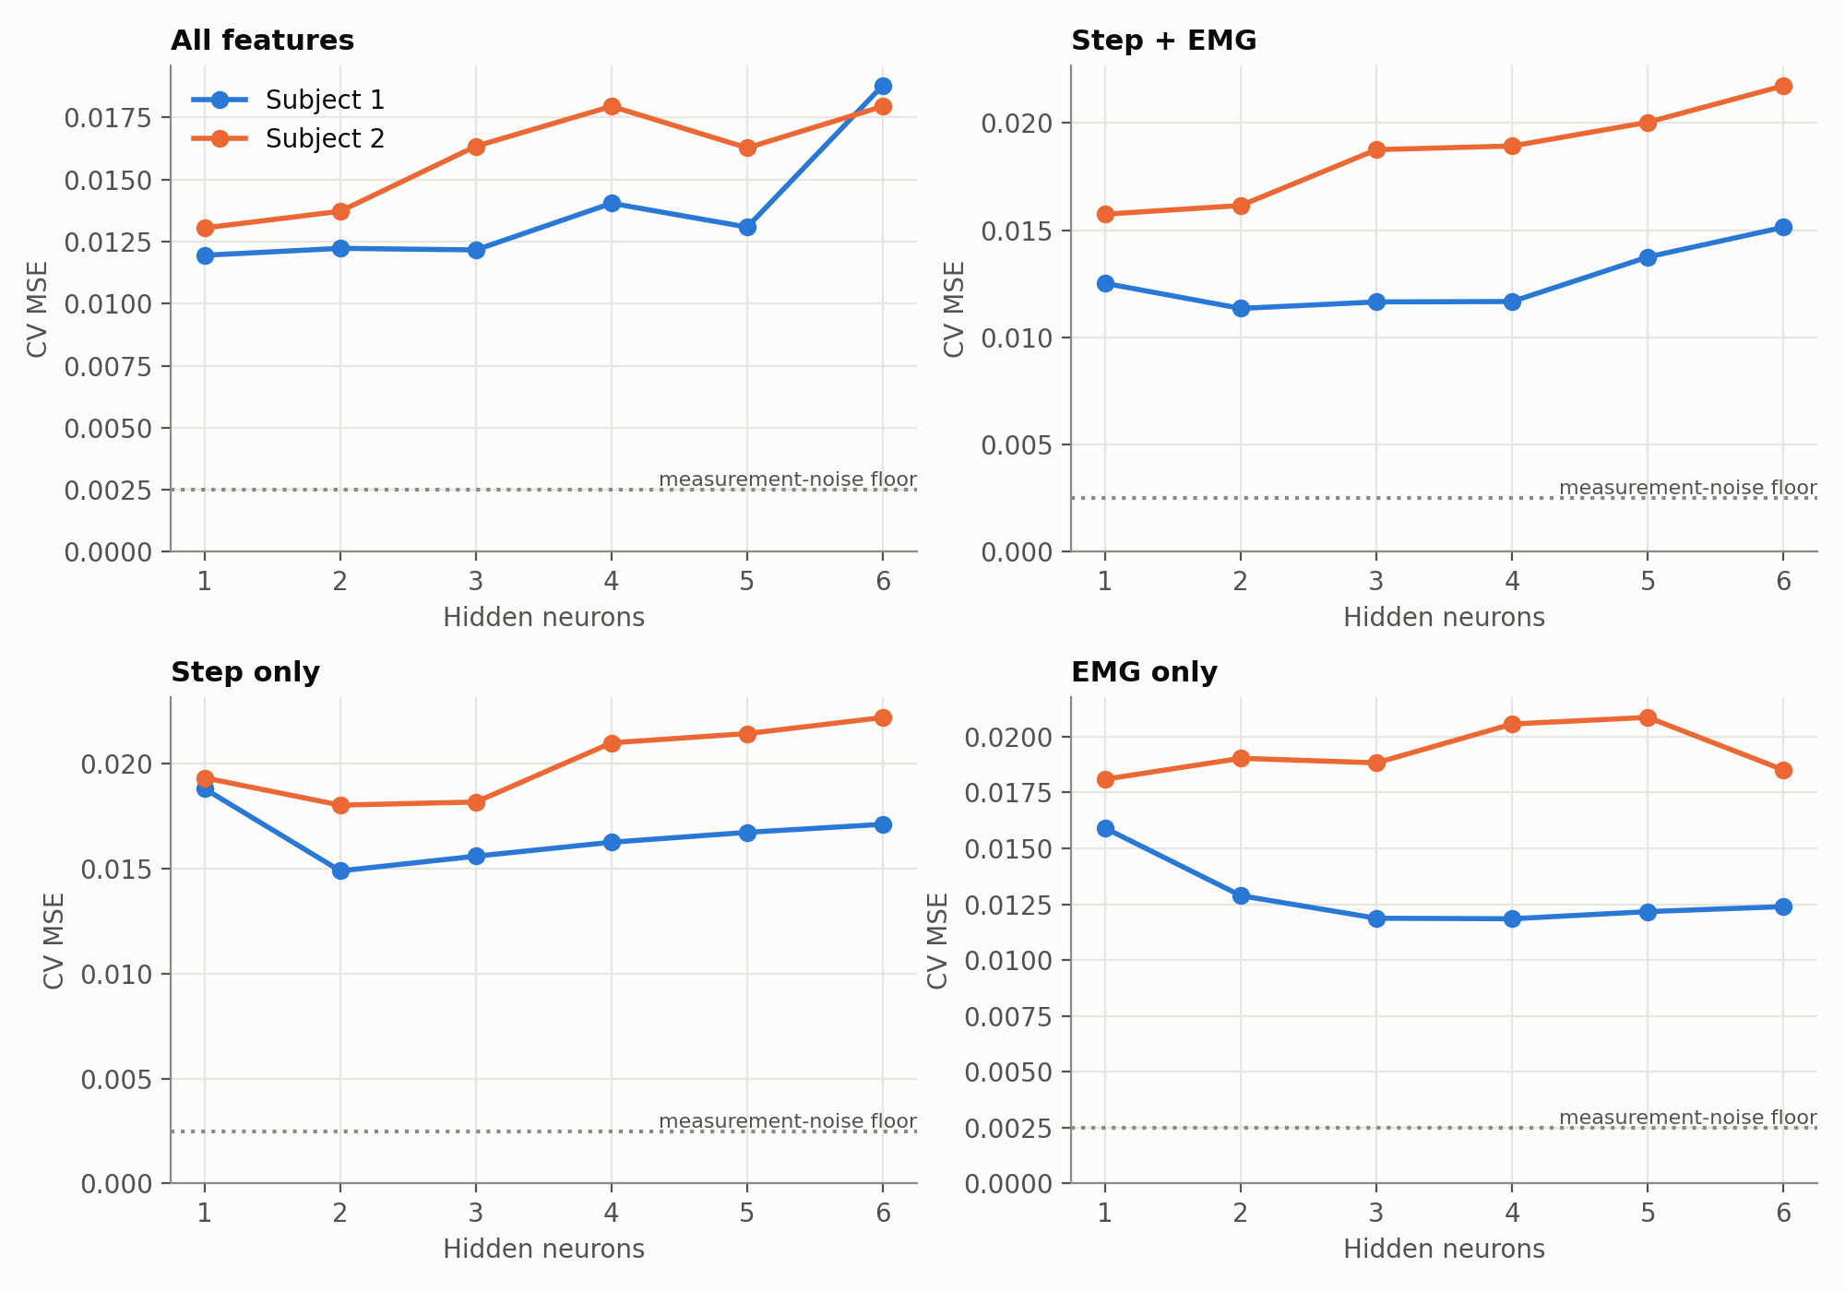
MODELS
13 models, including the paper's network rebuilt from scratch
Linear
OLS · LASSO · Ridge · Elastic Net · PLS
Kernel / instance
SVR (RBF) · kNN · Gaussian Process
Trees
Random Forest · Extra Trees · Gradient Boosting
Neural
Bayesian-regularised NN (trainbr)
Ensemble
average of GP + SVR + LASSO + Extra Trees
Bayesian-regularised NN, from scratch
F(w) = β·E_D + α·E_W
γ = P − α·tr(H⁻¹), α = γ / 2E_W, β = (N − γ) / 2E_D
Levenberg-Marquardt · closed-form Jacobian · picks 1-2 neurons
MetaCost · Predicting metabolic cost during HILO
5
Notes:
The paper used MATLAB trainbr. We re-implemented it in NumPy: Levenberg-Marquardt steps plus MacKay's evidence updates for alpha, beta and gamma, so regularisation is learned from the training data with no validation split. The Jacobian is closed form and unit-tested against finite differences. The neuron sweep (right) reproduces the paper's Fig. 1: 1-2 neurons are best. The Gaussian Process adds calibrated uncertainty.

Slide 6
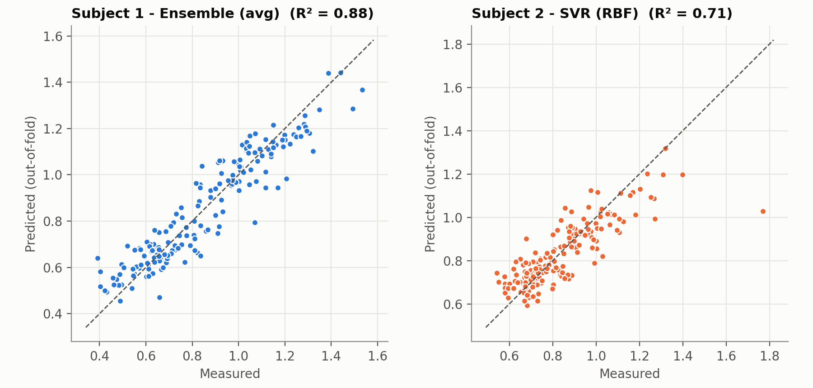
RESULTS
We beat the original study on both subjects
0.0079
−11 %
Subject 1 MSE (ours)
paper: 0.0089
error vs paper
on Subject 1
0.0109
−35 %
Subject 2 MSE (ours)
paper: 0.0168
error vs paper
on Subject 2
R² = 0.88 / 0.71
variance explained (S1 / S2), out-of-fold
MetaCost · Predicting metabolic cost during HILO
6
Notes:
Same protocol as the paper: random 5-fold CV, repeated 5 times and properly nested. S1: 0.0079 vs 0.0089 (11% lower). S2: 0.0109 vs 0.0168 (35% lower). In plain terms, about 9-10% error relative to normal-walking cost, versus 19-26% for predicting the mean. The noise floor is 0.0025, so headroom remains.

Slide 7
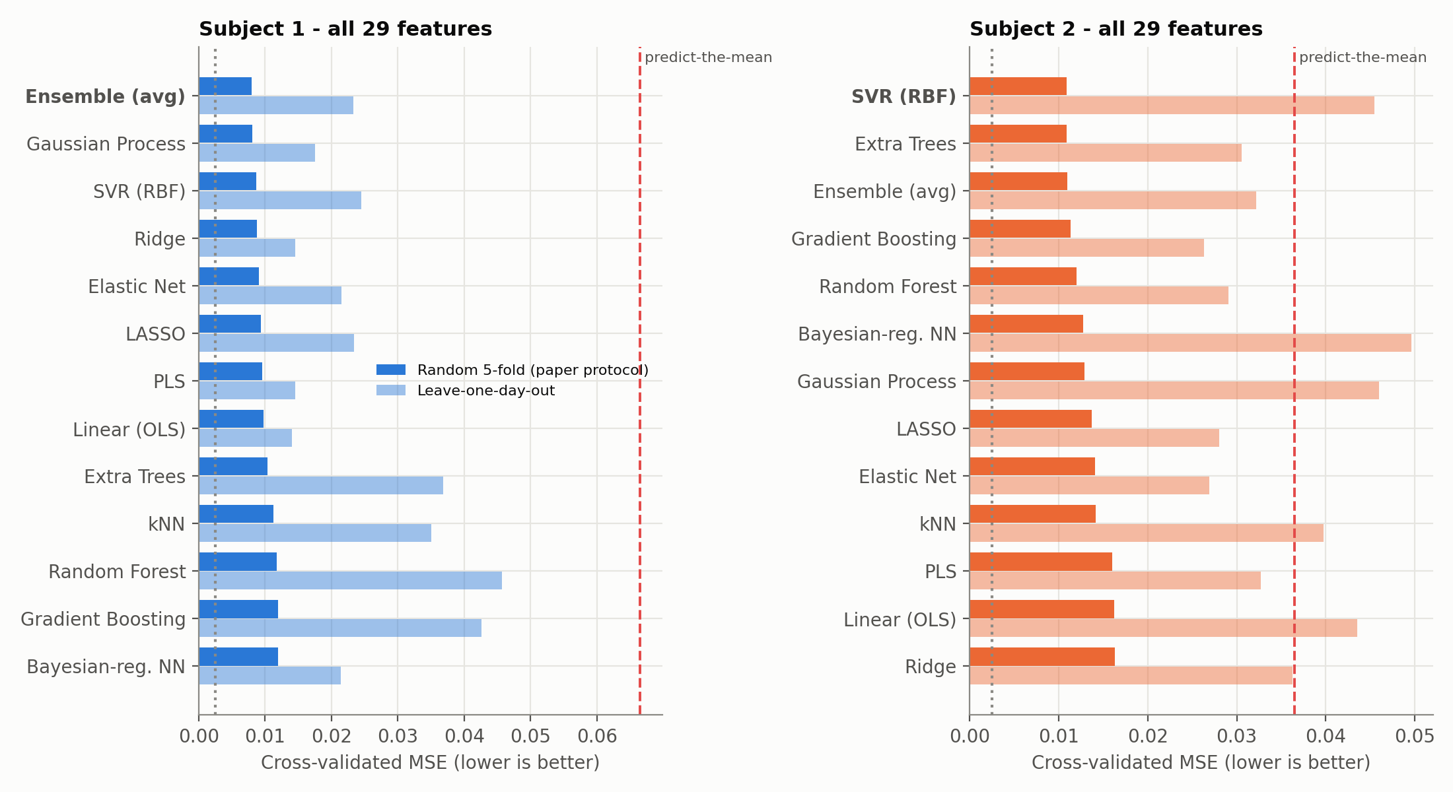
RESULTS · VALIDATION
Random splits flatter models: unseen days are the real test
▸ Random CV: GP, SVR and the ensemble lead (MSE ≈ 0.008-0.011)
▸ Unseen day: error roughly doubles
▸ Simple wins across days: PLS / Ridge reach 0.0145 on S1
▸ Trees & kNN overfit within-day structure
▸ Lesson: report the protocol that matches deployment
MetaCost · Predicting metabolic cost during HILO
7
Notes:
Dark bars use the paper's protocol; light bars use leave-one-day-out. Every model gets worse on an unseen day: neighbouring conditions from the same day leak information under random splits. For S1, heavily regularised linear models (OLS/PLS/Ridge) generalise best across days, while trees and kNN overfit. For S2, several models are worse than the mean on unseen days.

Slide 8
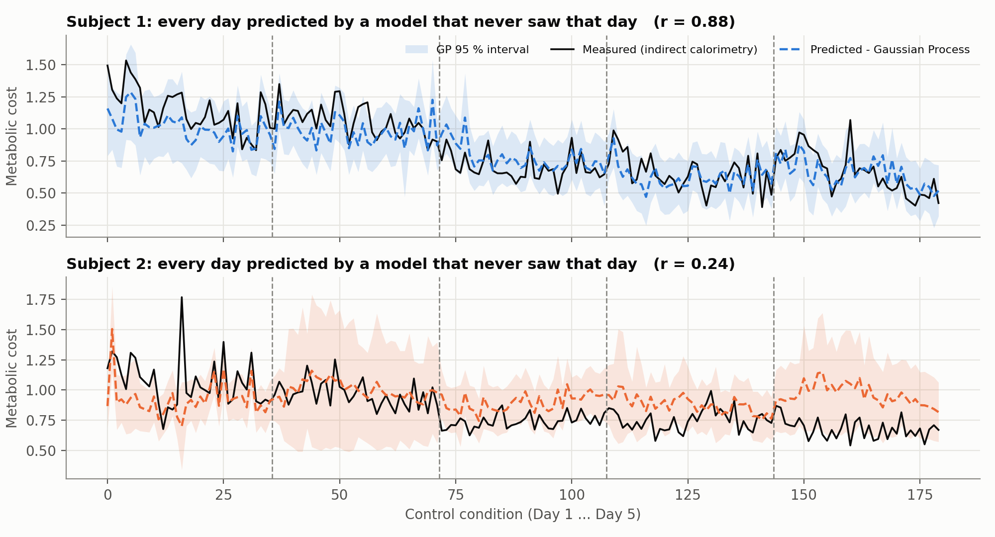
RESULTS · GENERALISATION
Predicting a session the model has never seen
≈ 12 %
error on unseen days, Subject 1 (R² 0.78)
ρ ≈ 0.62
within-day rank correlation (S1), what the optimiser needs
≈ 16 %
Subject 2: day-level shifts are invisible to the sensors
MetaCost · Predicting metabolic cost during HILO
8
Notes:
Each day is predicted by a GP trained only on the other four days; the shaded band is the GP 95% interval. S1 tracks closely (r = 0.88, R² ≈ 0.79 for the best linear model). S2 misses the drop in level on days 3-5: its sensors do not see that change, and the wider band shows the GP knows it is less sure. For CMA-ES, ranking within a day is what matters; Spearman rho is about 0.6 for S1.

Slide 9
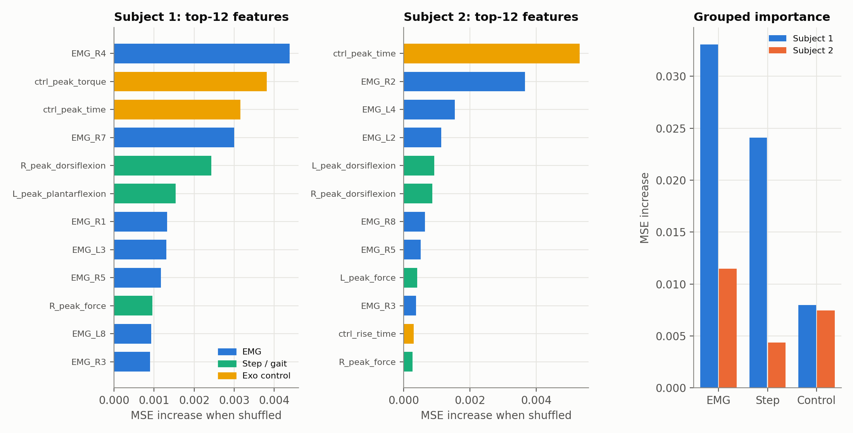
RESULTS · INTERPRETABILITY
EMG carries the signal, and a few muscles do most of the work
Feature set | S1 GP | S2 GP
All features | 0.0081 | 0.0129
Step + EMG | 0.0090 | 0.0120
EMG only | 0.0107 | 0.0146
Step only | 0.0151 | 0.0141
Feature-set ablation (CV MSE)
▸ EMG is the strongest group in grouped importance for both subjects; dropping the controls costs little, which helps transfer to other exo hardware
MetaCost · Predicting metabolic cost during HILO
9
Notes:
Permutation importance on held-out folds, plus a group-wise permutation. EMG > Step > Control for S1, and EMG > Control > Step for S2, matching the paper's ablation. LASSO stability selection over 200 bootstraps keeps R4 and R7 (S1) and R2 (S2) 93-100% of the time, so a reduced sensor set is realistic. Dropping the control parameters barely hurts, which is good for portability to other devices.

Slide 10
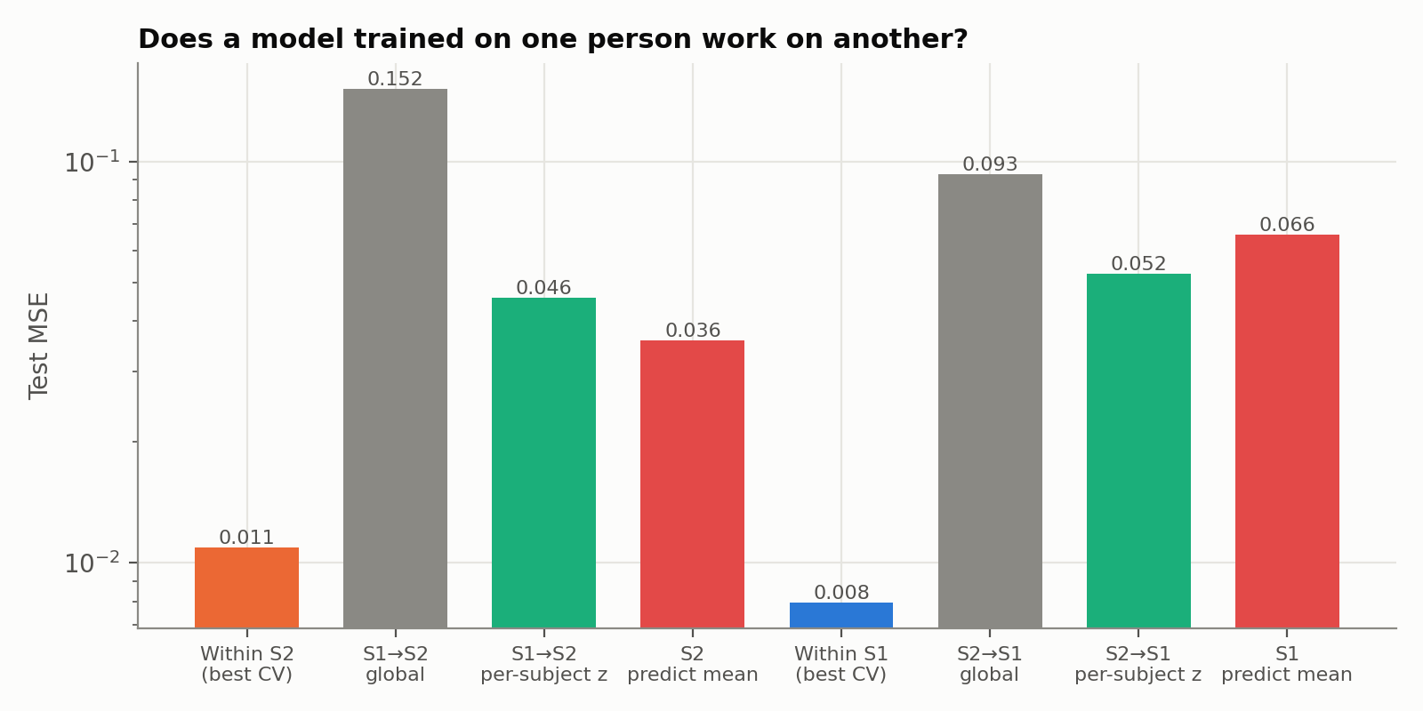
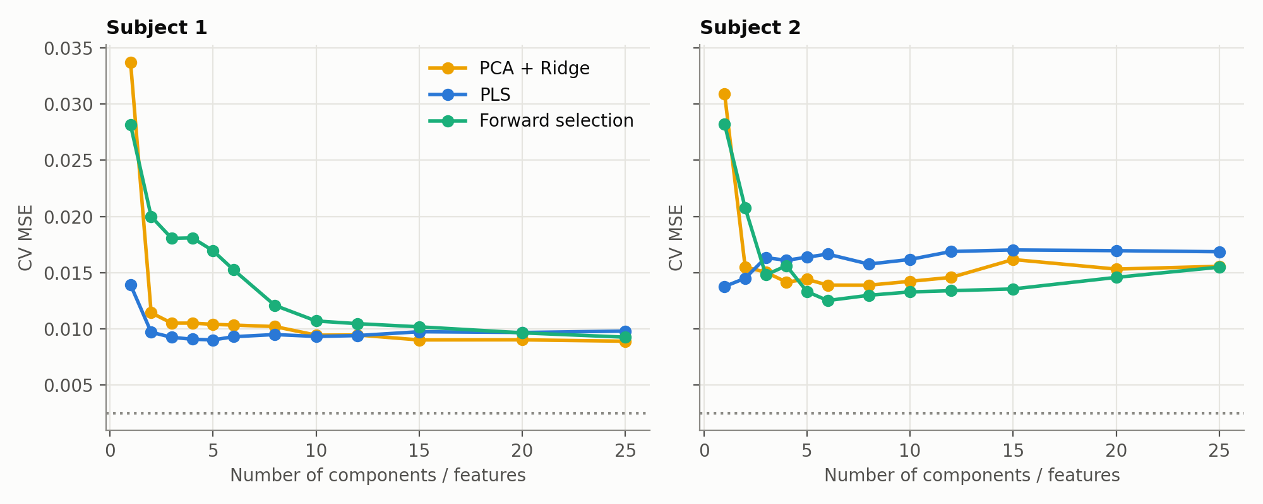
RESULTS · DEEPER ANALYSIS
Why PCA failed, and why one model cannot fit everyone
Supervised > unsupervised
1 PLS component (0.0138) = 8 PCA components on S2. Forward selection is greedy and unstable.
People are different
S1 → S2: MSE 0.152 vs 0.036 for the mean. Per-subject z-scoring → 0.046. Personal models are needed.
MetaCost · Predicting metabolic cost during HILO
10
Notes:
Left: PCA ignores the target. Supervised PLS with one component matches PCA with 8 on S2, which explains the paper's poor PCA result. Right: train on one person, test on the other: worse than predicting the mean. Per-subject z-scoring cuts the error 3x but is still not useful, so models must be subject-specific (or need many more subjects plus anthropometrics).

Slide 11
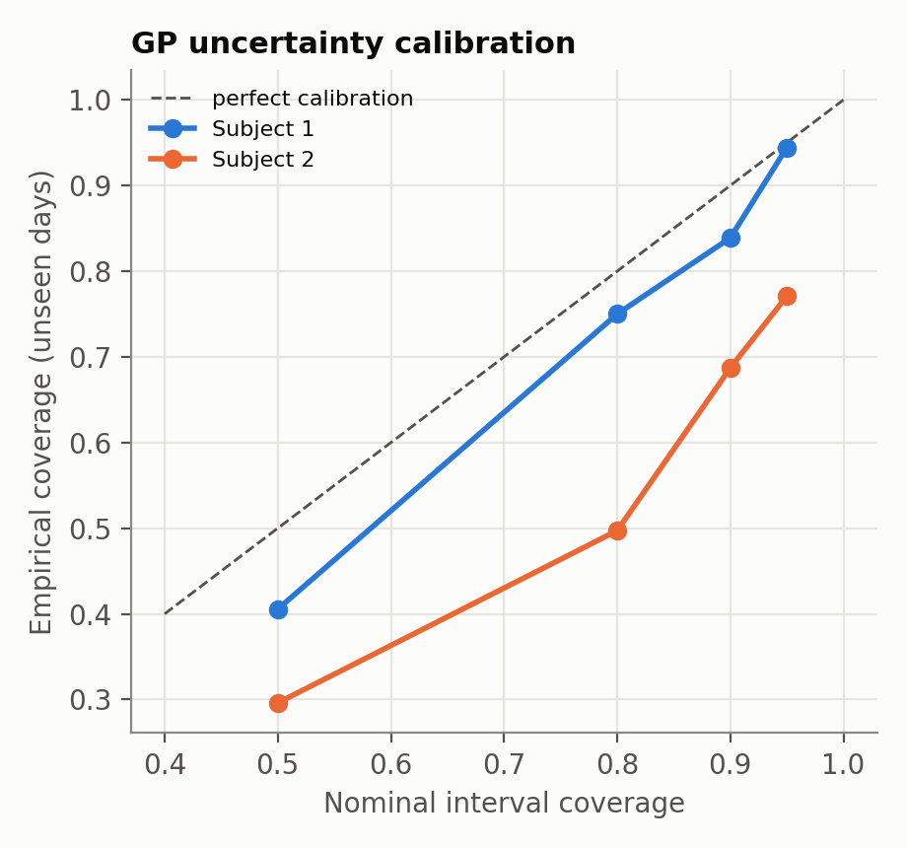
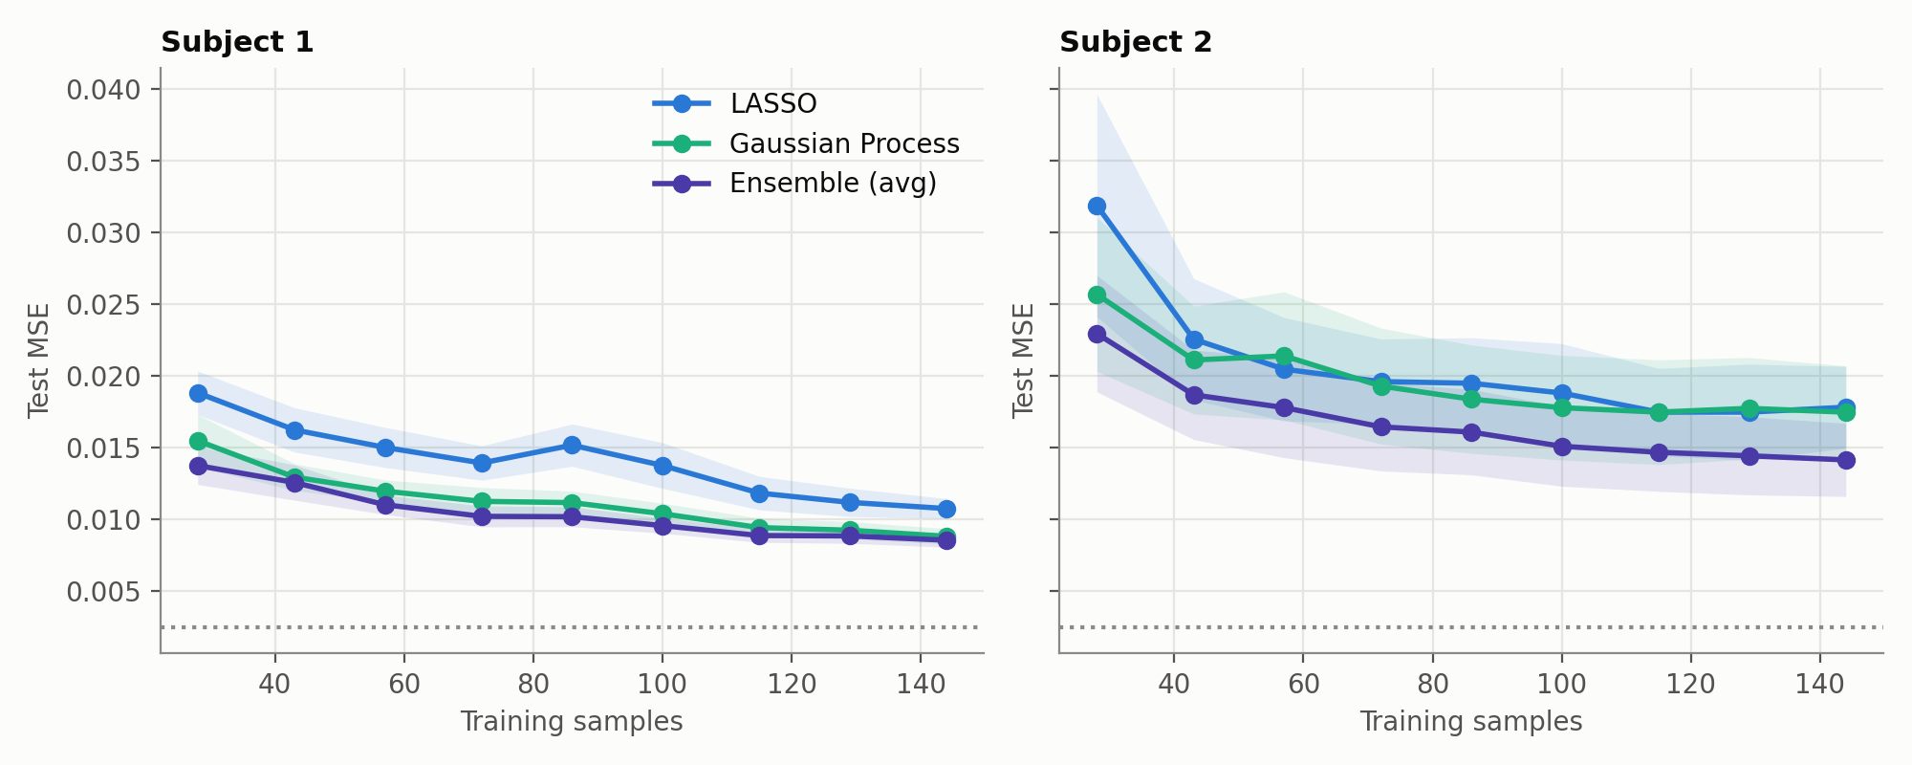
RESULTS · RELIABILITY
The model knows when it is unsure, and more data would help
94 %
0.0155 → 0.0088
of unseen-day points inside the S1 95 % interval
S1 GP test MSE from 28 to 144 training samples, still decreasing
MetaCost · Predicting metabolic cost during HILO
11
Notes:
Calibration: the GP's nominal 95% interval covers 94% of unseen-day points for S1, close to perfect. For S2 it covers 77%, so it is over-confident on the harder subject, but the intervals are visibly wider there. Learning curves are still falling for S1 at 144 samples: more sessions should keep improving accuracy.

Slide 12
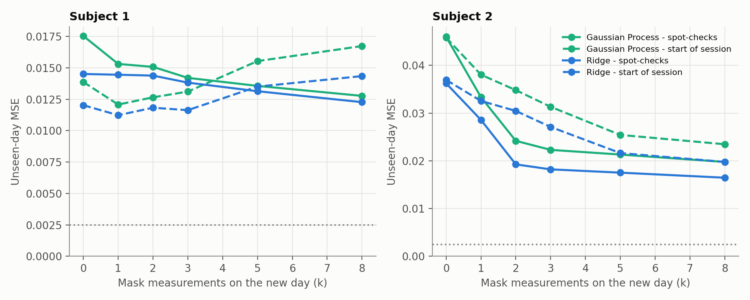
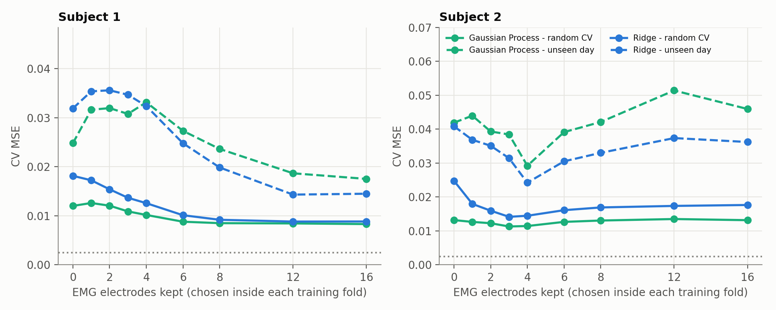
IMPROVEMENTS
Fixing the weaknesses, without collecting new data
−51 %
w = k/(k+σ²/τ²)
4 of 16
S2 unseen-day error with just 3 of 36 mask spot-checks (GP 0.046 → 0.022)
empirical-Bayes shrinkage: trusts calibration only as much as the training days justify
EMG electrodes beat all 16 for S2 (unseen-day Ridge 0.036 → 0.024)
MetaCost · Predicting metabolic cost during HILO
12
Notes:
Calibration: on a new day, measure k random conditions with the mask and shift that day's predictions by a shrunken offset w * mean residual, with w = k / (k + sigma^2 / tau^2). Both variances are estimated from the training days only (empirical Bayes). S2 trusts calibration (w about 0.87); S1, whose days are already well predicted, trusts it less. 3 of 36 readings: S2 GP 0.046 -> 0.022. Calibrating on the first conditions of a session is biased (cost runs high early on) and hurt S1 at k >= 5; shrinkage limits the damage. Sensors: electrode choice is made inside each training fold, so there is no leakage. Cross-subject recalibration did NOT help: a new person needs their own data.

Slide 13
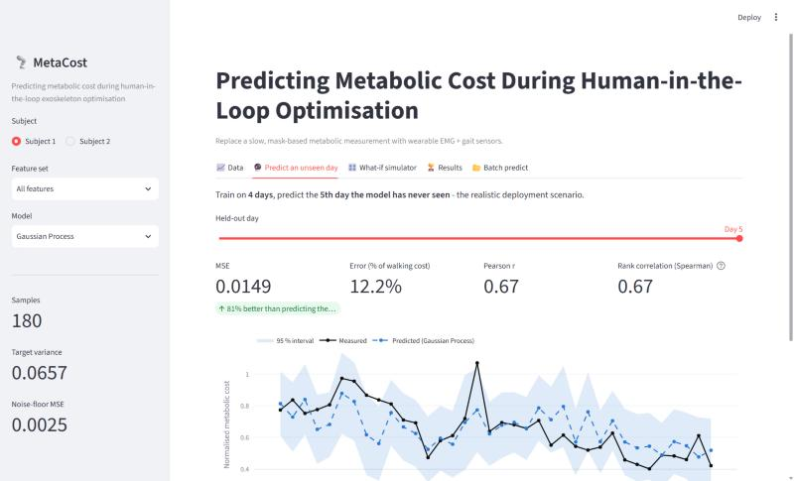
DEMO
Live demo: interactive dashboard
1
Data
5-day trajectories, correlations, raw table
2
Predict an unseen day
live retraining on 4 days + calibration slider (S2 day 5: 0.093 → 0.016)
3
What-if simulator
drag sensor sliders → cost ± uncertainty
4
Results
leaderboard for both protocols + all figures
5
Batch predict
upload CSV → download predictions
$ streamlit run app/streamlit_app.py
MetaCost · Predicting metabolic cost during HILO
13
Notes:
Run: streamlit run app/streamlit_app.py. Demo order: (1) Data tab: show the 5-day trend. (2) Predict an unseen day: choose Subject 2, Day 5 (MSE 0.093), then drag the calibration slider to 3: MSE falls to 0.016 and the yellow diamonds show the 3 mask readings. (3) What-if: drag the EMG_R4 slider and watch the predicted cost change. (4) Results tab: leaderboard. Backup: python scripts/predict.py --demo --subject S1

Slide 14
CONCLUSIONS & FUTURE WORK
Wearables can replace the mask, one person at a time
9-10 %
error within a session from EMG + gait (mean-baseline: 19-26 %); beats the original study
2×
error on a new day: random-split CV is optimistic, so deploy-style validation matters
EMG
is the key signal; 4 of 16 electrodes beat all 16 for S2, so cheaper hardware is possible
1 : 1
models must be subject-specific; cross-person transfer is worse than the mean
Next steps
More subjects + anthropometrics + IMU kinematics
Test spot-check calibration live in a real HILO session
Use the surrogate as a prior inside CMA-ES / Bayesian optimisation
Notes:
Recap the four numbers. Future work: the biggest lever is more people. A daily calibration walk could fix the day-level offset seen in Subject 2. Use the prediction as a prior to speed up the optimiser rather than as a complete replacement for the mask.

Slide 15
Thank you, questions?
Code, data, figures and the 2-page write-up are in the private GitHub repository.
Mukil Skanda A · PES1UG24CS281
Likhith M · PES1UG24CS282
Extended study: Bayesian-regularised NN, 13-model zoo, nested & leave-one-day-out validation, calibration, dashboard, write-up
Faithful MATLAB → Python port of the paper (paper_reproduction/): NN vs linear-regression baseline, 4 feature sets, forward selection, GitHub repo
Ref: Krimsky & Ng, CS229 2018 · Zhang et al., Science 2017 · MacKay 1992 · Rasmussen & Williams 2006
Notes:
Mukil: extended study, calibration, dashboard. Likhith: faithful MATLAB-to-Python port and GitHub repo.

