Slide 1
CGB1201 – JAVA PROGRAMMING PROJECT REVIEW-2
Department of Computer Science and Engineering(AIML)
Academic Year: 2024 – 2025 (Odd Semester)
Register Number :8115U23AM029
Name :MUKIL SUBRAMANI S G
Year :II YEAR
Semester :III
Date :23/11/24

Slide 2
Title of the Project
COLLEGE MANAGEMENT SYSTEM (CMS)

Slide 3
Abstract
The College Management System (CMS) is a robust platform designed to streamline and automate college operations. It integrates various academic and administrative functions into a single system. The CMS aims to enhance efficiency, accuracy, and communication within the college environment. This presentation explores its key features, benefits, and implementation.

Slide 4
Abstract with CO/PO Mapping
Abstract | CO | POs | PSO
The College Management System (CMS) is a robust platform designed to streamline and automate college operations. It integrates various academic and administrative functions into a single system. The CMS aims to enhance efficiency, accuracy, and communication within the college environment. This presentation explores its key features, benefits, and implementation.

Slide 5
Introduction
The application calculates the user's score in real time and sends the results via email. This project demonstrates basic concepts of object-oriented programming, including user interaction, dynamic content handling, and result reporting, all within a simple and user-friendly console interface.

Slide 6
Java Programming - Concepts Used
Object-Oriented Programming (OOP)
Polymorphism
Data Structures
Control Flow
String Manipulation
User Input/Output
Simulating Email

Slide 7
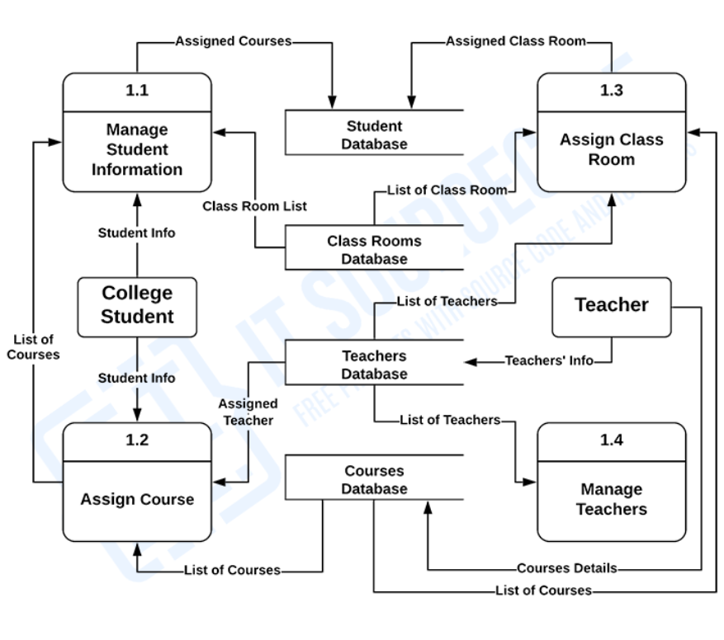
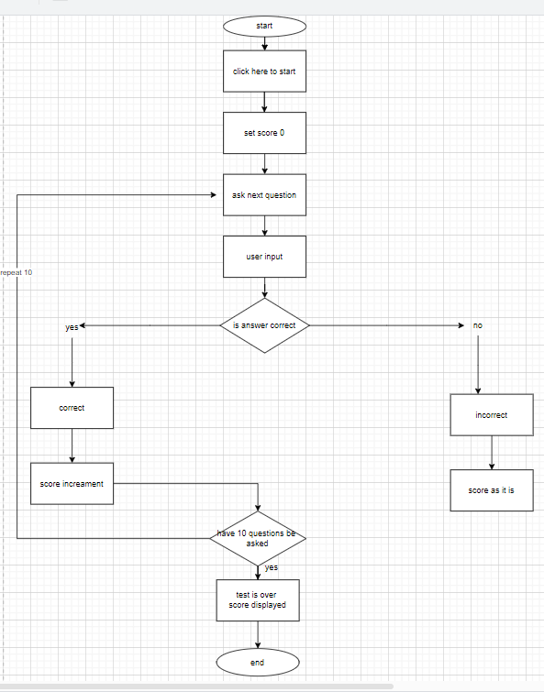
Proposed Architecture

Slide 8
Proposed Architecture - Description
1. Start with the user is student or staff.
2. Ask Question and take User Input
3. Check and proceed the user based requirement
Then it work on the input
4. It give the display as the requirment
5.Display final data management and provide
Class room and the attendance.

Slide 9
List of Modules
Main Module:
Student Management Module
Faculty Management Module
Attendance Management Module
Grade Management Module

Slide 10
Module Description
Main Module:
Entry point of the application. Starts the quiz process and manages the flow of the program.
Student Management Module
Features: Enrollment, personal information, academic history, and class schedules.
Faculty Management Module
Features: Faculty details, assignments, and schedules

Slide 11
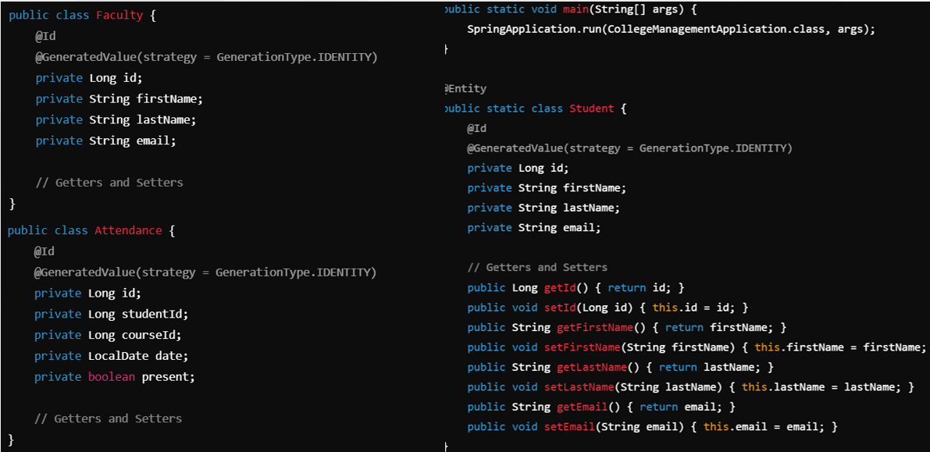
CODE

Slide 12
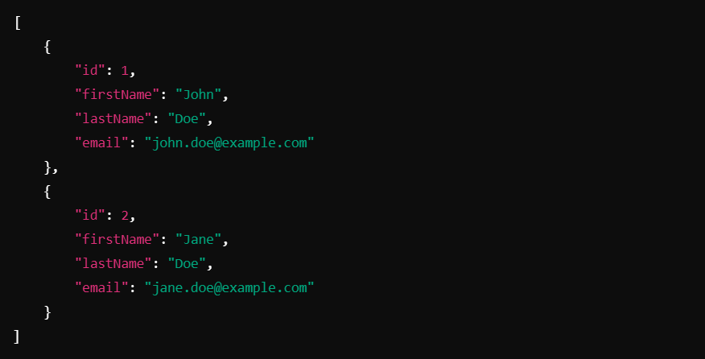
OUTPUT

Slide 13
Results and Discussion
Result:
By using the CMS we can able to get the data from the student and by the staff also so it can provide a better to use.
Discussion:
It Enhances efficiency, accuracy, and communication across all college functions.

Slide 14
Conclusion
The CMS is vital for modernizing college operations, offering significant benefits through integration and automation. It enhances efficiency, accuracy, and communication across all college functions. Next steps include detailed planning for implementation and ongoing support. We’re now open for any questions and discussions.

Slide 15
Thank You
Any queries???

