Slide 1
Advanced Java Performance Workshop

Slide 2





About me
Java Champion
vladmihalcea.com
@vlad_mihalcea
vladmihalcea

Slide 3
Spring Boot logging
SQL statements are printed to the console, so this setting should be avoided!
Bind parameters are not printed at all.
spring.jpa.show-sql=true
Hibernate: select distinct owner0_.id as id1_0_, owner0_.first_name as first_na2_0_, owner0_.last_name as last_nam3_0_, owner0_.address as address4_0_, owner0_.city as city5_0_, owner0_.telephone as telephon6_0_ from owners owner0_ where owner0_.last_name like ? limit ?

Slide 4
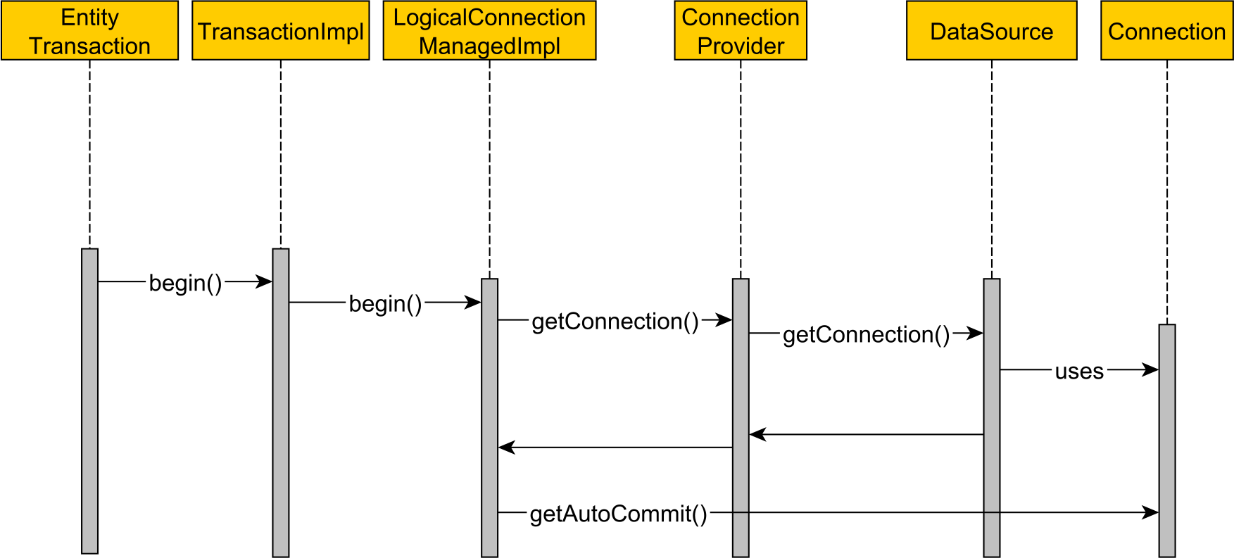
Spring Boot connection acquisition

Slide 5
Lazy connection acquisition
Hibernate 5.2.10 introduced a lazy connection acquisition strategy
Requires the DataSource to disable auto-commit
hibernate.connection.provider_disables_autocommit=true
spring.datasource.hikari.auto-commit=false

Slide 6
Query plan cache
Entity queries (JPQL, Criteria API) need to be compiled first.
The compilation takes time, so it has a cache with a default size of 2048 cached queries.
The cache is configured like this:
hibernate.query.plan_cache_max_size=8192

Slide 7
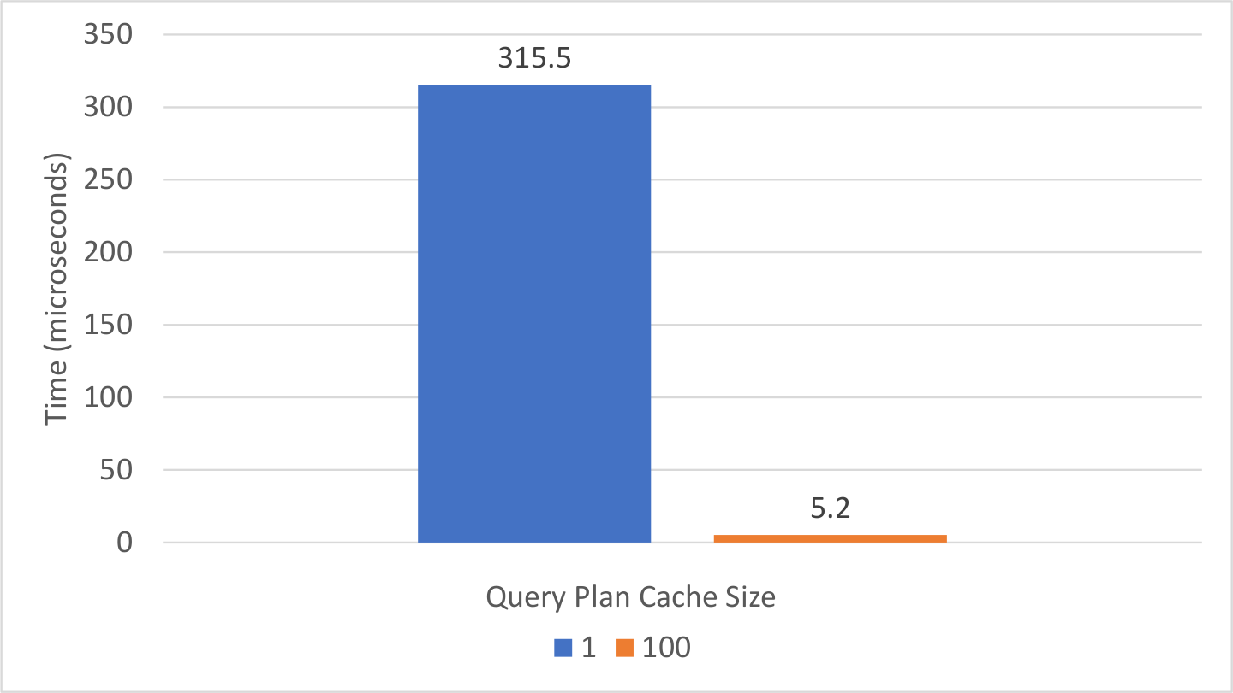
Entity query plan cache improvement

Slide 8
FetchType.EAGER – Secondary queries
The default fetching strategy for @ManyToOne associations is FetchType.EAGER.
@ManyToOne private Post post;
@Target({ElementType.METHOD, ElementType.FIELD}) @Retention(RetentionPolicy.RUNTIME) public @interface ManyToOne { … FetchType fetch() default FetchType.EAGER; }

Slide 9
FetchType.EAGER – Direct fetching vs. JPQL
PostComment comment = entityManager.createQuery(""" select pc from PostComment pc where pc.id = :id """, PostComment.class) .setParameter("id", 1L) .getSingleResult();
SELECT pc.id AS id1_1_, pc.post_id AS post_id3_1_, pc.review AS review2_1_ FROM post_comment pc WHERE pc.id = 1

Slide 10
FetchType.EAGER – Direct fetching vs. JPQL
PostComment comment = entityManager.createQuery(""" select pc from PostComment pc where pc.id = :id """, PostComment.class) .setParameter("id", 1L) .getSingleResult();
SELECT pc.id AS id1_1_, pc.post_id AS post_id3_1_, pc.review AS review2_1_ FROM post_comment pc WHERE pc.id = 1 SELECT p.id AS id1_0_0_, p.title AS title2_0_0_ FROM post p WHERE p.id = 1

Slide 11
FetchType.LAZY – Secondary queries
A much better default is to use FetchType.LAZY explicitly.
However, you can still bump into secondary query issues, which, in turn, can lead to N+1 query problems.
@ManyToOne(fetch = FetchType.LAZY) private Post post;

Slide 12
FetchType.LAZY – Secondary queries
PostComment comment = entityManager.find(PostComment.class, 1L);
LOGGER.info("Loaded comment entity");
SELECT pc.id AS id1_1_0_, pc.post_id AS post_id3_1_0_, pc.review AS review2_1_0_ FROM post_comment pc WHERE pc.id = 1
INFO - Loaded comment entity

Slide 13
FetchType.LAZY
PostComment comment = entityManager.find(PostComment.class, 1L);
LOGGER.info("Loaded comment entity"); LOGGER.info("The post title is '{}'", comment.getPost().getTitle());
SELECT pc.id AS id1_1_0_, pc.post_id AS post_id3_1_0_, pc.review AS review2_1_0_ FROM post_comment pc WHERE pc.id = 1
INFO - Loaded comment entity
SELECT p.id AS id1_0_0_, p.title AS title2_0_0_ FROM post p WHERE p.id = 1
INFO - The post title is 'Post nr. 1'

Slide 14
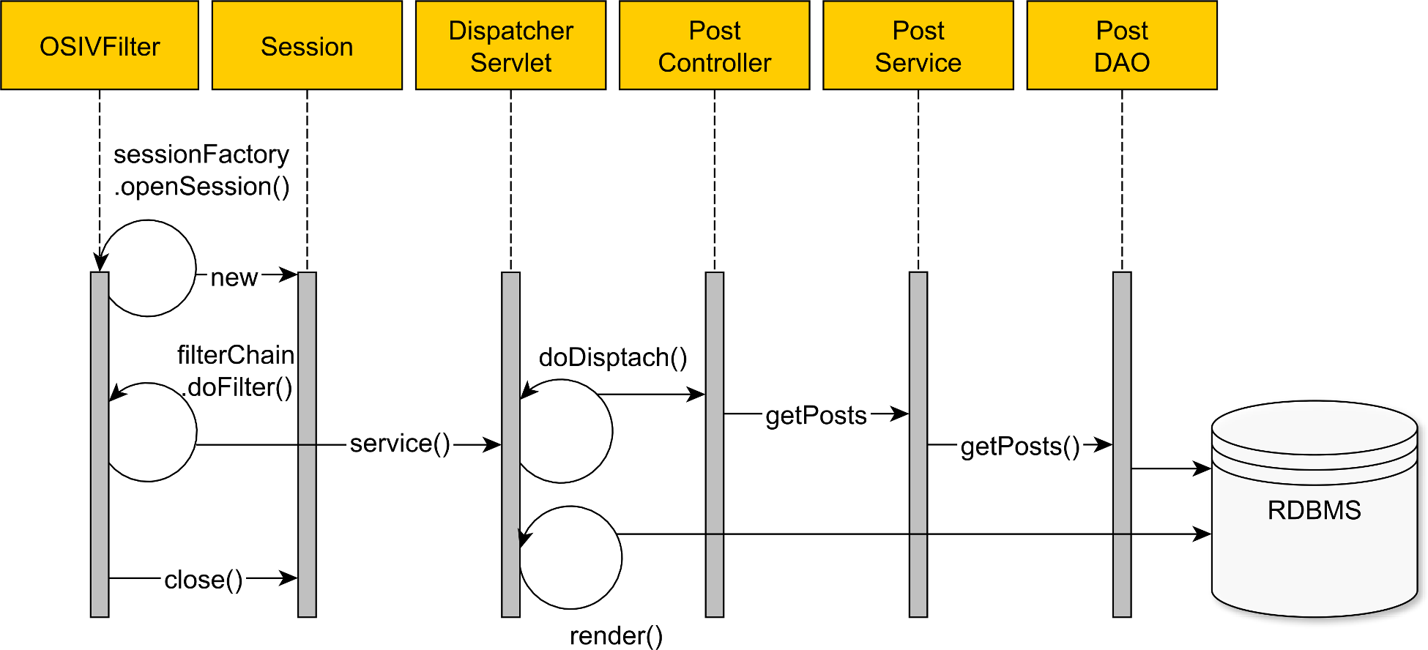
Open Session in View anti-pattern

