Slide 1
Idea/Approach Details Ministry/ Organization name: Ministry of Women and Child Development Problem Statement : Promoting holistic nutrition among women and children through/with the help of IT for Poshan Abhiyaan Team Name :Path Finders Team Leader Name : Bhavana Paladi College Code : WJ

Slide 2
Description
1. It’s a web based application where the health workers of Ministry of Women and Child Development are provided with unique IDs and password.
2. This interface facilitates the workers with data of the patients' last visit and provides monitoring tools to categorize the data.
3. Alarms will be triggered if the patient has not taken an upcoming dose which will help the health worker to make it more efficient.
4. The registered patient will also be sent a notification to visit for timely dosage.
5. The dose is provided to the patient by verifying their last visit and authenticating patient.
6. Our automated system alerts the customer of their upcoming alerts through alert messages and automated calls in regional Language.
Prototype
https://tinyurl.com/ujcc5hf
Technology stack
1.HTML,CSS,Javascript
2. Amazon SNS
3.Python
4.Amazon Web Services
5.Amazon SQS

Slide 3
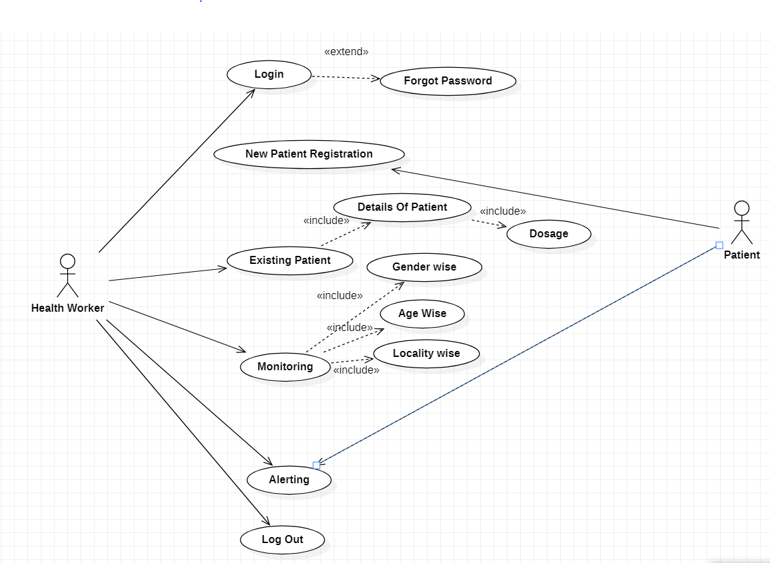
Use Case Diagram
Dependencies
1.Employee/Health workers
2. Patient
Show Stopper
1. Network issues

