Slide 1
Panic Builder
A response to Tower of Babble
Bradley McDonald

Slide 2
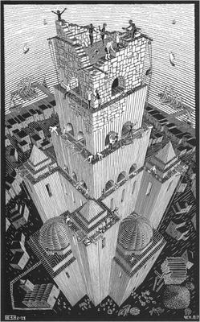
Tower of Babble
Created by the artist M.C Escher in 1928.
It was one of M.C Eschers earlier works and what made him want to pursue his style of perception in his later, more famous works of art.

Slide 3
<Some (more) context about your work of art>
The Tower of Babble painting is inspired by the bible story ‘The Tower of Babble’ where the residents of Babylon attempted to make a building to heaven, but as they built it taller God made it so the workers could no longer understand each other so the building became unstable and no more work could be done.
History
[Social conditions when it was created]
[Reception to the work of art when it was released]
[Any other thing that may be relevant]
[Why you selected this work of art]

Slide 4
Your response to <work of art>g
[Expand on your reaction to the work]
Explain the form that your game will take
Explain how your game will be a response to the work
Explain the technology you intending to use and why
Explain how you are intending to limit the scope to make it achievable

Slide 5
Proof of concept
Level layout (Visio?) or
Whitebox of level or
Mood board or
Storyboard or
Prototype

Slide 6
Planning
Date | What will I have finished?
25th February 2019
4th March 2019
11th March 2019
18th March 2019
25th March 2019
1st April 2019
8th April 2019
29th April 2019 (hand-in)

Slide 7
References
<Your best is to make the references in a Word document and then copy paste it here>

