Slide 1
Panic Builder
A response to Tower of Bable- M.C Escher
Bradley McDonald

Slide 2
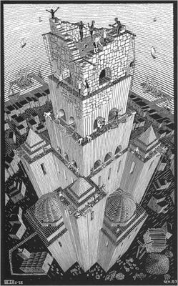
Tower of Bable
Created by the dutch artist M.C Escher in 1928.
It was one of M.C Eschers earlier works and what made him want to pursue his style of perception in his later, more famous works of art.

Slide 3
Tower of Bable explored
The Tower of Bable painting is inspired by the bible story ‘The Tower of Bable’ where the residents of Babylon attempted to make a building to heaven, but as they built it taller God made it so the workers could no longer understand each other so the building became unstable and no more work could be done.
M.C Escher was for long neglected in the art world as his focus was more to maths and illusion.
The story of the Tower of Bable can be found in the book of Genesis in the bible.

Slide 4
Response to Tower of Bable
I love the use of art and maths with the perception element of it. Shows intelligence as well as artistic skill. The kind of person who is naturally smart but wants to pursue a passion whilst incorporating a piece of himself in his work.
The game will have a forced perception element to it and you will be figuratively making the tower of bable. The player will be presented with pieces, of which they have to place in the available areas, however they can place them in the wrong place. The aim is to create a functioning corridor from a random place, chosen by the game, to another point. You then build on the level above however with a new set of pieces and more places to put them. You must do it quickly.
This game I a response in that you are a creating a building which becomes more chaotic and more impossible the more you build, which directly links to the story that the painting represents.
I have chosen the unreal engine because of the fact I’m more comfortable with it and can clearly plan of how I am to develop it within my head before proceeding.
I know its achievable because I off my experience with the engine and I know what I am capable off. So I could plan and see if I could do it. The only problem is with the unreal engine UI system which may cause a problem. As it is a very UI heavy based game

Slide 5
Proof of concept
Prototype

Slide 6
Planning
Date | What will I have finished?
25th February 2019 | Properly working UI
4th March 2019 | Have AI which determines if its solvable
11th March 2019 | Finish Win state of a level
18th March 2019 | Create harder level generator
25th March 2019 | Implement more pieces for harder generation
1st April 2019 | Finish Polish, textures and particles
8th April 2019 | Fix all major bugs for final build and submission
29th April 2019 (hand-in) | Finished game

Slide 7
References
About M.C Escher- https://www.mcescher.com/about/biography/
Tower of Bable painting information-https://en.wikipedia.org/wiki/Tower_of_Babel_(M._C._Escher)
Original tower of Bable story- https://en.wikipedia.org/wiki/Tower_of_Babel

