Slide 1
Game theory of Potato Eater
Bradley McDonald

Slide 2
Introduction
You don’t need to do it precisely like this, but this is one approach to introducing your presentation.
This presentation will go over
[Explain that the presentation is a discussion of various theories of games design in the context of the game that you have created]
[1. Brief discussion of the work of art to which you responded]
[2. Brief discussion of your game]
[3. Theorist 1 – VERY brief introduction to their work]
[4. Theorist 2 – VERY brief introduction to their work]
[5. Theorist … etc]
[6. Conclusion
[7. References]
[8. Opportunity for questions]
Don’t get too bogged down here, as you have only 15 minutes overall..

Slide 3
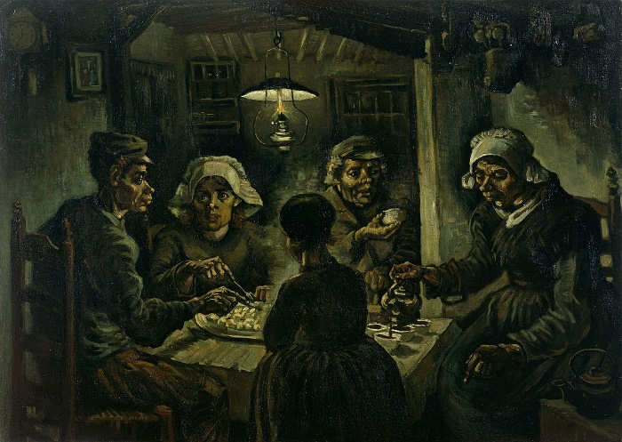
The Potato Eaters
Artist- Vincent van Gogh
Year of creation- 1885
The painting was made to show how peasants really are, using ugly models and eating by a single candle light.
Remember, this presentation is not about the response, so cover this briefly

Slide 4
Potato Eater
It’s worth pointing out here that you did not create the game with the theories in mind
Endless Runner
Play as a potato that is attempting to escape from a monster trying to eat you.
I hoped that the player will enjoy the progressive challenge, whilst trying to figure out the hidden metaphors in the game.
The experience is how long as the player wants. After a level is completed a new one is made with more platforms and obstacles.
Due to the obstacles being random it’s possible the player may not experience certain things until later playthroughs.

Slide 5
Justin Ma
Justin Ma (Game Designer) who made, ‘FTL: Faster Than Light’ and ‘Into the Breach’ who goes into how his games can allow the players to have the experience they want with the game. Such as, playtime length and difficulty is wide ranged, if they want to have a relaxing or challenging experience, they are able to do so.
In my game players are able to experience the game for as long or short as they want. As they immediately put into it.
Does not have set difficulty levels, but is random so a player could have a easier experience by luck rather than from experience or by design.
https://www.interactive.org/Interviews/the_game_makers_notebook.asp- Justin Ma- 58:30-59:21

Slide 6
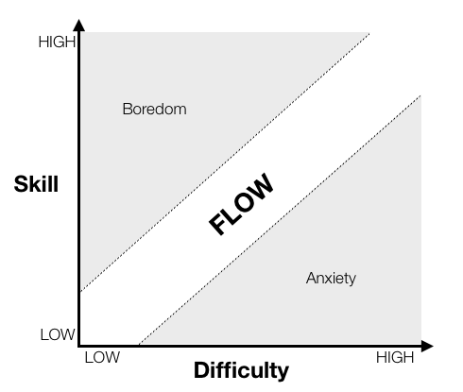
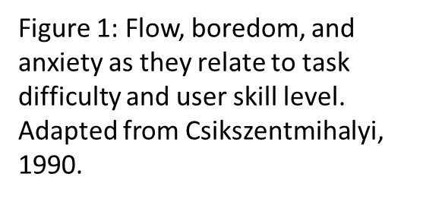
Shaun Baron
Shaun Barons theory is about cognitive flow, the engagement of the player when playing the game. This is done by increasing difficulty as the players skill increases, however to a somewhat equal balance as shown below.
[Where your game fits in]
[Where your game does not fit in]
https://www.gamasutra.com/view/feature/166972/cognitive_flow_the_psychology_of_.php

Slide 7
Shaun Baron
This fits in with my game as when the player completes a level, by clearing all the obstacles, the player must do the same however with more obstacles. More obstacles increases the difficulty as it increases the likelihood that the player will fail.
My games level difficulty is randomly generated meaning a later level could be incredibly easy because there is a chance it may spawn no obstacles, though this is improbable. Also a beginning level could be incredibly hard
Figure 1: Flow, boredom, and anxiety as they relate to task difficulty and user skill level. Adapted from Csikszentmihalyi, 1990.
https://www.gamasutra.com/view/feature/166972/cognitive_flow_the_psychology_of_.php

Slide 8
Katherine Isbister
This does not all have to be on one slide. Eg for Callois, you might show his table here and then show it again on the next slide but with your game included.
The theory is how video games affect the way you relate to others. This is shown by how the player places themselves as an avatar and gets emotionally invested.
The player can get emotionally invested in the games playable character which is a potato as the player may want it to be free and have a fear losing it in a variety of ways such as being eaten and being stabbed by forks.
The Potato has no visual familiarity to a human or share any visual or auditory feedback, so it is harder to have empathy for that object.

Slide 9
Conclusion
The theories talked about show different aspects of the game and how it reflects to the player from, player experience through difficulty, game flow for the player and emotional investment for the player.
Is there anything that you can say about the theories and their relevance for your game? If so, say it here!

Slide 10
References
<Your best bet is to make the References section in a Word document and then copy & paste it here>

Slide 11
Any questions?
?

