Slide 1
Game theory of Potato Eater
Bradley McDonald

Slide 2
Introduction
This presentation will go over multiple game theories that relate back to the game that I have created. These theories go over how the player can use the game to their required experience, how the game changes overtime and how it makes the player feels through play.
The theories presented are by public speakers with industry experience of which presented their theories in a peered reviewed manor, be that by a presentation, article or interview.
1. Art Work
2. Game Description
3. Theorist 1 – Justin Ma
4. Theorist 2 – Shaun Baron
5. Theorist 3 – Katherine Isbister
6. Conclusion
7. References
8. Questions

Slide 3
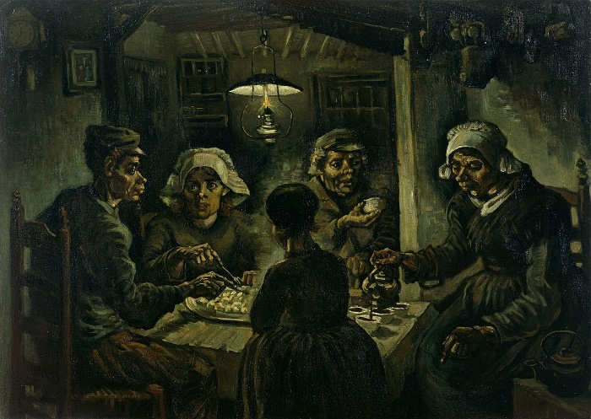
The Potato Eaters
Artist- Vincent van Gogh
Year of creation- 1885
The painting was made to show how peasants really are, using ugly models and eating by a single candle light.

Slide 4
Potato Eater
Endless Runner
Play as a potato that is attempting to escape from a monster trying to eat you.
I hoped that the player will enjoy the progressive challenge, whilst trying to figure out the hidden metaphors in the game.
The experience is how long as the player wants. After a level is completed a new one is made with more platforms and obstacles.
Due to the obstacles being random it’s possible the player may not experience certain things until later playthroughs.
The game was not originally created with the current game theories in mind, but were found later that they were incorporated within the game.

Slide 5
Justin Ma
Justin Ma (Game Designer) who made, ‘FTL: Faster Than Light’ and ‘Into the Breach’ who goes into how his games can allow the players to have the experience they want with the game. Such as, playtime length and difficulty is wide ranged, if they want to have a relaxing or challenging experience, they are able to do so.
In my game, players are able to experience the game for as long or short as they want. As they immediately put into it.
Does not have set difficulty levels but is random so a player could have an easier experience by luck rather than from experience or by design.
https://www.interactive.org/Interviews/the_game_makers_notebook.asp
Justin Ma- 58:30-59:21

Slide 6
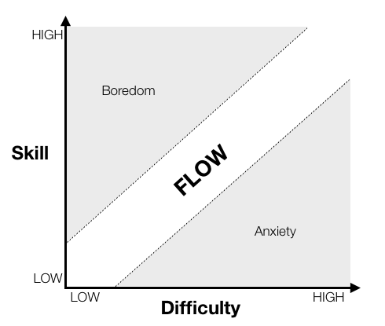
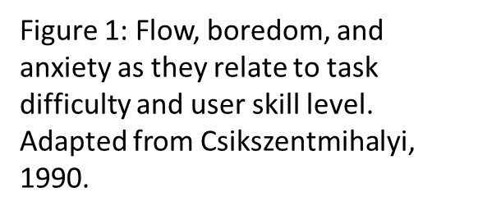
Shaun Baron
Shaun Barons theory is about cognitive flow, the engagement of the player when playing the game. This is done by increasing difficulty as the players skill increases, however to a somewhat equal balance as shown below.
Maintaining this equilibrium of difficulty and skills is believed to engage the player the most and thereby increase their enjoyment of the game.
https://www.gamasutra.com/view/feature/166972/cognitive_flow_the_psychology_of_.php

Slide 7
Shaun Baron
This fits in with my game as when the player completes a level, by clearing all the obstacles, the player must do the same however with more obstacles. More obstacles increases the difficulty as it increases the likelihood that the player will fail.
My games level difficulty is randomly generated meaning a later level could be incredibly easy because there is a chance it may spawn no obstacles, though this is improbable. Also a beginning level could be incredibly hard.
Figure 1: Flow, boredom, and anxiety as they relate to task difficulty and user skill level. Adapted from Csikszentmihalyi, 1990.
https://www.gamasutra.com/view/feature/166972/cognitive_flow_the_psychology_of_.php

Slide 8
Katherine Isbister
The theory is how video games affect the way you relate to others. This is shown by how the player places themselves as an avatar and gets emotionally invested.
-Video https://www.youtube.com/watch?v=YWL1jeL0uBU
In her Book ‘How Games Move Us’ she goes into detail of this ‘Avatar based Roleplay’ and how it allows the player to project themselves onto the character.

Slide 9
Katherine Isbister
The player can get emotionally invested in the games playable character which is a potato as the player may want it to be free and have a fear losing it in a variety of ways such as being eaten and being stabbed by forks. This gives the potato human traits as a want to survive and makes the player believe it is a real living thing.
The Potato has no visual familiarity to a human or share any visual or auditory feedback, so it is harder to have empathy for that object. There is also not customisable avatar for the player.

Slide 10
Conclusion
The theories talked about show different aspects of the game and how it reflects to the player from; experience through difficulty, game flow and emotional investment.
Though the game does follow these theories it does not dedicate itself to prove these theories, instead it is flexible and allows more theories to be implemented in later if needed.

Slide 11
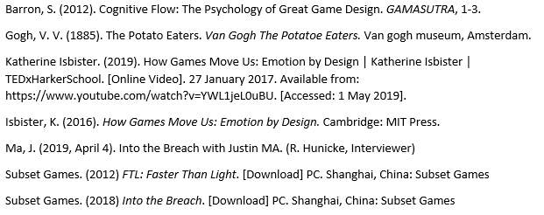
References

Slide 12
Any questions?
?

