Slide 1

📊 Retail Project Analysis & Insights
Data-Driven Strategies for Growth

Slide 2
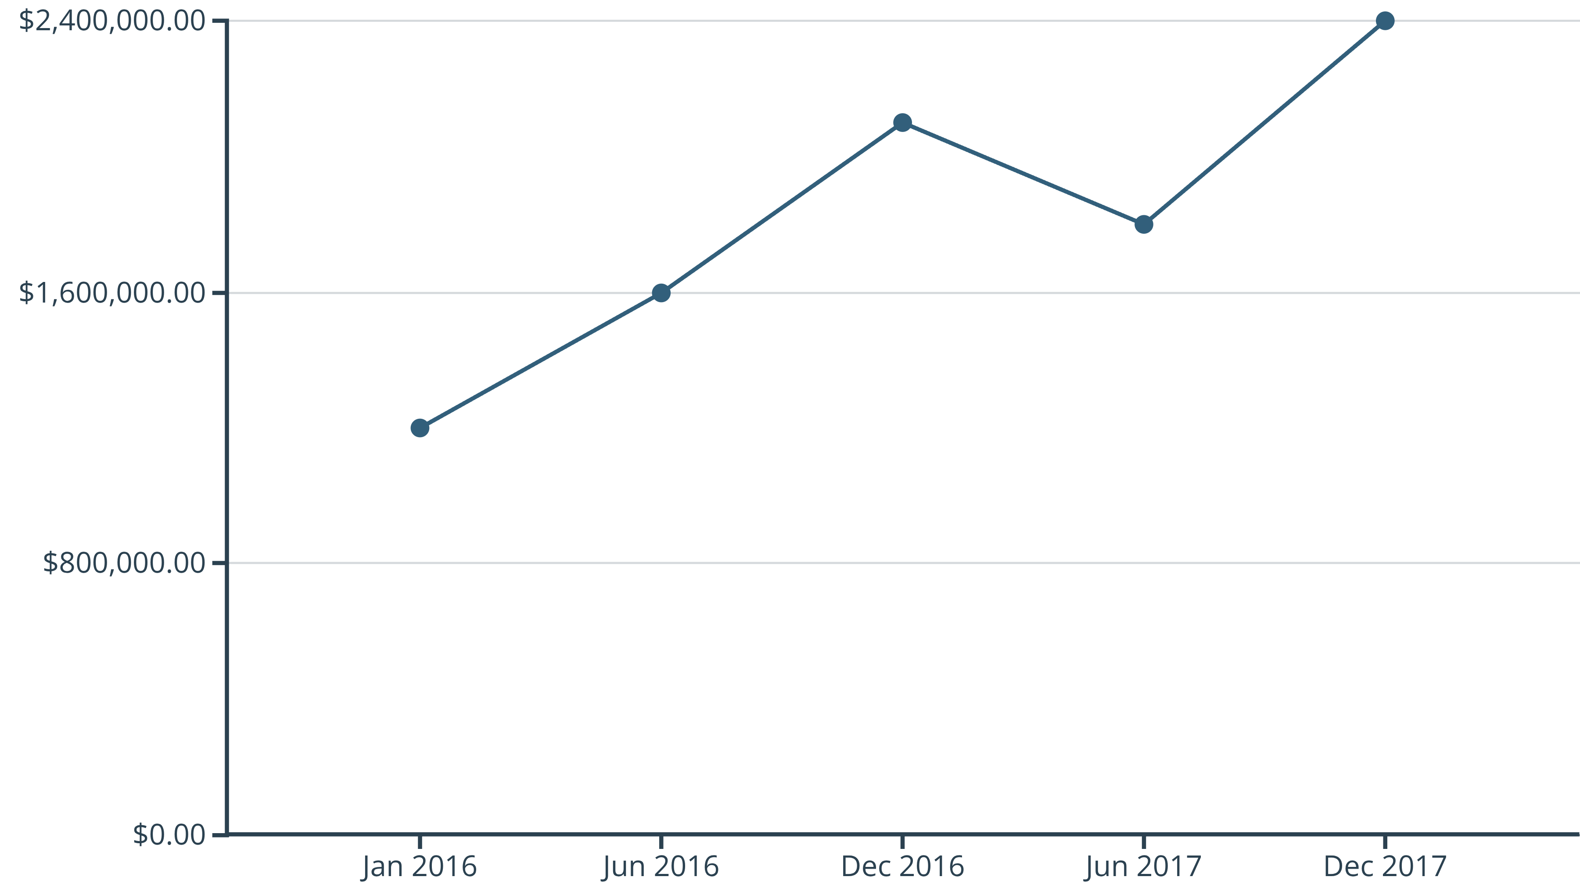
Time-Based Analysis: Unpacking Sales Trends
Understanding our sales performance over time is crucial for identifying patterns and optimizing future strategies. This section dives into monthly and daily sales trends to reveal key behavioral insights.
Monthly Sales Trend (2016–2017)
Sales consistently show strong growth towards the end of the year, with December being the peak month in both 2016 and 2017.
A significant year-over-year growth is observed, with December 2017 reaching $2.4M compared to $2.1M in December 2016.
Mid-year sales (June) also show an increase from 2016 to 2017, indicating overall positive momentum.

Slide 3
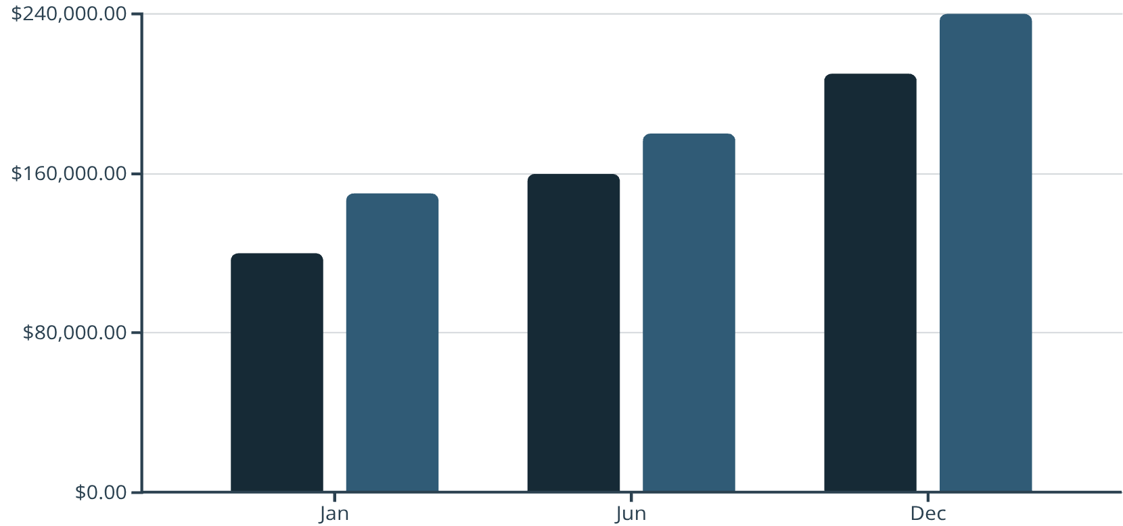
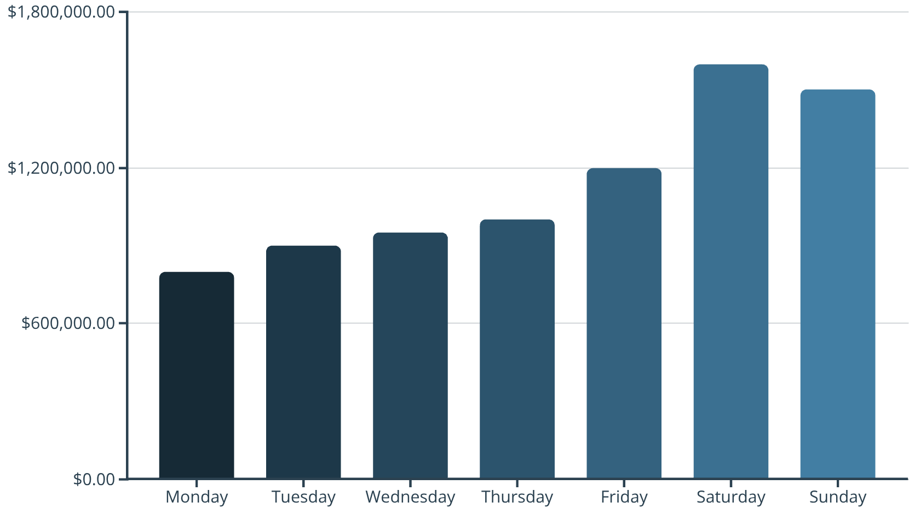
Time-Based Analysis: Detailed Monthly & Weekly Performance
2016 Sales (USD)
2017 Sales (USD)
2016 vs 2017 Monthly Sales
Sales by Day of Week
Consistent year-over-year growth is evident across all months.
Weekends (Saturday and Sunday) are the strongest sales days.
December exhibits the highest sales in both years, confirming its peak seasonality.
Sales gradually increase from Monday to Friday.
Weekends collectively account for nearly double the sales of mid-weekdays.

Slide 4
Key Insights & Recommendations: Time-Based
Strong Seasonal & Weekend Shopping Behavior
Positive Growth Trajectory
Sales data clearly indicates pronounced peaks during festive seasons (especially December) and over weekends. This highlights consumer habits and periods of heightened purchasing intent.
The consistent year-over-year growth across all analyzed periods demonstrates the overall health and increasing appeal of our retail operations. This momentum should be leveraged.
1
2
3
Pre-Festival Campaigns
Weekend Flash Offers
Weekend Staffing & Stock Alignment
Launch targeted marketing campaigns and promotions 4-6 weeks before major holidays (e.g., Black Friday, Christmas) to capture early shoppers and maximize seasonal uplift. Focus on bundled deals and gift items.
Implement exclusive weekend-only flash sales or loyalty point bonuses to further drive traffic and conversion on peak days. Advertise these offers on Thursday/Friday.
Adjust staffing levels to match weekend demand, ensuring optimal customer service and checkout efficiency. Pre-position high-demand inventory closer to the sales floor to prevent stock-outs and improve replenishment.

Slide 5
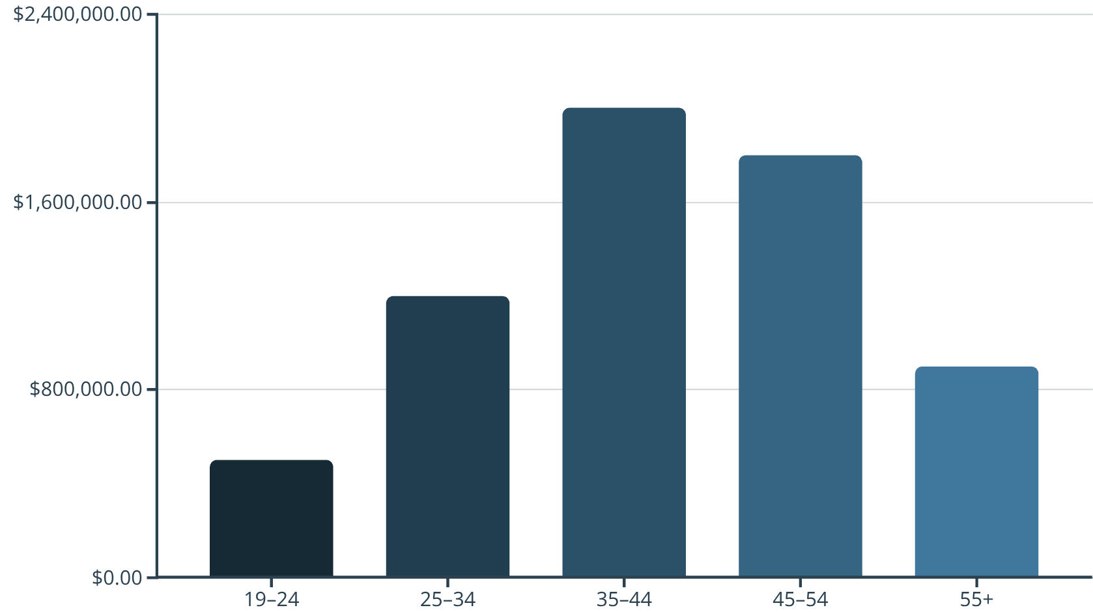
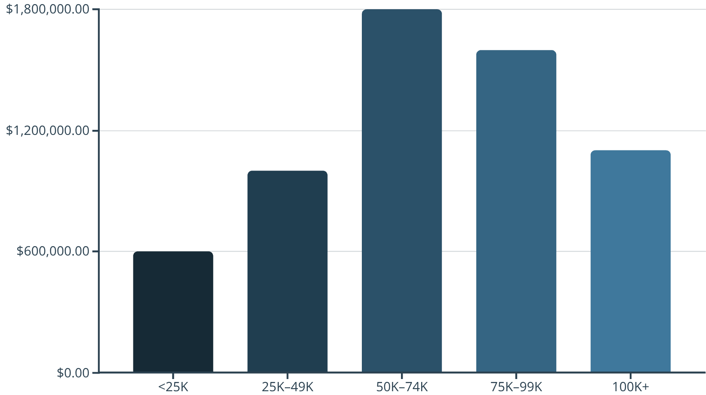
Demographic Analysis: Understanding Our Customer Base
To effectively tailor our marketing and product offerings, it's essential to understand who our core customers are. This section breaks down sales by age, income, and household composition.
Sales by Age Group
Sales by Income Group
The 35-44 age group represents the largest sales contribution, closely followed by 45-54.
Mid-to-high income groups ($50K-$99K) contribute the most significantly to sales.
The $50K-$74K bracket shows the highest individual contribution.
Customers aged 25-54 are our primary spenders, accounting for the majority of revenue.

Slide 6
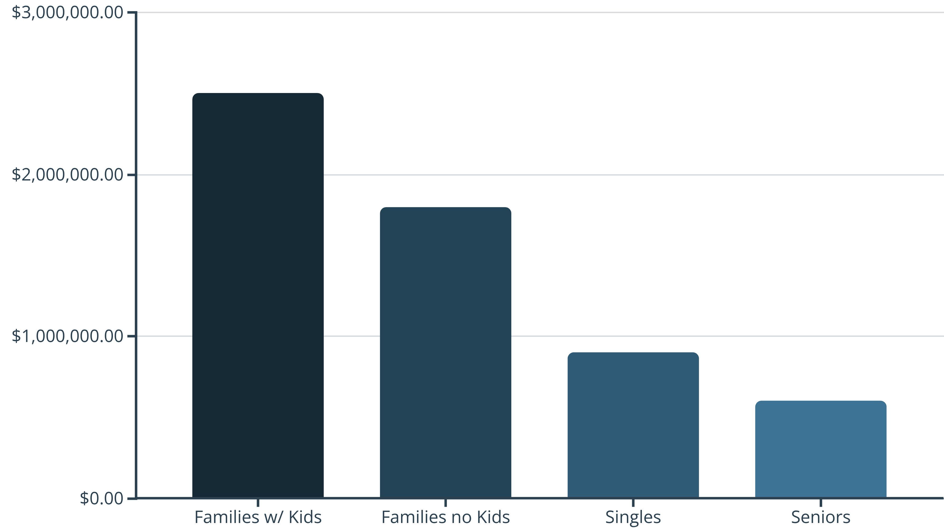
Demographic Analysis: Household Composition & Interpretations
Sales by Household Composition
Families, particularly those with kids, are the largest spending segment.
Both family segments (with and without kids) significantly outspend singles and seniors.

Slide 7


Key Insights & Recommendations: Demographics
Core = Mid-High Income Families
Singles & Low-Income Under-Penetrated
Our primary customer base consists of families aged 35-54, earning between $50K and $99K. This segment drives the bulk of our sales.
There's an opportunity to grow sales within the singles and lower-income groups, as these segments currently contribute less proportionally.
1
2
Family Bundles & Loyalty Tiers
Budget Packs for Low-Income
Develop specialized product bundles and tiered loyalty programs that cater to families, offering greater value for larger purchases and encouraging repeat visits.
Introduce budget-friendly product lines or smaller-sized packages to attract lower-income customers. Highlight value and essential items in marketing for this segment.

Slide 8
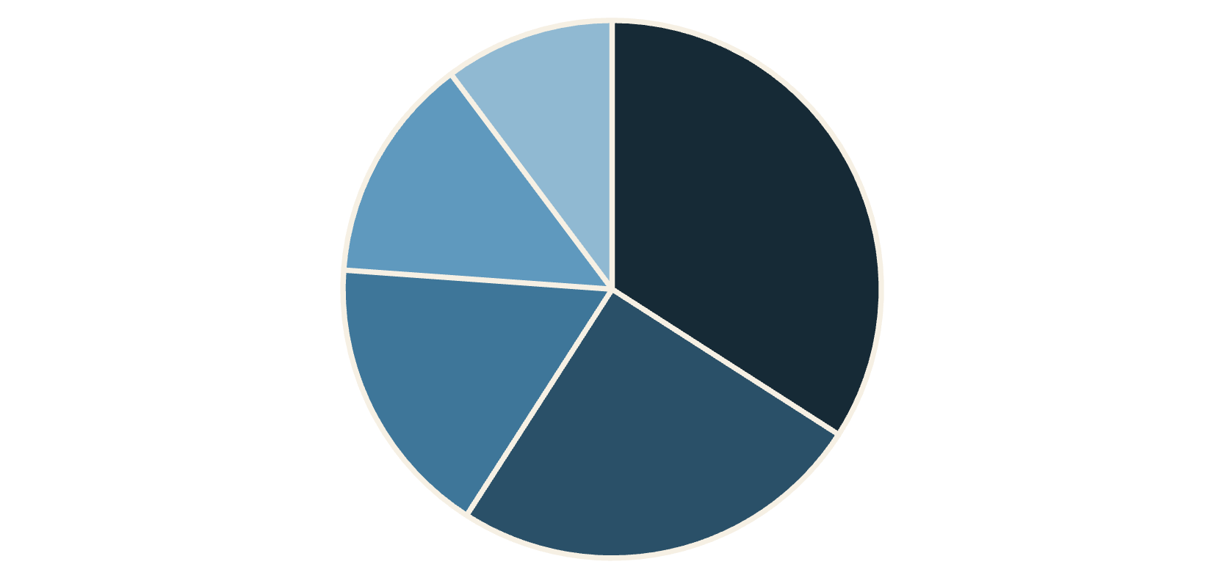
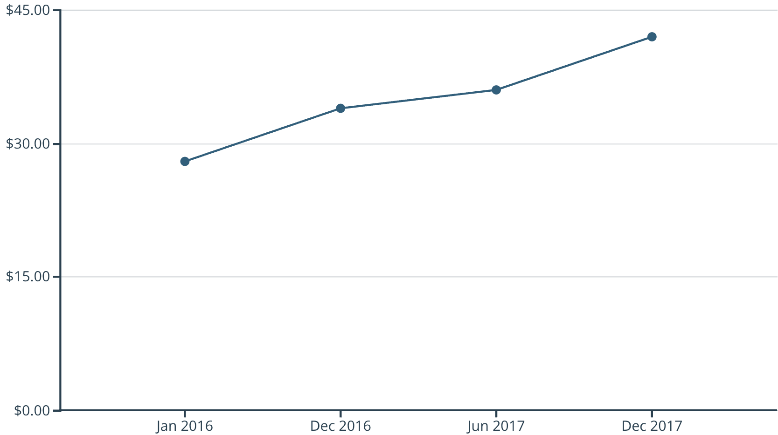
Product Performance Analysis: Optimizing Inventory
Understanding how individual products and categories perform is vital for inventory management, merchandising, and maximizing profitability. This section details sales by department, average basket size, and the impact of our top-selling SKUs.
Groceries
Beverages
Personal Care
Snacks
Frozen
Sales by Department
Average Basket Size Over Time
Groceries and Beverages are the dominant sales categories, acting as major traffic drivers.
Average basket size has consistently increased year-over-year, from $28 in Jan 2016 to $42 in Dec 2017.
Personal Care and Snacks also contribute significantly, while Frozen foods show the least sales.
This indicates customers are purchasing more items or higher-value items per visit.

Slide 9

Product Performance Analysis: Pareto Principle & Interpretations
The Pareto principle, or 80/20 rule, states that roughly 80% of effects come from 20% of causes. In retail, this often means a small number of products drive the majority of sales.
Top SKUs
20% of SKUs drive 80% sales
Supporting SKUs
Long Tail
30% contribute moderate sales
50% low contribution SKUs
Pareto Top Products (80/20 Rule)
Analysis confirms that a relatively small number of SKUs (approximately 20%) generate the vast majority (around 80%) of our total sales.
These "power SKUs" are critical for revenue and customer satisfaction.
This highlights the importance of maintaining optimal stock levels and visibility for these key products.

Slide 10
Overall Insights & Strategic Recommendations
Consistent YoY Sales Growth
Our retail operations are on a healthy growth trajectory, demonstrating increasing customer engagement and market penetration.
Demographic Powerhouse
Mid-to-high income families aged 35-54 are our most valuable customer segment, driving significant sales volume.
Peak Performance Periods
Weekends and festive months (especially December) represent critical sales opportunities due to heightened consumer activity.
Product Portfolio Dynamics
Essentials like Groceries and Beverages drive store traffic and purchase frequency, while specific "power SKUs" underpin overall sales.
Increasing Basket Size
Customers are consistently purchasing more per visit, indicating successful cross-selling and upselling efforts, or increased perceived value.
Maximize Seasonal & Weekend Opportunities
Deepen Engagement with Core Demographics
Implement dynamic pricing, flash sales, and enhanced staffing for weekends and pre-holiday periods. Optimize merchandising to feature seasonal items prominently.
Develop highly targeted marketing campaigns, loyalty programs, and product offerings (e.g., family packs, bulk discounts) specifically for 35-54 year old, mid-to-high income families.
Optimize Product Assortment & Placement
Increase Basket Size Further
Ensure consistent availability of top-selling SKUs. Strategically place high-margin "premium" items near essential traffic drivers to encourage upselling and cross-selling.
Implement bundling strategies and impulse purchase zones near checkout. Train staff on suggestive selling techniques.

