Slide 1
Agenda
Overview of early stages of WaterTAP3 Python
Tutorials that demonstrate building blocks and basic capabilities
Building a treatment train (~10 mins)
Running a simulation (~10 mins)
Optimization example (~10 mins)
Next steps
Feedback on everything and anything

Slide 2
Overview
Model framework is based on network topology
Should allow us to represent any combination of process flows
First step is to build the network (train), then build the model and run it
Includes all Poseidon water source and use case studies (10 constituents)
Model currently represents 7 unit processes based on the Texas Water Board tool:
Chlorination, media filtration, microfiltration, ultrafiltration, nanofiltration, UV,
Reverse osmosis (Texas Water Board and Bureau of Reclamation methods)
7 membrane options for RO
Note: unit processes are 80% complete – some elements still missing across each such as chemical costs.
Model can simulate a treatment train and optimize (select unit processes)
Current optimization for: treated water volume, system cost, levelized cost
Some constituents represented, but not included as optimization variables yet
First tutorial…

Slide 3
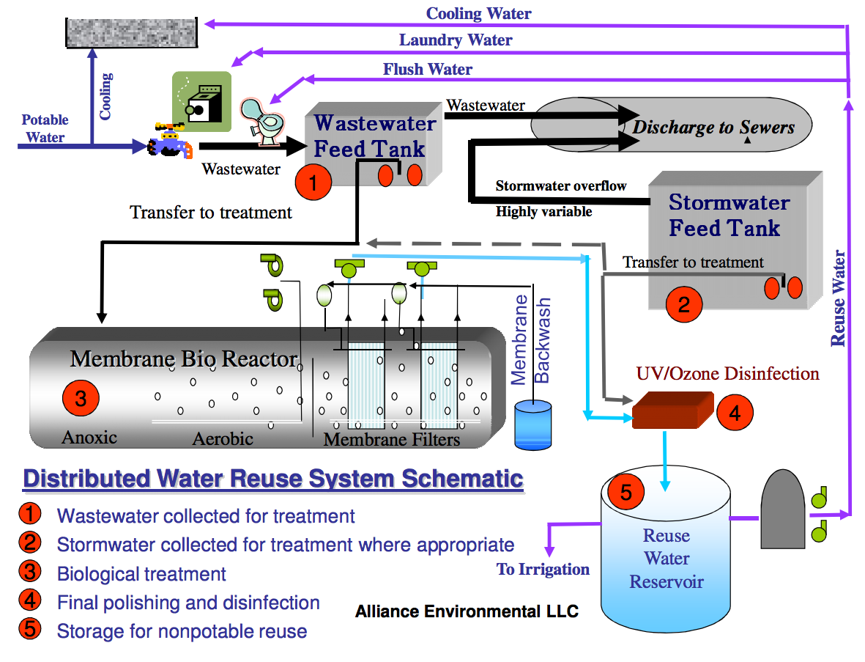
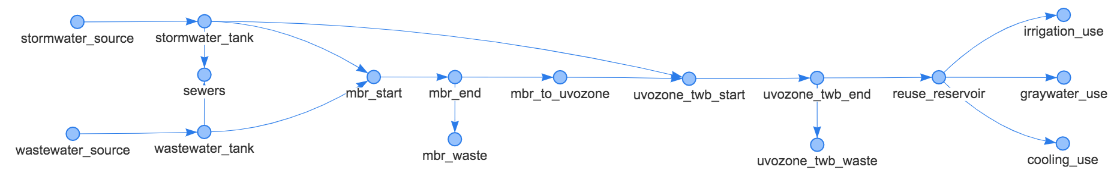
Example of the Battery Park Process Flow Diagram captured in the WaterTAP3 Python model framework.
Representation in WaterTAP3

Slide 4
Next steps (between now and January):
Complete representation of constituents
Finalize recycle capability
Add missing financial and life-cycle impact data/calculations
Add more model output options (total costs broken down etc.)
Sensitivity analyses (nearly complete)
Clean and document model to upload on private GitHub account (aiming for October). Send username if interested in using/testing the model
Complete BoR model representation (almost there), and add more unit processes as needed/possible.
Validation?
Finalize tutorials
Discussion
Main need to progress model development: data tables and TEA equations documentation (non Excel format)
Do we want to represent baseline pathways as network topologies?
If so, what is the best approach – together with cartographers or separate and get feedback?
How do we fill in data gaps and unit process equations?
Do we refine TWB data and other modules from literature and validate results?
Should we develop a protocol on how we deal with missing data/information?
Differences from Excel results – expected but important to keep track of why.
Linking with Proteus
Do we need to simulate more than one system state? (question for cartographers?)

Slide 9
Design Features
Create treatment train:
Start with 1 unit process, with defined source and end use
Add other unit processes: in parallel or series. No limit on number.
Add recycle streams for unit processes for ‘waste flow’
User defines the recycle volume as fraction of waste flow
Add multiple water sources. No limit.
Add multiple end uses. No limit.
Remove unit processes, source water, end uses etc.
Add a stream from any point to any point for design. BUT user will need to define any associated characteristics such as cost, flow capacity etc.
Set up treatment network for simulation or optimization
Save and load treatment train -> any size.

Slide 10
Overview
Create treatment train:
Start with 1 unit process, with defined source and end use
Add other unit processes: in parallel or series. No limit on number.
Add recycle streams for unit processes for ‘waste flow’
User defines the recycle volume as fraction of waste flow
Add multiple water sources. No limit.
Add multiple end uses. No limit.
Remove unit processes, source water, end uses etc.
Add a stream from any point to any point for design. BUT user will need to define any associated characteristics such as cost, flow capacity etc.
Set up treatment network for simulation or optimization
Save and load treatment train -> any size.

Slide 11
Modules and Computational Features
X unit process modules from XXXX
X treatment trains as identified in XXX
X source and end use case studies from Poseidon

Slide 12
Are any processes bi-directional
Do we need to simulate more than one system state? For example, are any flows bi-directional.
To do units

