Slide 1

INTERNSHIP REVIEW
Name: Mukta Patil (CS-A-1 32)
Role: Software Development Intern
Company: Systech Solutions, Pune
Industry Mentor: Mr.Gaurav Patil sir
Guide: Prof.Anant Kaulage sir

Slide 2
Projects
DocER - HealTech
SystechERP - Systech
A Saas aimed at helping doctors and patients
Designed for public use
An application to handle company’s day-to-day operations
Built for in-house purposes

Slide 3
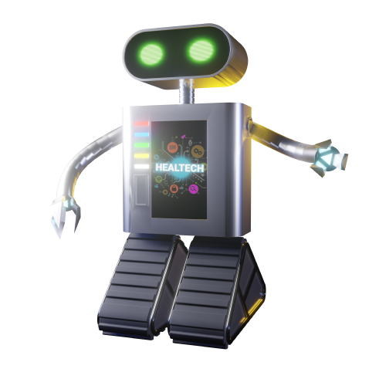
DocER

Slide 4
Introduction - DocER
It is a holistic Health Database Monitoring System with cost-effective, fast and reliable SaaS-based service.
Consolidates data on one platform
Remotely accessible
Secure operation
JWT Token

Slide 5
Objectives - DocER
Centralized Healthcare Data
Solid Data Security
Enhanced Efficiency
Affordability
Improved Patient Care
Data Analytics and Insights

Slide 6
Operations - DocER
Dashboard with dynamic analytics
Fast and efficient Prescription Generation.
Records and maintains individual patient data.
Can assign one or more course of treatment.
Wide variety of medicines database for prescription
Maintains record of all patients treated by the doctors.

Slide 7
Literature Review
Healthcare Monitoring Systems: A Review of Current State and Future Trends
Challenges to Patient Monitoring Systems
Prescription Digitization
Patient Data Security

Slide 8
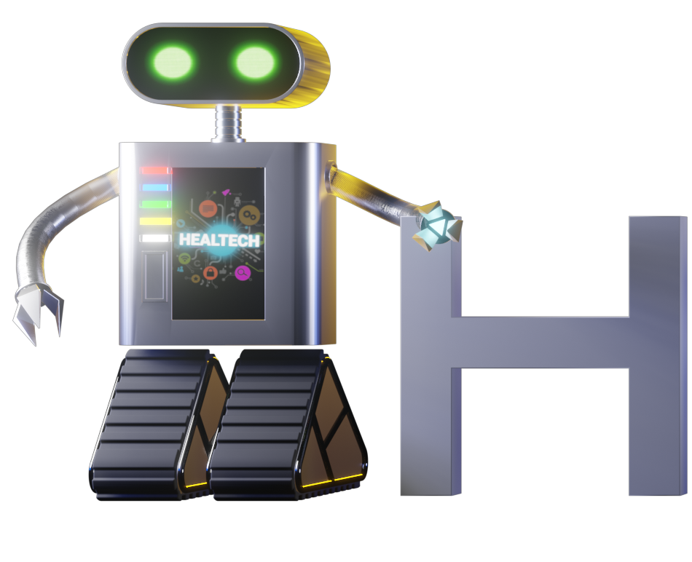
Technological Stack - MERN
Frontend
Backend
Generals
React. Js
Tailwind
SQLite
ASP.Net Server
NodeJs Server
Hostinger
Versioning
Documentation
Figma to Code
Express and Axios
Data Security
API
C#
ASP.Net

Slide 9
Future Scope
Until November – Beta Testing
By 15 doctors in Pune
Working on the results
Optimization of operations
Costing
Large-scale deployment

Slide 10


SystechERP

Slide 11
Introduction - SystechERP
It is in-house Enterprise Resource Planning Project that automates and facilitates the working of the organization
Interconnected modules
Accelerate business growth and scalability with efficient operation and effective resource management

Slide 12
Objectives - SystechERP
Streamline business operations and processes
Automate repetitive task
Enhance data management and access
Reduce costs and enhance financial management

Slide 13
Operations
Employee Management
Salary Management
Storing essential information about all employee and their projects.
Salary calculation based on Attendance Module, Advance Request, Bonuses and More
Inventory Management
Project management
A record of the items in their inventory, items ready for the buyer, transaction logs
Details about the project, necessary goods, teams assigned to it, progress record and more

Slide 14
Literature review
Enterprise Resource Planning Implementation: Success Factors, Critical Risks, and Mitigation Strategies
ERP Implementation: A Tale of Ten Mistakes
ERP Implementation: Lessons Learned from 10 Companies
ERP Systems: A Comprehensive Guide

Slide 15
Technological Stack - MERN
Frontend
Backend
Generals
React. Js
Tailwind
MySQL
Stored Procedure
NodeJs Server
Hostinger
Versioning
Documentation
Express and Axios
Data Security
API
PHP
MySQL

Slide 16
Future Scope and Status
Project Started: September 2023, Project is in Progress.
Currently completed HRM Module

Slide 17
Conclusion
Wonderful opportunity
Enhanced my coding abilities
Soft skills
Personal and professional Development

Slide 18
Thank You

