Slide 1

PROJECT REPORT ON WORLD MAP COLOURING
Submitted by
BISWAJIT KUMAR SENAPATI-(2241019366)​
BHANU PRATAP SINGH-(2241019482)​
MUKTI SINGH-(2241019496)​
ANISHA SUBUDHI-(2241019564)​
SUBARNA SURAL-(2241019576)​
Supervised by
Mr. Shiva Agarwal
Assistant Professor
Computer Science and Engineering
Faculty of Engineering and Technology
Centre For Artificial Intelligence and Machine Learning
Institute of Technical Education And Research(ITER)
SIKSHA ‘O’ ANUSANDHAN (DEEMED TO BE) UNIVERSITY
Bhubaneswar-751030, Odisha, India
Shiva Agarwal
(Supervisor)

Slide 2
Contents
1 Abstract
2 Introduction
3 Literature Survey
4 Methodology
4.1 Forward checking algorithm:
4.2 pseudo code
5 Results
6 Conclusion
7 Future Scope

Slide 3
ABSTRACT
Map coloring is a classic problem in the field of Artificial Intelligence (AI) and falls under the category of Constraint Satisfaction Problems (CSPs). The objective of this problem is to assign colors to different regions on a map in such a way that no two adjacent regions share the same color. With an emphasis on effectively assigning colors to map regions within constraints, the study attempts to investigate effective methods and approaches for resolving this issue through the use of AI techniques. The goal of the project is to advance the field of geographic information systems by using artificial intelligence to solve combinatorial optimization challenges.
The abstract approach to solving the Map Coloring Problem in CSP involves defining a set of variables representing the regions, each with a domain of possible colors. Following that, constraints are provided to ensure that neighboring regions have different coloring. The goal is to find a consistent color assignment for all regions that meets the requirements.

Slide 4
INTRODUCTION
Map coloring, a well-known problem in graph theory, has garnered increased attention due to its practical significance in geographic information systems, urban planning, and resource allocation. Traditional approaches to map coloring often face scalability challenges, motivating the exploration of AI-based solutions. The investigation of AI-based solutions is driven by the scaling issues that traditional methods of map coloring frequently encounter. Using this method, regions on a map are given colors while having to follow specific guidelines, such making sure neighboring regions have different hues. Our goal is to produce visually beautiful and informative maps that clearly and organizedly represent geographical data by implementing constraint satisfaction to global map coloring. This method improves the visual appeal of maps while also making it easier to understand spatial linkages and geopolitica.

Slide 5
LITERATURE SURVEY
Constraint satisfaction problem in artificial intelligence involves identifying constraints and finding optimal(maybe) solutions that satisfy them. Various algorithms, such as backtracking, forward checking, and local search, can be used to solve this problem. It has various applications in scheduling, resource allocation, and automated reasoning. A solution in AI is a complete assignment of values to all variables that satisfies all constraints. Variable domains can be finite, infinite, or continuous, and constraints can be unary, binary, or global. The problem has a wide range of applications, including scheduling, resource allocation, and automated reasoning.

Slide 6
METHODOLOGY
4.1 Forward checking algorithm:
The forward checking algorithm for solving constraint satisfaction problems is a popular and successful alternative to backtracking. However, its success has largely been determined empirically, and there has been limited work towards a real understanding of why and when forward checking is the superior approach

Slide 7
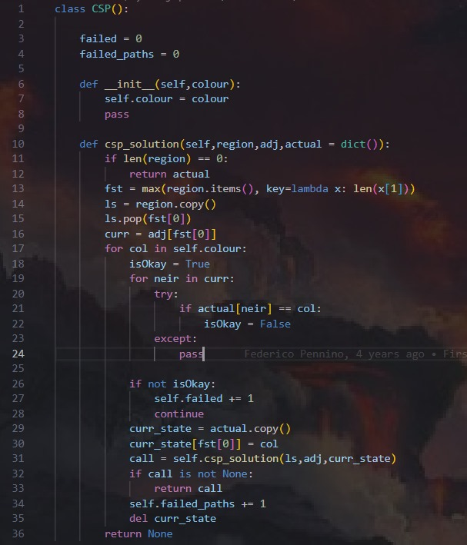
CSP Code

Slide 8
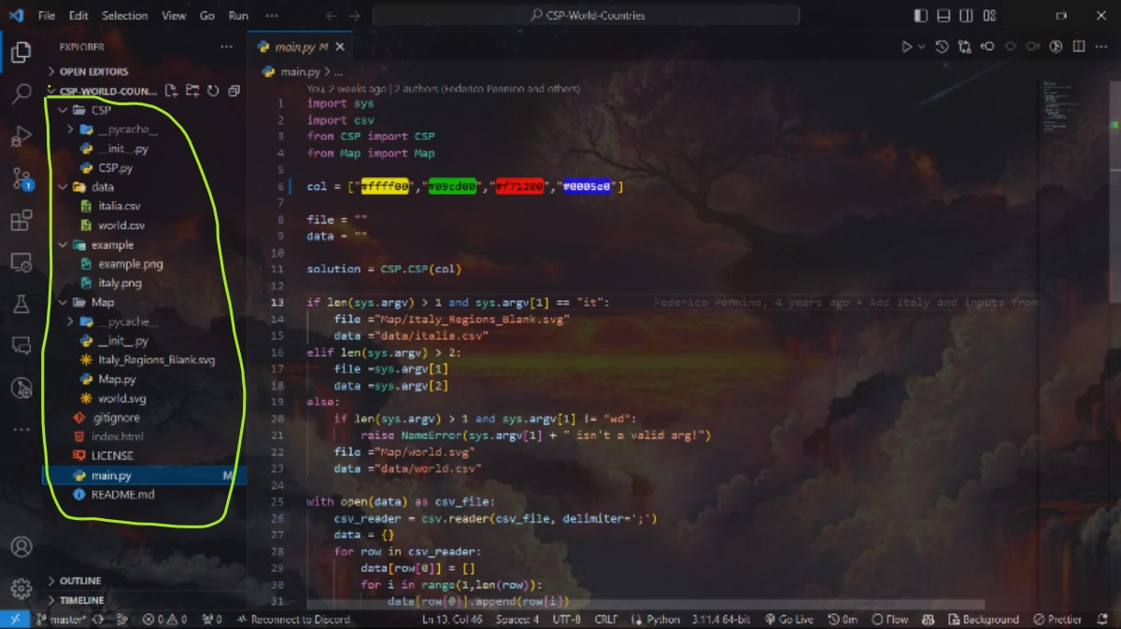
Main Code

Slide 9
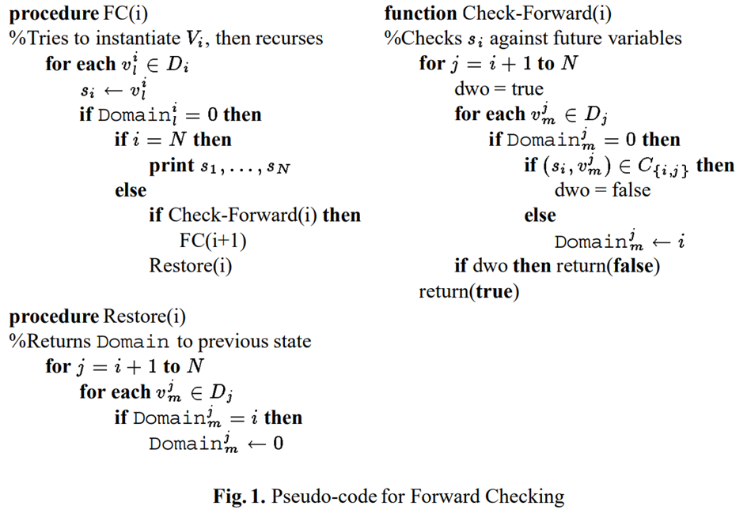
METHODOLOGY 4.2 Pseudocode

Slide 10
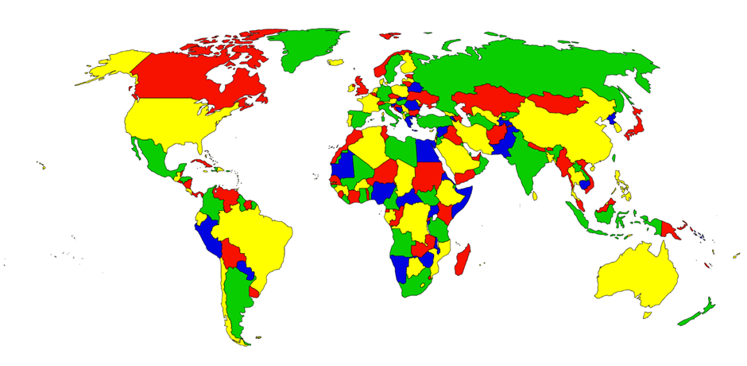
RESULTS
Figure1.1 csp map colour with 4 colours

Slide 11
RESULTS
Map coloring in csp allows us to color the different region in the map using 4 colors only. With the help of various step and algorithm we are able to color the whole world map with the use of 4 colors only.
The algorithm used is forward tracking algorithm which helps to reduce the complexity of the solution and make it more efficient to solve in less time.
However the solution obtained maybe optimal.
Since the problem is based on CSP , so it has played a vital role to understand the concept of solving the given problem.
So Constraint satisfaction problem in artificial intelligence involves identifying constraints and finding optimal(maybe) solutions that satisfy them. Various algorithms, such as backtracking, forward checking, and local search, can be used to solve this problem. It has various applications in scheduling, resource allocation, and automated reasoning. A solution in AI is a complete assignment of values to all variables that satisfies all constraints. Variable domains can be finite, infinite, or continuous, and constraints can be unary, binary, or global. The problem has a wide range of applications, including scheduling, resource allocation, and automated reasoning

Slide 12
CONCULSION
A key tool in artificial intelligence (AI) is the Constraint Satisfaction Problem (CSP), which provides a flexible method for solving problems involving discrete variables and constraints. They have been used in many different areas, including resource allocation, planning, scheduling, and configuration. Researchers and practitioners may clearly define restrictions, variables, and domains thanks to CSPs, which offer an organized means of doing so. The efficiency and effectiveness of CSP solvers have been greatly enhanced by the invention of search algorithms, constraint propagation strategies, and algorithms. CSPs have proven useful in solving real-world issues, and this has led to useful applications in sectors like as project management, telecommunications, and manufacturing. The study of CSPs has been aided by interdisciplinary cooperation, where researchers collaborate with specialists in operations research and optimization to tackle challenging issues.

Slide 13
FUTURE SCOPE
Constraint satisfaction problems (CSPs) in artificial intelligence have a wide range of potential uses in terms of innovation, research, and practical applications in the future. In the upcoming years, there will probably be notable breakthroughs and developments in a number of areas:
The goal of research will be to create methods and algorithms that are more effective at handling bigger, more complicated problems.
In the future, CSP solvers might develop to be more dynamic and adaptive, changing their approaches according on the features of particular problem instances.
We'll be looking on ways to improve distributed and parallel computing architectures in order to make CSP solvers faster and more scalable.
In the case of probabilistic and uncertain CSPs—that is, restrictions that contain probabilities or uncertainties—more research is probably needed.
The creation of CSPs that enable human-AI system collaboration will become more significant.
CSP solvers able to manage online decision-making scenarios and constantly changing contexts.
Robotic system restrictions like motion planning, task distribution, and collaboration in complicated situations will probably be greatly aided by CSPs.
It is anticipated that the usage of CSP will spread into new industries, including as banking, healthcare, and smart cities, where it is necessary to take complex limitations into account in order to make the best decisions and use available resources.
There may be an increase in the creation of instructional resources and platforms that impart CSP ideas and problem-solving methods.
In conclusion, there are a lot of exciting things that can happen with CSPs in AI in the future. Some of these things include improvements in algorithmic efficiency, machine learning integration, flexibility to changing conditions, and applications in new and emerging areas.

Slide 14
REFERENCES
K. Barnard, V. Cardei, B. Funt “A comparison of computational colour constancy algorithms. I: Methodology and experiments with synthesized data ” IEEE Transactions on Image Processing ( Volume: 11, Issue: 9, September 2002)
Mr. Varun Singla “How Constraint Satisfaction Algorithm Works” www.youtube.com/Gatesmashers YouTube channel
Federico Pennino “code reference” GitHub profile halykoss/CSP-Map-Coloring
cs.colostate.edu “Definition of CSP” Russell and Norvig Chapter 6 Constraint Satisfaction Problems (CSPs)
Geeks For Geeks “forward-checking algorithm” Constraint Satisfaction Problems (CSP) in Artificial Intelligence
Fahiem Bacchus and Adam Grov “Pseudo-code for Forward checking algorithm” On The Forward Checking Algorithm ,page 4, under Preliminaries, fig 1

