Slide 1
Malignant comments Classification
Presented by : Muktikanta Sahoo

Slide 2
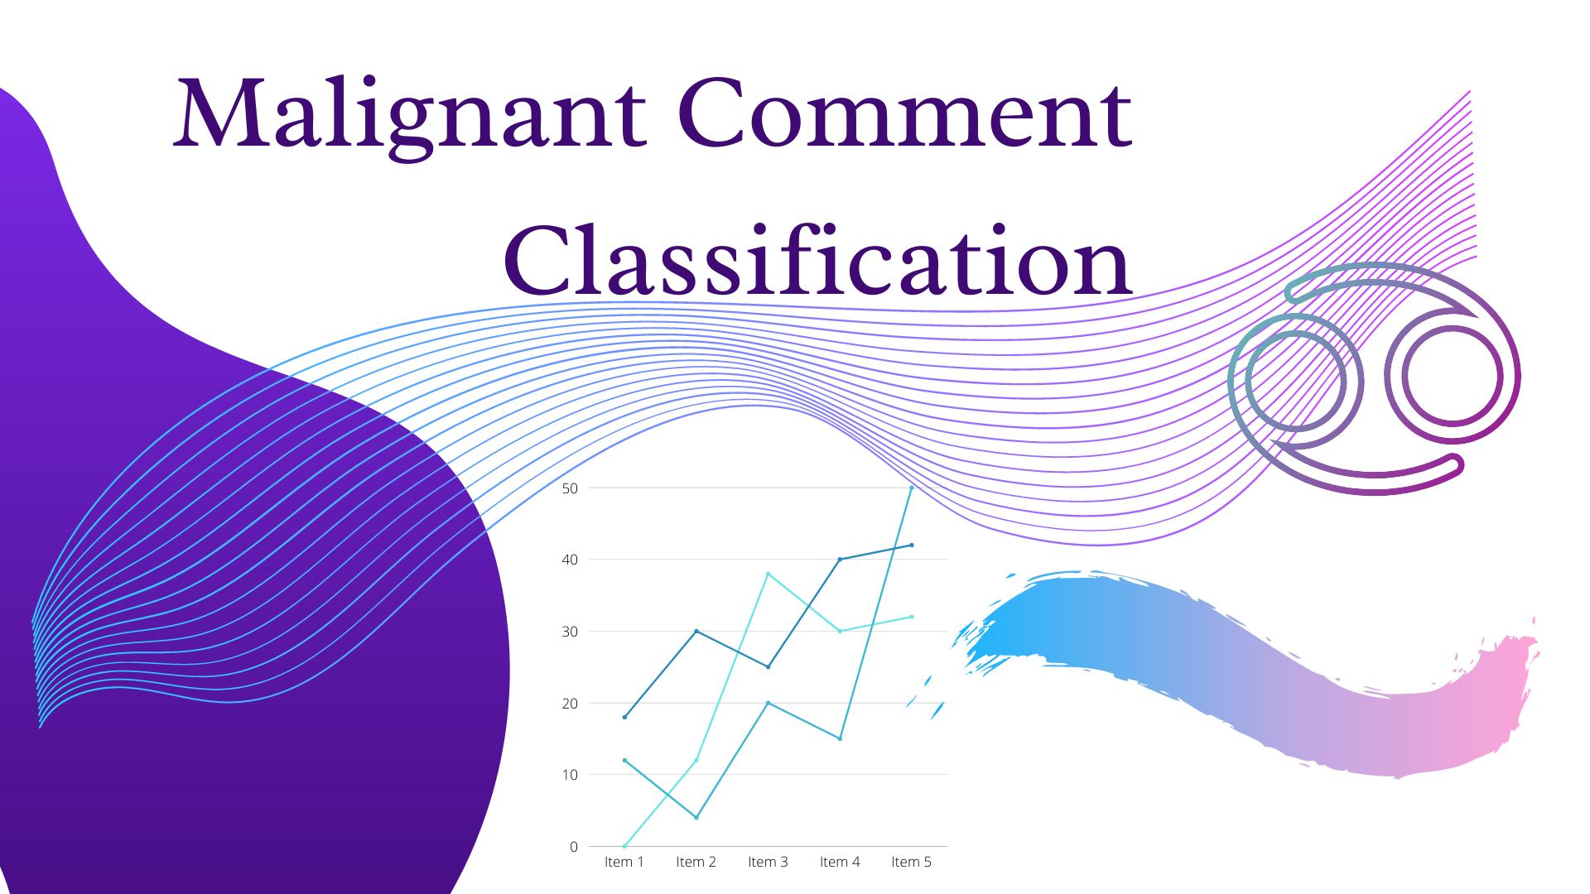

Slide 3
OBJECTIVE
We have undertaken this project to classify the comments made by different users on social media platforms, like the tweets from Twitter in this case, to build a model that is capable of detecting and classifying these tweets into various classes like threat, obscene, insult and identity-based hate.

Slide 4
INTRODUCTION
People use social media as a platform to express their opinions and views.
They do this freely and without any reluctance.
With it comes the risk of cyber abuse and harassment, which can put an end to people expressing themselves and giving up on seeking opinions.
To protect the users from cyberbullying, every organization should have an automated system in place to identify such malicious comments and suitable actions against the same.

Slide 5
Problem Statement
The proliferation of social media enables people to express their opinions widely online. However, at the same time, this has resulted in the emergence of conflict and hate, making online environments uninviting for users. Although researchers have found that hate is aproblem across multiple platforms, there is a lack of models for online hate detection.
Online hate, described as abusive language, aggression, cyberbullying, hatefulness and many others has been identified as a major threat on online social media platforms. Social media platforms are the most prominent grounds for such toxic behaviour.
There has been a remarkable increase in the cases of cyberbullying and trolls on various social media platforms. Many celebrities and influences are facing backlashes from people and have to come across hateful and offensive comments. This can take a toll on anyone and affect them mentally leading to depression, mental illness, self-hatred and suicidal thoughts.
Internet comments are bastions of hatred and vitriol. While online anonymity has provided a new outlet for aggression and hate speech, machine learning can be used to fight it. The problem we sought to solve was the tagging of internet comments that are aggressive towards other users. This means that insults to third parties such as celebrities will be tagged as unoffensive, but “u are an idiot” is clearly offensive.
Our goal is to build a prototype of online hate and abuse comment classifier which can used to classify hate and offensive comments so that it can be controlled and restricted from spreading hatred and cyberbullying.

Slide 6

PREPROCESSING OF THE DATA
We have performed the following preprocessing on the data:
Removed punctuations
Removed the stop words
Stemming and lemmatization
Applied TfidfVectorizer

Slide 7
DATA MODELLING
Problem Transformation Method
We used the Random Forest Classifier for classification.
We used this classifier, since it is suitable for classification with discrete features.
The algorithm estimates the conditional probability of a particular word given a class as the relative frequency of term t in documents belonging to class(c).
The variation takes into account the number of occurrences of term t in training documents from class (c),including multiple occurrences.

Slide 8
DATA MODELLING
Adaptation Algorithms
We used the Backpropagation for Multilabel Learning algorithm.
The BPMLL algorithm is a back-propagation neural network algorithm adapted for multi-label classification by having multiple binary outputs as the label variables.
It helped to classify the tweets in real-time as the algorithm changes its behavior at the time it is run, based on information available and on a priori defined criterion.

Slide 9


Slide 10
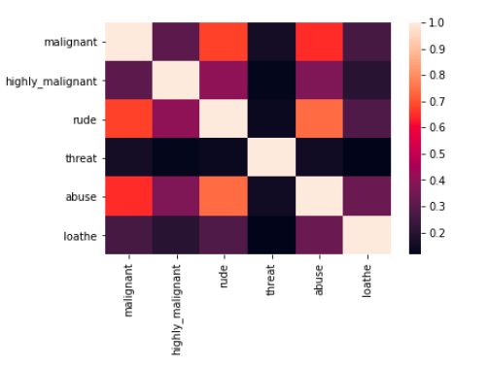
HEATMAP

Slide 11
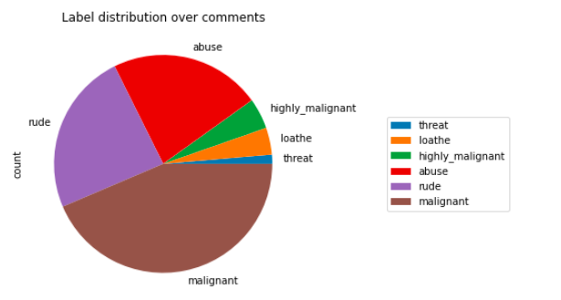
DATA VISUALIZATIONS

Slide 12
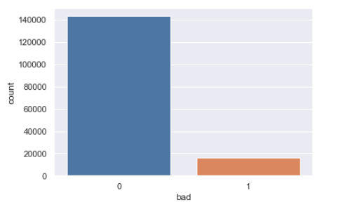
DATA VISUALIZATIONS

Slide 13
CHALLENGES
Multiple labels – For Binary classification we have many models available but for multilabel classification the selection of models decreases drastically.
Collection of USABLE DATA – although we extracted over 100000 records, only 14000 records were usable among them.
Cleaning the data – Due to the character limit tweets contain a lot of short forms which are different to classify using bag of words model.
TWITTER RATE LIMIT – Due to the twitter rate limit we were getting timed out every 15 mins due to which the data collection process took over 8 hours.

Slide 14
FUTURE SCOPE
The current project predicts the type or toxicity in the comment.
We are planning to add the following features in the future:
Analyze which age group is being toxic towards a particular group or brand.
Add feature to automatically sensitize words which are classified as toxic.
Automatically send alerts to the concerned authority if threats are classified as severe.
Build a feedback loop to further increase the efficiency of the model.
Handle mistakes and short forms of words to get better accuracy of the result.

Slide 15

Thank You

