Slide 1
RATINGS PREDICTION PROJECT
Presented by : Muktikanta Sahoo

Slide 2
INTRODUCTION
This is a Machine Learning Project performed on customer reviews. Reviews are processed using common NLP techniques.
Millions of people use Amazon and Flipkart to buy products. For every product, people can rate and write a review. If a product is good, it gets a positive review and gets a higher star rating, similarly, if a product is bad, it gets a negative review and lower star rating. My aim in this project is to predict star rating automatically based on the product review.
The range of star rating is 1 to 5. That means if the product review is negative, then it will get low star rating (possibly 1 or 2), if the product is average then it will get medium star rating (possibly 3), and if the product is good, then it will get higher star rating (possibly 4 or 5).
This task is similar to Sentiment Analysis, but instead of predicting the positive and negative sentiment (sometimes neutral also), here we need to predict the rating.

Slide 3
OBJECTIVE
In our scrapped dataset, our target variable "Rating " is a categorical variable i.e., it can be classified as ‘1.0’, ‘2.0’,’3.0’,’4.0’,’5.0’. Therefore, we will be handling this modelling problem as classification.
This project is done in two parts:
Data collection phase
Model Building phase

Slide 4
In Data collection phase, we will scrape nearly 25500 of reviews data from different e-commerce websites like Flipkart, etc. and it is collected by using Webscraping and Selenium.
Fetch an equal number of reviews for each rating, for example if you are fetching 10000 reviews then all ratings 1,2,3,4,5 should be 2000. It will balance our data set.
Convert all the ratings to their round number, as there are only 5 options for rating i.e., 1,2,3,4,5. If a rating is 4.5 convert it 5.
After collecting the data, you need to build a machine learning model. Before model building do all data pre-processing steps involving NLP. Try different models with different hyper parameters and select the best model. Follow the complete life cycle of data science. Include all the steps like-
1. Data Cleaning
2. Exploratory Data Analysis
3. Data Pre-processing
4. Model Building
5. Model Evaluation
6. Selecting the best model

Slide 5
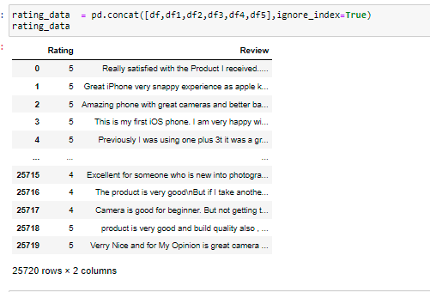
DATA SOURCES AND THEIR FORMATS

Slide 6

PREPROCESSING OF THE DATA
We have performed the following preprocessing on the data:
Removed punctuations
Removed the stop words
Stemming and lemmatization
Applied TfidfVectorizer

Slide 7
HARDWARE AND SOFTWARE REQUIREMENTS AND TOOLS USED
For doing this project, the hardware used is a laptop with high end specification and a stable internet connection. While coming to software part, I had used anaconda navigator and in that I have used Jupyter notebook to do my python programming and analysis.
For using an CSV file, Microsoft excel is needed. In Jupyter notebook, I had used lots of python libraries to carry out this project and I have mentioned below with proper justification:

Slide 8
DATA MODELLING
Problem Transformation Method
We used the Random Forest Classifier for classification.
We used this classifier, since it is suitable for classification with discrete features.
The algorithm estimates the conditional probability of a particular word given a class as the relative frequency of term t in documents belonging to class(c).
The variation takes into account the number of occurrences of term t in training documents from class (c),including multiple occurrences.

Slide 9
DATA MODELLING
Adaptation Algorithms
We used the Backpropagation for Multilabel Learning algorithm.
The BPMLL algorithm is a back-propagation neural network algorithm adapted for multi-label classification by having multiple binary outputs as the label variables.
It helped to classify the tweets in real-time as the algorithm changes its behavior at the time it is run, based on information available and on a priori defined criterion.

Slide 10


Slide 11
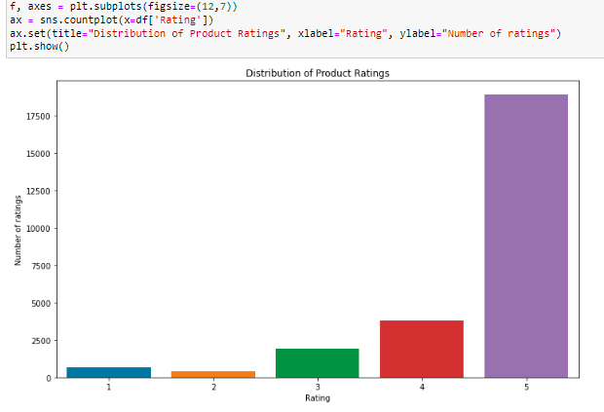
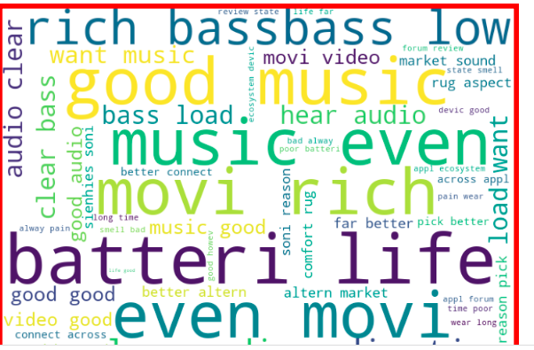
DATA VISUALIZATIONS

Slide 12
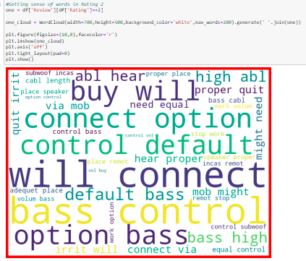
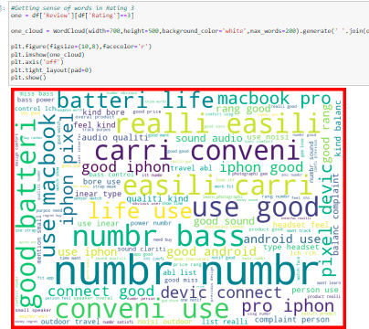
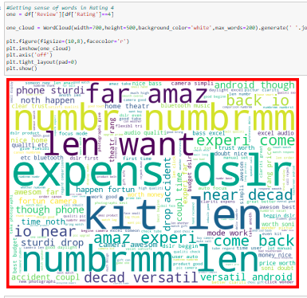
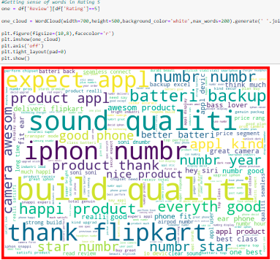
DATA VISUALIZATIONS

Slide 13
FUTURE SCOPE
The current project predicts the rating in the comment.
We are planning to add the following features in the future:
Analyze which was rating towards a particular product or brand.
Add feature to automatically sensitize words which are classified as rating.
Automatically send alerts to the concerned authority if threats are classified as severe.
Build a feedback loop to further increase the efficiency of the model.
Handle mistakes and short forms of words to get better accuracy of the result.

Slide 14
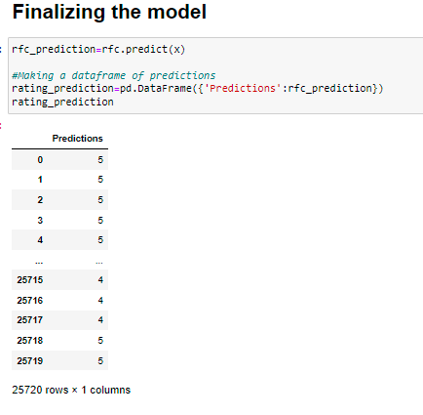
FINAL THE MODEL

Slide 15

Thank You

