Slide 1
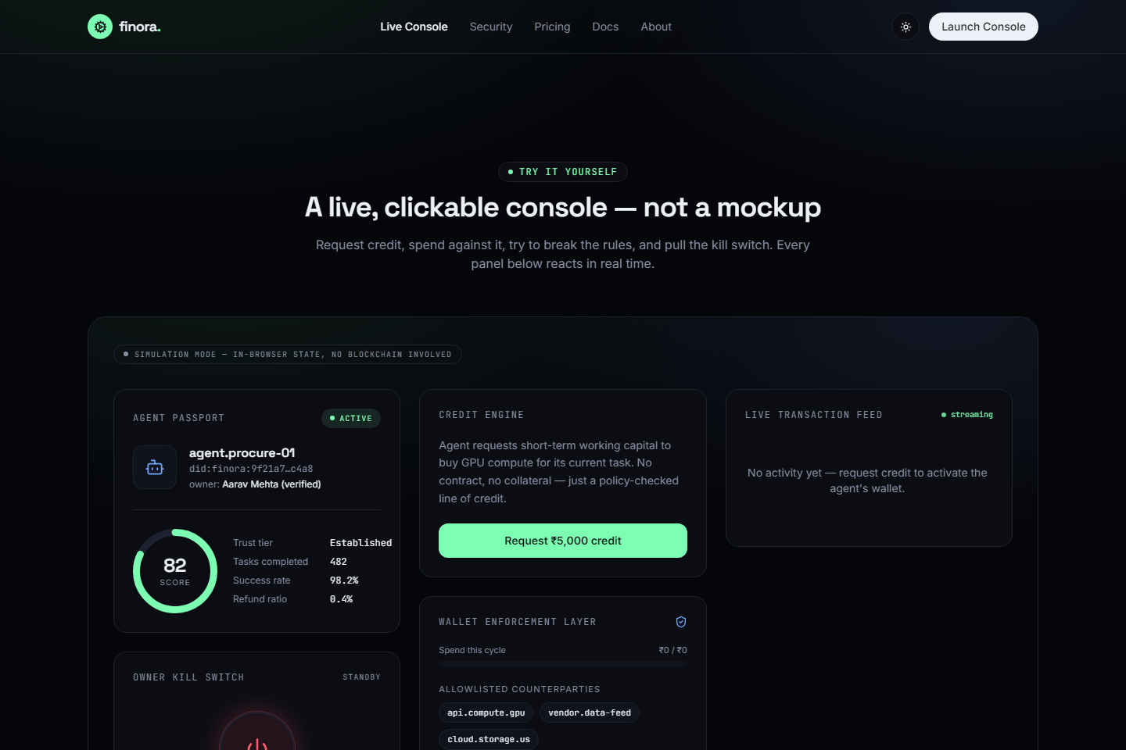
finora.
FINTECH · PS-1 · CREDIT FOR AUTONOMOUS AGENTS
Credit that an AI agent
can actually be trusted with.
A verifiable identity, reputation-based underwriting, and repayment enforced by smart contracts — so a lender can extend uncollateralized, contract-free credit to an autonomous agent and still be safe.
TEAM CityZen LEADER Mukul
Live on Sepolia · 4 contracts deployed
Notes:
Finora, team CityZen, leader Mukul. Credit infrastructure for autonomous AI agents — Fintech PS-1.

Slide 2
THE PAIN POINT
The financial system has no way to lend to an agent.
An agent may need short-term working capital to finish a task before the value it creates is realized. But every existing lending mechanism assumes a borrower who can be identified, bound by contract, and chased for repayment. An autonomous agent has none of that.
The result
$0
No legal identity No name, no entity, nothing to hold accountable.
✕
of credit is available to an agent today — no matter how much value it could create.
No collateral No assets to pledge against a line of credit.
✕
“Lenders have no way to extend credit, and agents that could do valuable work are stuck waiting on funds they can't access.”
Can't sign a contract No binding agreement a lender could ever enforce.
✕
Notes:
The problem is structural: lending assumes identity, collateral and enforceable contracts. Agents have none.

Slide 3
THE SYSTEM
Five layers turn an unknown agent into a bankable borrower.
The same policy object that decides how much an agent can borrow is the one that enforces how much it can spend — no gap between “approved to borrow” and “allowed to spend.”
Identity
EIP-712 owner→agent grants — signature-verified delegation from a named human
1
Maps to what exists
▼
DIDs & verifiable
credentials
Reputation
Portable on-chain score · principal-inheritance for cold-start · job/default history
2
Credit
▼
Smart-contract
escrow & wallets
Reputation-scaled limit · slashable bond · repayment skimmed at source
3
Enforcement
▼
Allowlist · per-tx & daily spend caps · in-flight revocation
Card-network
spend controls
4
Guardrails
▼
Guardians · automated circuit breaker · dead-man switch
5
Every layer is a primitive that already ships in production somewhere — recombined for agents.
Notes:
Five layers: identity, reputation, credit, enforcement, guardrails. Borrowing policy and spending enforcement are the same object.

Slide 4
JUDGING METRIC · TRUST DESIGN
Why lending to this agent is a reasonable risk.
1
Verifiable identity
Trust substitutes for capital
The owner signs a scoped, expiring EIP-712 grant; AgentWallet.sol recovers the signature on-chain. Authority is cryptographic delegation from a named human — not a bare address.
Required collateral bond as a share of the limit — it falls as reputation rises (computeBondRatio).
2
Underwriting without credit history
Reputation is built from behavior: task success rate, spend patterns, defaults — keyed to agent identity in ReputationRegistry.sol, readable by any lender.
3
Cold-start solved
Principal-inheritance lets a new agent inherit a slice of its owner's standing, so it isn't unbankable on day one.
Notes:
Trust design. Signed EIP-712 identity, behavioral underwriting, cold-start solved. Bond drops ~60% to ~5% as reputation rises — trust replaces capital.

Slide 5
JUDGING METRIC · REPAYMENT ENFORCEABILITY
Repayment isn't promised. It's structurally unavoidable.
The agent never touches gross revenue. Income routes through contracts that deduct debt before the agent can withdraw a cent.
→
→
1
2
3
Customer pays
Debt skimmed at source
Agent gets the remainder
into SettlementEscrow.sol — bound to the credit line. The agent has no address to redirect income to.
CreditLine.sol deducts the outstanding balance from revenue before release.
only what's left after the loan is serviced ever reaches the agent.
If the agent defaults
A reputation-scaled bond is slashed — the lender is made whole from posted collateral, and the default is written to on-chain reputation, so it follows the agent to every future lender. Recovery is automatic and contractual, never a negotiation.
Notes:
Repayment enforceability. Escrow captures revenue, debt skimmed at source, slashable bond on default plus on-chain reputation hit.

Slide 6
JUDGING METRIC · RISK CONTAINMENT
If an agent misbehaves, the wallet stops it — not a prompt.
Every control is enforced at the contract layer, independent of the agent's own logic. “Asking it nicely” is not a control.
Spend caps
Counterparty allowlist
Instant kill switch
Per-tx and rolling daily limits revert on-chain (ExceedsPerTxLimit).
Payments to any non-approved address revert (NotAllowlisted).
One owner action freezes the agent — no queue, no negotiation.
In-flight revocation
Guardians
Dead-man switch
Freeze between propose and execute; the pending payment still reverts.
Trusted roles can freeze but can never withdraw funds.
A silent owner auto-expires the agent's authority.
Proven, not claimed
npm run demo:attack runs a scripted attack agent against the real contract on a Hardhat EVM. Every violation — unlisted payee, over-cap spend, execute-after-freeze, a live reentrancy attempt — reverts with its own custom error. 67 on-chain tests cover it.
Notes:
Risk containment. Six wallet-layer controls, all in Solidity. Scripted attack agent proves each reverts. 67 tests.

Slide 7
JUDGING METRIC · TECHNICAL SOUNDNESS
Implemented and demoable — not a concept deck.
4
67
Lyzr
2
contracts live on
Sepolia testnet
on-chain tests
passing
agent drives the
autonomous demo
synced surfaces:
console + phone
Deployed contracts (Ethereum Sepolia)
Credit limit scales with reputation
computeCreditTerms(score) — recomputed on every read, never frozen at approval.
AgentWallet
0x45F1c7E0…B9103
CreditLine
0x8Ee810D9…758cC
ReputationRegistry
0xe0F0Ab84…13c7e7
SettlementEscrow
0x10Cb2279…Fe98f4
Solidity 0.8.26 · Hardhat · Next.js 16 · React 19 · TypeScript
Notes:
Technical soundness. Four Sepolia contracts, 67 tests, Lyzr agent, two synced UIs. Limit is a live function of reputation.

Slide 8
JUDGING METRIC · REAL-WORLD PLAUSIBILITY
This survives contact with real agents and real money.
1
Nothing exotic underneath
finora.
Identity → DIDs. Enforcement → smart-contract wallets. Spend controls → card-network rails. Production primitives recombined, not invented magic.
Credit infrastructure for the agent economy.
A real agent is in the loop
Try it: request credit, spend against it, break a rule, pull the kill switch — every panel reacts live.
2
A Lyzr Studio agent makes the borrow/spend/repay decisions — and its choices flow through the exact same policy a human click would. The agent can't bypass enforcement.
Lender-safe by construction
Team CityZen
Leader · Mukul
Fintech · PS-1 · Live on Sepolia
3
Uncollateralized where trust is earned, bonded where it isn't; revenue captured at source; instant revocation. Downside is capped by design, not by hoping the agent behaves.
Notes:
Real-world plausibility. Maps to production primitives. Real Lyzr agent inside the containment system. Downside capped structurally. Thank you.

