Slide 1
Drink & Delight
Inventory Management System

Slide 2
NAME | ROLE
MUKUL GARG | PRODUCT OWNER

Slide 3
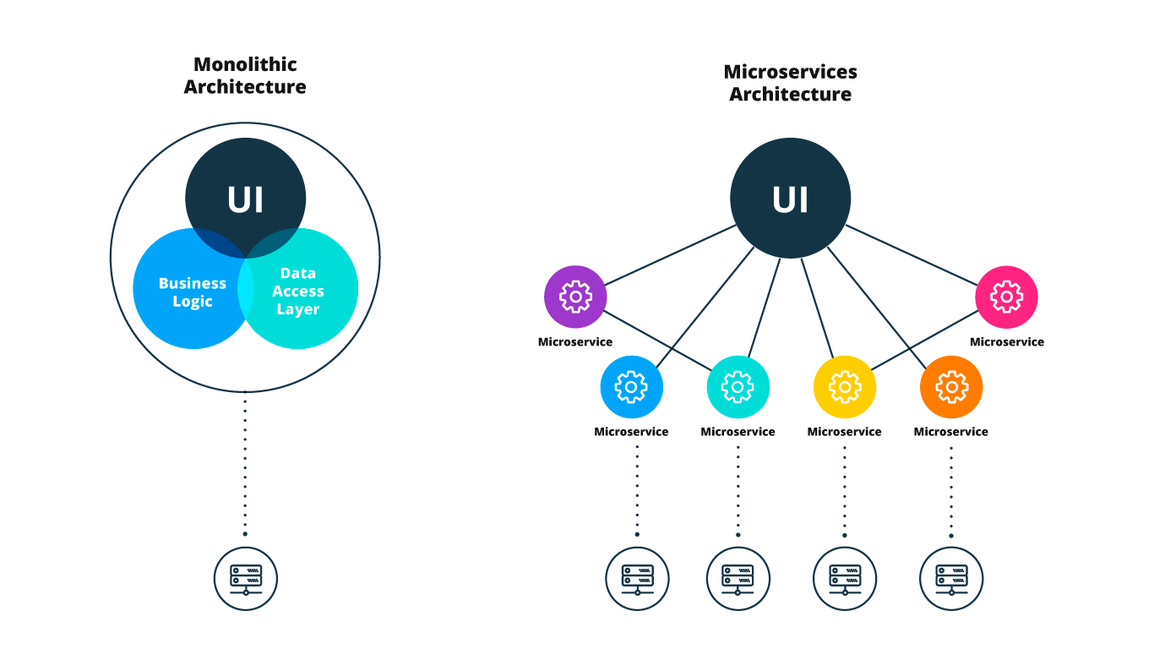
Architecture Design

Slide 4
MODULES

Slide 5
UPDATE RAW MATERIAL STOCK AND DISPLAY DISTRIBUTOR DETAILS

Slide 6
SEQUENCE DIAGRAM

Slide 7
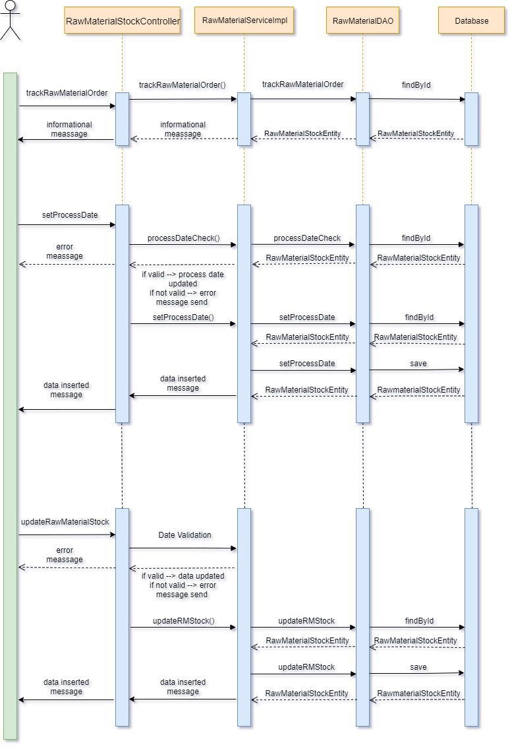
Update Raw Material Stock

Slide 8
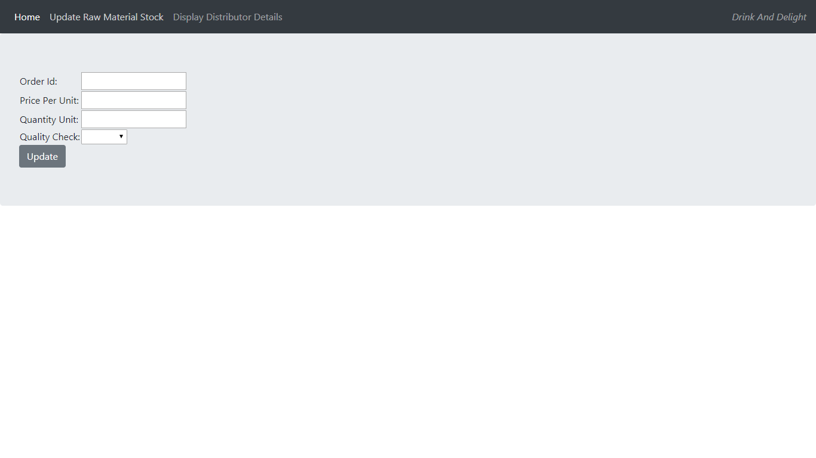

Slide 9
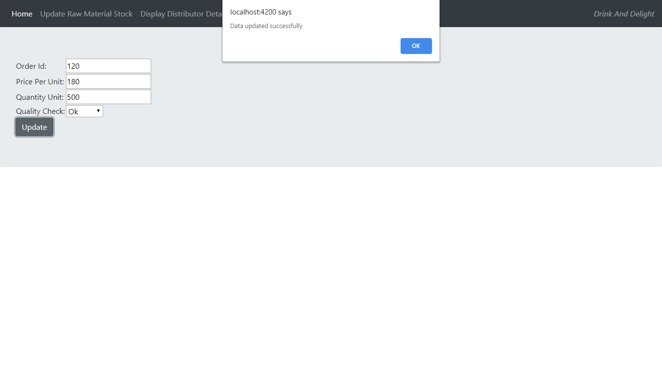

Slide 10


Slide 11
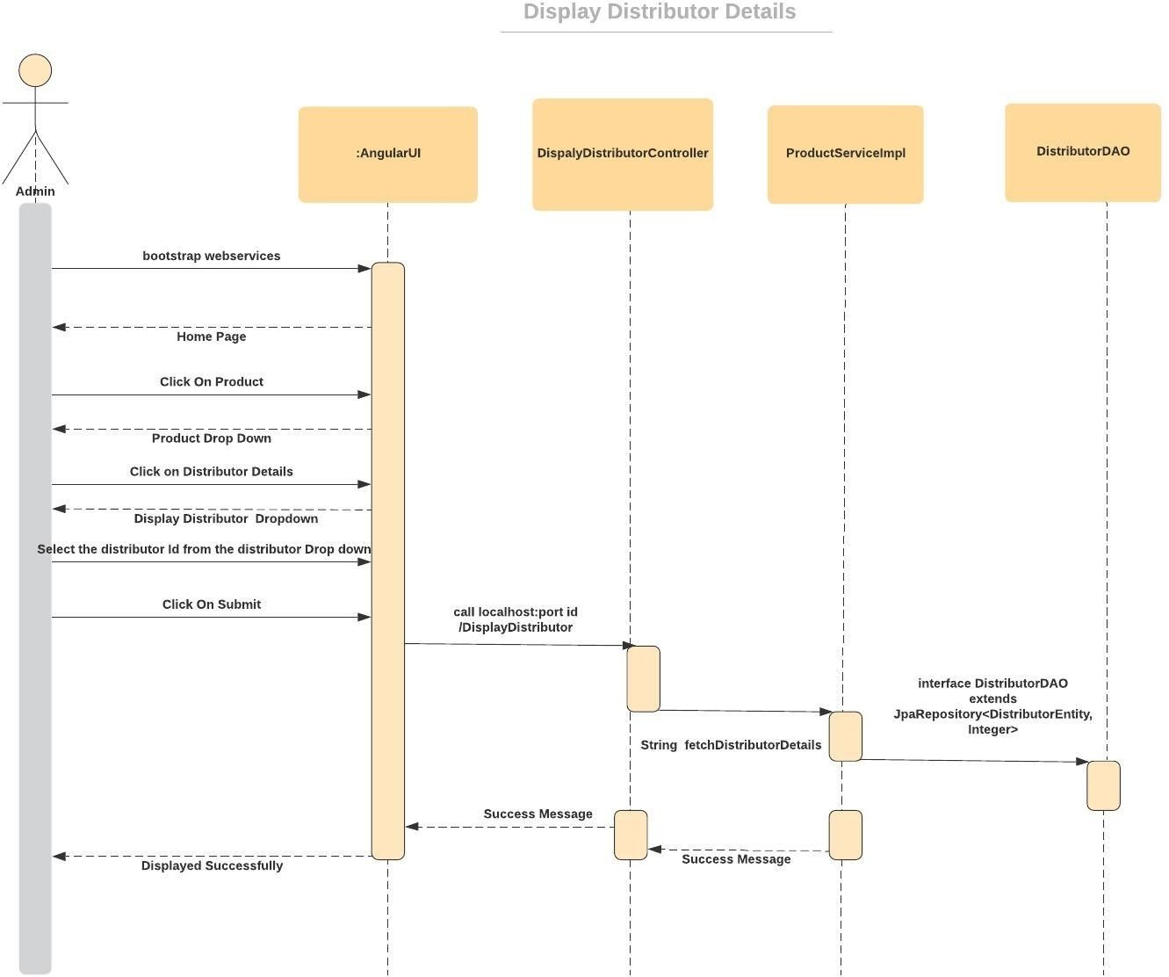
Display Distributor Details

Slide 12
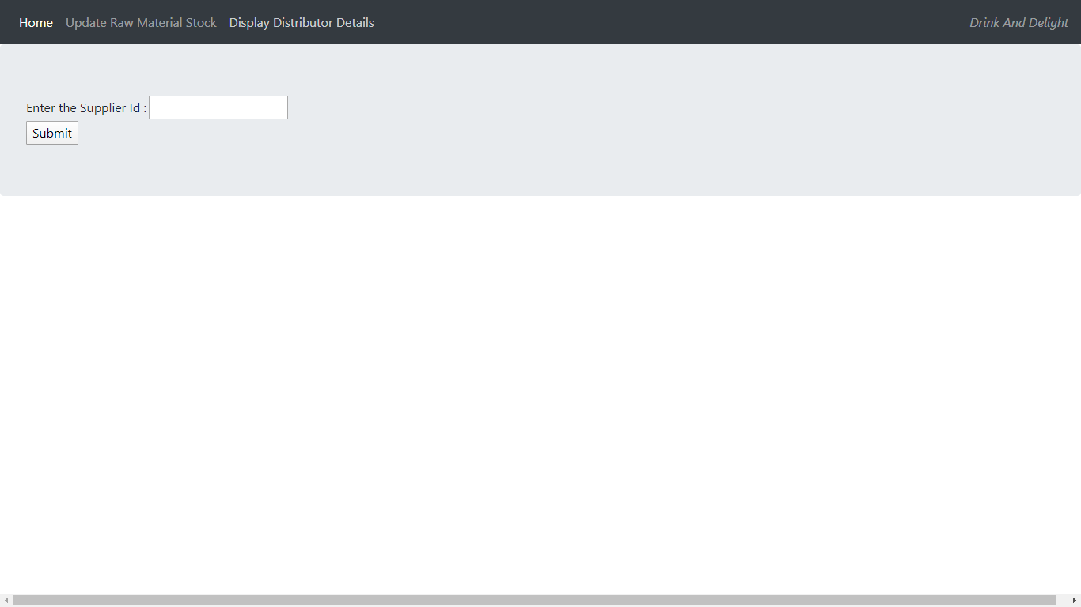

Slide 13
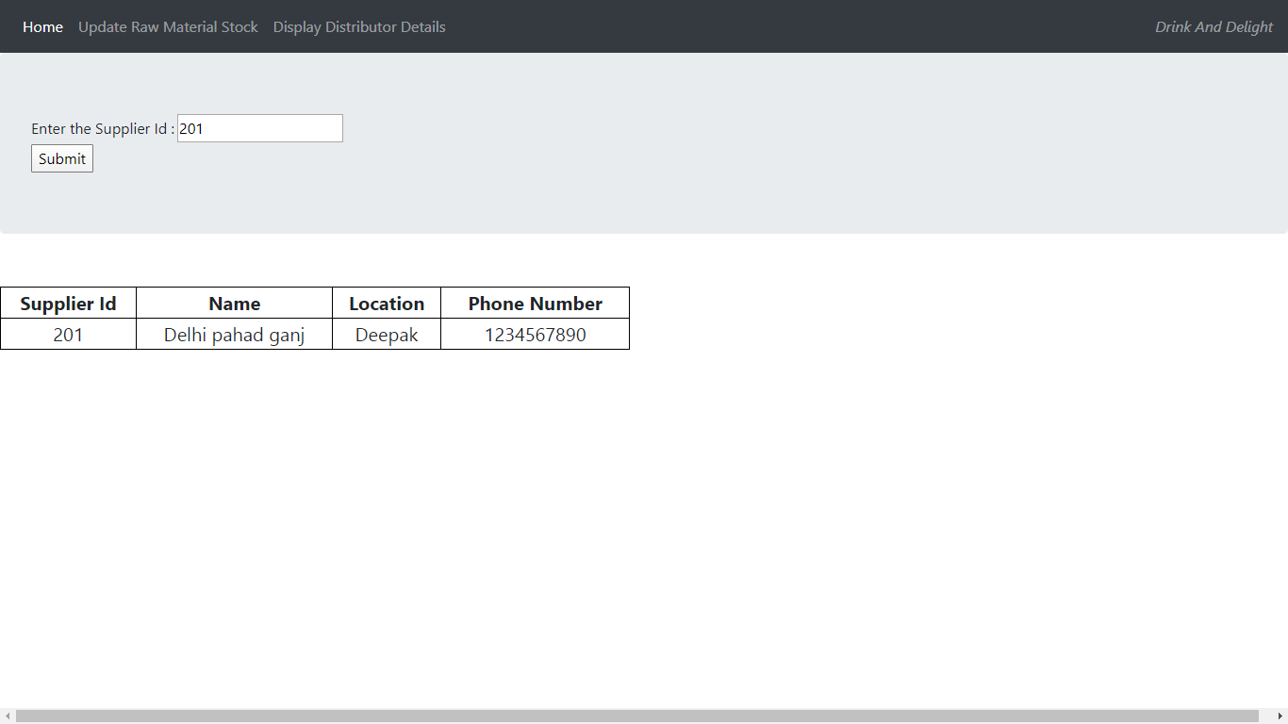

Slide 14
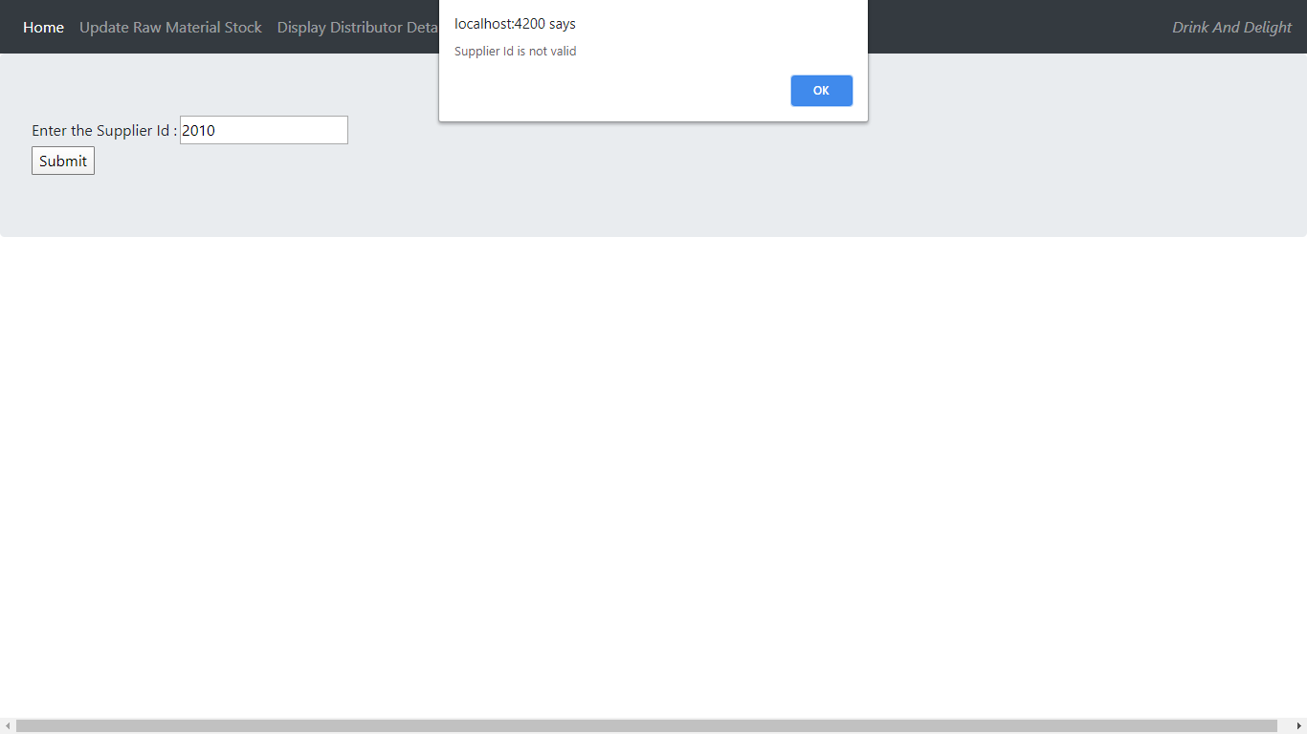

Slide 15
Thank you

