Slide 1







Project Name: Game Analytics
Subtitle : Unlocking Tennis Data using SQL & Streamlit
Team Members : Ruchi , Mukul, Drish
Mukul : Database Architecture + Data Loading
SportRadar API | Python | PostgreSQL
Ruchi : SQL Queries + Key Insights
MYSQL | PostGreSQL
Drish : STREAMLIT DASHBOARD
Supabase PostgreSQL | Streamlit
Date : 20 Jan 2026

Slide 2




PROBLEM STATEMENT
Problem Brief
SportRadar provides detailed tennis competition data through its API, but the data comes in raw, nested JSON format. Because of this structure, it becomes difficult to directly understand competition hierarchies, track tournaments, and analyze key event information without first organizing it into a structured system.
Why It Matters
Without structured data, analyzing tournament hierarchies and competition details becomes slow and inefficient for analysts and stakeholders.
What We Solve
We transform SportRadar JSON data into a structured SQL database. Then we visualize key insights through an interactive Streamlit dashboard.

Slide 3




PROJECT OVERVIEW
What We Built
An end-to-end tennis data solution that extracts, stores, analyzes, and visualizes SportRadar competition data.
Workflow
SportRadar API → Raw JSON → Parsed Data → SQL Database → Streamlit Dashboard → Insights
Core Modules
Data Ingestion: Fetch & parse SportRadar API data (Python)
Database Layer: Structured tables + relationships (PostgreSQL/MySQL)
Analytics: SQL queries for insights & trends
Dashboard: Interactive Streamlit app (Supabase PostgreSQL)
Key Outputs
Competition hierarchy & categories
Venue / complex information
Competitor rankings & points insights

Slide 4


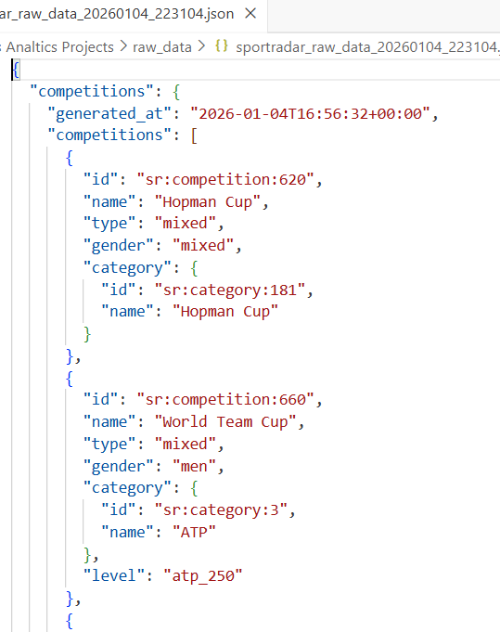


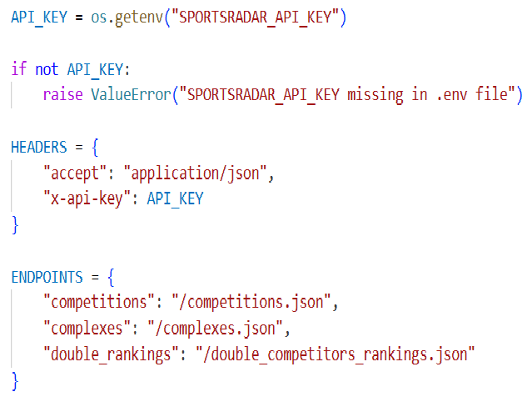
DATA SOURCE
API Endpoints
Complexes & Venues: /complexes.json
Doubles Rankings: /double_competitors_rankings.json
Competitions: /competitions.json
Data Format
Raw response in JSON (nested structure)
Entities Extracted
Categories & Competitions
Complexes & Venues
Competitors & Rankings

Slide 5
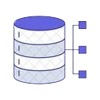
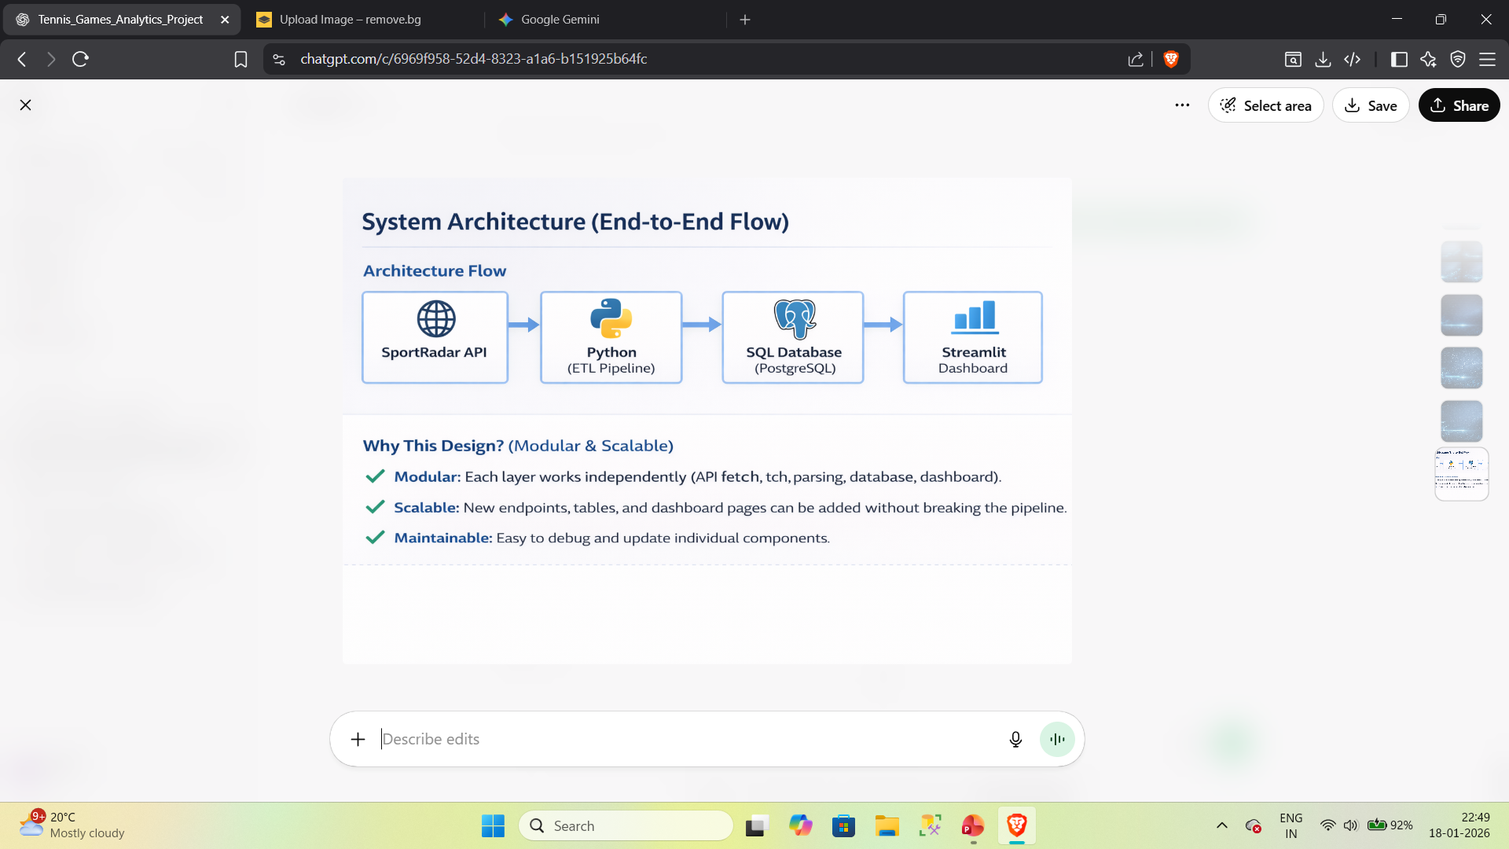
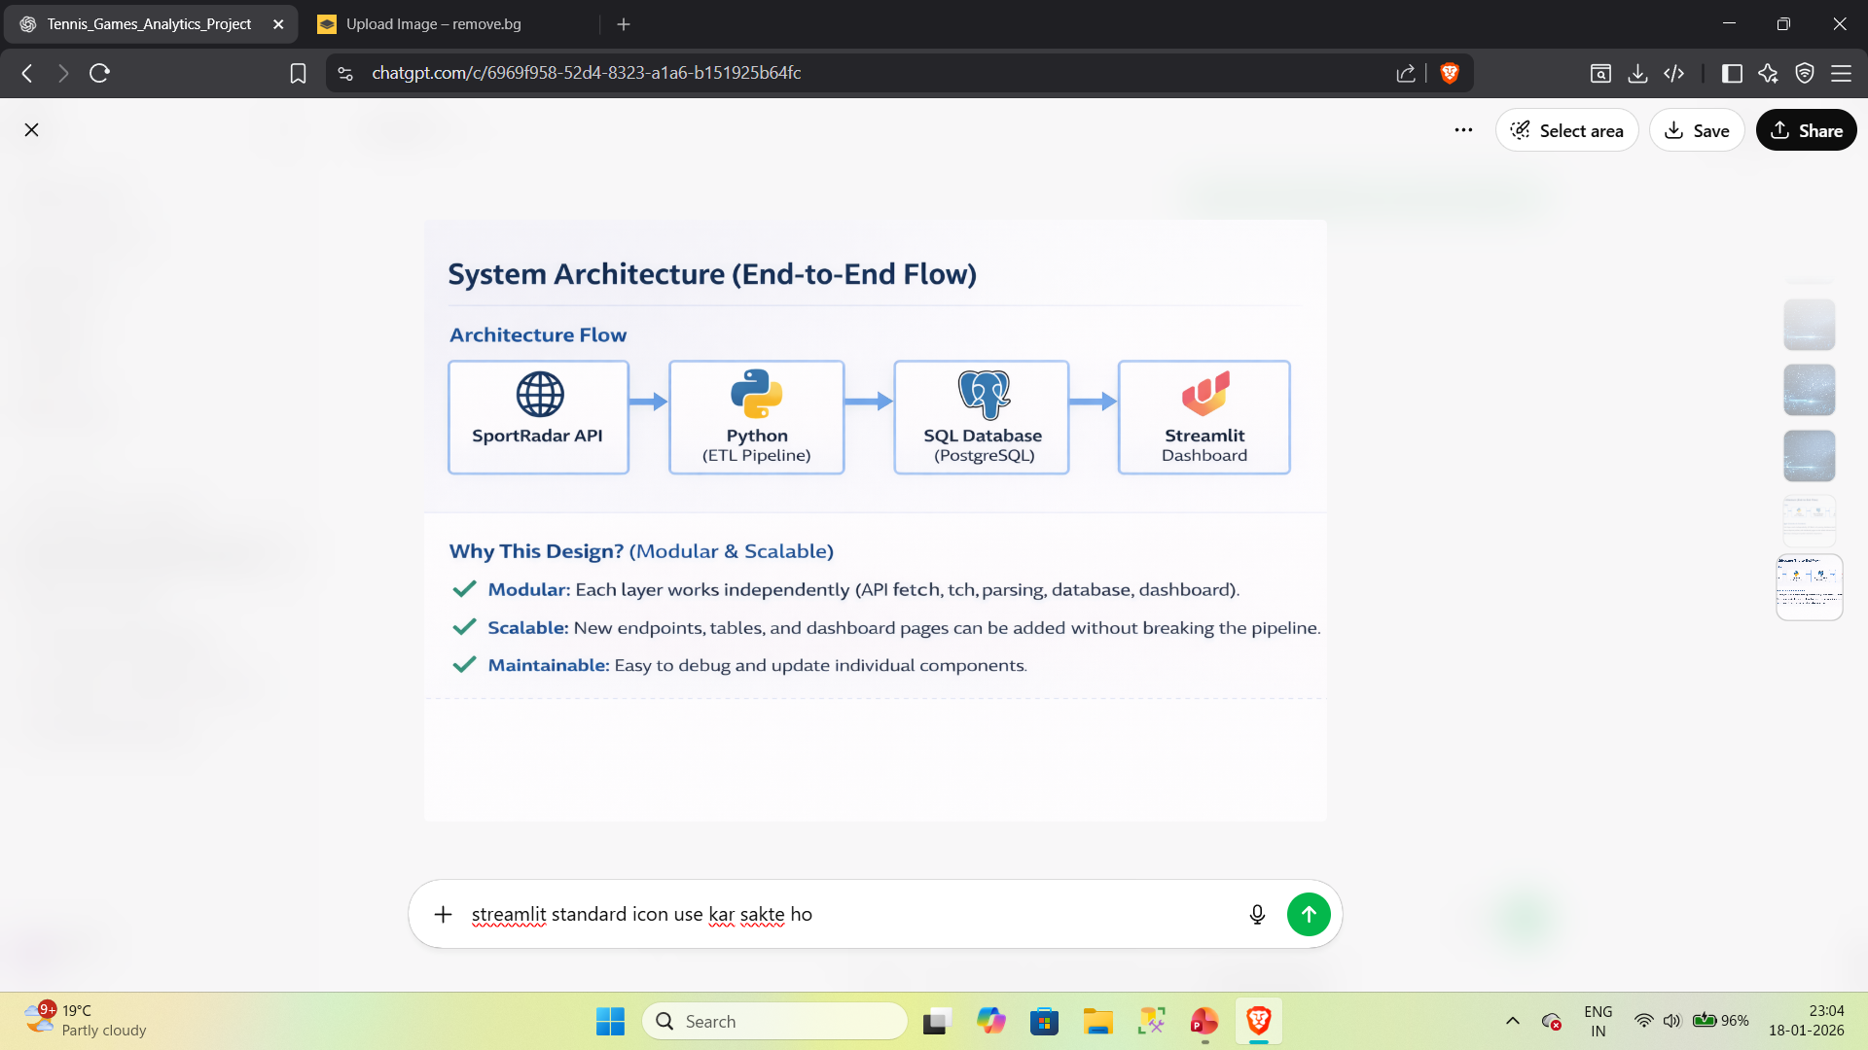

DATABASE ARCHITECTURE
Architecture Flow
Why This Design?
Modular:
Each layer works independently (API fetch, ETL processing, database, dashboard).
Scalable:
New endpoints, tables, and dashboard pages without breaking pipeline.
Maintainable:
Simple to debug, update, and manage each component separately.

Slide 6

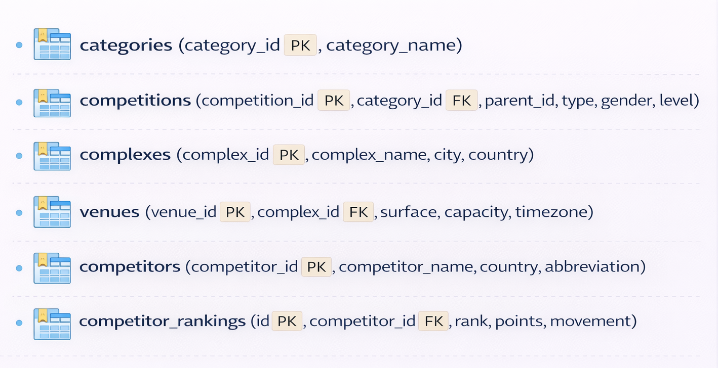
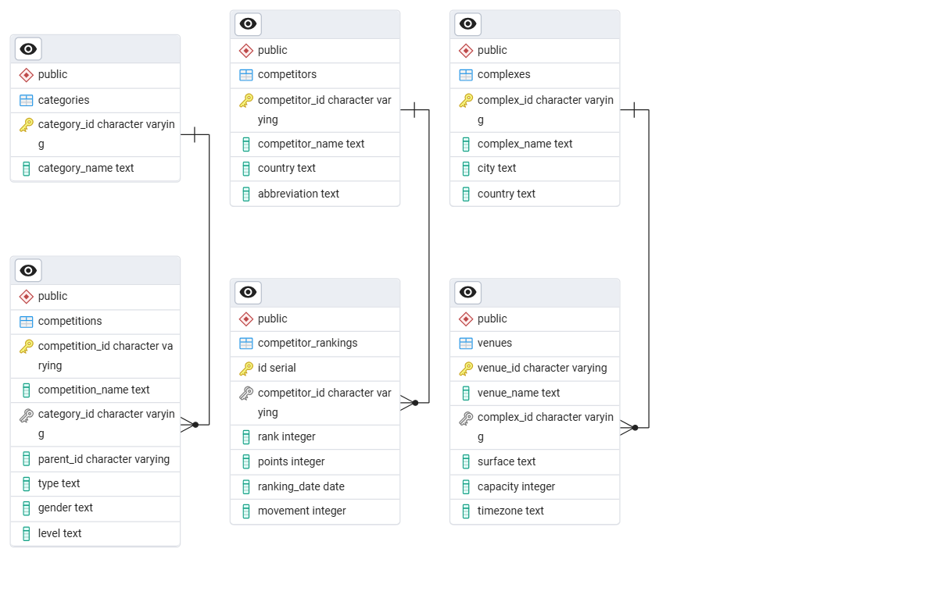
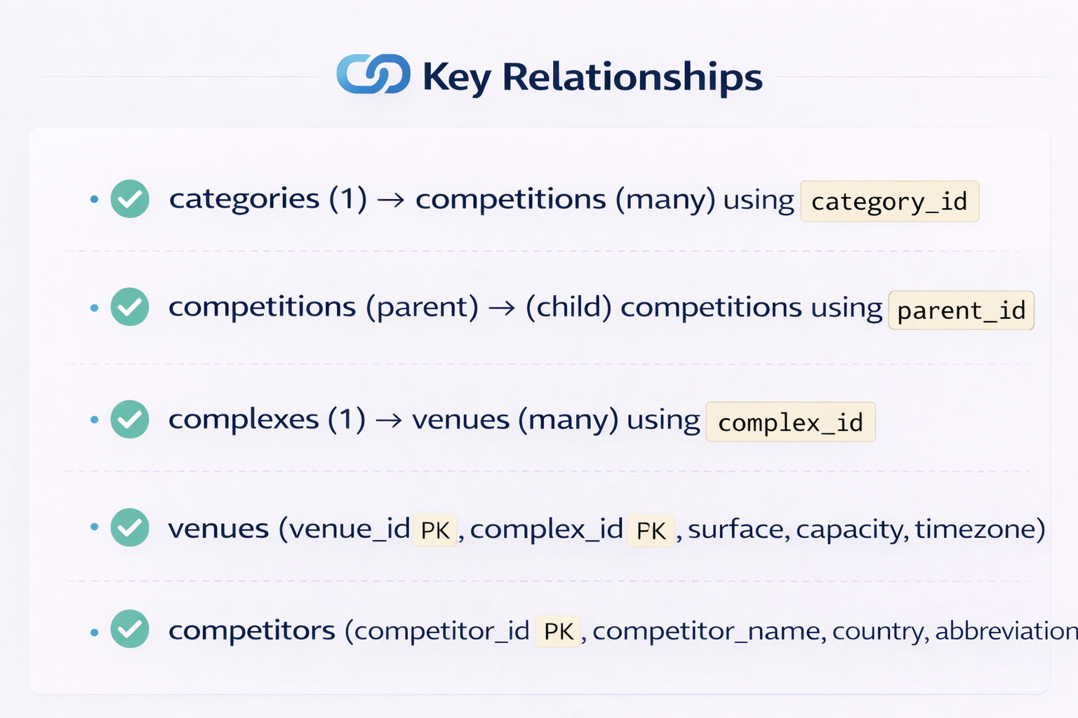
DATA MODEL
Tables
Key Relationships

Slide 7
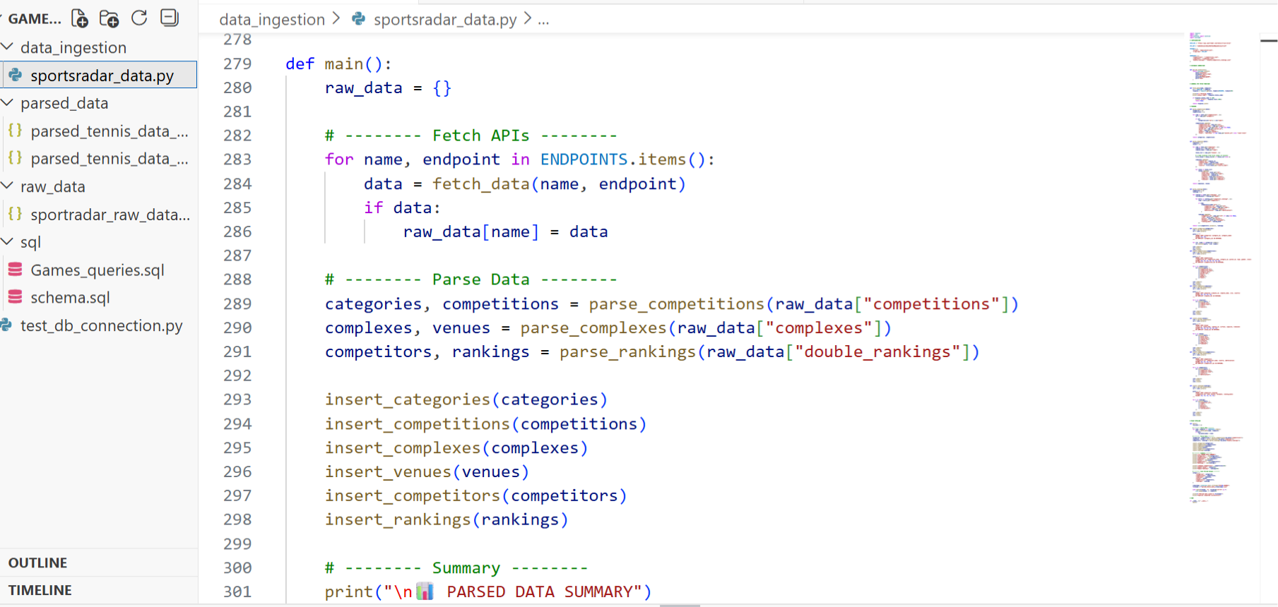
Data Ingestion & Loading
ETL Pipeline
Fetched data from SportRadar API endpoints
Stored raw response as JSON
Parsed & cleaned into structured format using Python
Inserted into PostgreSQL tables using psycopg2
Used ON CONFLICT DO NOTHING to avoid duplicates

Slide 8

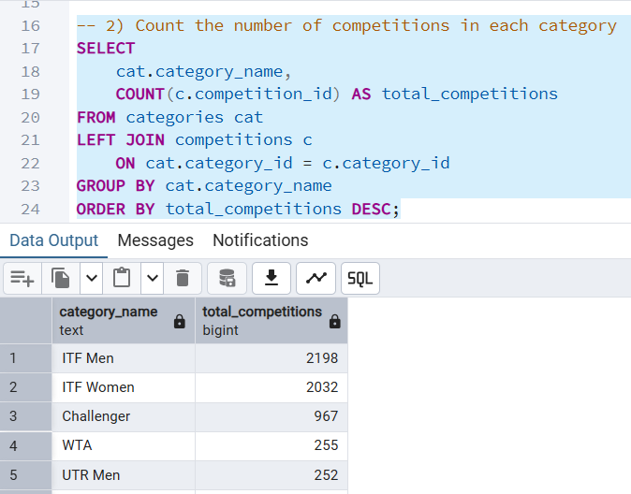
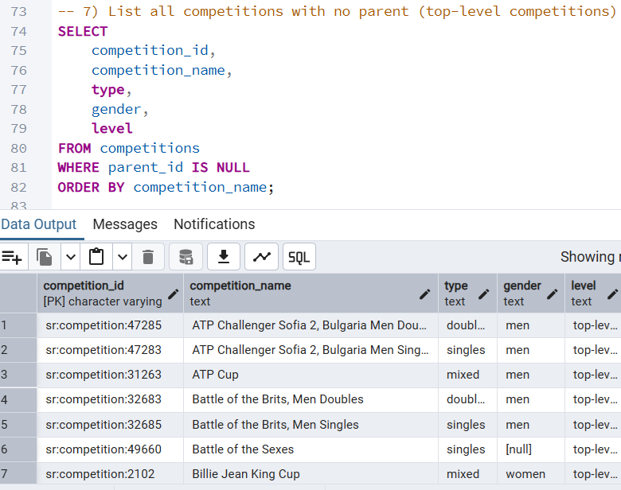
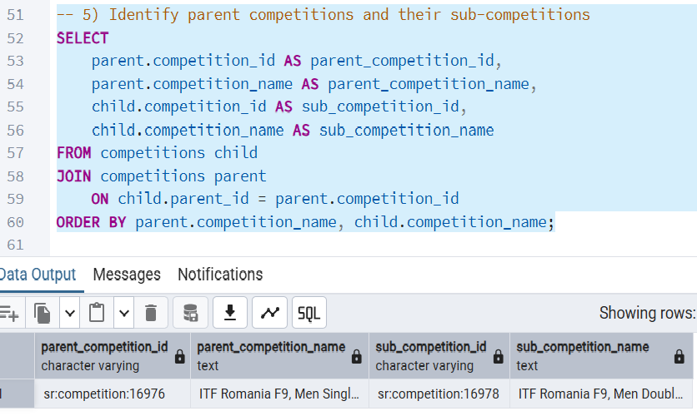
SQL ANALYSIS
Query 1 : Competitions Count by Category
Query 2 : List all competitions with no parent (top-level competitions)
Query 3 : Parent vs Sub-Competitions (Hierarchy)

Slide 9
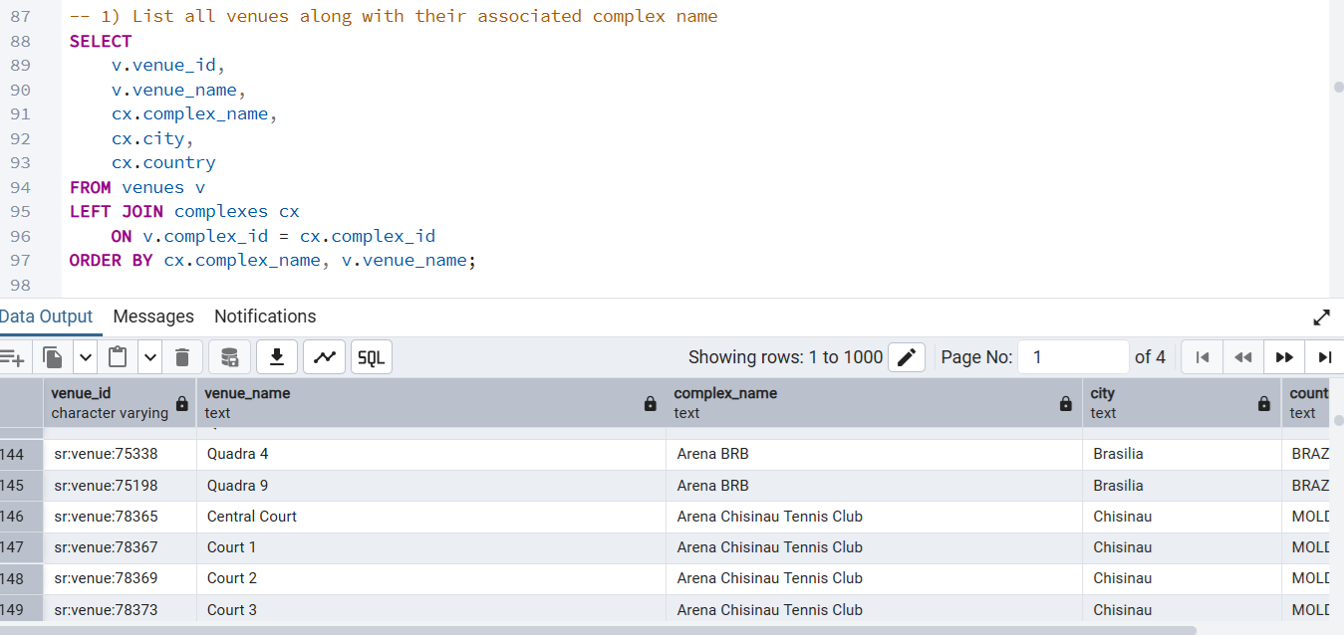
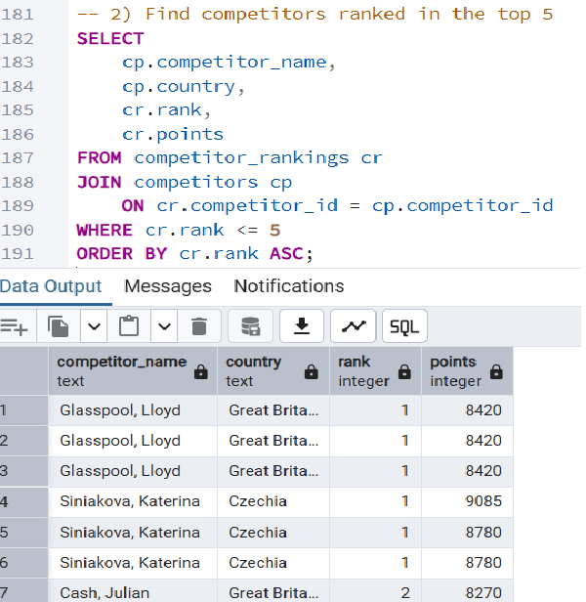
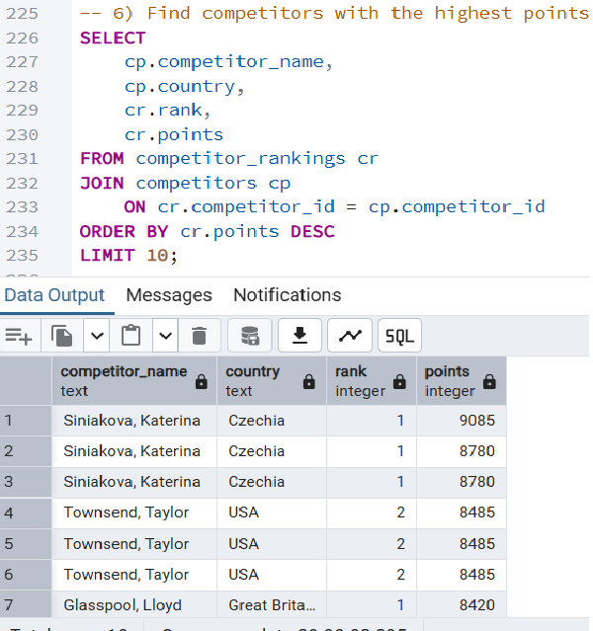
SQL ANALYSIS
Query 4 : Competitions Count by Category
Query 5 : Find competitors ranked in the top 5
Query 6 : Find competitors with the highest points in the current week

Slide 10
STREAMLIT DASHBOARD OVERVIEW
What the Dashboard Shows
Competition & Rankings analytics in an interactive format
Country-wise performance and top competitor insights
Quick exploration with filters + leaderboard views
Main Features
KPI Cards: Total Competitors, Countries Represented, Highest Points
Search & Filter: By competitor name, country, rank range, points threshold
Leaderboards: Top ranked players + highest points table
Country-wise Analysis: Average points distribution by country
Backend Integration
Dashboard connected to Supabase PostgreSQL
Data fetched live using secure Streamlit secrets/config

Slide 11
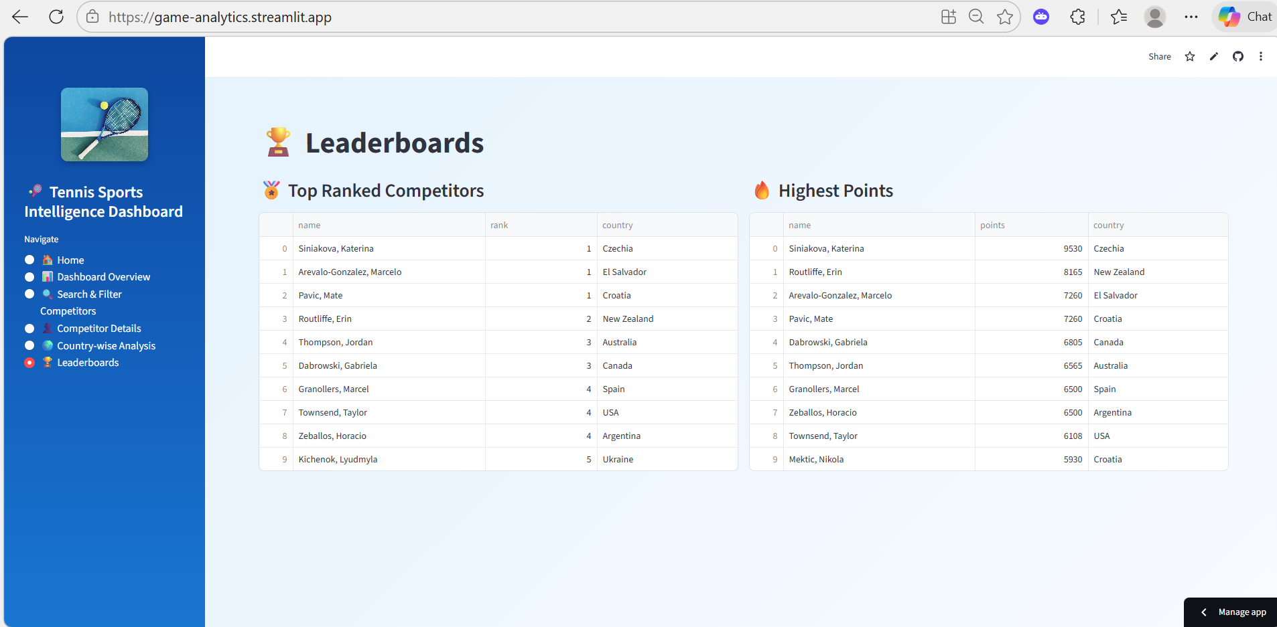
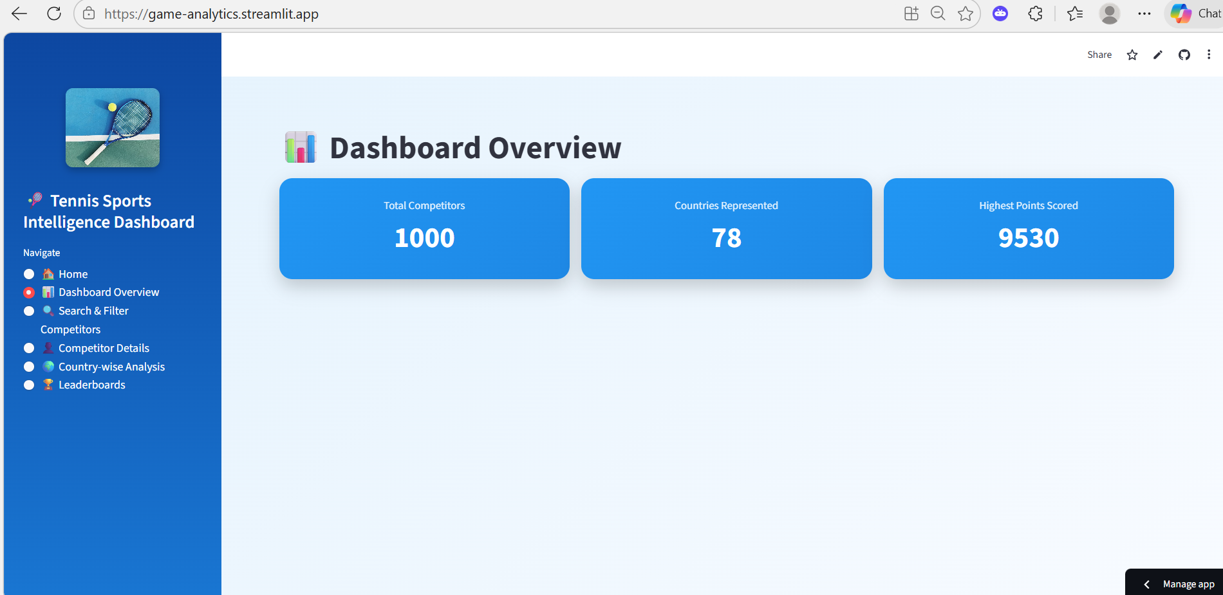

STREAMLIT DASHBOARD

Slide 12
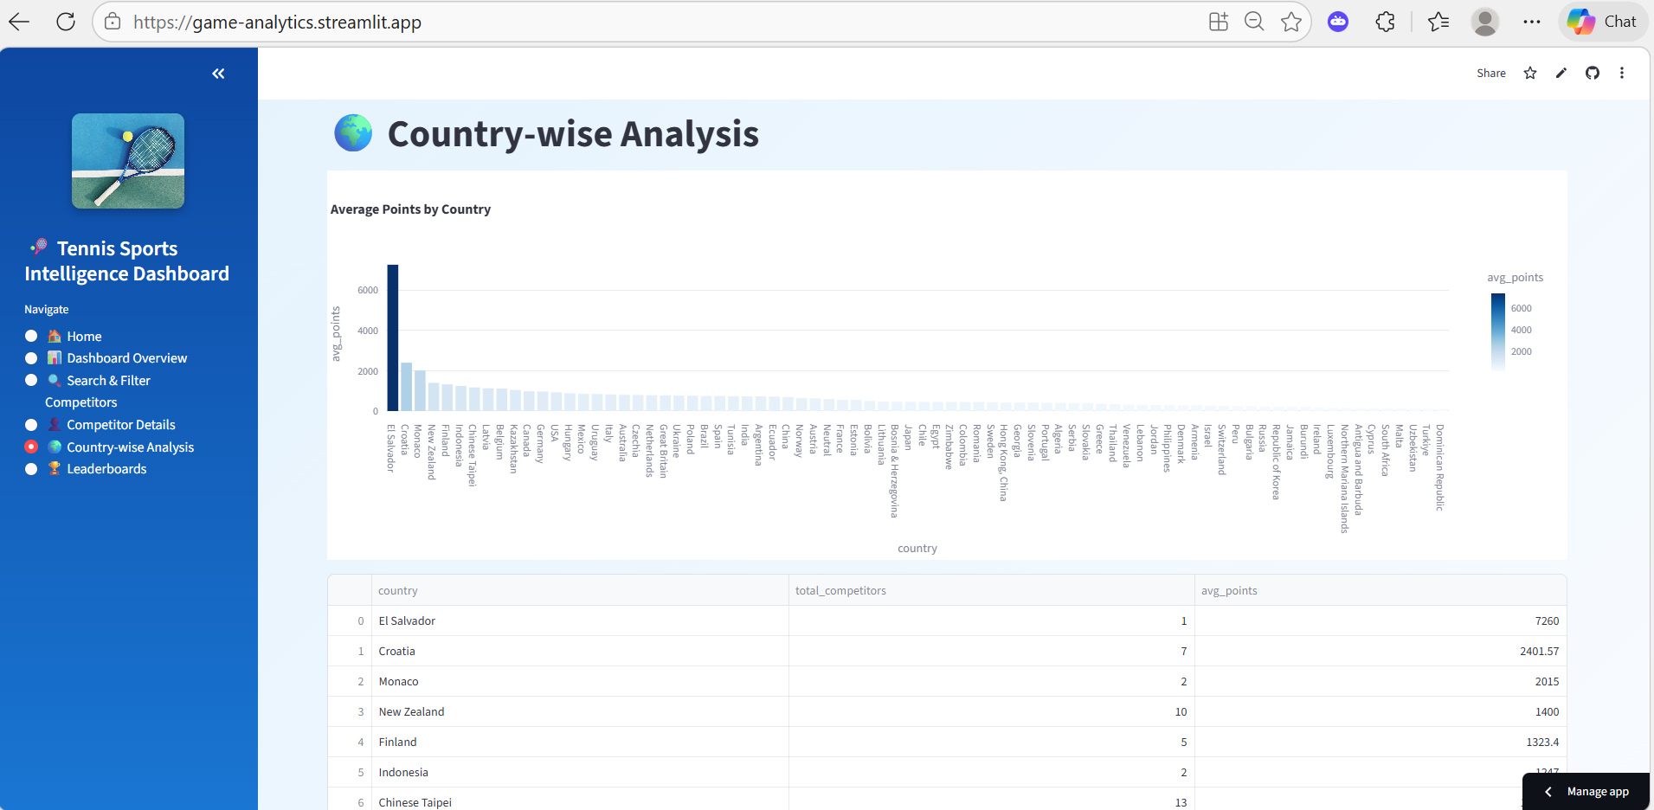
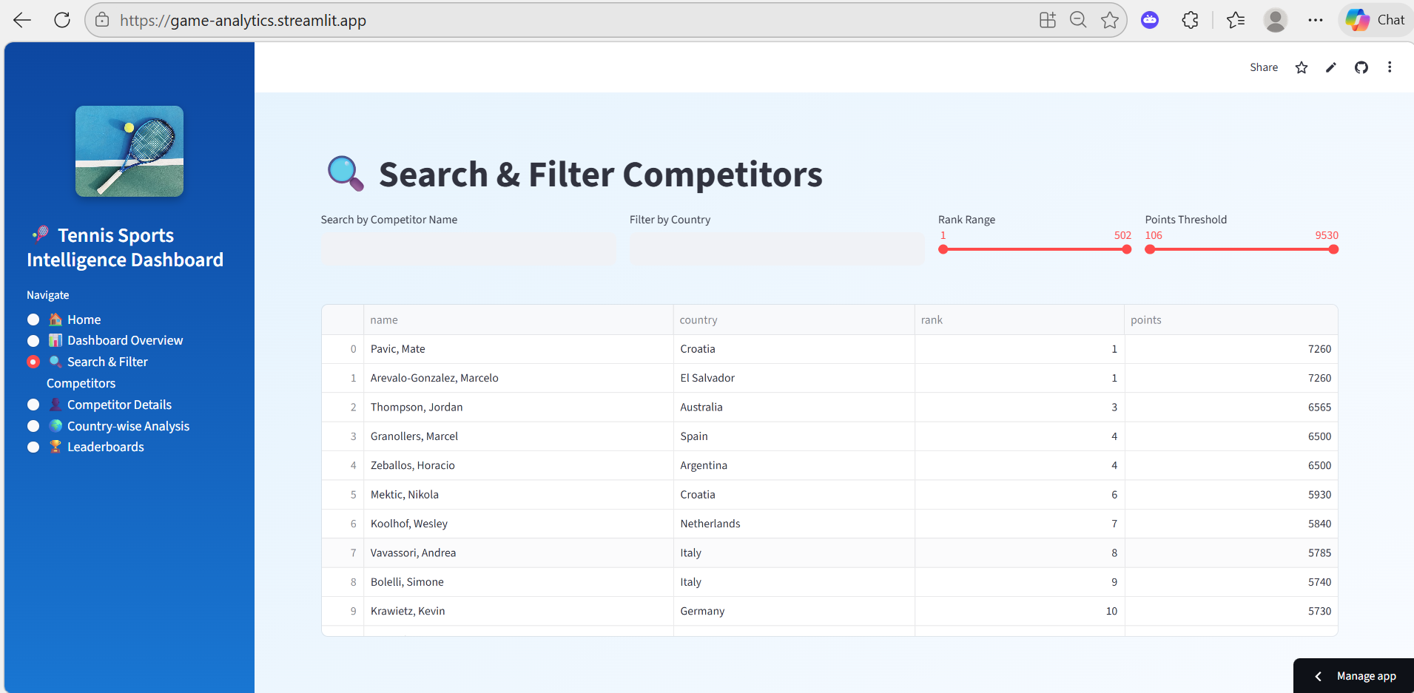
STREAMLIT DASHBOARD

Slide 13

CHALLENGES FACED
Data Loading (API → Python Parsing)
Nested JSON parsing was complex due to deep structure and entity mapping.
City/Country fields had nulls, so extra handling was needed.
Column mismatch in CSV/parsed files.
Database Architecture + SQL Layer
PK–FK relationships and joins required strict schema consistency.
Duplicate primary keys
Incorrect data types / overflow errors
Dashboard (Streamlit + Supabase)
Streamlit–Supabase secure connection: Used Streamlit Secrets to securely store credentials and connect the dashboard to the Supabase PostgreSQL database.

Slide 14
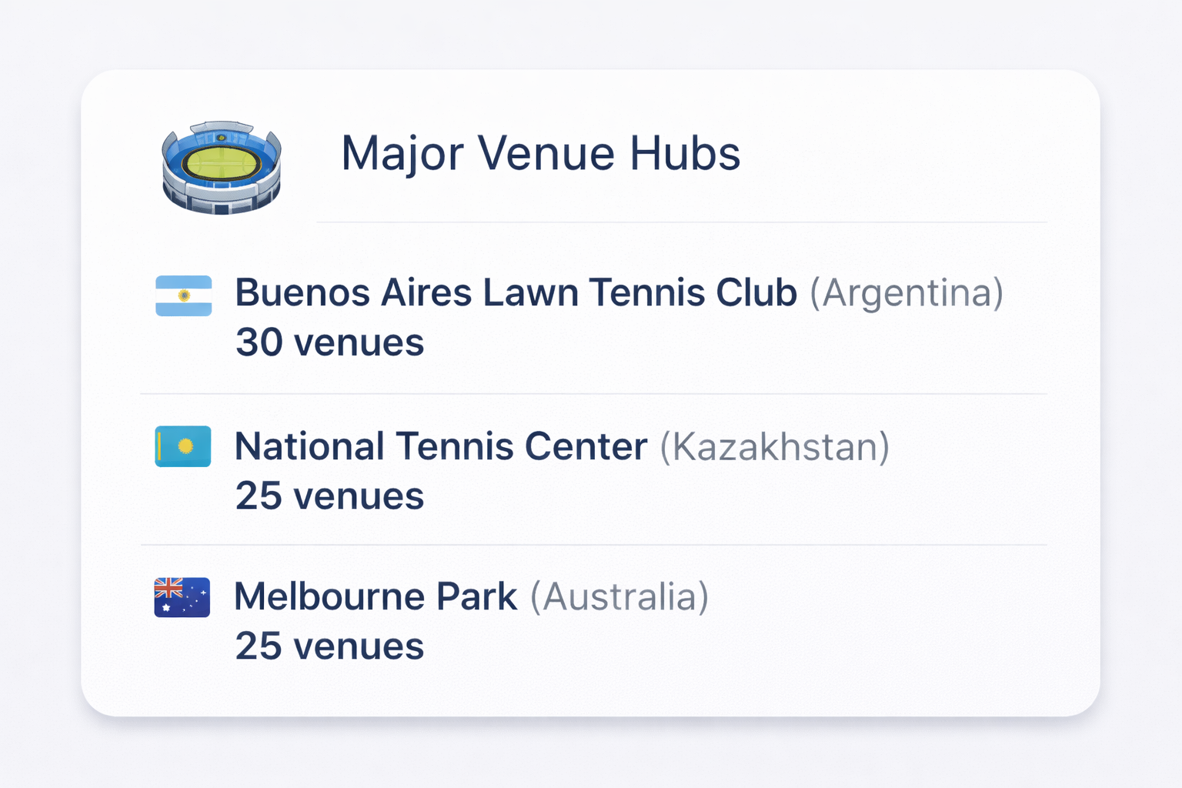
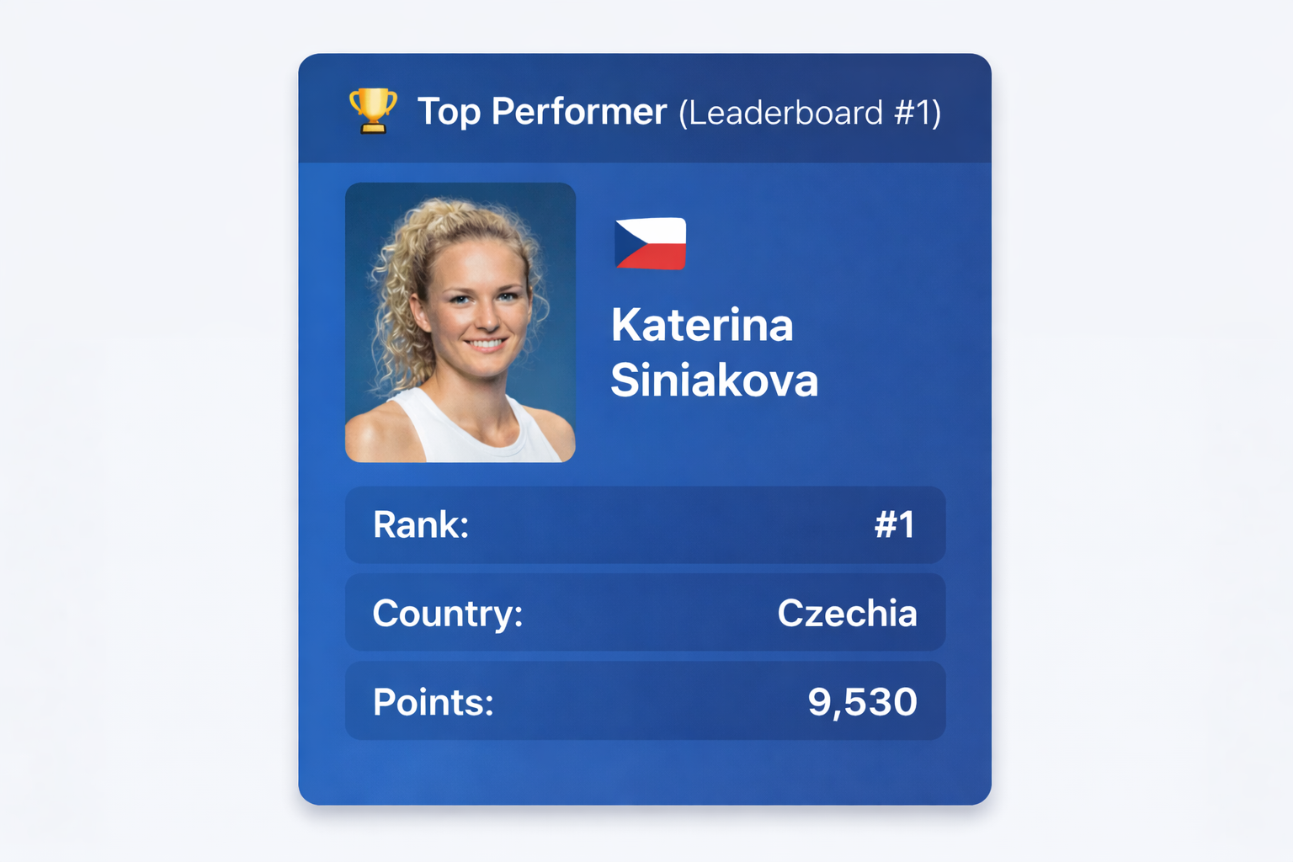
Key Insights & Findings
The dataset contains 1,000 competitors representing 78 countries, showing strong global diversity.
ITF Men (2,198) and ITF Women (2,032) have the highest number of competitions, making them the most active tournament categories.
The database successfully maps Parent → Sub-Competitions, enabling structured analysis of tournament relationships (Singles/Doubles under the same event).
Venues are linked with Complex + City + Country, enabling location-based venue analytics and event planning insights.

Slide 15

CONCLUSION & RECOMMENDATIONS
Conclusion :
Overall, we built a complete tennis analytics system from end to end — from SportRadar API data to a Streamlit dashboard.
This setup makes it easy to explore competition, venues, and rankings interactively.
Recommendations :
Add more SportRadar endpoints like matches and player profiles.
Automate data refresh will schedule pipeline runs.
Enhance dashboard with additional filters for better analysis.
Automate the data pipeline to refresh rankings and competition data regularly.

