Slide 1
Problem Statement Title:
Team Name:
Conversational Fashion outfit Generator by GenAI
68615751U89RBW62

Slide 2
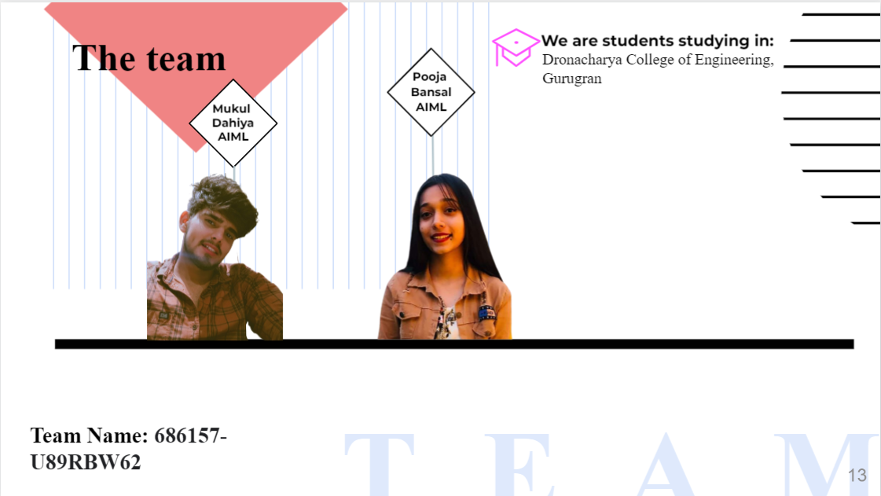

Slide 3
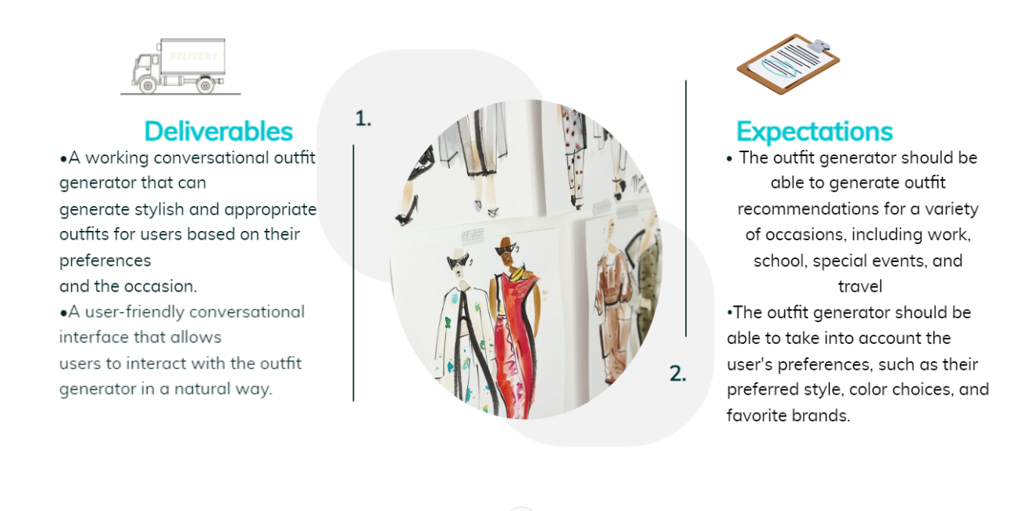

Slide 4
GLOSSARY
Open Pose:
OpenPose is an open-source library for real-time pose estimation. It can be used to detect and track the key points of a human body in real time. The heatmap shows the intensity of the key points, with brighter areas indicating more important key points.
CP-VTON:
CP-VTON is a deep learning model that can be used to wrap cloth over a human body model. It is based on the Generative Adversarial Network (GAN) framework.CP-VTON has been shown to be effective in generating realistic images of people wearing clothing.
JPPNet:
JPPNet is a deep learning model that can be used to predict the physical properties of clothing.JPPNet has been shown to be effective in predicting the physical properties of clothing, such as the fabric type, the color, and the size.
Virtual try-on is a technology that allows users to try on clothes virtually. This can be done using a variety of techniques, such as augmented reality (AR) and virtual reality (VR).
Virtual try-on:
GAN:
Generative adversarial network (GAN) is a type of machine learning model that can be used to generate realistic images. GANs consist of two neural networks: a generator and a discriminator. The generator is responsible for creating new images, while the discriminator is responsible for distinguishing between real and fake images.
NLP:
Natural language processing (NLP) is a field of computer science that deals with the interaction between computers and human (natural) languages. In the field of fashion technology, NLP can be used to understand customer preferences, generate product descriptions, and answer customer questions.

Slide 5

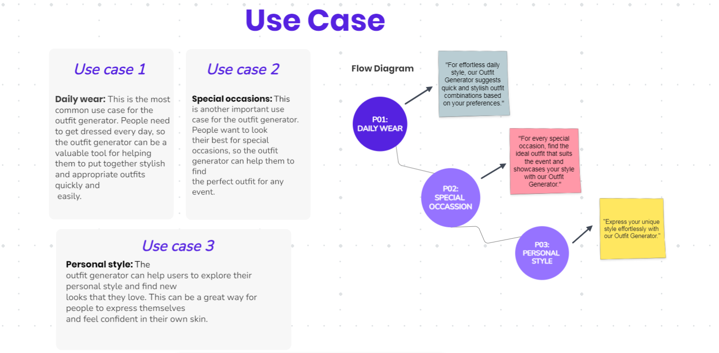

Slide 6
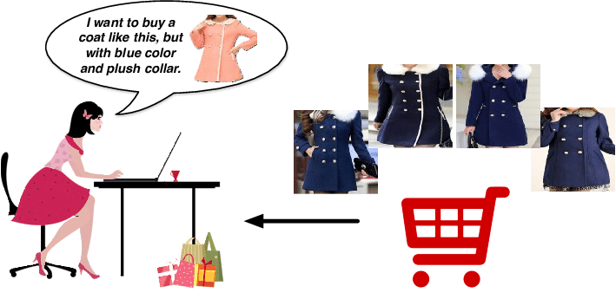
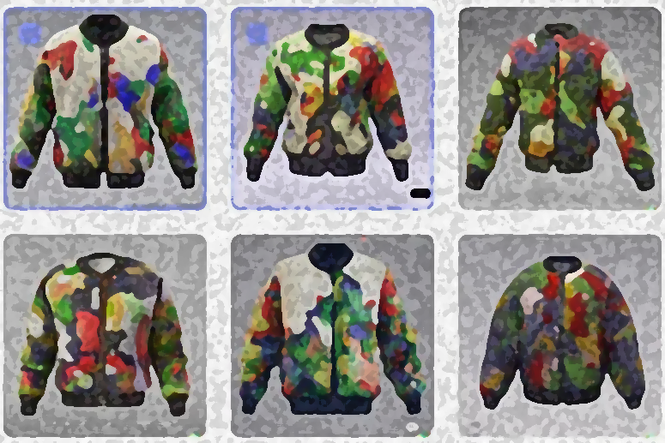
User Preference
User Body Shaping and Mass:
1. User Input: Collect text descriptions from users in chatbot about their body attributes and clothing sizes.
2. User Image: Allow users to upload images of themselves.
3. It will give us a Human Body Shape model.
User History Integration:
Retrieve the user's historical data, such as wish list items or previously purchased clothing, from your database.
Historical Preferences:
Analyze the historical data to understand the user's preferences and style choices.
This information can include clothing types, colors, patterns, and sizes.
Preference Alignment:
Merge the historical preferences with the preferences collected during the current interaction.
Align the user's past choices with their current body details and preferences.
Clothing Visualization:
Upon user's request for clothing options, generate a virtual clothing recommendation.
Begin by creating a dummy human body image from a predefined dataset.

Slide 7
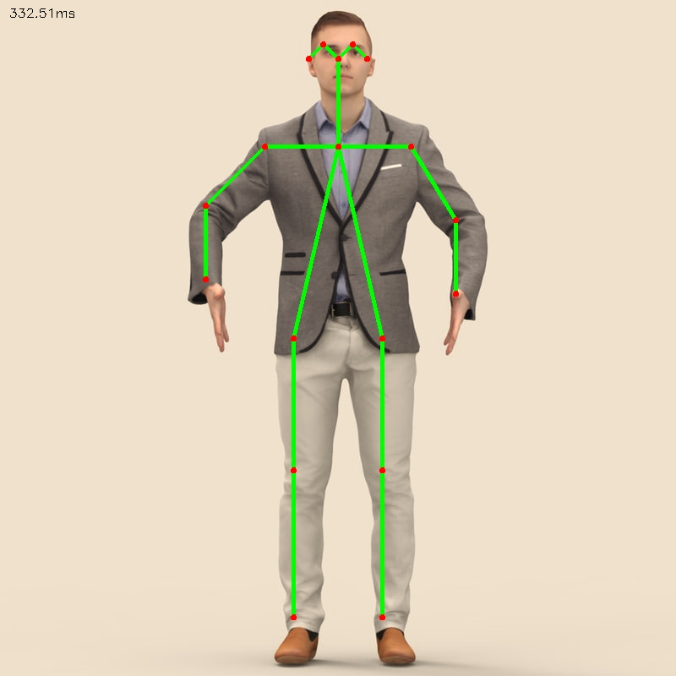
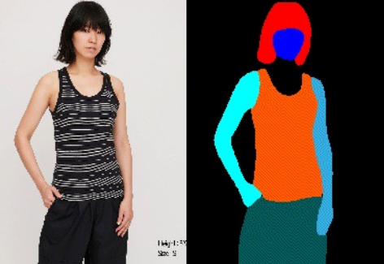
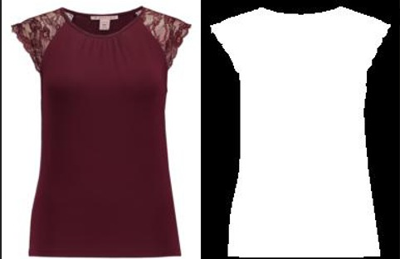
Image Processing
Human Image key Point:
It can be used to detect and track the key points of a human body in real time with OpenPose.
The red dots in the image show the key points of the human body.
These key points are used to accurately position the clothing on the body. For example, if the key points of the knees are detected, the clothing can be positioned so that it covers the knees.
Heatmap and Human Segmentation:
The heatmap shows the intensity of the key points, with brighter areas indicating more important key points.
Human segmentation involves separating the body from the background and generate a mask for the dummy cloth.
The mask is aligned with the body's detected key points, which helps to ensure that the cloth fits realistically over the body with JPP Net model.
Cloth Processing:
Cloth Image Masking: Creating a mask aligned with the cloth's contours to seamlessly overlay it on the body.
Background Removal: Isolating the cloth image from its background to ensure focus on the garment itself.
Pose-Aligned Cloth Generation: Constructing cloth in accordance with the human body's pose for a realistic fit and appearance.

Slide 8
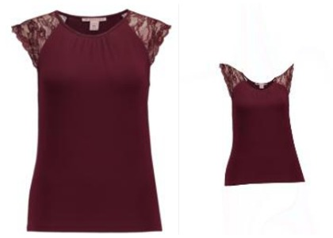
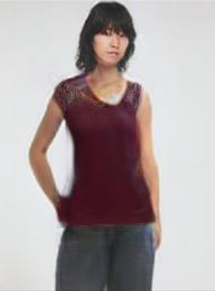
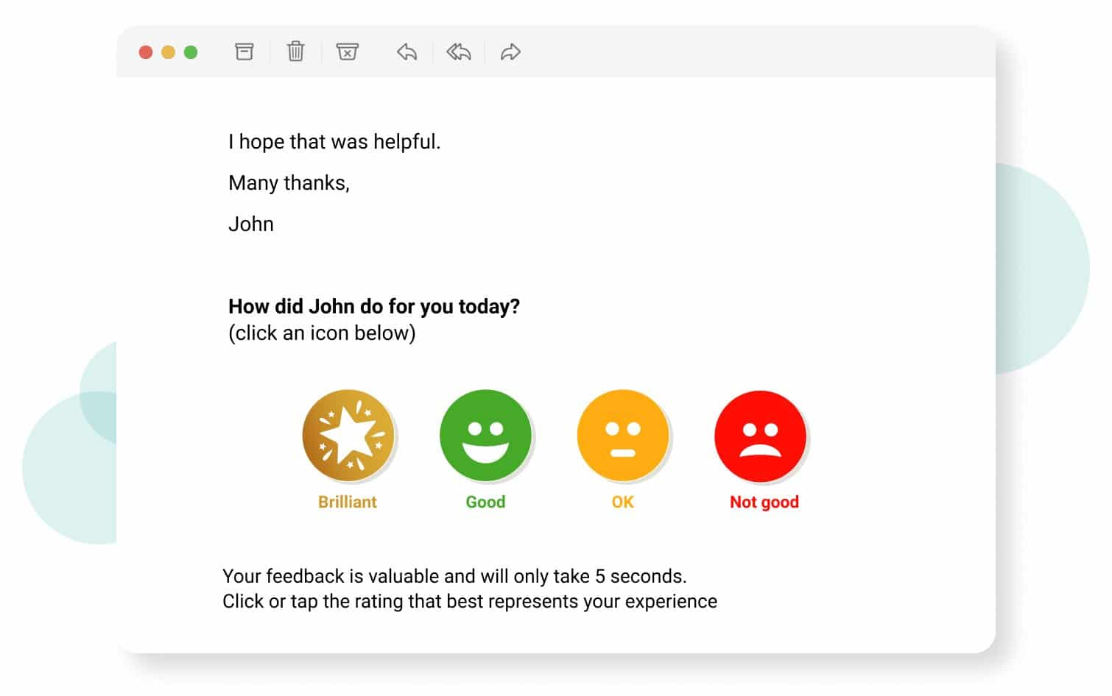

Smart Integration
Seamless Integration with Cp-Ton:
Feed the human body model, heatmap, and masked dummy cloth to Cp-Ton.
Cp-Ton is responsible for cloth simulation and wrapping the clothing over the human body.
Enhanced Clothing Visualization:
Cp-Ton's output showcases the virtual clothing on the dummy human body.
This gives the user an accurate representation of how the selected clothing would appear on them.
User Interaction and Feedback:
Engage the user with the virtual clothing visualization.
Gather feedback and allow users to make adjustments if necessary.
Iterative Refinement:
Based on user feedback, refine the virtual clothing simulation to enhance realism.
Adjust cloth fit, position, and other aspects as needed.

Slide 9
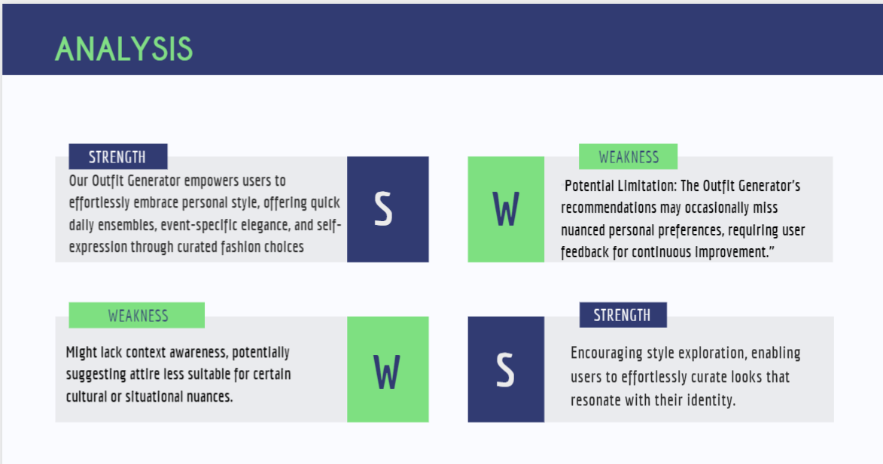
The generative AI model may not be able to generate realistic and stylish outfit recommendations for all users. The model is trained on a dataset of clothing images and descriptions, but this dataset may not be representative of all styles and preferences. As a result, the model may not be able to generate outfit recommendations that are appropriate for all users.
The outfit generator may not be able to keep up with the latest fashion trends. The outfit generator is trained on a dataset of social media trends, but this dataset may not be updated frequently enough to keep up with the latest trends. As a result, the outfit generator may generate outfit recommendations that are not in line with the latest trends.

Slide 10
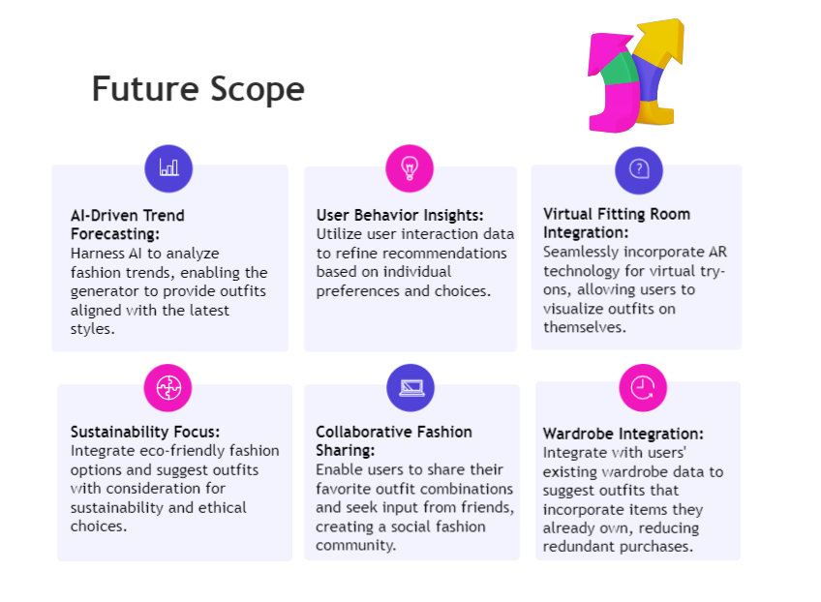
Future Scope

Slide 11
Thank You

