Slide 1




OBJECTIVE
Problem Statement
Pick Meesho and one global e-commerce app. Evaluate the two homepages. Tell us the 3 most impactful changes we can make on the homepage and why.
The Role of the Homepage
 | First Impression: Communicate what the app sells & establish brand identity. |  | Seamless Navigation: Guide users effortlessly to their desired products or categories.
 | Product Discovery: Showcase a curated selection of products to spark user interest and encourage browsing. |  | Drive Conversions: Convert visitors into customers with clear calls to action like "Shop Now“.
Desired Objectives of New Changes
North Star Metric of Meesho → Incremental NMV
Based on Meesho’s North Star and the role of homepage, the objective is now to find features which can –
Reduce bounce rate and lead to users browsing and checking out more products
Increase average session time (specifically through activities which can drive conversion)
Increase frequency of recurring visits
Objective
App Selection
User Persona
Features
F1
F2
F3
Prioritization

Slide 2



APP Selection
Criteria
 | Product type: The app’s offering should be similar to ones offered by Meesho. |  | Customer Profile: Customers visiting the app should be similar to the one visiting Meesho.
App Selected – Shopee Indonesia
Shopee Indonesia is the leading online shopping platform in Indonesia with around 36% market share. It offers a wide variety of products at competitive prices, with features like free shipping, cash on delivery, and a secure payment system.
Similarities
Rationale for selecting Indonesia - Indonesia and India share striking similarities.
Median Age: India has median age of 28 while it is 30 for Indonesia.
Growth: Both are experiencing GDP growth exceeding 5% in recent years.
Income Level: Both are classified as lower-middle-income economies with a GDP per capita of around US$5,500 (Indonesia) and US$7,000 (India) in 2023
Rationale for selecting Shopee – Shopee Indonesia and Meesho share similar customer profile
Value-Conscious Shoppers: Both target a customer base that prioritizes affordability and finding good deals.
Mobile-First Users: A significant portion of their customers rely on smartphones for browsing and shopping online.
Focus on Tier 2 & 3 Cities: Both platforms have a strong presence in cities beyond the major metropolitan areas, catering to the growing middle class.

Slide 3
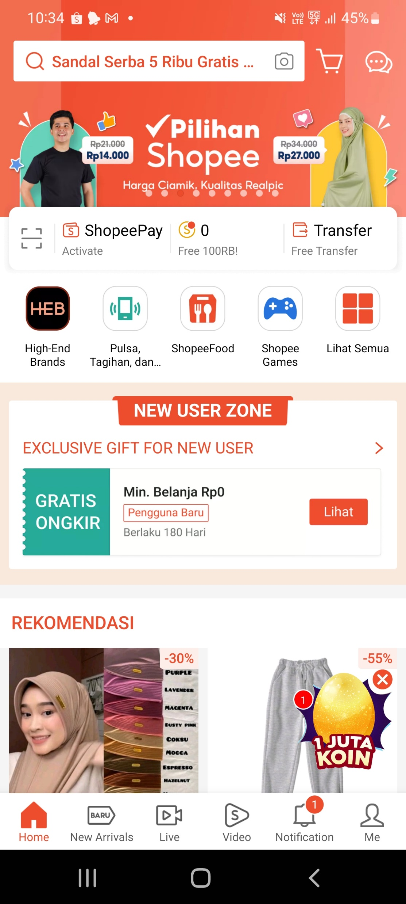
Homepage Teardown
Above the fold (ATF)
Personalized
Recommendations
Reward Points for Daily Check-in
GIFs of some product instead of
static picture
Live stream (commerce) –
influencers trying-on products
Short-format videos on
products available on the app
New arrivals –
listing of new and trendy products
Objective
App Selection
User Persona
Features
F1
F2
F3
Prioritization

Slide 4
Feature Selection
Criteria
While selecting features following factors were taken into consideration -
Customer Value
The feature is centered towards Meesho’s customers
The feature should solve an existing user pain point and provide value to the customer
The feature should be such that the customer is willing to adopt it over current alternatives
Business Value
Leads to users browsing more products
Increases average session time (specifically through activities which can drive conversion)
Increases frequency of recurring visits
Has the potential to increase NMV
Rejected Features
GIFs in place of static images – While it can draw more attention to certain products, it does not solve any major customer problem plus it can lead to information overload and fatigue, as all the users might no be having high end phones this can even slow down the app performance and lead excess data usage.
Above the fold (ATF) Personalized Recommendations – While it can definitely lead to lower bounce rates and user browsing more products, similar listing is not only available but fairly accessible on Meesho’s homepage, also accuracy of such algorithm can also become a constraint.
Live stream (commerce) – Although it can help users in product discovery and boost engagement, this feature may take time in wide-spread adoption due to issues like time constraint, language and cultural diversity and limited internet data plans and connectivity. Also, this will shift loyalty of customers from Meesho to influencers.
Objective
App Selection
User Persona
Features
F1
F2
F3
Prioritization

Slide 5
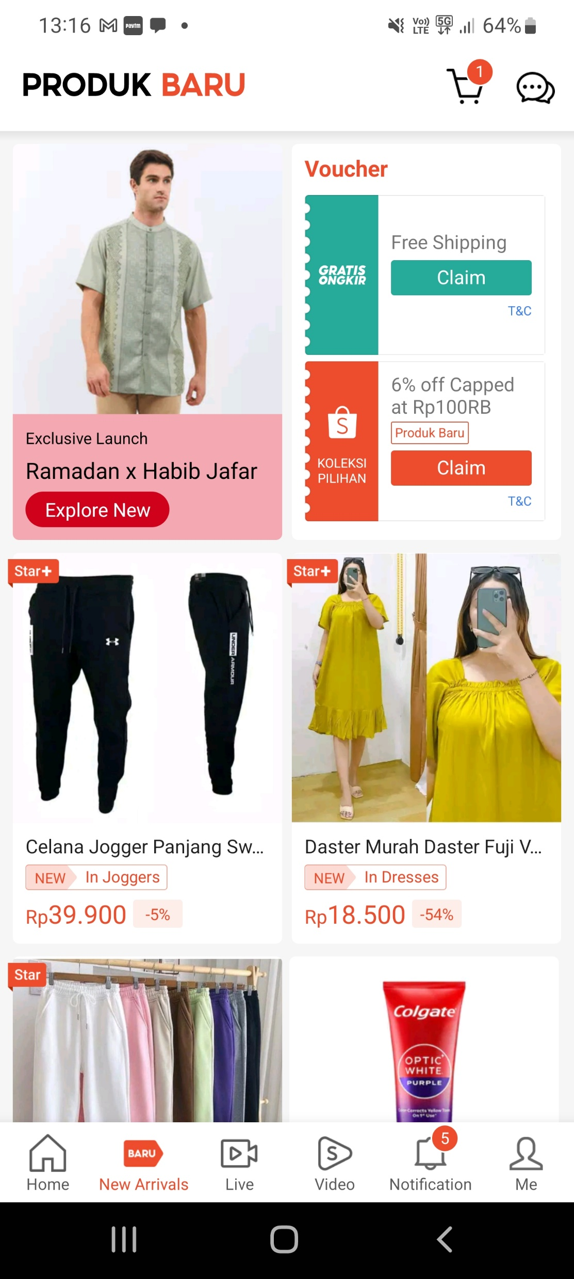
Feature 1 - New Arrivals
Description
The "New Arrivals" category in the Shopee app is a dedicated section designed to help users discover products that have recently been added to the platform This feature makes it easier for users to stay updated on the latest trends and offerings across various product categories on Shopee.
Pros
Cons
Enhanced Product Discovery
Better visibility of new items
Boosts user engagement
Focus on Novelty over Quality
Potential for Irrelevant Products Listings
Challenging to maintain high quality new arrivals
Rationale & Implementation
Customer Value - Stay updated on the latest trends and offerings across various product categories, especially useful for users who have a habit of browsing products
Business Value - Enhanced new products discovery; can boost sales of products which are new and don’t have many reviews and ratings
Implementation – The ranking of new products should also take into consideration individual user’s preferences
Objective
App Selection
User Persona
Features
F1
F2
F3
Prioritization

Slide 6

Feature 2 - Short Format Product Videos
Description
Shopee Video is a feature within the Shopee app where users can watch and create short videos with product links for easy purchasing. It promotes engagement with likes, comments, and sharing, offering a variety of content from entertainment to product recommendations, ultimately encouraging users to add items to their carts.
Pros
Cons
Enhanced Product Discovery
Increased User Engagement
Influencer Marketing Potential
Development and Maintenance Costs
Content Moderation Challenges
Data limits on Mobile Plans
Rationale & Implementation
Customer Value – Apart from providing a new more engaging way of product discovery, can be useful for resellers who find it hard to convince their customers just based on images
Business Value - Enhanced product discovery & user engagement may lead to more conversions.
Implementation – Can initially restrict the video creation access to sellers/ verified accounts to limit content moderation and data storage costs.
Objective
App Selection
User Persona
Features
F1
F2
F3
Prioritization

Slide 7

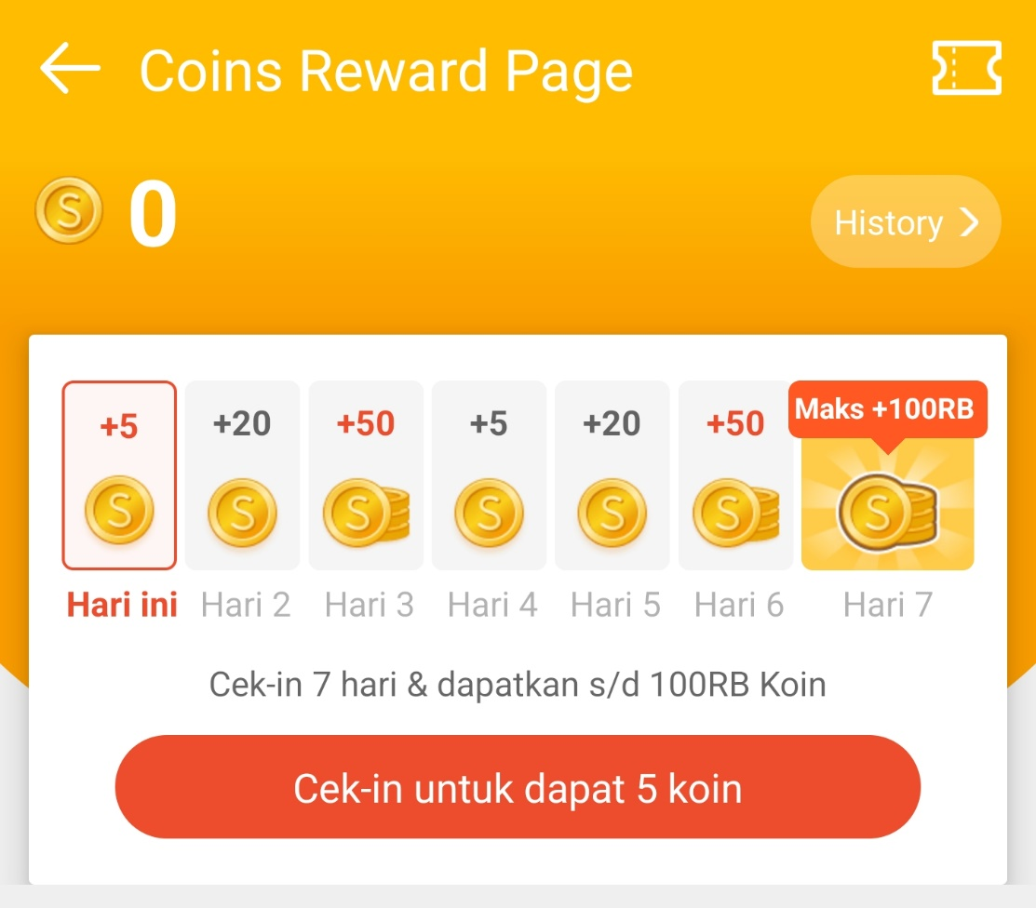
Feature 3 - Reward Points for Daily Check-ins
Description
Shopee offers a coin reward system where you can earn Shopee Coins simply by checking in to the app daily. You get a base amount for the first check-in, and this amount can increase for consecutive daily check-ins. This feature encourages users to engage with the app regularly and potentially earn discounts or other benefits by accumulating Shopee Coins.
Pros
Rationale & Implementation
Incentivizing users for daily check-in, can lead to habit formation
Probability of user checking out some products and eventually buying them increases
Customer Value – For deal seeking budget conscious users, provides an easy way to save extra bucks.
Business Value - Increases frequency of recurring visits which may lead to more conversions.
Implementation – This feature should be visible after few product listings to ensure user atleast goes through some products before earning coins.
Cons
Hard to find optimal coin value; too little value – user sees it as a gimmick; to much of a value becomes expensive to the company.
Objective
App Selection
User Persona
Features
F1
F2
F3
Prioritization

Slide 8
Prioritization
Assigning Weights
Based on the ability to impact Incremental NMV and some basic assumptions, weights are assigned to factors on a scale of 0 to 1
 | Value to Customer | Increased recurring visits | More product checkouts | Increased session time | Needs support of influencers/ sellers | Efforts /Time required in development & adoption
Weights | 1 | 0.5 | 1 | 0.8 | 0.8 | 0.5
Score $=\frac{Weighted SumProduct of ( \text{Value} \text{to} \text{Customer}\text{, }\text{Increased} \text{recurring} \text{visits}\text{, }\text{More} \text{product} \text{checkouts}\text{, }\text{Increased} \text{session} \text{time}) }{Weighted SumProduct of(\text{Needs} \text{support} \text{of} \text{influencers}\text{/ }\text{sellers}\text{, }\text{Efforts}\text{ /}\text{Time} \text{required} \text{in} \text{development}\text{ \& }\text{adoption})}$
Features | Value to Customer | Increases Frequency of recurring visits | Leads to user checking out more products | Increases average session time | Needs support of influencers/ sellers | Efforts /Time required in development & adoption | Score
New Arrivals | 8 | 6 | 8 | 6 | 5 | 6 | 3.4
Short format product videos | 7 | 7 | 8 | 8 | 10 | 8 | 2
Reward Points for Daily Check-ins | 6 | 8 | 6 | 3 | 5 | 4 | 3
Objective
App Selection
User Persona
Features
F1
F2
F3
Prioritization
On basis of this analysis New Arrival feature should be prioritized first followed by Rewards Points for check-ins and finally the short format product videos

