Slide 1

Android Blood Bank
By
Sahil kumar(17BCS2904)
Mukul Singh(17BCS2921)

Slide 2
Why We Need Blood Bank
Today, blood banks collect blood and separate it into its various components so they can be used most effectively according to the needs of the patient. Blood is the vital connection to having a healthy body, and according to the American Red Cross, nearly 5 million people receive blood transfusions each year.

Slide 3
What is Blood Bank
A blood bank is a center where blood gathered as a result of blood donation is stored and preserved for later use in blood transfusion. The term "blood bank" typically refers to a division of a hospital where the storage of blood product occurs and where proper testing is performed (to reduce the risk of transfusion related adverse events). However, it sometimes refers to a collection center, and some hospitals also perform collection. Blood banking includes tasks related to blood collection, processing, testing, separation, and storage.

Slide 4
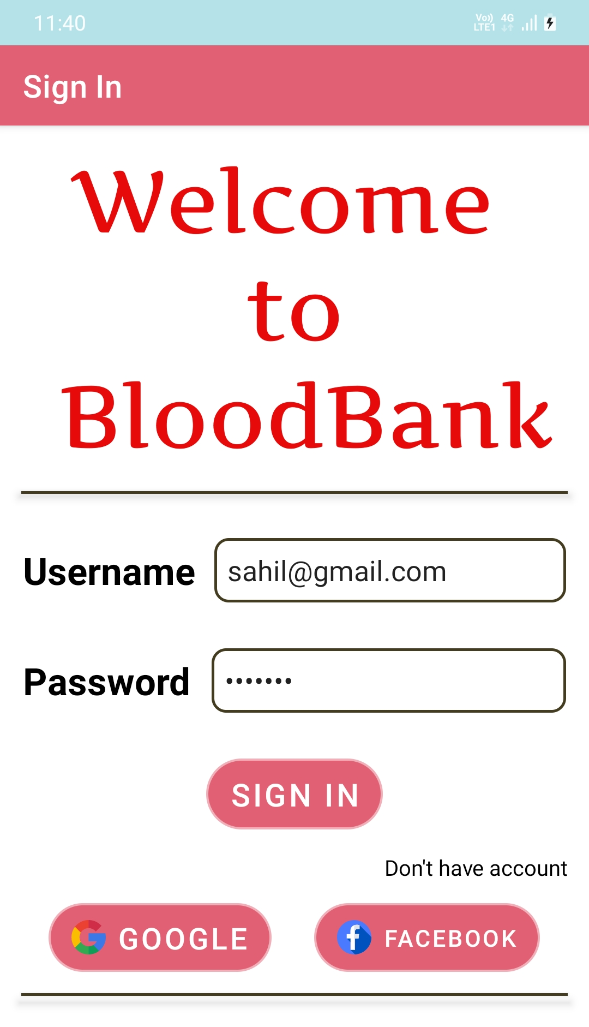
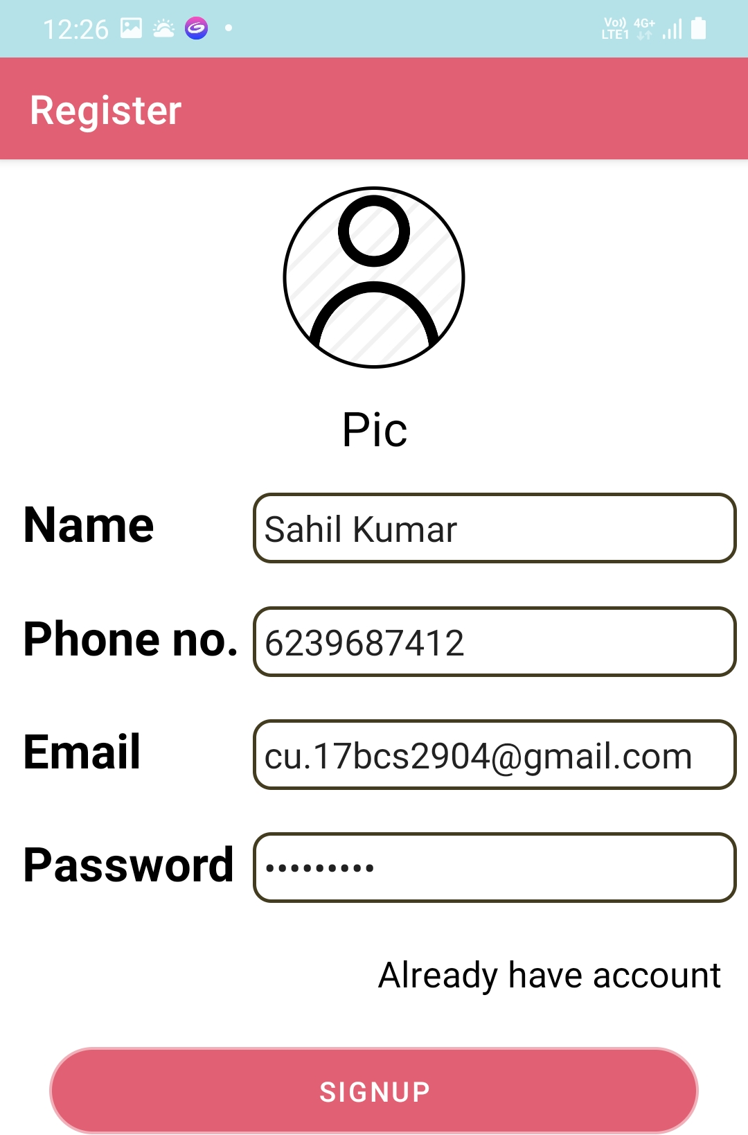
Blood Bank Application Tutorial
Step 1:- Register Your Self. Step 2:- Go to LogIn

Slide 5
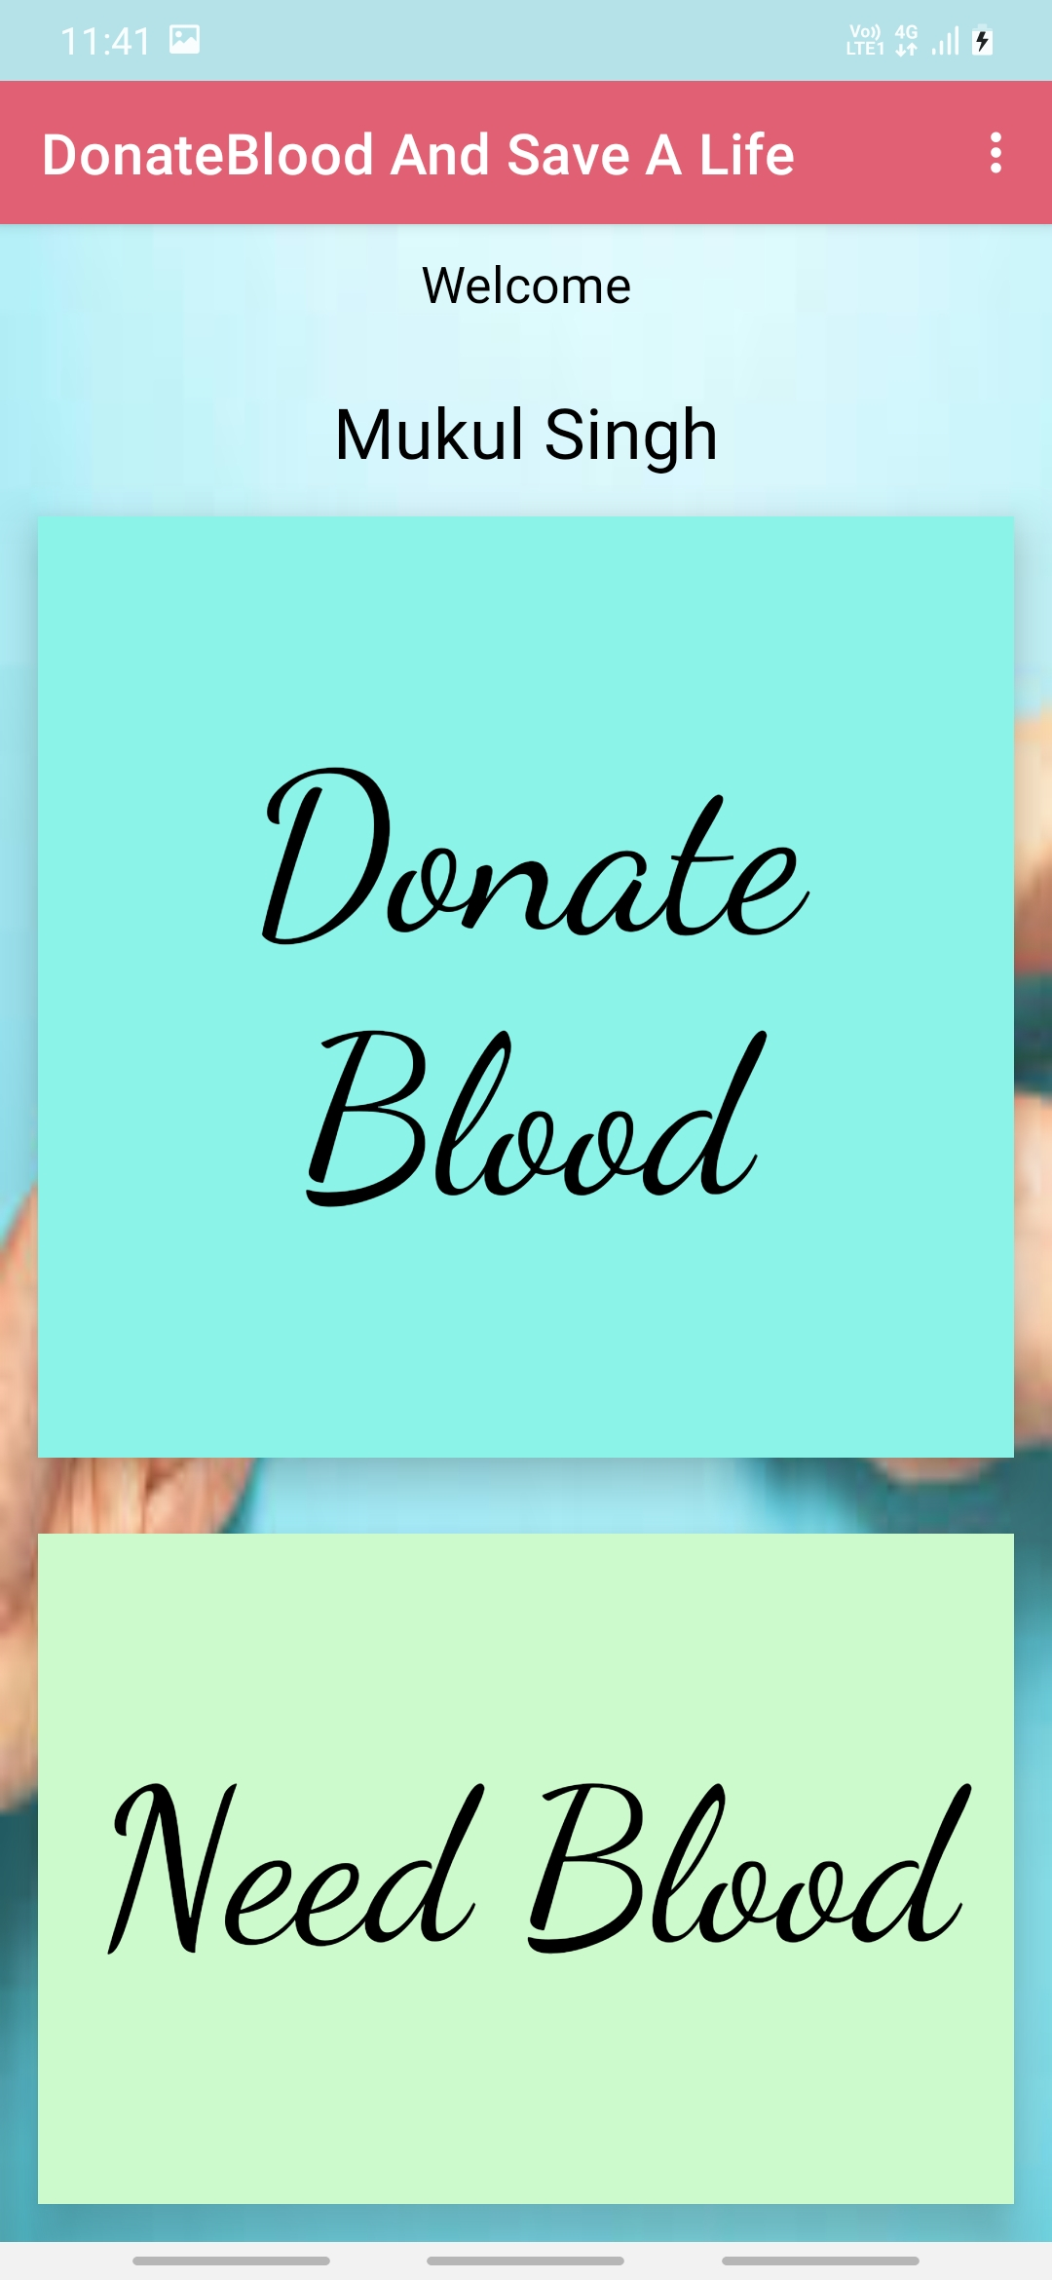
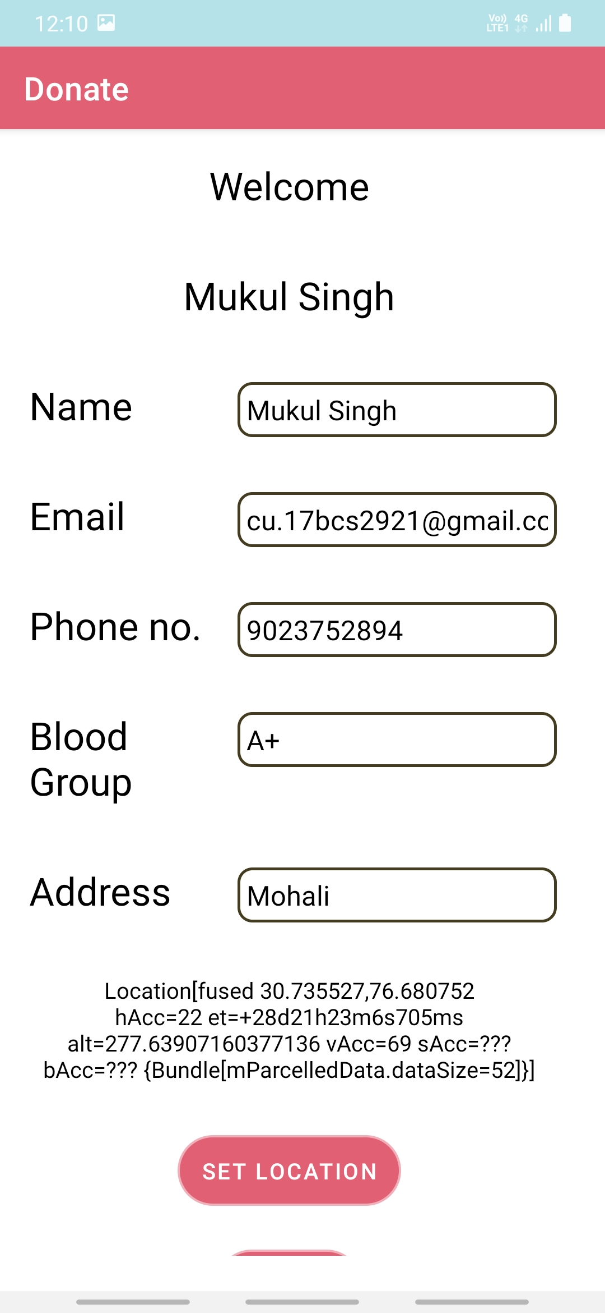
Continue...
Step 3:- Select Your Option.
Step 4:- Donate Blood

Slide 6
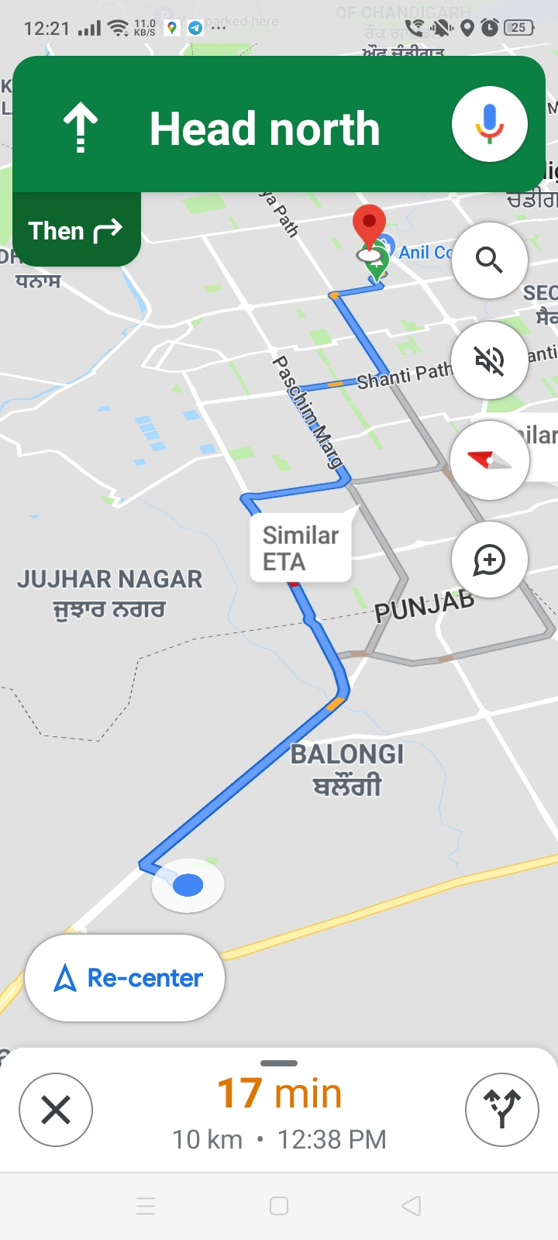
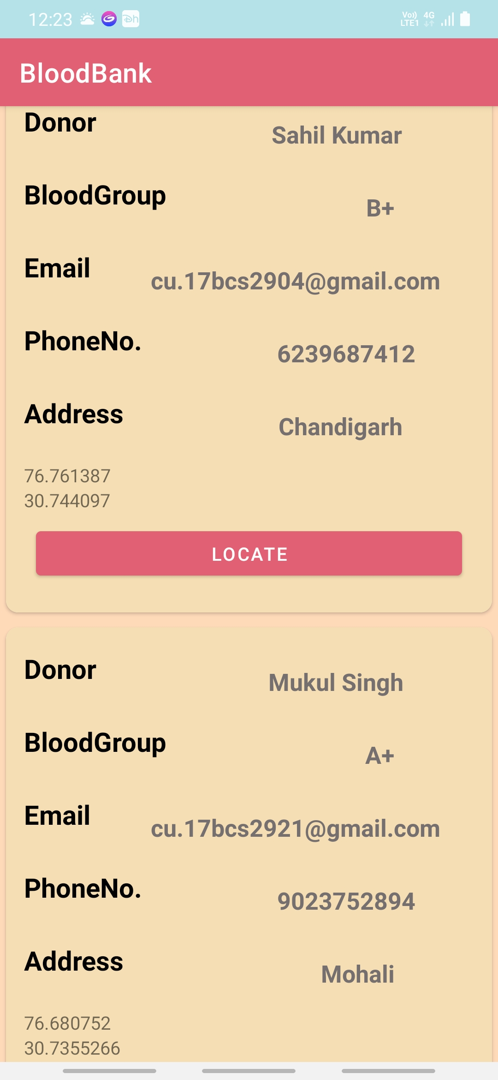
Continue...
Step 5:- Receive Blood
Step 6:- Locate

Slide 7
Innovation in Project
In previous version there is no live location and no calling,mailing Intent. But in our project there is calling and mailing intent also which make project user friendly.

Slide 8
THANK YOU

