Slide 1
Secure Data Hiding in Image Using Steganography
CAPSTONE PROJECT
Presented By
Student Name - Mukul Nilesh Dhorje
College Name & Department - Asian college of science
CS Department

Slide 2
OUTLINE
Problem Statement
Technology used
Wow factor
End users
Result
Conclusion
Git-hub Link
Future scope

Slide 3
Problem Statement
The challenge is to develop an efficient method for encoding, decoding, and detecting concealed data while ensuring minimal distortion and maintaining the integrity of the original geographical information. The solution must be resistant to unauthorized extraction and support real-world applications like secure geospatial communication and data protection.

Slide 4
Technology used
Language Used – Python
Library Used – Open cv2, OS lib,
Pip install opencv-python
pip install opencv-contrib-python

Slide 5
Wow factors
High Security & Stealth
Real-World Applications
Minimal Distortion
Adaptive Encoding
Cross-Disciplinary Integration
Custom Encryption Support
Unique Concept Fusion

Slide 6
End users
Military & Defense Organizations
Government Agencies
Cybersecurity Experts & Ethical Hackers
Geospatial Analysts & GIS Professionals
Journalists & Activists
Financial & Corporate Sector
Forensic & Law Enforcement Agencies
Academic & Research Institutions

Slide 7
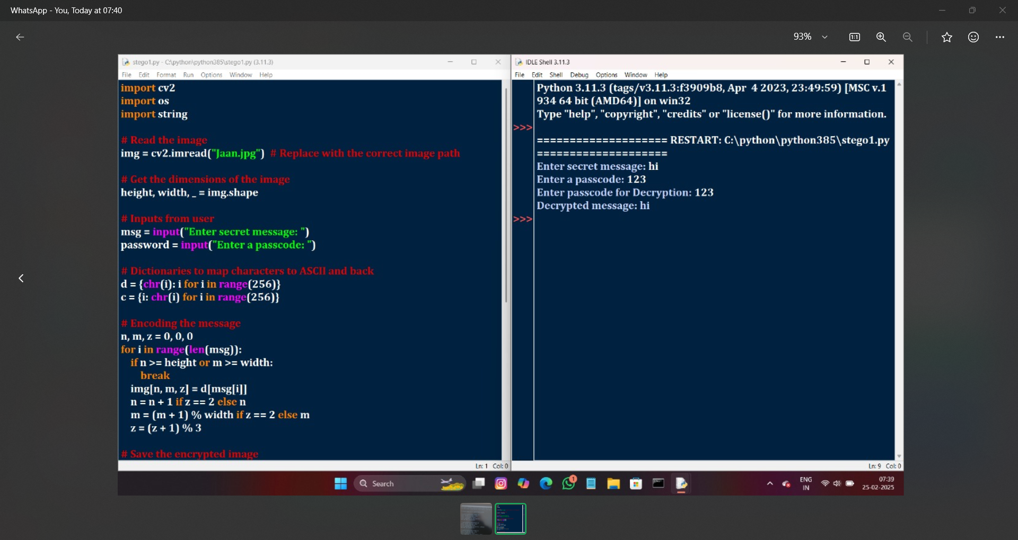
Results

Slide 8
Conclusion
The Stan geography project successfully integrates steganography and geography to develop a secure method for embedding hidden data within geographical images and maps. By ensuring high security, minimal distortion, and resistance to unauthorized extraction, the project addresses the critical challenge of covert communication and geospatial data protection. With applications in military, government intelligence, cybersecurity, and forensic investigations, this approach offers a robust and innovative solution for secure data transmission. Future enhancements could incorporate AI-based optimization and encryption layers to further strengthen security and adaptability.

Slide 9
GitHub Link
https://github.com/Mukuldhorje1/secure-data-hiding-in-image-using-steganography

Slide 10
THANK YOU

