Slide 1
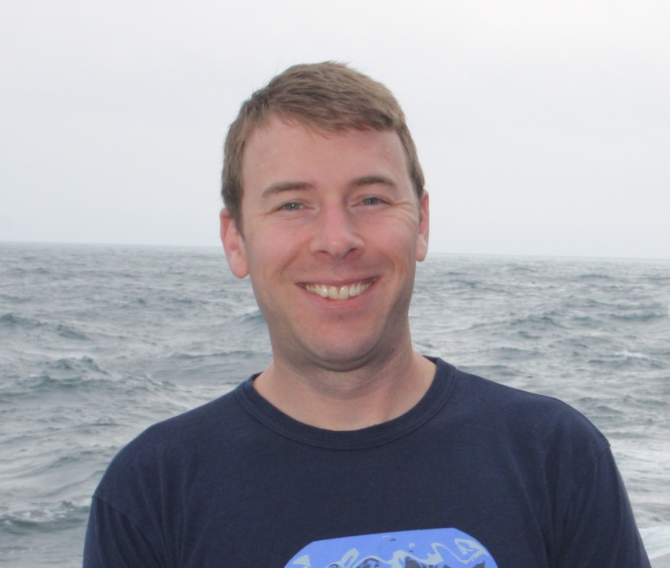


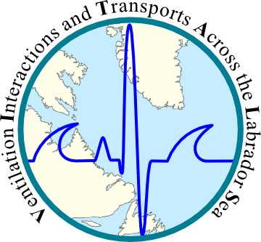

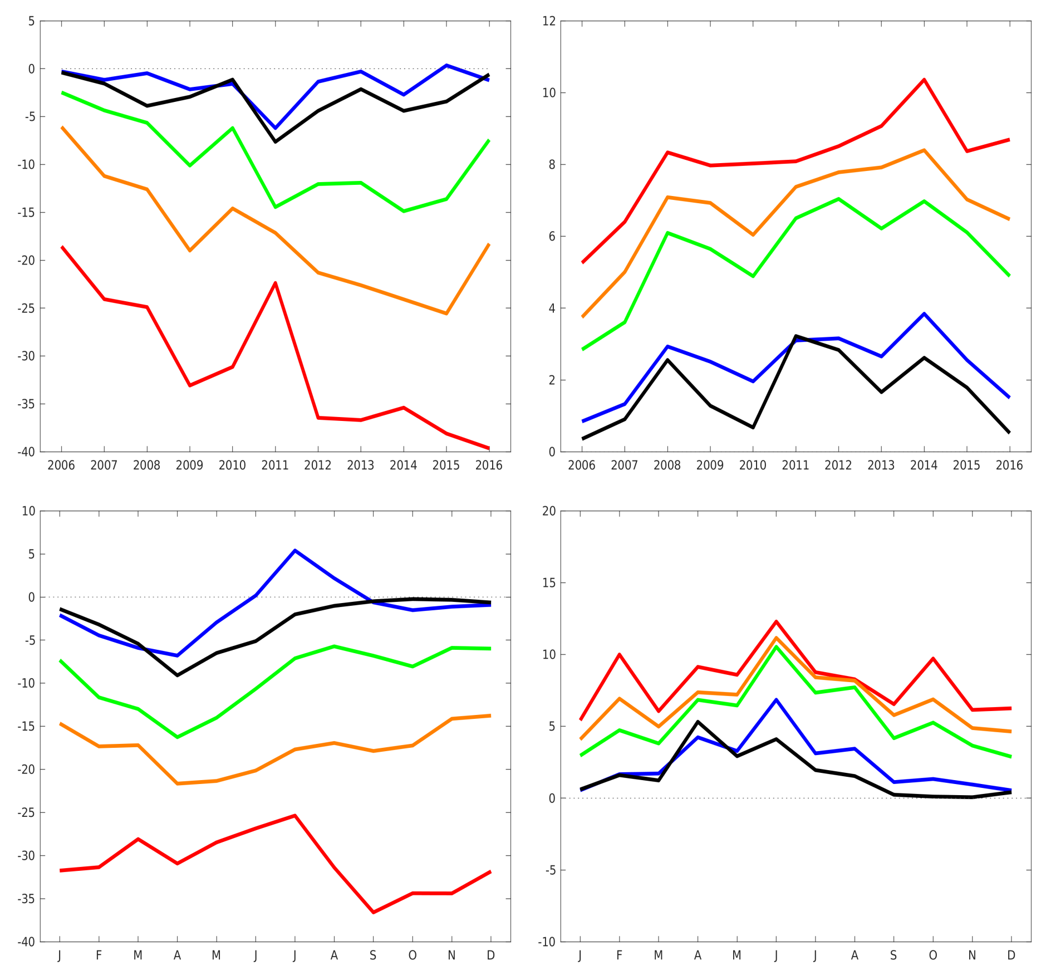
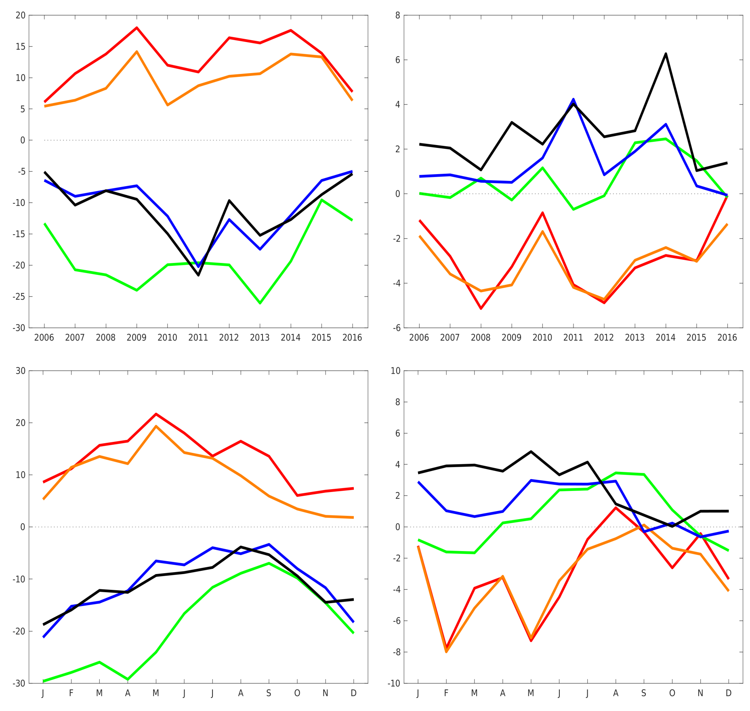
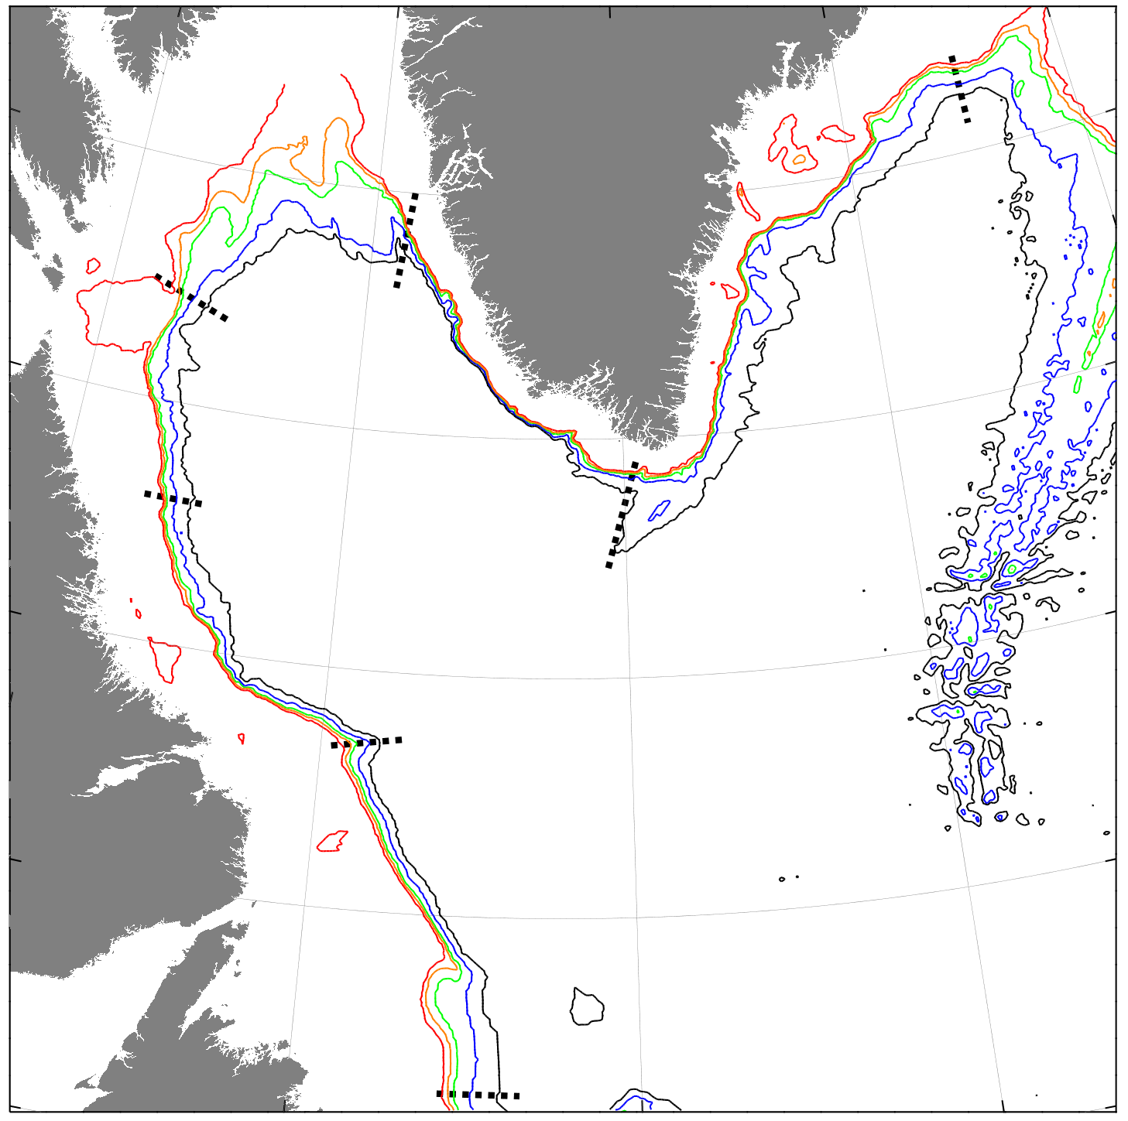
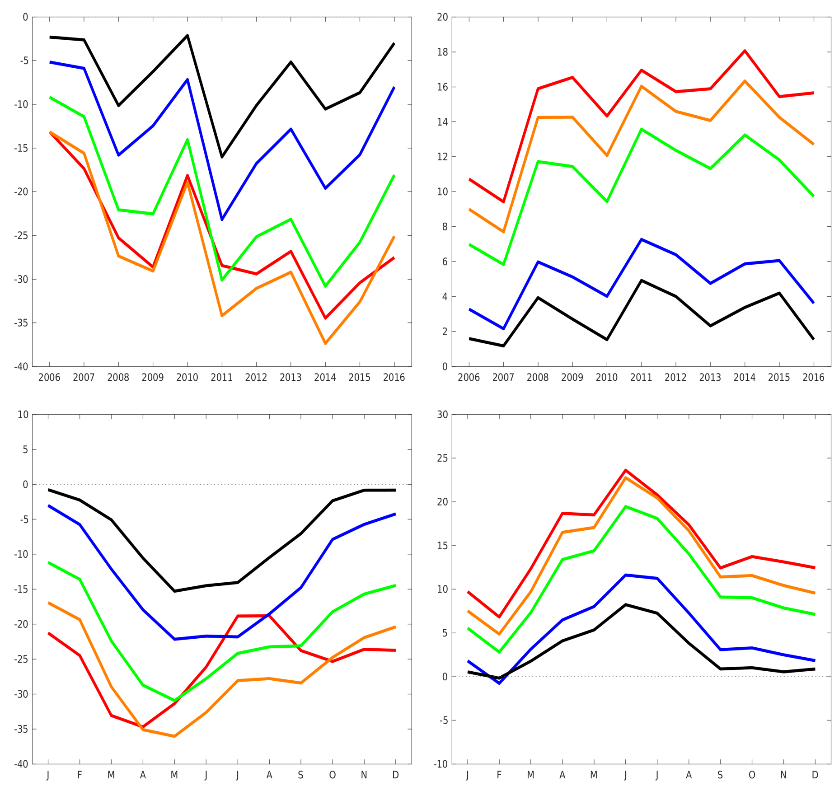
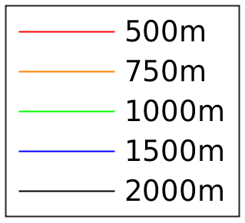
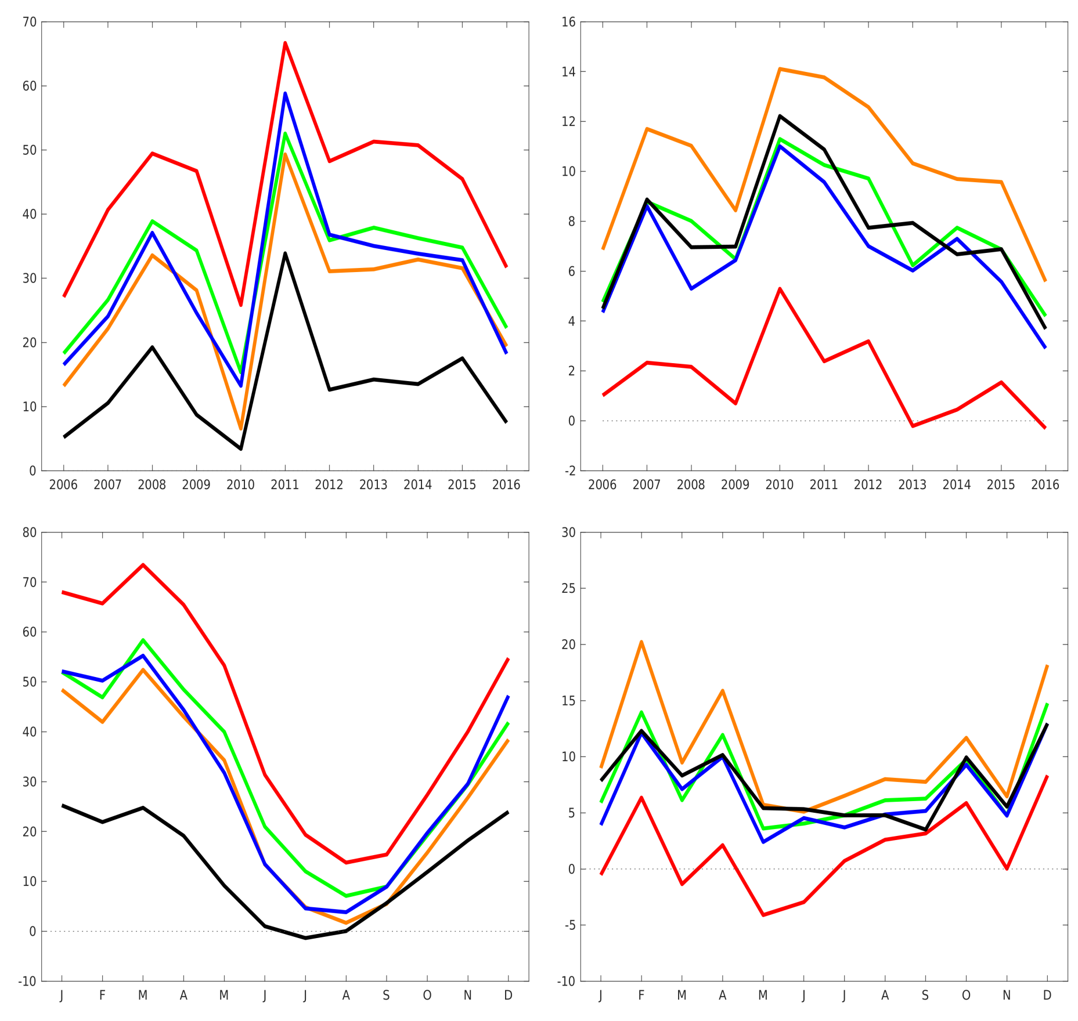
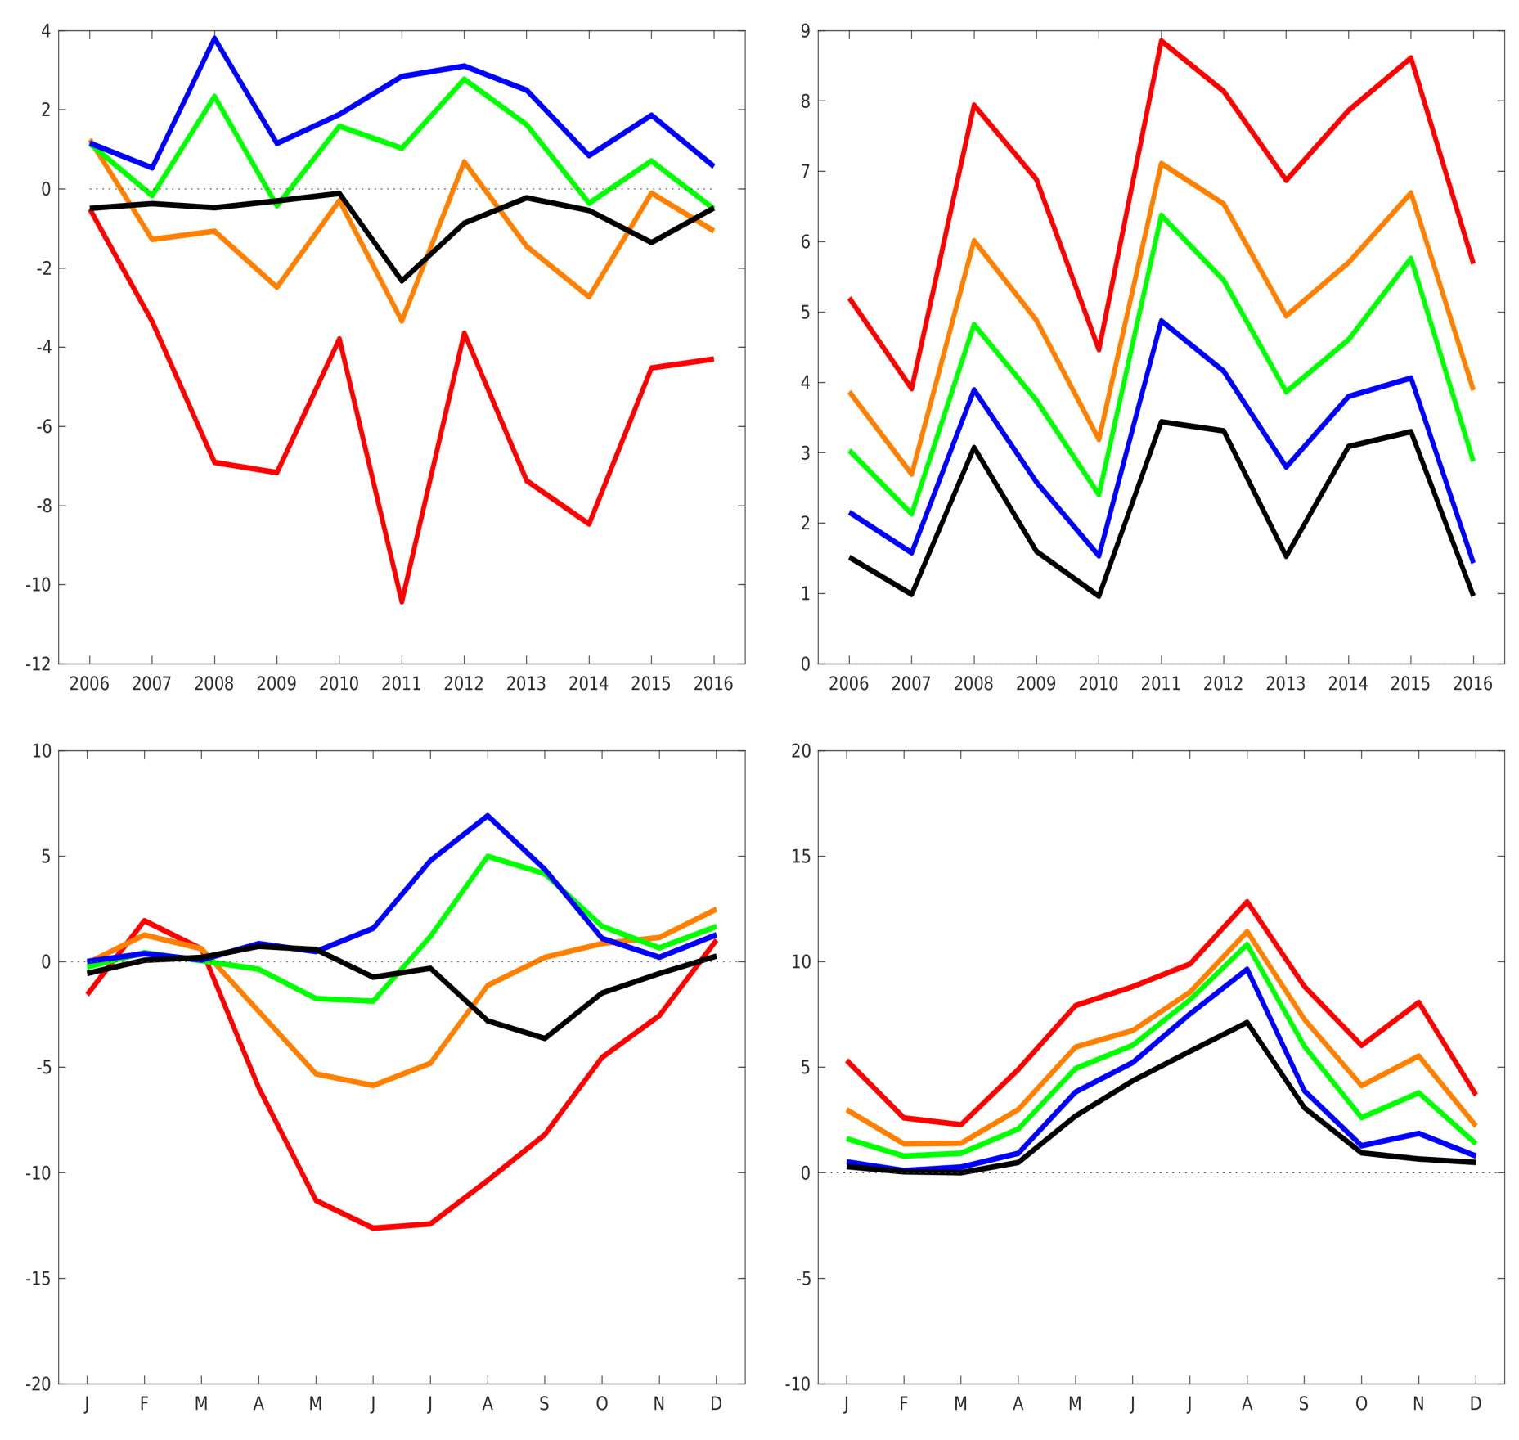
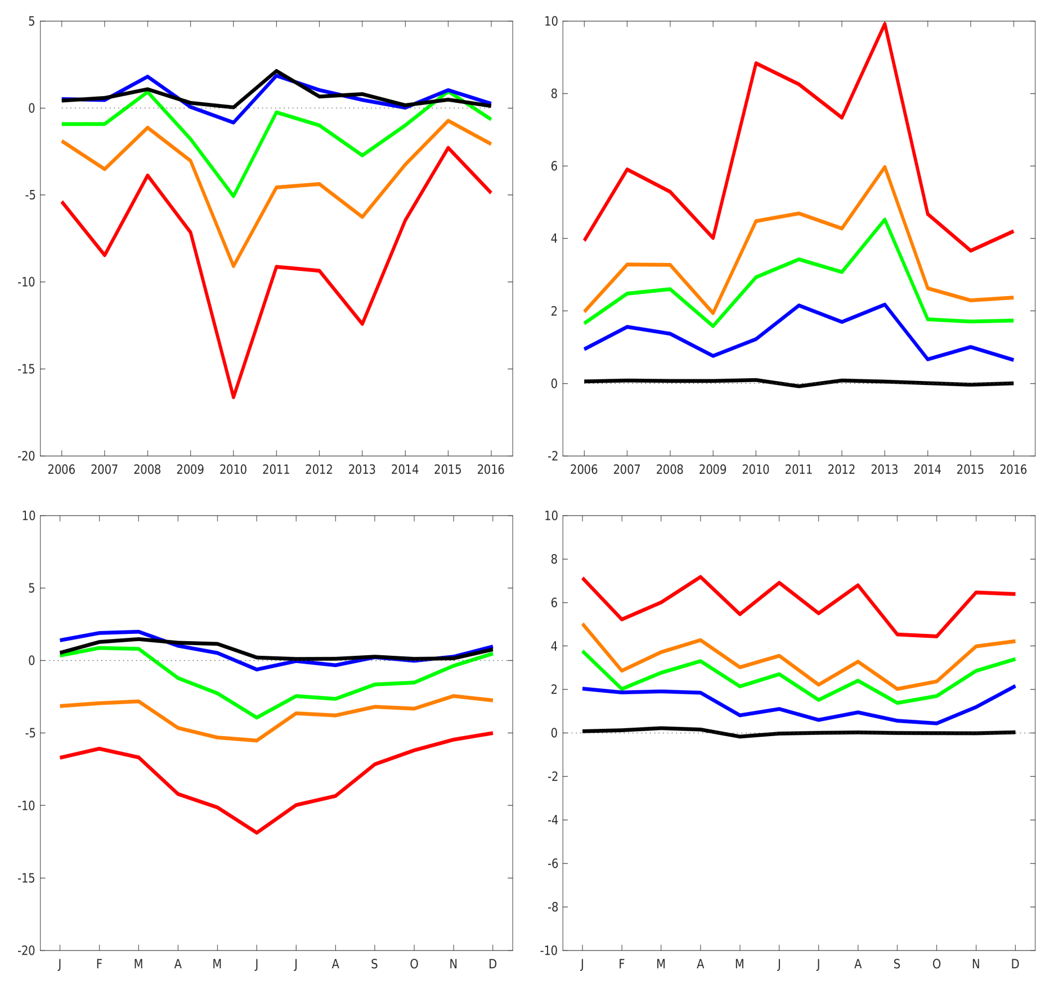
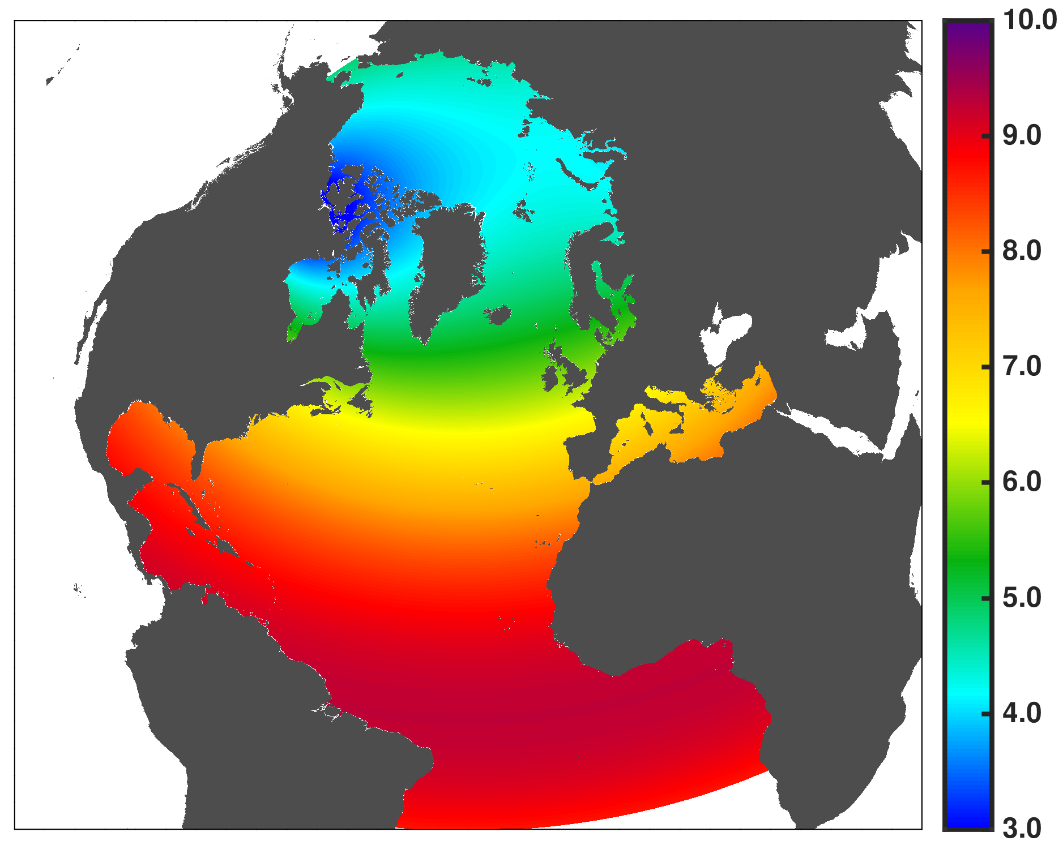
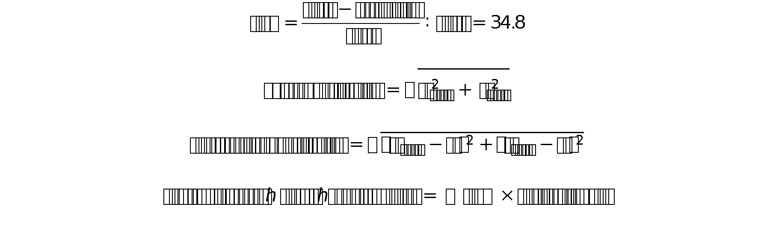
Cross-Isobath Freshwater Exchange Within the Labrador Sea
HE24A
2873
Clark Pennelly¹, Xianmin Hu^{1,2}, Paul G. Myers¹
¹Department of Earth and Atmospheric Sciences, University of Alberta, Canada
²Department of Fisheries and Oceans, Bedford Institute of Oceanography, Canada
pennelly@ualberta.ca
Motivation
The Labrador Sea contains an important region of deep convection
An input of freshwater increases stratification within the Labrador Sea, reducing convection strength
Convection in this region produces Labrador Sea Water
Labrador Sea Water is part of the Atlantic Meridional Overturning Circulation (AMOC)
Reduced Labrador Sea Water causes a reduction in AMOC
Changes in AMOC strength have climate implications
Freshwater currents along the east coast of Greenland, in Davis Strait, and Hudson Strait
Set out to study and quantify where freshwater exchange occurs
M
Davis Strait
Mean
Turbulent
Mean
Turbulent
Hudson Strait
Mean freshwater transport:
Shallow isobaths: large onshore transport
Stronger transport in later years
Minimal seasonal cycle
Turbulent freshwater transport:
Some offshore transport
Little seasonal cycle
Net freshwater transport:
500m: onshore 23 msV
2000m: onshore 1.3 mSv
Mean freshwater transport:
Offshore at shallow isobaths
Onshore across deeper isobaths
Clear season signals
Turbulent freshwater transport:
Opposite direction as mean transport
Low transport
Some seasonal signal
Net freshwater transport:
500m: offshore 10 mSv
2000m: onshore 7.5 mSv
Freshwater Transport [ mSv ]
100 mSv₁
100-125
mSv₂
Simulation Year
Freshwater Transport [ mSv ]
Simulation Year
40
mSv₃
Monthly Climatology
Monthly Climatology
Mean
Turbulent
Northern Labrador
West Greenland
Mean
Turbulent
Mean transport:
Strong onshore transport
High inter-annual variability
Seasonal cycle
Turbulent transport:
Strong offshore transport
Strong seasonal cycle
Net transport:
500m: onshore 10 mSv
2000m: onshore 4 mSv
Seasonal cycles out of phase
Mean transport:
Offshore transport of freshwater
Very strong
Large inter-annual variability
Clear and strong seasonality
Turbulent transport:
Offshore transport of freshwater
Limited seasonality
500m has low transport, others are greater
Net transport:
500m:offshore 46 mSv
2000m: offshore 21 mSv
Transport terms in same direction
Freshwater Transport [ mSv ]
Simulation Year
Freshwater Transport [ mSv ]
Simulation Year
Monthly Climatology
Key Points
Monthly Climatology
Large amounts of freshwater released from West Greenland Current
Other regions provide a saline water flux to the Labrador Sea
Many regions have a clear seasonal cycle of freshwater exchange
Large fluxes across shallow isobaths, often far less at depth
Across all regions, Polar Water transfers ~9 mSv across the 2000m isobath
Mean transport generally stronger than turbulent transport
Turbulent and mean transport often act in opposite directions
Mean
Turbulent
Southern Labrador
East Greenland
Mean
Turbulent
Mean transport:
Primarily onshore
Low amounts of transport
Seasonal cycle depends on isobath
Turbulent transport:
Stronger than mean transport
Offshore
Seasonal cycle: Max in summer
Net transport:
500m : offshore 1.5 mSv
2000m: onshore 1.5 mSv
Mean transport:
Offshore transport at shallow depths
Onshore transport at deeper regions
High variability at shallow depths
Low seasonality
Turbulent transport:
Offshore transport
Little exchange across 2000m
No seasonality
Net transport:
500m: onshore 1.8 mSv
2000m: offshore 0.6 mSv
Freshwater Transport [ mSv ]
Simulation Year
Freshwater Transport [ mSv ]
Simulation Year
Monthly Climatology
Horizontal Resolution
[ km ]
Methods
Monthly Climatology
Numerical Simulation
Freshwater Calculations
Simulation performed using NEMO⁴, an ocean model coupled with a sea-ice model
Horizontal resolution was set to 1/12° with 50 vertical levels
Simulations were forced by the high spatial and temporal resolution Canadian Meteorological Centre’s
Global Deterministic Prediction System⁵
Initial conditions were taken from GLORYS 2v3: SSH, horizontal velocities, salinity, and temperature
Boundary conditions were also taken from GLORYS 2v3
The simulation was integrated from 2002 until the end of 2016. Output saved every 5 days
First years used as a spin-up state; first year of analysis was 2006
Freshwater was calculated based on a salinity reference of 34.8
Freshwater transport was calculated for mean and turbulent transport
Mean transport was taken over a 25 day moving mean.
Turbulent transport was the deviation from the mean state
Freshwater transport was integrated across 5 isobaths and 6 sections
Freshwater was calculated for Polar Water: density < 27.68 kg/m³, salinity < 34.8, any temperature
Citations:
¹ Cuny et al., 2005: Davis Strait volume, freshwater, and heat fluxes. Deep Sea Research Part 1: Oceanographic Research Papers. 52.3, 519-542
² Dickson et al., 2007: Current estimates of freshwater flux through Arctic and subarctic seas, Progress in Oceanography, 73, 210-230
³ Straneo and Saucier, 2008b: The Arctic-Subarctic Exchange Through Hudson Strait, Arctic-Subarctic Ocean Fluxes, Springer, Dordrecht, 249-261
⁴ Madec and the NEMO team, 2008: NEMO ocean engine, Technical Note, Institut Pierre-Simon Laplace, France
⁵ Smith et al., 2014: A new atmospheric dataset for forcing ice-ocean models: Evaluation of reforecasts using the Canadian global deterministic prediction system, Quarterly Journal of the Royal Meteorological Society, 140.680, 881-894

