Slide 1



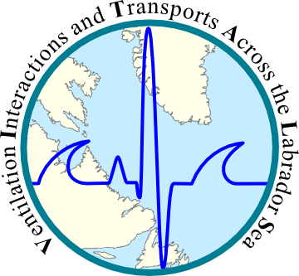
Effect of grid resolution on ocean simulations in the Labrador Sea using NEMO and AGRIF
Clark Pennelly
Xianmin Hu
Paul G. Myers
Department of Earth and Atmospheric Sciences
University of Alberta

Slide 2
Outline
Nesting software: AGRIF
Modeling framework: NEMO
Simulation configurations
Comparison of simulations
Ongoing/future work

Slide 3
AGRIF: Adaptive Grid Refinement In Fortran¹
Control
Grid Box
1/4°
1/12°
1/4°
AGRIF
Transformation
(1:3 ratio)
1/12°
AGRIF Grid Boxes
Parent
Example: Simulation using one nest
1/4°
X:814
AGRIF
1/12°
Y:544
Y:180
X:270
¹Debreu, Laurent, Christophe Vouland, and Eric Blayo. "AGRIF: Adaptive grid refinement in Fortran." Computers & Geosciences 34.1 (2008): 8-13.

Slide 4


AGRIF features
Nest simulation runs alongside parent
Nest requires a complete separate set data
Computationally expensive
1-way or 2-way feedback between nest and parent
1/12° IC & forcing data
Parent time step:
Supply BC
AGRIF time step:
Interpolate to parent
dt=180s
dt=540s

Slide 5
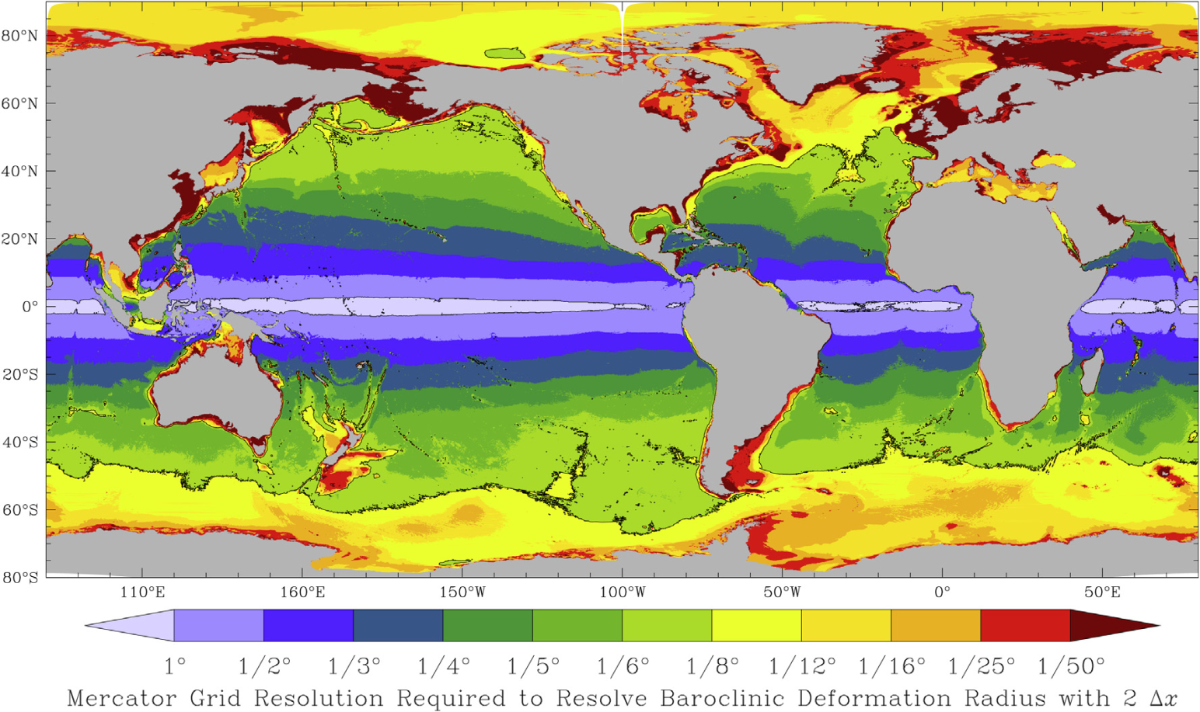
Why use nests?
High resolution is needed to resolve eddies
Hallberg (Ocean Mod. 2013)
More realistic simulation of small scale features: bathymetry, boundary currents, etc
Computationally cheaper than high resolution across entire domain

Slide 6
NEMO
Numerical ocean modeling framework with multiple models available to use:
Blue ocean: Ocean dynamics model
White ocean: Sea ice model
Green ocean: Biogeochemical model
Mesh refinement software: AGRIF
Tracer package
Operational
Future plans
AGRIF

Slide 7
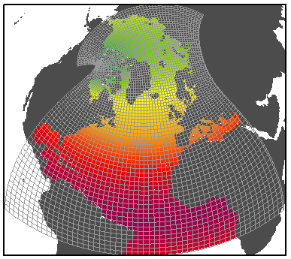
NEMO Simulation Settings
ANHA:
Arctic Northern Hemisphere Atlantic
NEMO version 3.4
Ice Model: LIM2
50 vertical levels
Open Boundaries: Bering strait, 20°S
Initial Conditions: (3D) T, S, U, V, and (2D) SSH, Ice
Forcing: Hourly wind, rain, snow, LW/SW, air temp, air humidity from Environment Canada- GDPS

Slide 8
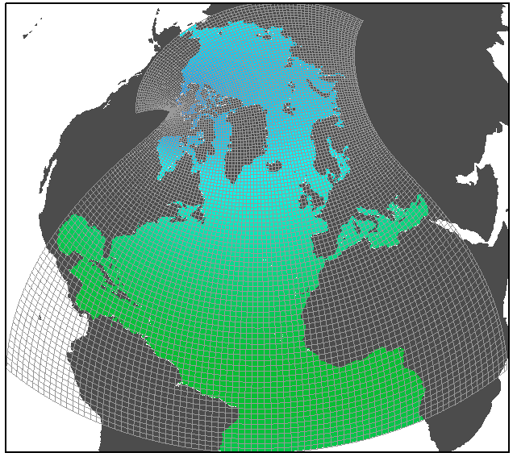
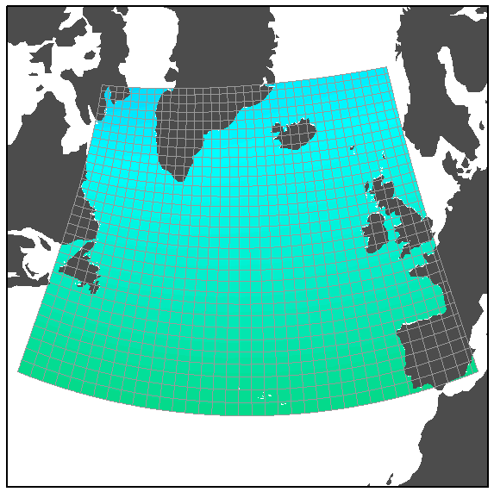
Simulations 2002-2010
ANHA4
ANHA12
Horizontal mesh
(km)
0
5
10
15
20
25
30
Configuration | ANHA4 | ANHA12 | AGRIF12
Time step | 1080s | 180s | 540s : 180s
Horz. Resolution | 1/4° | 1/12° | 1/4° : 1/12°
Simulation time | ~4 days | 54+ days | ~28 days
CPUs used | 64 | 256 | 48
Core years | 0.7 | 37.8 | 3.7
AGRIF12 (within ANHA4)

Slide 9
Science questions
Resolution: does higher resolution resolve some important processes in Labrador Sea?
What is the fate of freshwater from off the West Greenland shelf?

Slide 10

Eddy Kinetic Energy:sqrt [cm/s]
ANHA12
ANHA4
Same
Resolution
ANHA4-Runoff
AGRIF12
Same Forcing/IC

Slide 11
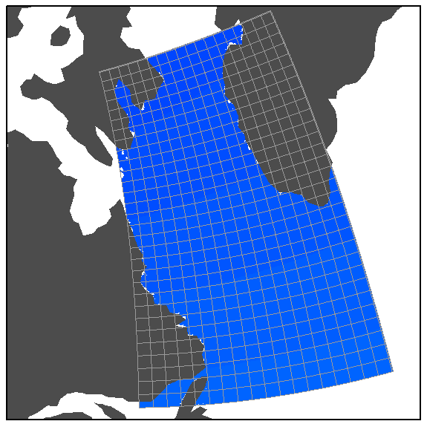
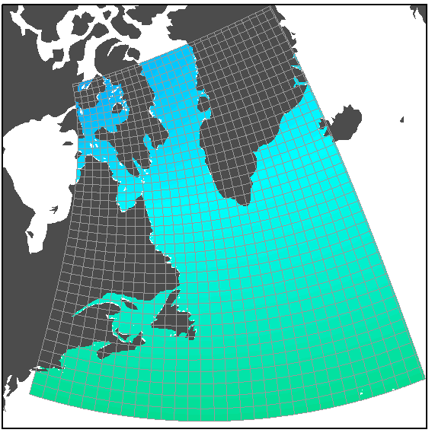
Ongoing work: Double(+) Nesting
0
5
10
15
20
25
30
544
1/4°
800
(1.4 to 2.0 km)
724
604
1/36°
1204
1/12°
769

Slide 12
Computation Cost of Simulations
Configuration | ANHA4 | ANHA12 | AGRIF12 | AGRIF 36 | ANHA36 (est)
Time step | 1080s | 180s | 540s : 180s | 540s: 180s: 60s | 60s
Horz. Resolution | 1/4° | 1/12° | 1/4° : 1/12° | 1/4° : 1/12° : 1/36° | 1/36°
Simulation time | ~4 days | 54+ days | ~28 days | ~2100 days (4 cpus) | ~1500 days
CPUs used | 64 | 256 | 48 | 4 | 256
Core years | 0.7 | 37.8 | 3.7 | 23 | ~1000
AGRIF provides a way to have high resolution numerical simulations with a dramatic reduction in computational cost

