Slide 1



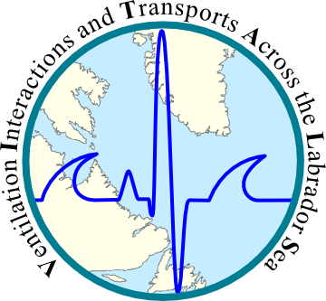
Effect of grid resolution on ocean simulations in the sub-polar North Atlantic using NEMO and AGRIF
Clark Pennelly
Xianmin Hu
Paul G. Myers
Department of Earth and Atmospheric Sciences
University of Alberta

Slide 2
Outline
Nesting software: AGRIF
Modeling framework: NEMO
Simulation configurations
Comparison of simulations
Ongoing/future work
Conclusions

Slide 3
AGRIF: Adaptive Grid Refinement In Fortran¹
Control
Grid Box
1/4°
1/12°
1/4°
AGRIF
Transformation
(1:3 ratio)
1/12°
AGRIF Grid Boxes
Parent
Example:
Simulation using two nests
X:240
1/4°
Y:290
AGRIF
AGRIF
1/12°
1/12°
X:724
X:814
Y:180
Y:544
Y:874
X:270
¹Debreu, Laurent, Christophe Vouland, and Eric Blayo. "AGRIF: Adaptive grid refinement in Fortran." Computers & Geosciences 34.1 (2008): 8-13.

Slide 4


AGRIF features
Nest simulation runs alongside parent
Nest requires a complete separate set data
Computationally expensive
1-way or 2-way feedback between nest and parent
1/12° IC & forcing data
Parent time step:
Supply BC
AGRIF time step:
Interpolate to parent
dt=180s
dt=540s

Slide 5
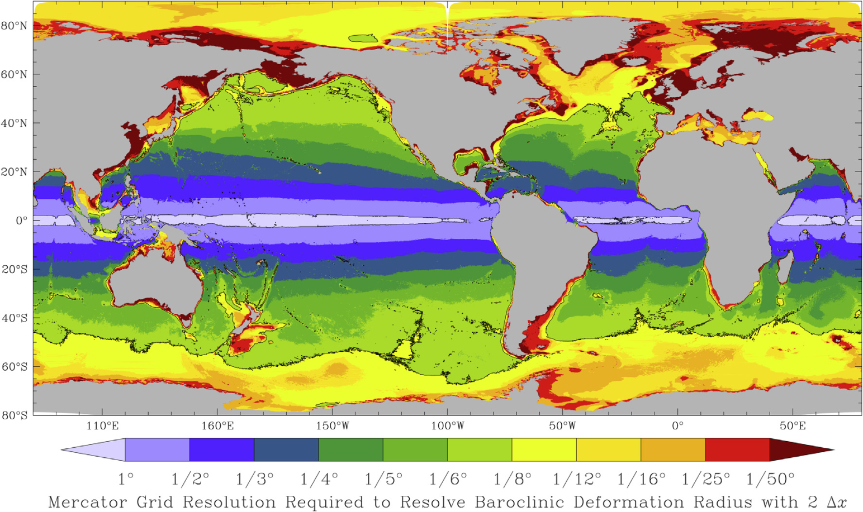
Why use nests?
High resolution is needed to resolve eddies
Hallberg (Ocean Mod. 2013)
More realistic simulation of small scale features: bathymetry, boundary currents, etc
Computationally cheaper than high resolution across entire domain

Slide 6
NEMO
Numerical ocean modeling framework with multiple models available to use:
Blue ocean: Ocean dynamics model
White ocean: Sea ice model
Green ocean: Biogeochemical model
Mesh refinement software: AGRIF
Tracer package
Operational
Future plans
AGRIF

Slide 7
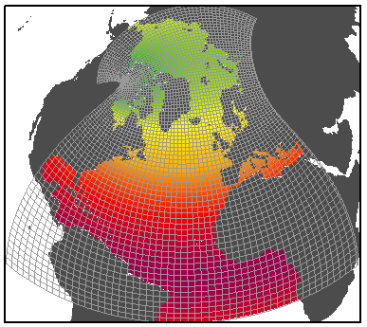
NEMO Simulation Settings
ANHA:
Arctic Northern Hemisphere Atlantic
NEMO version 3.4
Ice Model: LIM2
50 vertical levels
Open Boundaries: Bering strait, 20°S
Initial Conditions: (3D) T, S, U, V, and (2D) SSH, Ice
Forcing: Hourly wind, rain, snow, LW/SW, air temp, air humidity from Environment Canada- GDPS

Slide 8
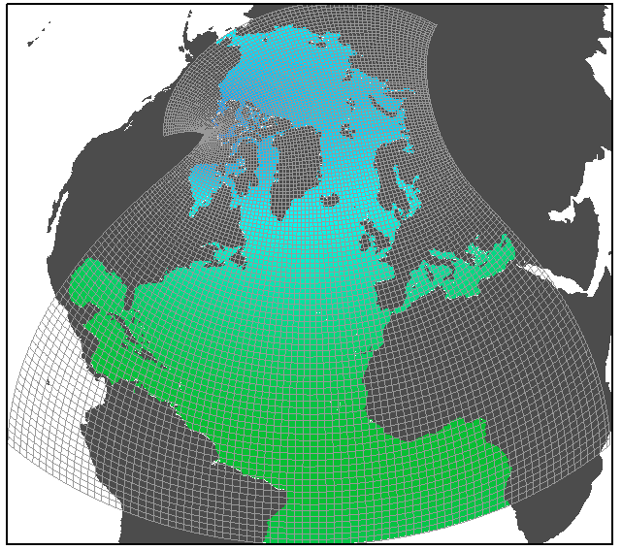
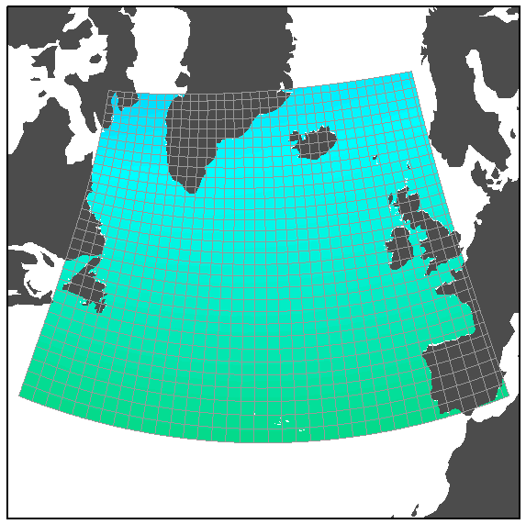
Simulations 2002-2010
ANHA4
ANHA12
Horizontal mesh
(km)
0
5
10
15
20
25
30
Configuration | ANHA4 | ANHA12 | AGRIF12
Time step | 1080s | 180s | 540s : 180s
Horz. Resolution | 1/4° | 1/12° | 1/4° : 1/12°
Simulation time | ~4 days | 54+ days | ~28 days
CPUs used | 64 | 256 | 48
Core years | 0.7 | 37.8 | 3.7
AGRIF12

Slide 9
Research Objectives
AGRIF12 similar to ANHA12?
Examine sea ice, mixed layer depth, and EKE
Examine volume, heat, and freshwater fluxes through different SPG sections.
Hydrographic representation of different water masses

Slide 10

Eddy Kinetic Energy:sqrt [cm/s]
ANHA12
ANHA4
Same
Resolution
ANHA4-Runoff
AGRIF12
Same Forcing/IC

Slide 11
Mixed Layer Depth [m]
ANHA4
ANHA12
Same
Resolution
ANHA4-Runoff
AGRIF12
Same Forcing/IC

Slide 12
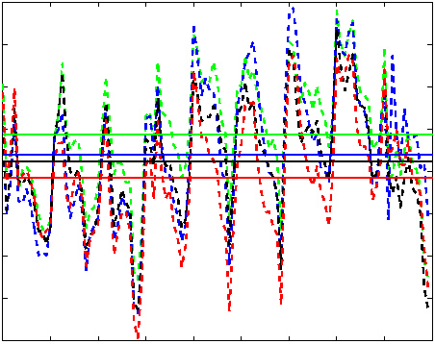
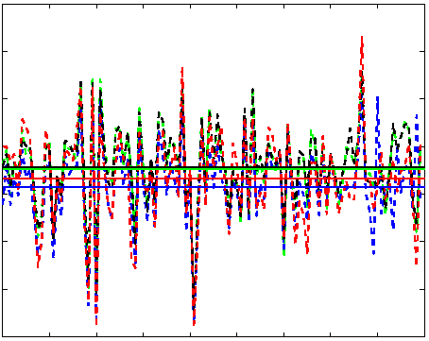
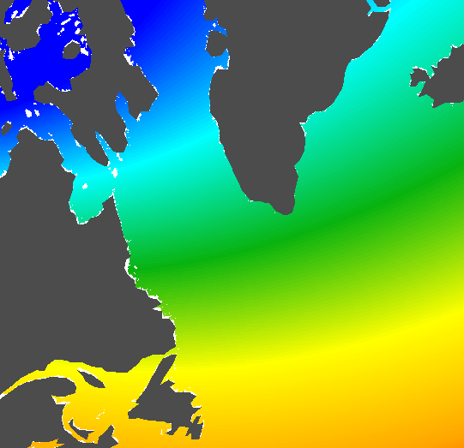
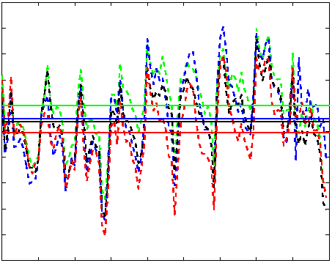
Section: Volume flux [Sv]
4
Davis
3
2
1
ANHA4 ANHA12
ANHA4-Runoff AGRIF12
0.2
Hudson
D
0.1
0
H
A
AR7W
4
3
2
AGRIF had higher volume fluxes
ANHA12 had lower volume fluxes
Net volume ~0 : volume in=out
1
2002
2004
2006
2008
2010

Slide 13
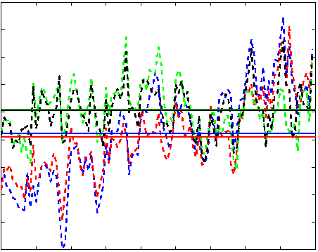
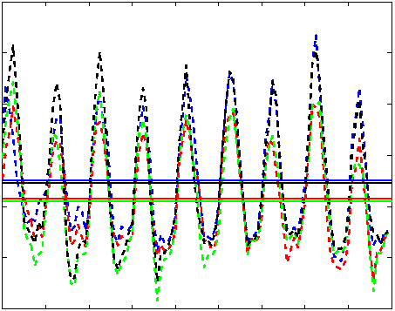
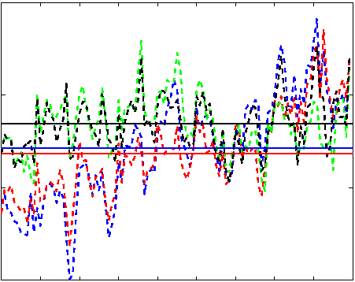
West Greenland Shelf water: AR7W
4
Volume [Sv]
3
2
1
Heat [Tw]
30
Water Mass:
Salt < 34.1 g/kg
Temp < 7° C
10
ANHA4 ANHA12
ANHA4-Runoff AGRIF12
-10
Salt [kt/s]
Volume and salt more dependent
on IC than resolution
Heat flux appears the opposite
100
50
2002
2004
2006
2008
2010

Slide 14
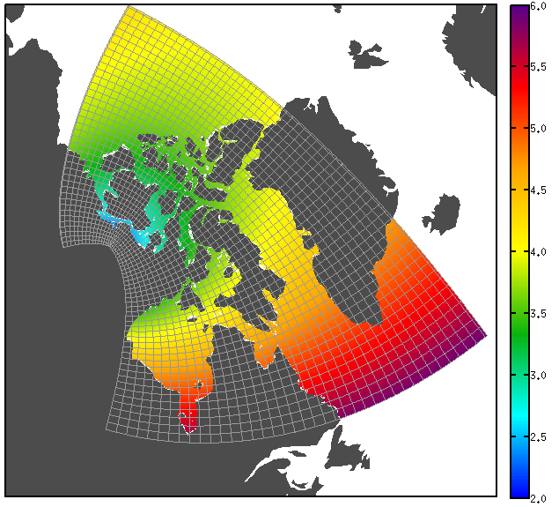
Ongoing work: CAA
0
5
10
15
20
25
30

Slide 15
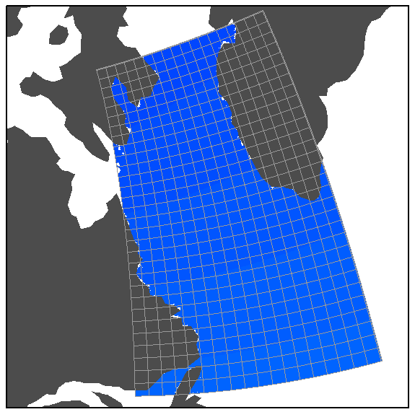
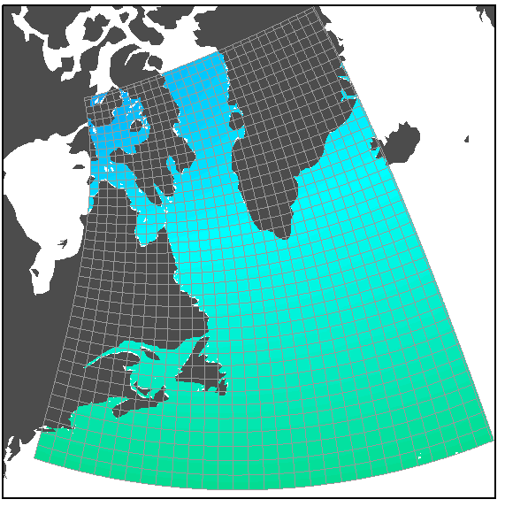
Future work: Double(+) Nesting
0
5
10
15
20
25
30
544
800
724
604
1/36°
1204
769

Slide 16
Conclusions
AGRIF simulation was similar to domain-wide 1/12° simulation: EKE, MLD, fluxes and water mass
Significant reduction in computing expense, thus AGRIF provides an advantage when performing high-resolution simulations.
Questions?

Slide 17
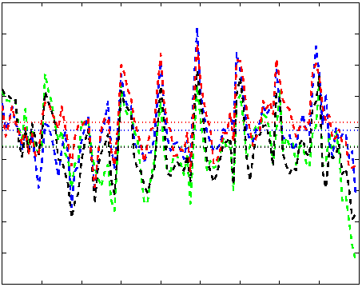
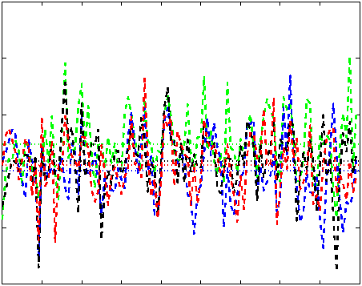
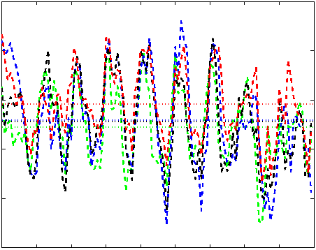
Section: Heat flux [Tw/s]
Davis
0
-20
-40
ANHA4 ANHA4-Runoff
AGRIF12 ANHA12
-60
Hudson
D
10
5
0
H
A
-5
AR7W
-50
-100
-150
-200
Davis: Heat flux dependent on IC
Hudson: Larger AGRIF 12 flux
2002
2004
2006
2008
2010

Slide 18
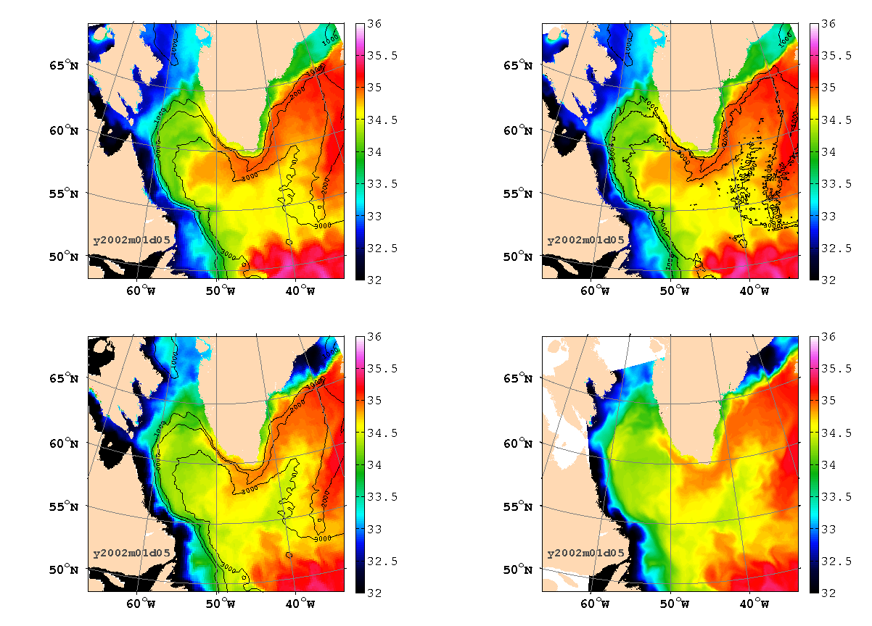
ANHA4
Initial Conditions: GLORYS 1v1
Open boundary Conditions: GLORYS 1v1
Atmospheric Forcing: CGRF
Runoff: Monthly Climatology
ANHA12
Initial Conditions: GLORYS 1v1
Open boundary Conditions: GLORYS 1v1
Atmospheric Forcing: CGRF
Runoff: Monthly Climatology
Same Forcing/IC
Same
Resolution
Same
Resolution
ANHA4-Runoff
Initial Conditions: GLORYS 2v3
Open boundary Conditions: GLORYS 2v3
Atmospheric Forcing: CGRF
Runoff: Monthly Climatology (remapped)
AGRIF12
Initial Conditions: GLORYS 2v3
Open boundary Conditions: GLORYS 2v3
Atmospheric Forcing: CGRF
Runoff: Monthly Climatology (remapped)
Bathymetry: Updated 1/12°
Same Forcing/IC

