Slide 1
Music Sound Interpreter
Nikolaos Eleftheriadis
Team #6
One Man Army
November 29, 2011

Slide 2
The Rundown
Who is the client?
What is the project?
Why is this being done?
How will this project be done?
How much time will it take?
How much is this project going to cost?

Slide 3
The Client
My client is Rosemary
Has Down Syndrome
Is deaf
Communicates by sign language
Spends some of her time at Bridgewell in Lynn

Slide 4
Some Facts about Down Syndrome
Down Syndrome is a genetic disorder involving
the 21st chromosome
About 1 in 700 people are born with DS
400,000 diagnosed people in the U.S.
Most prominent type is Trisomy 21
Accounts for 95% of all cases
Cells have an extra copy of chromosome 21

Slide 5
Effects of Down Syndrome
Effects vary from person to person
Possible for diagnosed people to lead normal lives
Common effects include:
Physical disfigurement
Slow mental development
Increased risk of health issues

Slide 6
The Problem
Bridgewell hosts learning activities such as concerts
Since Rosemary is deaf, she feels the speakers
to understand what's going on
In doing so, she is physically left out of her groups

Slide 7
The Solution: My Project
Lap pad that senses audio signals then activates visual
effects on one side and vibrational effects on the other
Contains recorded responses such as: ”That's awesome!”
Using the Music Sound Interpreter,
she will able to join her groups extensively

Slide 8
Functions
Visual and vibrational effects controlled by
frequency and strength of audio signals
Visual components consist of a rectangular LED grid
Each column represents a different frequency range
As intensity changes, LEDs fade in and out
Vibrational effects activated similarly

Slide 9
Bonus Purposes
Can be used to teach individuals how to control their voices
Instructor would say something to be copied,
then the user would then try to match the instructor
Could also be used as decorative piece

Slide 10
Designing for Everyone
Rosemary will most likely not be the only user
Should be designed so it's usable by anyone
Design factors include:
Safety
Accessibility
Simplicity

Slide 11
Physical Specifications
About as big as an open notebook (12”x21”x1”)
Weight = 5 lbs
The lighter, the better
Cushioned
Shatterproof
Waterproof
Easily cleanable
Cased in flexible material

Slide 12
Electrical Specifications
Powered via wall outlet
Includes a function toggle switch
Only vibrations, only lights, both on, both off
Automatic shut-off feature
Low voltage, about 12V maximum
Medium current, about 2A maximum

Slide 13
Effect Specs
Uses calming colors such as pink, purple and green
Avoid using red, yellow, and orange
Uses smooth visual components
No fast-blinking lights
Intensity of lights and vibrations shouldn't be strong

Slide 14
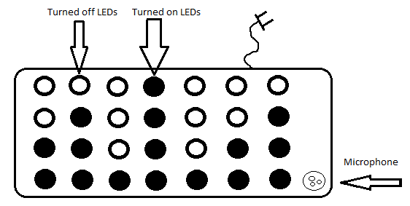
Functional Diagram

Slide 15
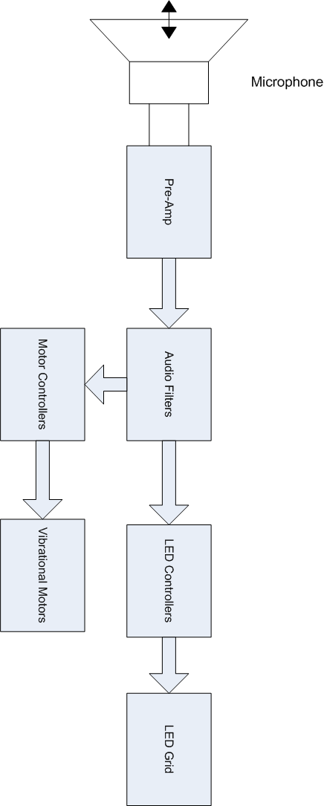
Block Diagram

Slide 16
Creation Procedure
Design parts from beginning of product activation
towards output
Test parts in descending order
First tests are stand alone
Second are with previous parts included

Slide 17
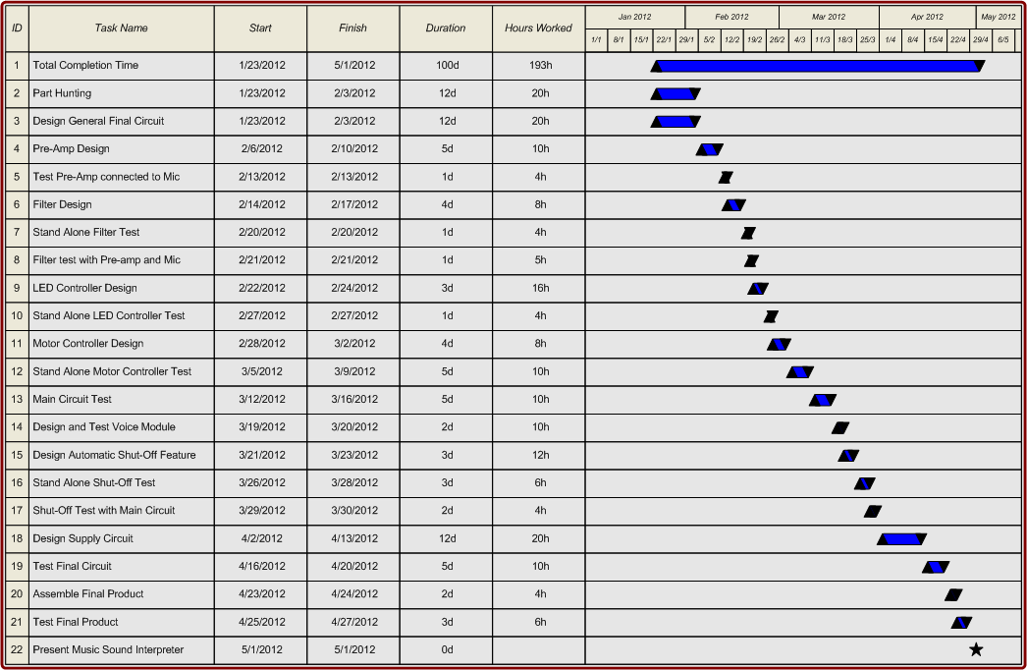
Gantt Chart

Slide 18
Time Analysis
Beginning Date: January 23, 2012
Ending Date: May 1, 2012
Duration: 100 days
Time spent on project: 193 hours
Designing each block mostly takes up a week
Testing usually takes a few days
Work between 2-4 hours per day

Slide 19
Market Research
Most products are very expensive
Not many found that have similar functions
Most products have simple, “discrete” functions
Very few are sound controlled
Potential for large market, even outside
of assistive technology

Slide 20
Main Competing Product
Interactive Fanlight
Displays lights in a fan-like manner
Automatic and sound controlled modes
Multiple display styles within each mode
Only amplitude dependent
Priced at $2,675.00

Slide 21
Labor and Overhead
Average time worked per week: 13.5 hours
14 week long project
Labor Cost = $5,724
Overhead Cost= $2,919

Slide 22
Parts and Prices

Slide 23
Total Cost
Direct Labor: $5,724
Overhead: $2,919
Parts: $325
Total Cost of Project: $8,962

Slide 24
Final Words
Any Questions?
Thanks everyone for your time!

