Slide 1
Term Deposit subscription
BY
Mukund g kallapur

Slide 2
Overview
Three W’s, One H.
Data speaks, let us listen !
One Picture is worth thousand words.
Flow
Best Model.
Models Built and Metrics.
Final Words

Slide 3
What, Who, Why and how
What is the problem?
TD subscription by customers.
Who has this problem?
A Portuguese bank
Why should this problem be solved?
Bank will be benefited if more customers subscribe for Term Deposits.
How to solve the problem?
Build a TD Subscription Engine.

Slide 4
Data Speaks, let us listen !
Dimension and data types.
41188 rows and 20 columns including Target.
Missing values.
Only one column had missing values and was handled appropriately.

Slide 5
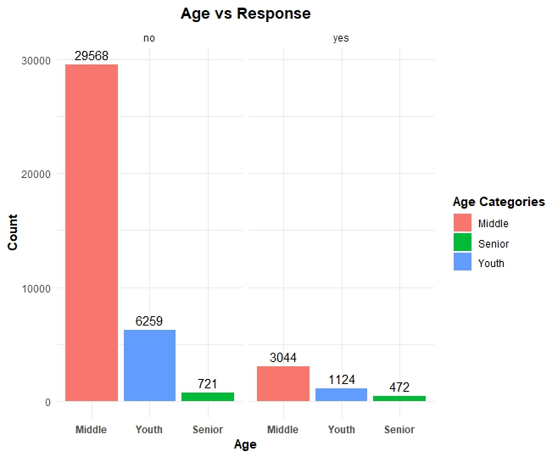
Visualizations

Slide 6
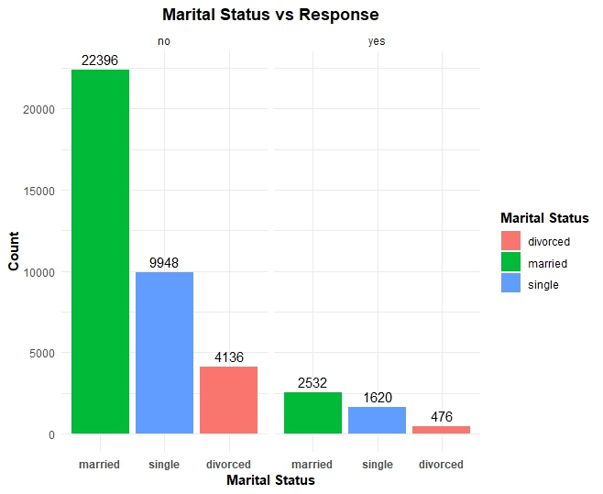
Visualizations

Slide 7
Flow
Read & Understand
Data
Data Pre-Processing
Model Building
Fine Tuning

Slide 8
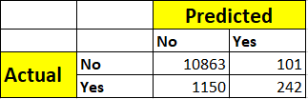
Best Approach/Model
Model: ADABoost (Fine tuned)
Confusion Matrix for Validation Data:
Validation Accuracy: 89.87%
Precision(Weighted Avg): 88%

Slide 9
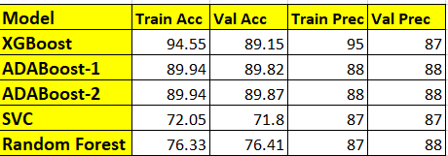
Metrics in a visual form

Slide 10

Final words
The solution provided was accepted by the Portuguese Bank.
Bank can now easily predict the customers and target them to buy the Term Deposits.
The solution also helps to reduce the cost to the bank.

Slide 11
Thank You

