Slide 1
Using MovieLens 1M Dataset to aid Movie Production Houses in data driven decision making
Todd Hay, Mukund Khandelwal, Zeling Lei, Brandon Werner, Zhe Lyu
Notes:
TODD - ASK QUESTIONS TO AUDIENCE

Slide 2
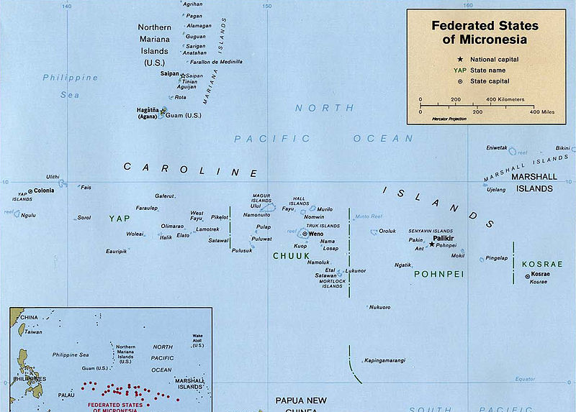
Costly
Pirates of the Caribbean: At World's End (2007) production cost: $341 million
Endowment of WPI: $435 million
Federated States of Micronesia 2016 Gross Domestic Product (GDP): $322 million
https://en.wikipedia.org/wiki/Federated_States_of_Micronesia#/media/File:Map_of_the_Federated_States_of_Micronesia_CIA.jpg
http://www.nacubo.org/Documents/EndowmentFiles/2015_NCSE_Endowment_Market_Values.pdf
Notes:
TODD - ONCE QUESTIONS WERE ASKED SHOW THIS SLIDE

Slide 3
Introduction
Data Sources
MovieLens
BoxOfficeMojo and IMDB and YouTube
Analyzed data
Provided a business question recommendation
Notes:
SKIP

Slide 4
Motivation
Unlock value using statistical rigor
2
Help DreamWorks grow
4
Determine most successful movie genre
3
Making a Hollywood movie is not easy
1
Notes:
TODD - READ MOTIVATION

Slide 5
Analysis Methodology
Analyze movies by rating, genre
Categorize reviews by age, gender, occupation, location
Compared data from BoxOfficeMojo, IMDB, YouTube
Notes:
TODD

Slide 6
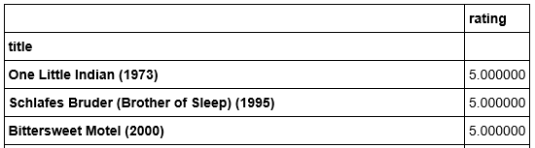
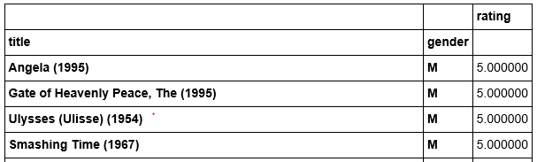
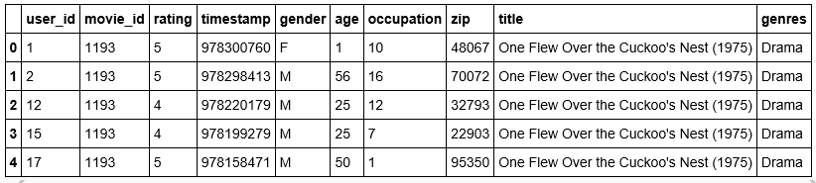
Problem 1
Movie titles with rating by MEN greater than 4.5
Mean rating greater than 4.5
Notes:
TODD

Slide 7
9 out of 10 titles on our "Ten Most Popular Movies" were the top grossing movies for their opening weekend.
American Beauty: No.3 rank, 706 theaters, $11,598 average
Star Wars: Episode IV - A New Hope: No.1 rank, 757 theaters, $8,992 average
Star Wars: Episode V - The Empire Strikes Back (1980): No.1 rank, 823 theaters, $13,171 average
Star Wars: Episode VI - Return of the Jedi (1983): No. 1 rank, 1,002 theaters, $22,973
Jurassic Park (1993): No. 1 rank, 2,404 theaters, $19,561 average
Saving Private Ryan (1998): No. 1 rank, 2,463 theaters, $12,414 average
Terminator 2: Judgment Day (1991): (Non-3D) No. 1 rank, 2,463 theaters, $12,414 average
(3D) No. 25 rank, 371 theaters, $1,490 average
Matrix, The (1999: No. 1 rank, 2,849 theaters, $9,753 average
Back to the Future (1985): No. 1 rank, 1,420 theaters, $7,853 average
Silence of the Lambs, The (1991): No. 1 rank, 1,497 theaters, $9,196 average
Notes:
TODD

Slide 8
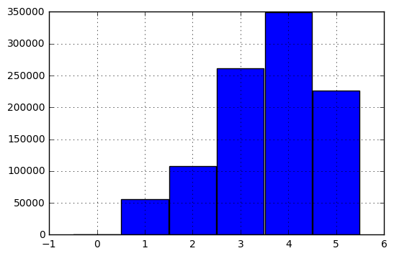
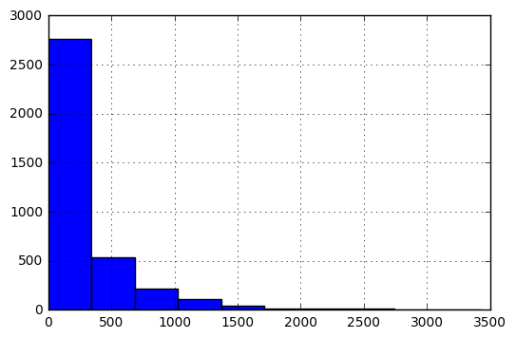
Problem 2
Number of ratings each movie received
Ratings of all movies
Notes:
ANDREW

Slide 9
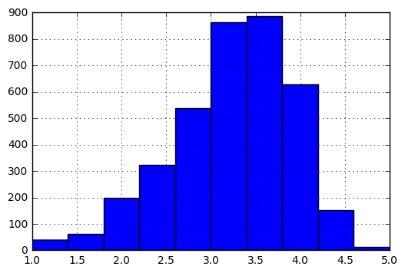
Problem 2
Average rating for each movie.
Notes:
ANDREW

Slide 10
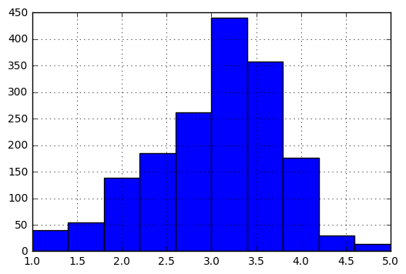
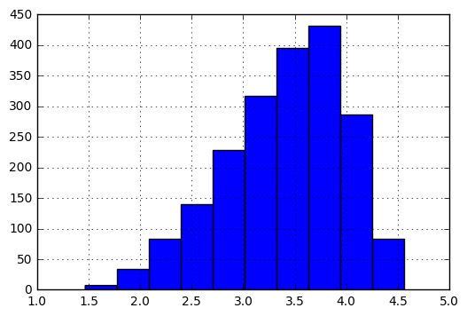
Problem 2
Average rating for movies which are rated less than or equal to 100 times
Average rating for movies which are rated more than 100 times
Notes:
ANDREW

Slide 11
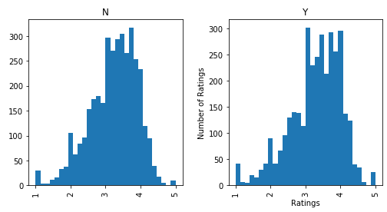
Histogram for average rating by Science, Technology, Engineering, Education, Math (STEEM) occupation
Non-STEEM
STEEM
Notes:
ANDREW

Slide 12
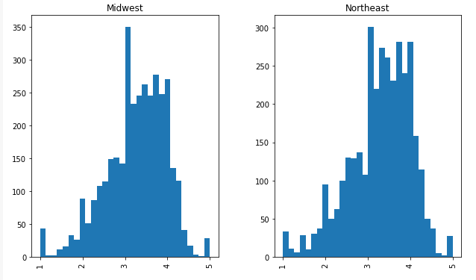
Movies rating based on geographical region
Notes:
ANDREW

Slide 13
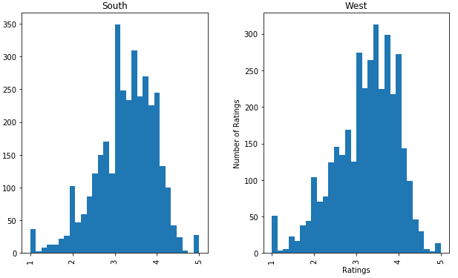
Movies rating based on geographical region
Notes:
ANDREW

Slide 14
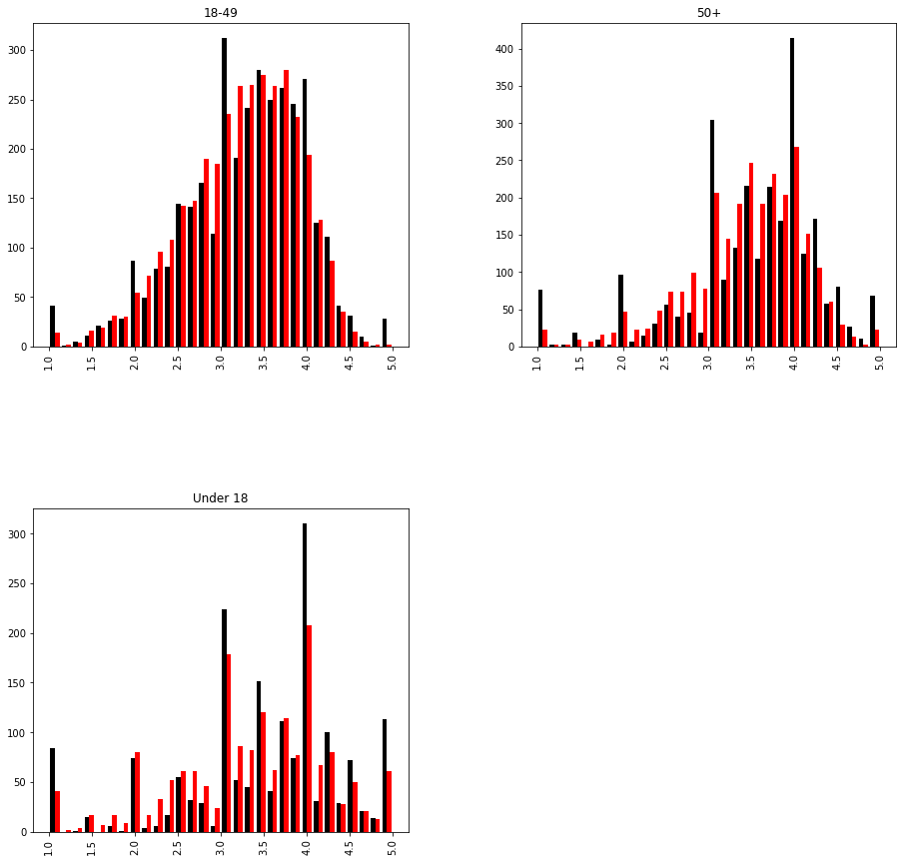
Ratings based on Age
Black: Men
Red: Female
Notes:
ANDREW

Slide 15
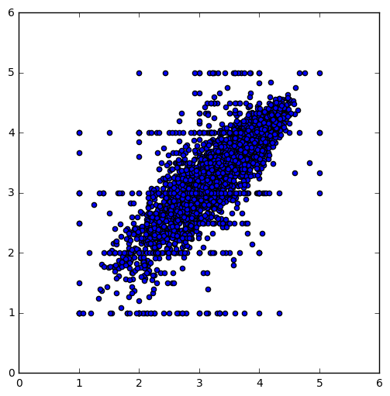
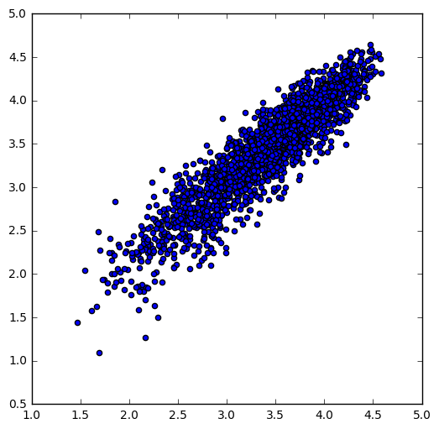
Problem 3
Men versus women and their mean rating for every movie
Men versus women and their mean rating for movies rated more than 200 times
Notes:
ROBIN

Slide 16
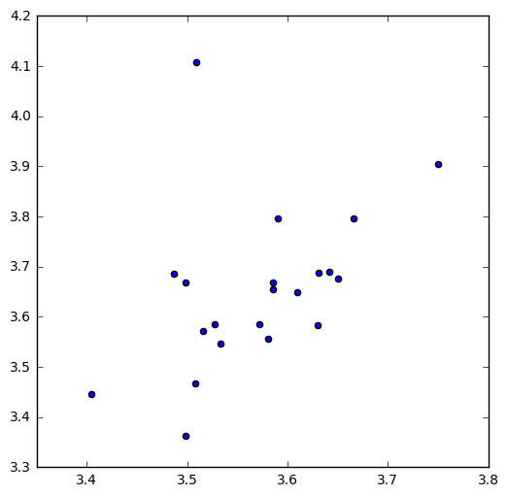
Problem 3: Conjecture 1
Men versus women and their mean rating grouped by occupation description
Notes:
ROBIN

Slide 17
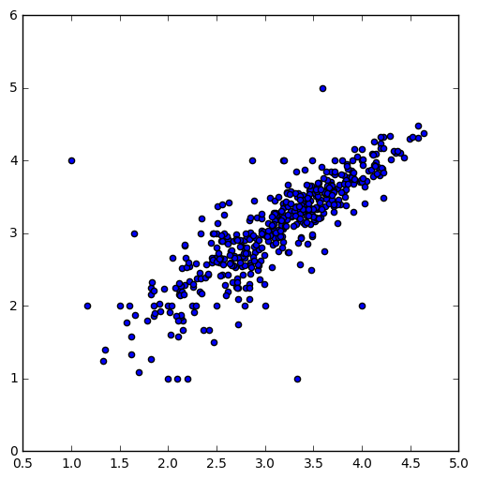
Problem 3: Conjecture 2
Men versus women and their mean rating by Action movie genre
Notes:
ROBIN

Slide 18
Goal
Provide
Provide DreamWorks a way to get their feet wet in the action genre
Influence
Influence DreamWorks to produce an action movie
Convince
Convince DreamWorks to create a trailer as MVP
Notes:
MICKEY

Slide 19
Assumptions
IMDB ratings are based on proprietary formula
IMDB ratings are on a scale of 10
Our Top 10 movies were released before YouTube
Notes:
MICKEY

Slide 20
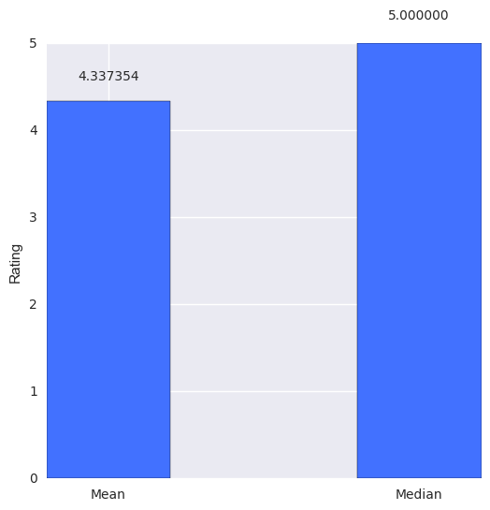
Problem 4
All the observations (Users) who rated the movie Saving Private Ryan (1998).
Notes:
MICKEY

Slide 21
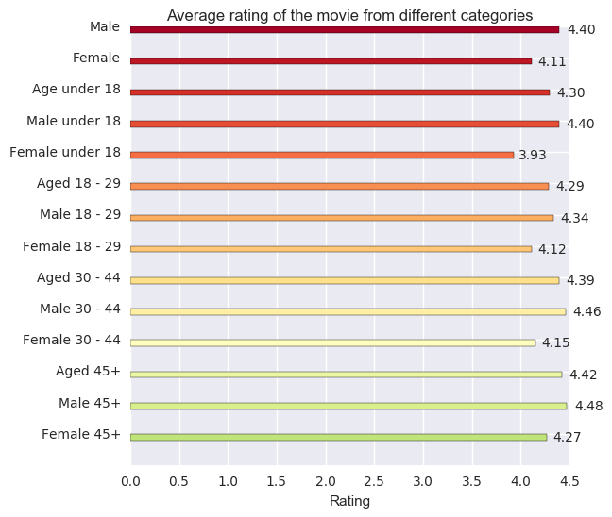
Average rating of Saving Private Ryan from different categories
Notes:
MICKEY

Slide 22
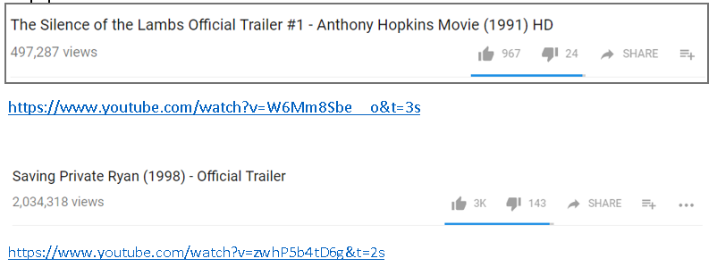
YouTube Statistics

Slide 23
Scope for improvement
Data for number of distributors
1
Data for number of theaters
2
Gross revenue data
3
Return on Investment (ROI) data
4
Analyze socio-economic data
5
Implement geographic data
6
Notes:
MICKEY

Slide 24
Conclusion
DreamWorks produces an action genre movie
Gather consumer sentiment by producing a trailer as a MVP
Use sentiment as stop or go
Notes:
BRANDON

