Slide 1
Using Twitter data to enhance the effectiveness of advertising for the iPhone 8
Todd Hay, Mukund Khandelwal, Zeling Lei, Brandon Werner, Zhe Lyu

Slide 2
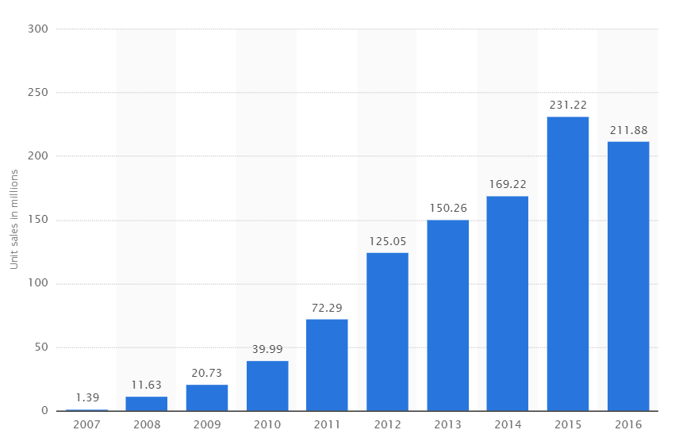
Introduction
Source: https://www.statista.com/statistics/276306/global-apple-iphone-sales-since-fiscal-year-2007/
With iPhone 8 at the forefront, the idea of analyzing customer sentiments in not just the United States of America, but also in two major cities of significant geographical markets i.e. UK and India, motivated us to conduct this study.

Slide 3
Data Requirements
Gathered tweets 2 days before launch and 3 days after
We choose 3 regions to analyze
New York, London, Mumbai
Performed sentiment analysis
Positive, Neutral, Negative
Analyzed users by Apple vs Android

Slide 4
Assumptions
Negative are too entrenched
Neutral can be influenced
Positive are loyal
London – United Kingdom
Mumbai – India
New York – United States

Slide 5
Goal
Provide Apple 3 cities to run targeted ad campaign
Neutral-to-positive sentiment conversion
Potential application: TV, Facebook, Twitter
Positive tweeters most likely to purchase iPhone 8

Slide 6
Data Processing
NLTK library to perform natural language processing
Sentiment analysis
JSON library to enhance readability
MATPLOTLIB library to generate graphs and process geographic distribution
Trend analysis
Notes:
Andrew

Slide 7
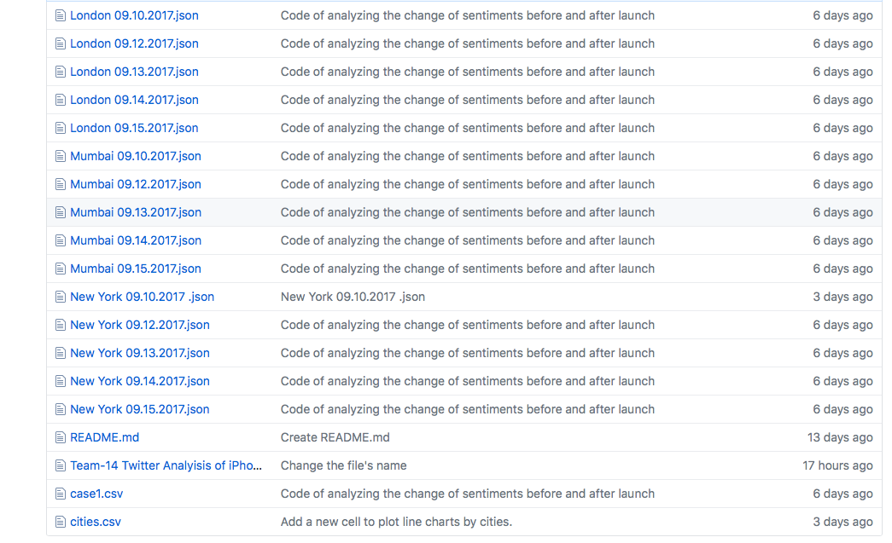
Data collected

Slide 8
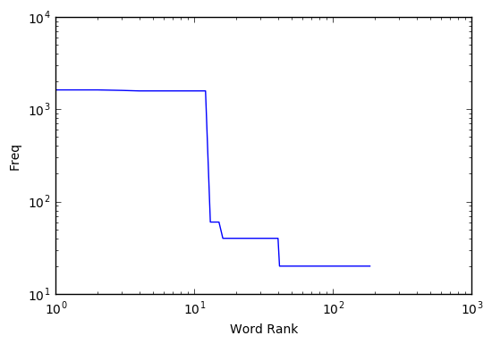
Word count vs. Frequency
Notes:
Robin

Slide 9
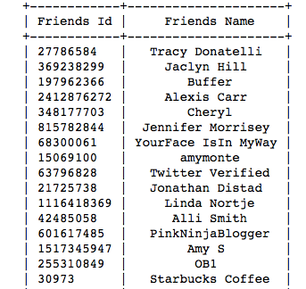
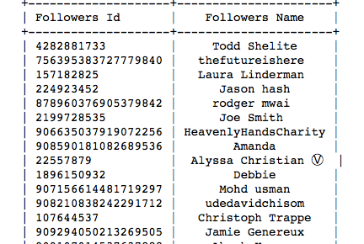
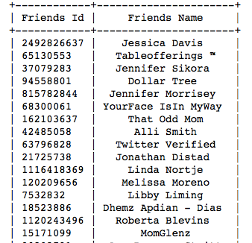
Friends and followers of Hefty

Slide 10
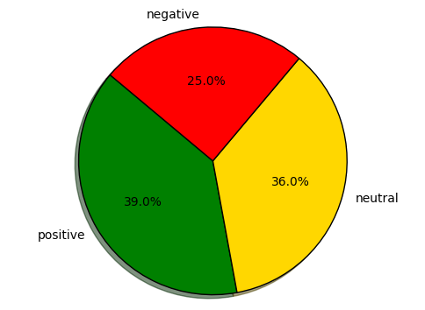
Mumbai – Sep 15 {'positive': 1950, 'negative': 1250, 'neutral': 1800}
Notes:
Brandon

Slide 11
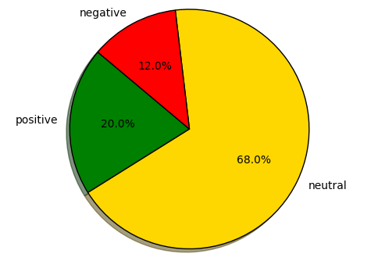
London – Sep 15 {'positive': 1000, 'negative': 600, 'neutral': 3400}

Slide 12
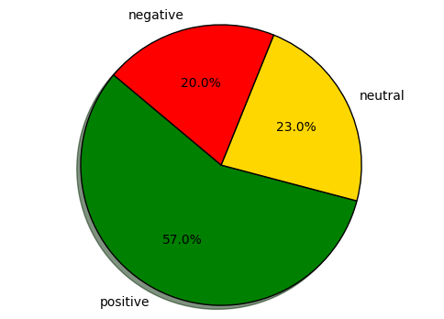
New York – Sep 15 {'positive': 2850, 'negative': 1000, 'neutral': 1150}

Slide 13
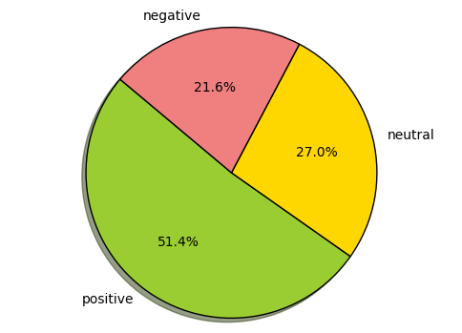
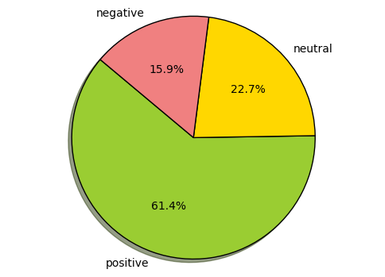
New York – Sep 15
Data from Apple users {'positive': 950, 'negative': 400, 'neutral': 500}
Data from Non-Apple users {'positive': 1350, 'negative': 350, 'neutral': 500}

Slide 14
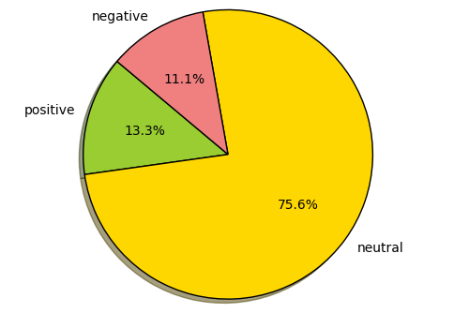
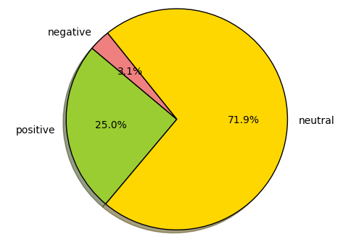
London - Sep 15
Apple users {'positive': 300, 'negative': 250, 'neutral': 1700}
Data from Non-Apple users {'positive': 400, 'negative': 50, 'neutral': 1150}

Slide 15
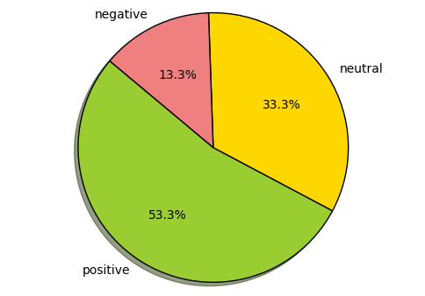
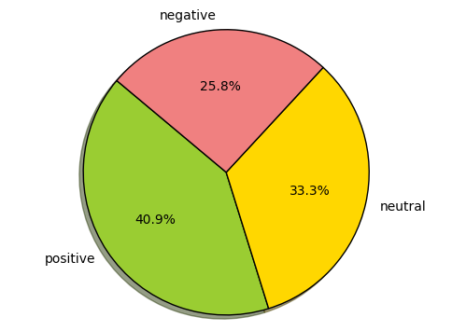
Mumbai - Sep 15
Data from Apple users {'positive': 400, 'negative': 100, 'neutral': 250}
Data from Non-Apple users {'positive': 1350, 'negative': 850, 'neutral': 1100}

Slide 16
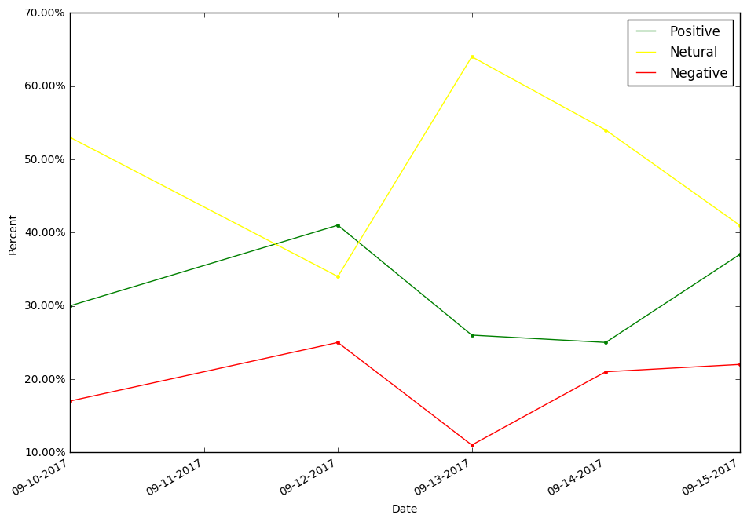
Tweets by Date
Notes:
Todd

Slide 17
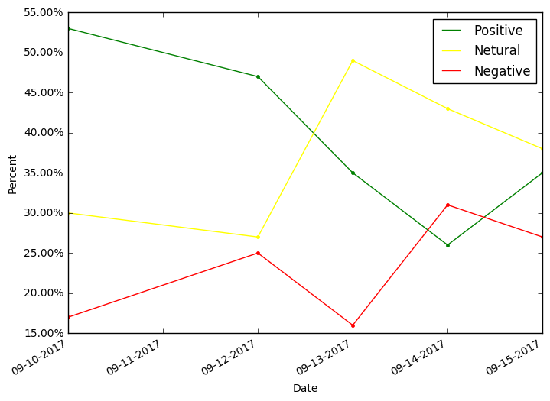
Mumbai

Slide 18
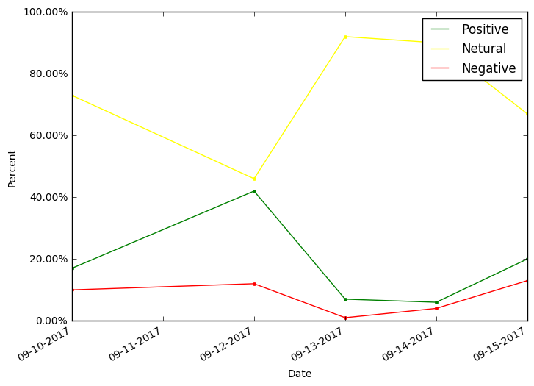
London

Slide 19
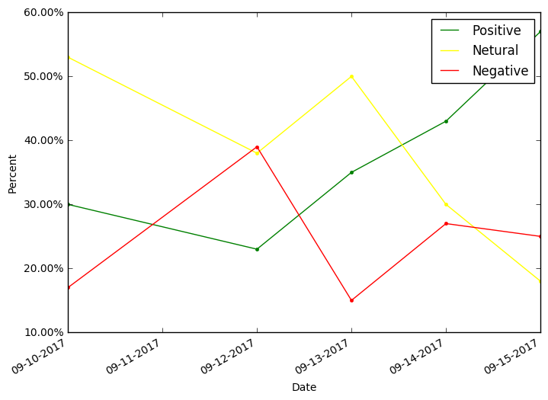
New York

Slide 20
Observations
New York had largest % of positive tweets
London had smallest % of negative tweets
London had largest % of neutral tweets
Mumbai was relatively balanced positive & negative
UK’s population is too small to be effective
India’s size is great!

Slide 21

Any Questions
Source: http://clipart-library.com/images/zcX5a56qi.jpg

