Slide 1
Analysis of v2.0 polarity dataset consisting of 2,000 textual movie reviews
Todd Hay, Mukund Khandelwal, Zeling Lei, Brandon Werner, Zhe Lyu

Slide 2
Introduction
Data Sources
Polarity 2.0 dataset
Analyzed data
Dimension reduction
Applied machine learning algorithms to classify positive and negative reviews
Implemented dimension reduction techniques to plot positive and negative reviews
A business application?

Slide 3
Motivation
Explore the accuracy of machine learning algorithms on textual data using Python’s Scikit learn library
1
Graphically represent pos. and neg. reviews using two-dimension plot
2

Slide 4
Assumptions
Reviews were properly classified neg. or pos.

Slide 5
Goal
Gather
Collect the data
Analyze
Perform textual analysis by apply various classifiers from Scikit learn library then visualizing results with Matplotlib library
Identify
Identify the best classifier based on prediction accuracy and other metrics

Slide 6
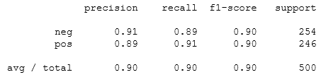
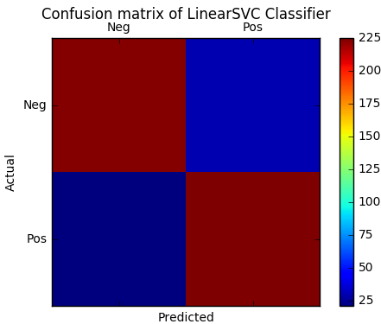
Confusion matrix of LinearSVC

Slide 7
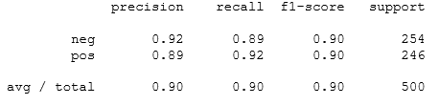
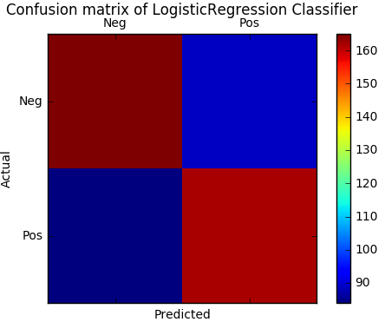
Confusion matrix of Logistic Regression Classifier

Slide 8
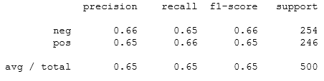
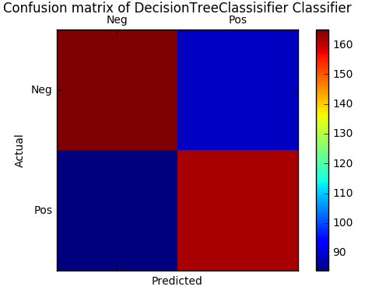
Confusion matrix for DecisionTreeClassifier

Slide 9
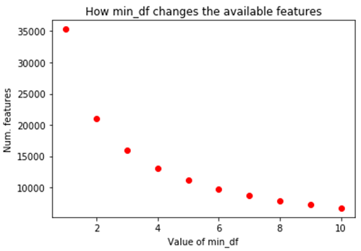
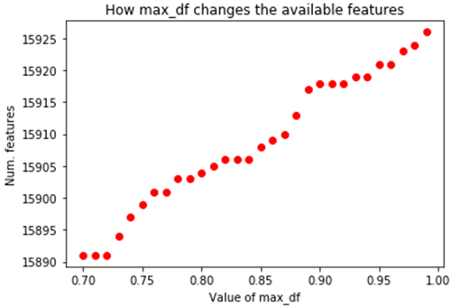
MAX_DF vs MIN_DF

Slide 10
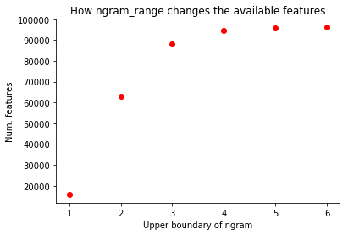
Ngram_range versus the number of features

Slide 11
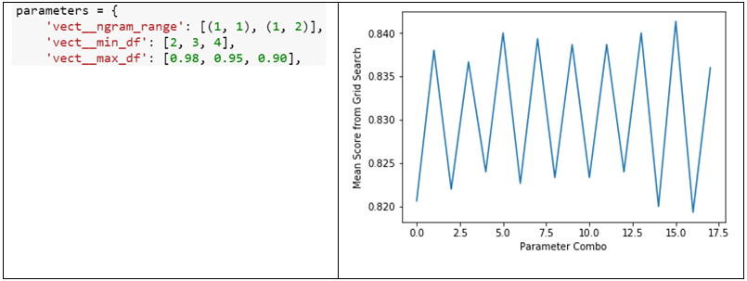
Parameter combinations for LinearSVC

Slide 12
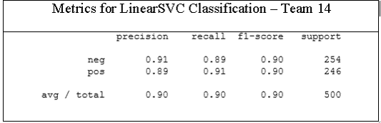
Metrics for LinearSVC Classification

Slide 13
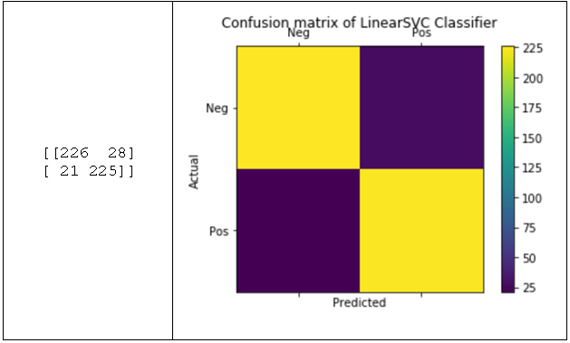
Confusion matrix for LinearSVC classifier

Slide 14
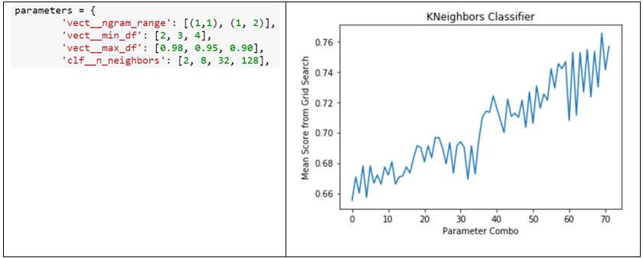
Parameter combinations for KNeighbors

Slide 15
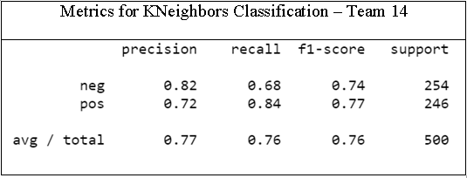
Main classification metrics

Slide 16

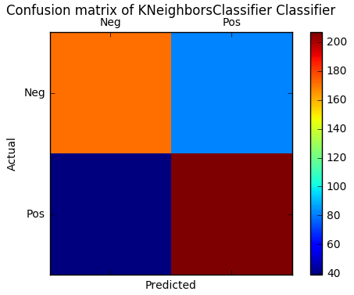
Confusion matrix for the KNeighbors classifier

Slide 17
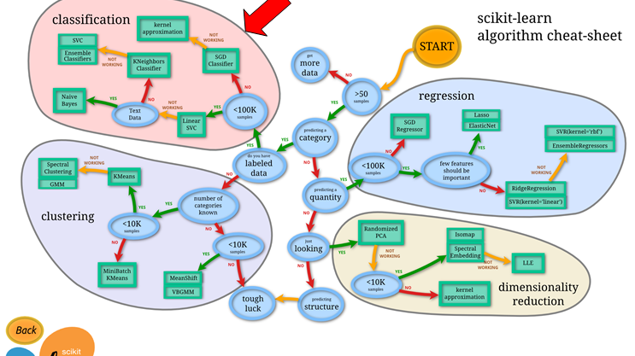

Slide 18
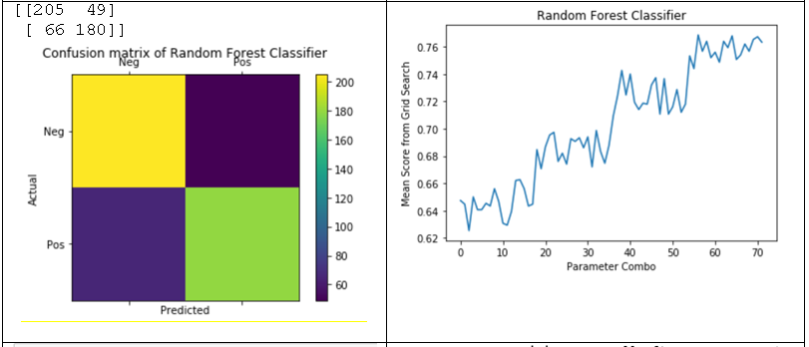
Random Forest Classifier

Slide 19
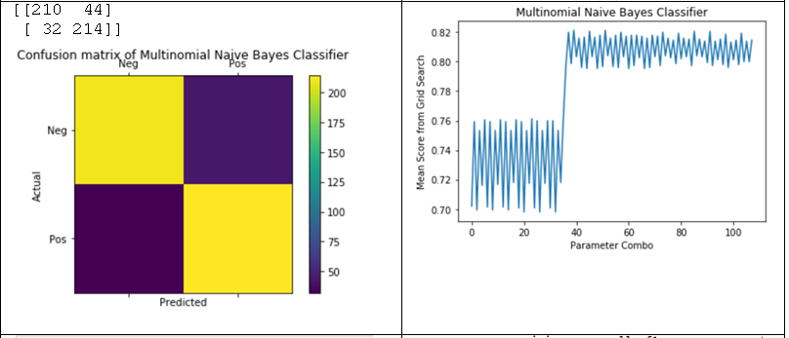
Multinomial Naïve Bayes Classifier

Slide 20
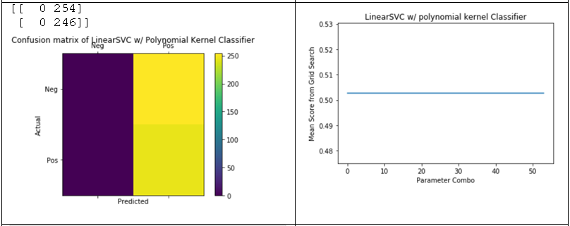
LinearSVC Classifier using Polynomial Kernel

Slide 21
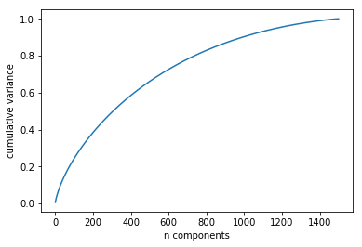
Principal Component Analysis
It takes approximately 1,000 dimensions to preserve 90% of the variance

Slide 22
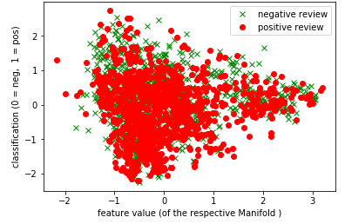
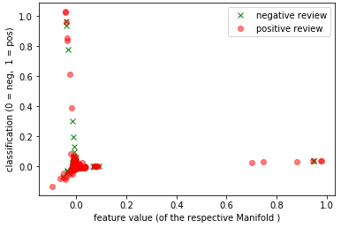
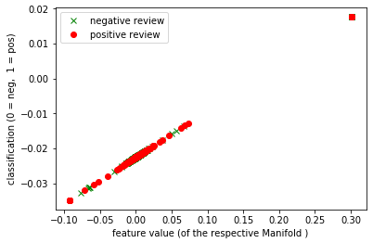
Manifold learning
Locally Linear Embedding
Isometric Mapping
Spectral Embedding
= Negative
= Positive

Slide 23
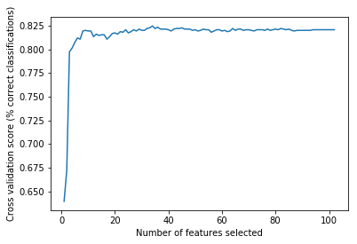
Recursive Feature Elimination
Optimal Number of Features : 20,168

Slide 24
Business Recommendation
Claim: Action movies are more popular
Obtain a list of action movies up to 2004
Create list of positive and negative words
Compare words present in the positive reviews to list of action movies
Perform similar steps for neg. reviews
If more action movies are rated pos., then we can support our claim

Slide 25
Conclusion
Tried manifold learning and PCA
Separated pos. and neg. reviews
Able to plot reviews in a 2-d space with overlapping

Slide 26
Scope for improvement
Learn about other dimensionality reduction techniques such as graph based kernel PCA and LDA
1
Try different parameters to create a 2-d plot
2
Use effective data techniques to plot a graph with more than 2-dimensions
3

